Slide 1
Getting Live Hardware Data
to the GPU, Faster
Dami Thomas
Notes:
I'm Dami. I spent the summer on one question: when an instrument is producing data without stopping, how long does it take to get that data into a GPU, and what is actually eating the time.
I'll go through the path in two stages, then what I did about the gap I found.

Slide 2
The data path, not the math, is what slows real time GPU work
Instruments send data without pause, and it has to reach the GPU in microseconds
The usual network path adds delay from the operating system and from copying data in memory
So I measured the path in stages, then compared transports at each stage
Live instrument data
▼
Part 1: across the network
▼
Part 2: into the GPU (FFT)
▼
Part 3: closing the gap
Notes:
[60 sec]
When GPU work is slow, people assume the math is slow. Usually it isn't. A 4 megabyte FFT on this hardware takes about 60 microseconds. Getting those 4 megabytes to the GPU can take twice that.
So the interesting problem is the plumbing, not the math. I split the path into two stages and measured what each one adds.
Part 1 is the network: instrument to computer. Part 2 is memory: computer to GPU. Part 3 is what I did about what I found in Part 2.

Slide 3
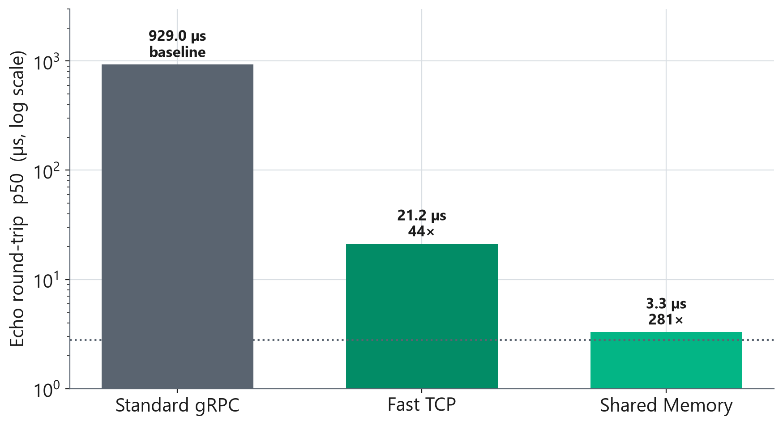
PART 1: ACROSS THE NETWORK
Keeping the same code but swapping the transport cut latency up to 281 times
When both sides run on the same machine, shared memory passes the data straight across and skips the operating system's copies. A round trip takes 3.3 microseconds, which is 281 times faster than standard gRPC.
When the data has to reach a second machine, RDMA handles that instead.
Notes:
[70 sec]
Same application code in all three bars. Only the transport underneath changes.
Standard gRPC over a socket does a round trip in about 929 microseconds. Fast TCP is the same TCP with Nagle's algorithm turned off. Nagle is a rule that holds a small send while it waits for an acknowledgement, which is exactly wrong for send-one-wait-for-reply traffic. Turning it off gets you to 21 microseconds.
Shared memory drops it to 3.3, because the receiver reads the same physical pages the sender wrote. Nothing moves.
Say this out loud: all three are on one machine. This is the software cost, not the wire.

Slide 4
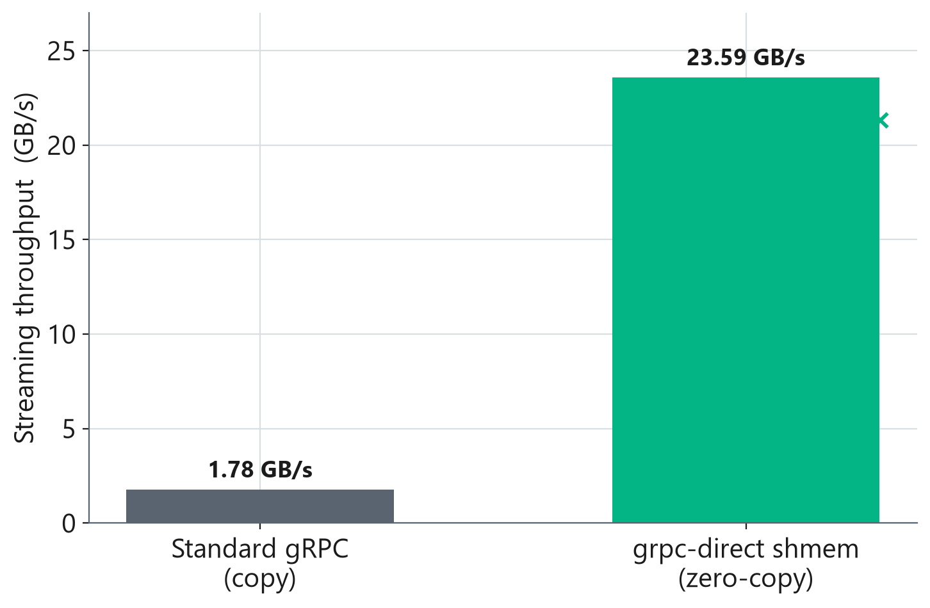
PART 1: ACROSS THE NETWORK
Skipping the memory copies gave almost four times the streaming throughput
Notes:
[55 sec]
Same idea, but throughput instead of latency, and still one machine.
Standard gRPC copies the payload at least twice: once to serialize it, once for the receiver to unpack it. That caps it near 1.78 gigabytes a second. The zero copy path writes straight into memory the receiver already maps, so nothing is copied, and it runs about four times faster.
One caveat I'd rather say than be caught on: this number comes from an earlier run and I don't have the full conditions written down. The direction is right. Don't hold me to the decimal.

Slide 5
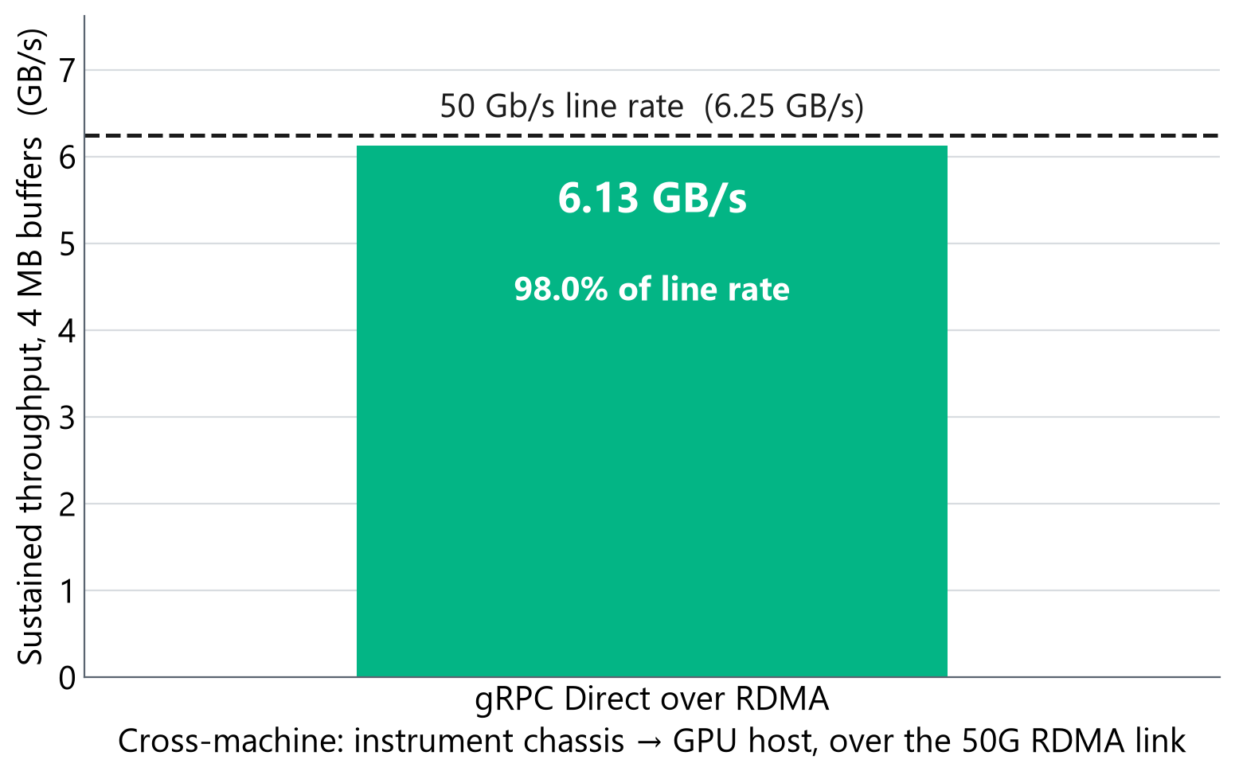
PART 1: ACROSS THE NETWORK
gRPC Direct over RDMA reaches 98% of the 50-gigabit line rate
This test measures how much data per second crosses the 50 gigabit link. gRPC Direct over RDMA gets 6.13 gigabytes per second, which is 98 percent of the theoretical maximum. This shows us that transport is not the bottleneck for RDMA since it moves data as fast as the wire physically allows.
How fast a single buffer reaches the GPU is a separate topic for discussion.
Notes:
[70 sec]
Now a real network link.
The math: 50 gigabits per second, divide by 8, gives 6.25 gigabytes per second as the ceiling. We measured 6.13. That's 98 percent.
If someone asks how you reach 98 percent with packet headers in the way: at a 4 kilobyte MTU, the Ethernet, IP, UDP and RoCE headers add up to roughly 82 bytes per packet, which is about 2 percent. So 98 is the ceiling for this frame size, and we're sitting on it.
This is throughput. How long a single buffer takes to arrive is a separate question, and that's Part 2.

Slide 6
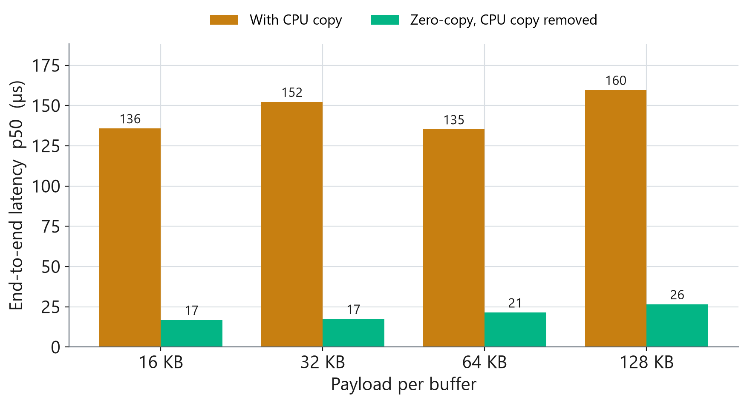
PART 2: INTO THE GPU
In the GPU pipeline, both transports now skip the big CPU copy
Notes:
[60 sec]
Second stage, computer to GPU.
This machine has unified memory, so the CPU and GPU share one pool. A buffer in host memory can be read by the GPU with no transfer at all, if you set it up correctly. Both transports now do that.
That matters for the next slide. From here on, when one is faster than the other, it is not because one is copying and the other isn't. They start level.

Slide 7
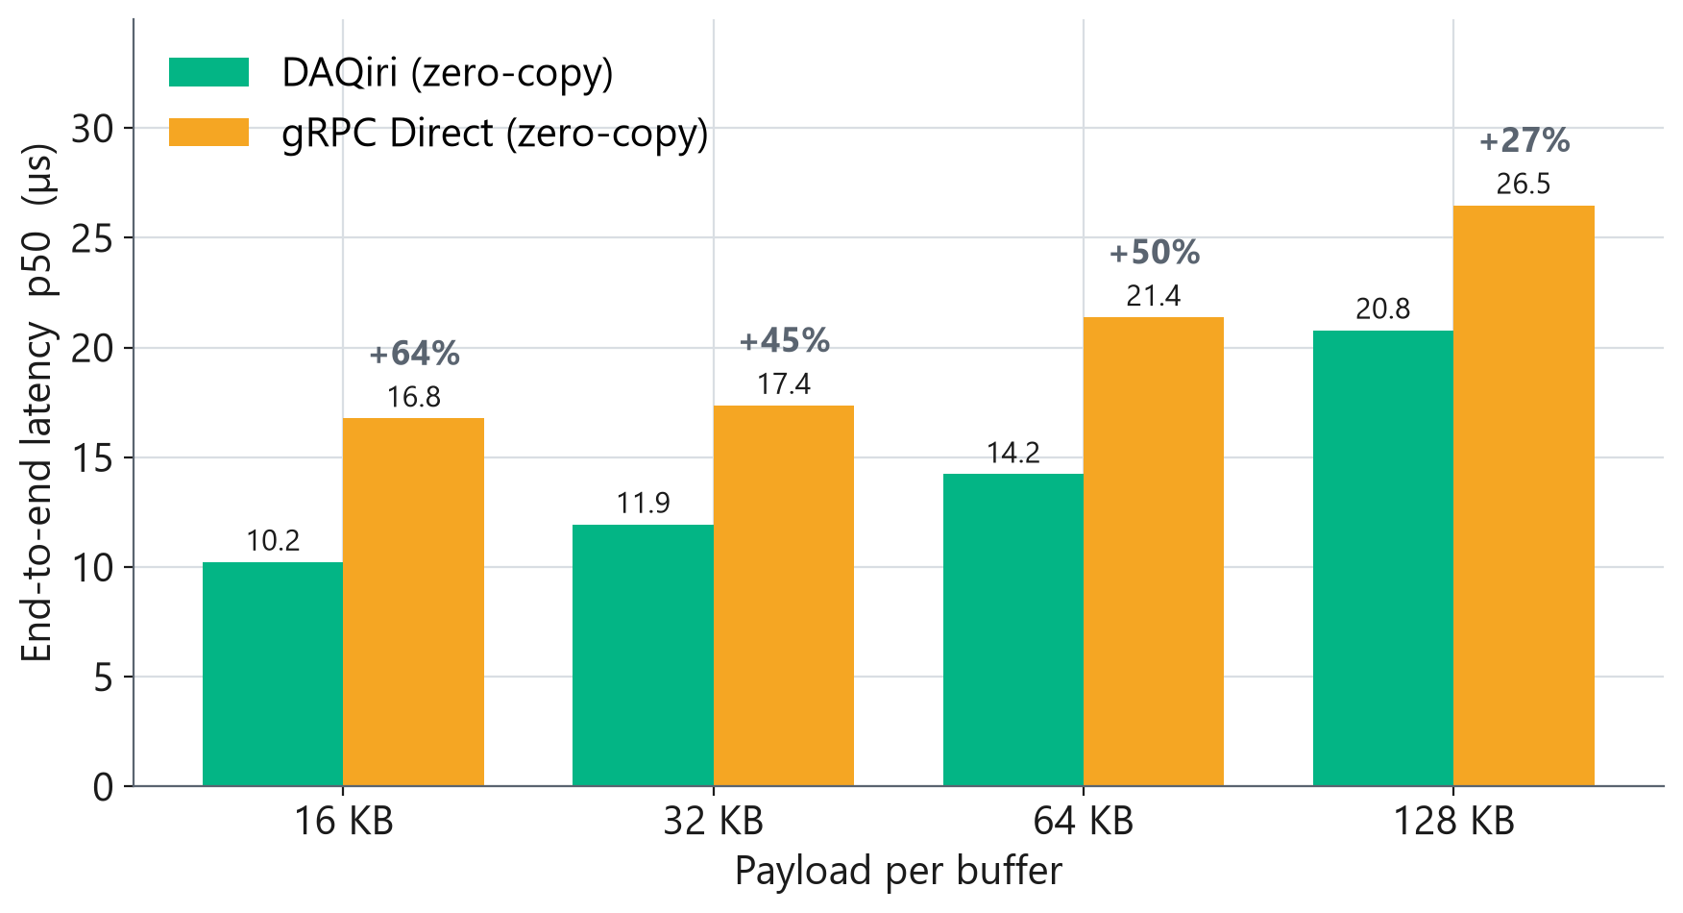
PART 2: INTO THE GPU
Getting a buffer into the GPU, DAQiri was faster at every size we tested
Part 1 measured how much data per second the link carries. This measures how long one buffer takes to get from the wire into the GPU.
DAQiri came out ahead at every payload size.
Notes:
This is the comparison between daqiri and grpc direct
Time for one buffer to go from arrival to a finished FFT, at four payload sizes. DAQiri is ahead at every one, by 27 to 64 percent.
Notice that Part 1 and Part 2 point different ways. On throughput the two are close. On per-buffer latency they aren't. Those are genuinely different questions. Throughput asks how much fits down the pipe. Latency asks how long one thing takes to get through. A system can be good at one and bad at the other.
So: why is DAQiri ahead? That's Part 3.

Slide 8
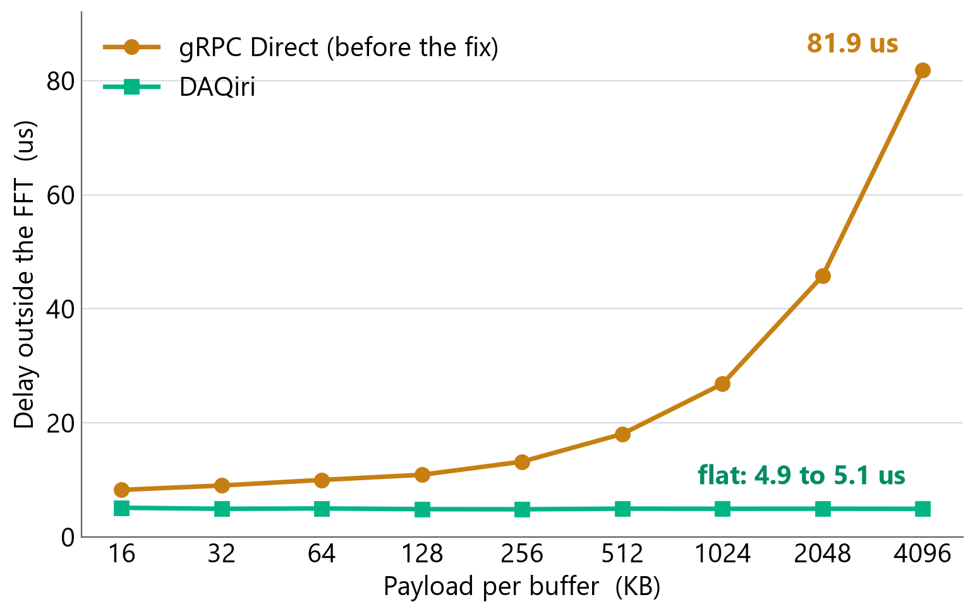
PART 3: CLOSING THE GAP
The delay grew with the size of the buffer, which told me where to look
I subtracted the FFT time from the total to leave everything the pipeline does around the math.
DAQiri's stays flat near 5 microseconds from 16 KB all the way to 4 MB, but
gRPC Direct’s climbs from 8 to 82. This cost grows with the byte count suggested to me that something is touching every byte.
So there was Something copying the data still.
Notes:
The network card finishes writing bytes into a slot
The card posts a completion notice
Your thread sees that notice
timer starts
Your code grabs the pointer for that slot
Launches cuFFT
GPU computes
Your code waits for the GPU
timer stops The trick on this slide is simple. Take the total time, subtract the FFT time. What's left is everything the pipeline does around the math( steps 5,6,8)
Now look at the shape, not the values. DAQiri's leftover time is flat: about 5 microseconds whether the buffer is 16 kilobytes or 4 megabytes. Flat means fixed overhead. A setup step, a launch, a notification. It doesn't care how much data there is.
gRPC Direct's climbs from 8 to 82. A cost that grows with the byte count means something is reading or writing every byte.
So I stopped looking for a slow FFT and started looking for a copy.

Slide 9
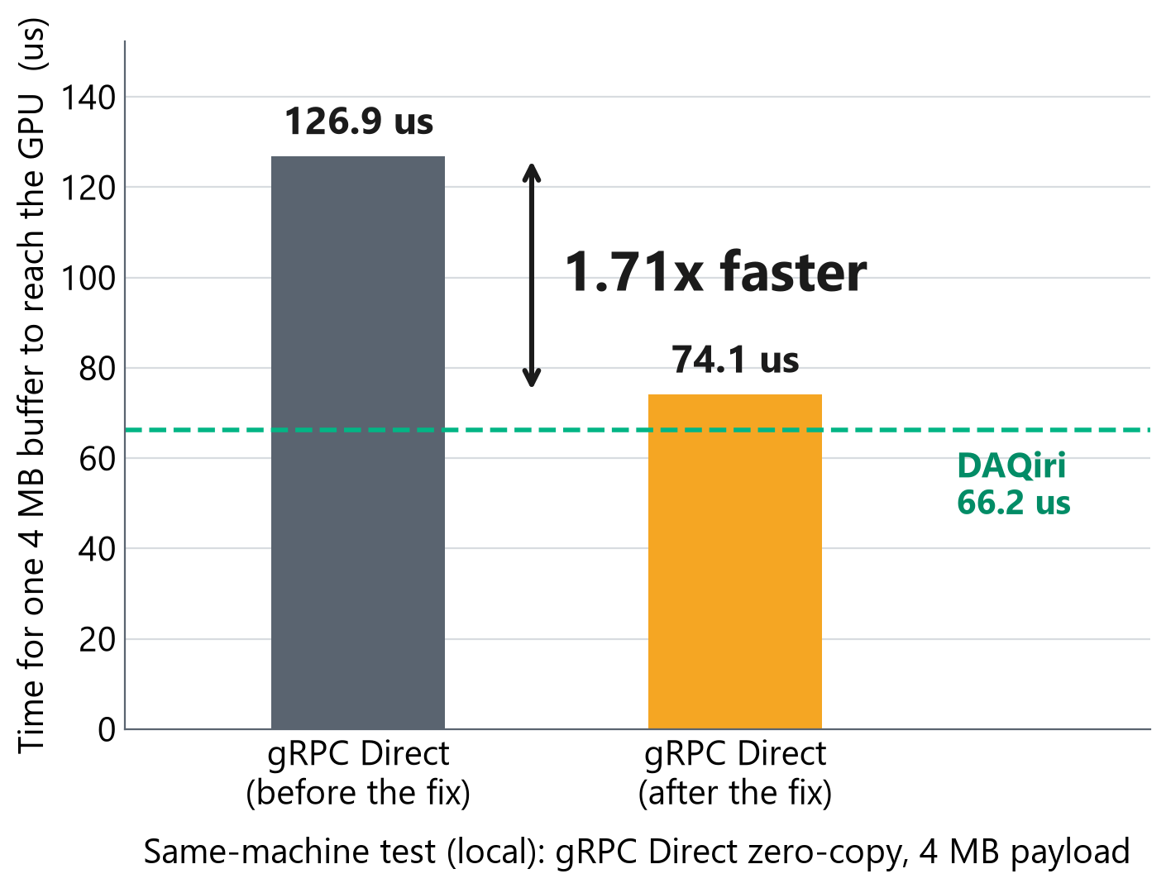
PART 3: CLOSING THE GAP
The cause was an alignment check that could never pass
The receiver checked whether each incoming buffer was aligned to 16 bytes, and copied it somewhere aligned when it was not.
The library that packs the messages only ever gives 8-byte alignment, so the check failed on every single message.
cuFFT accepts the 8-byte pointer anyway. The fix stops guessing and asks cuFFT directly whether it will take the buffer.
It hid because the copy is asynchronous. The timer around it read 3.5 microseconds; the real 77 surfaced later, inside the wait for the FFT.
Notes:
[85 sec]
And there was one.
Every location in memory has an address, which is just a number. 16 byte aligned means that number divides evenly by 16. Some wide load instructions prefer that.
Our receiver had a line that said: if this buffer isn't 16 byte aligned, copy it somewhere that is. That looks like careful code. The problem is that protobuf, the library that packs the message, guarantees 8 byte alignment and never promises 16. So the check failed on every single message, forever, and every message paid to copy itself. cuFFT was happy with 8 the whole time.
The fix stops guessing. If the pointer isn't 16 aligned, we ask cuFFT directly whether it will take it. It says yes, and the copy disappears.
Why did this hide for so long? The copy is asynchronous. The call returns when the work is queued, not when the bytes have moved. Our timer read 3.5 microseconds. The real 77 showed up later and got billed to the FFT. Worth remembering: an async API will happily let you time the wrong thing.

Slide 10
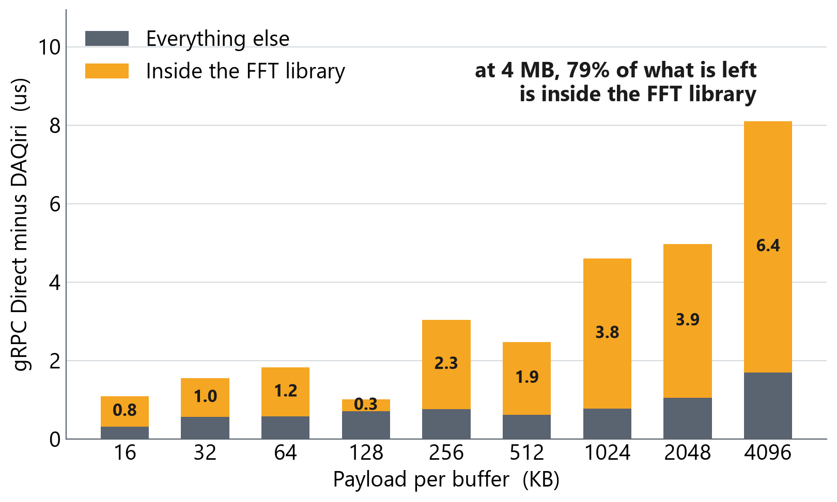
PART 3: CLOSING THE GAP
What is left sits inside the FFT library, not in the transport
After the fix, gRPC Direct is still a little behind DAQiri. I split that remainder into two parts.
The part outside the FFT library stays under 2 microseconds at every size.
The part inside it grows with the payload, from 0.8 to 6.4 microseconds.
At 4 MB, 79 percent of what is left is inside the FFT library. The transport is no longer the thing to work on.
Notes:
That fix was worth 1.71 times. DAQiri is still ahead, so where is the rest of it.
I split the remaining gap in two: the part inside the FFT library and the part outside it. Outside stays under 2 microseconds at every size. Inside grows with the payload, and at 4 megabytes it's 79 percent of what's left.
Launch overhead doesn't grow with payload, so this isn't launch overhead. It points at the buffer itself, at where the data is sitting when cuFFT reads it. Which is what sent me into memory.

Slide 11
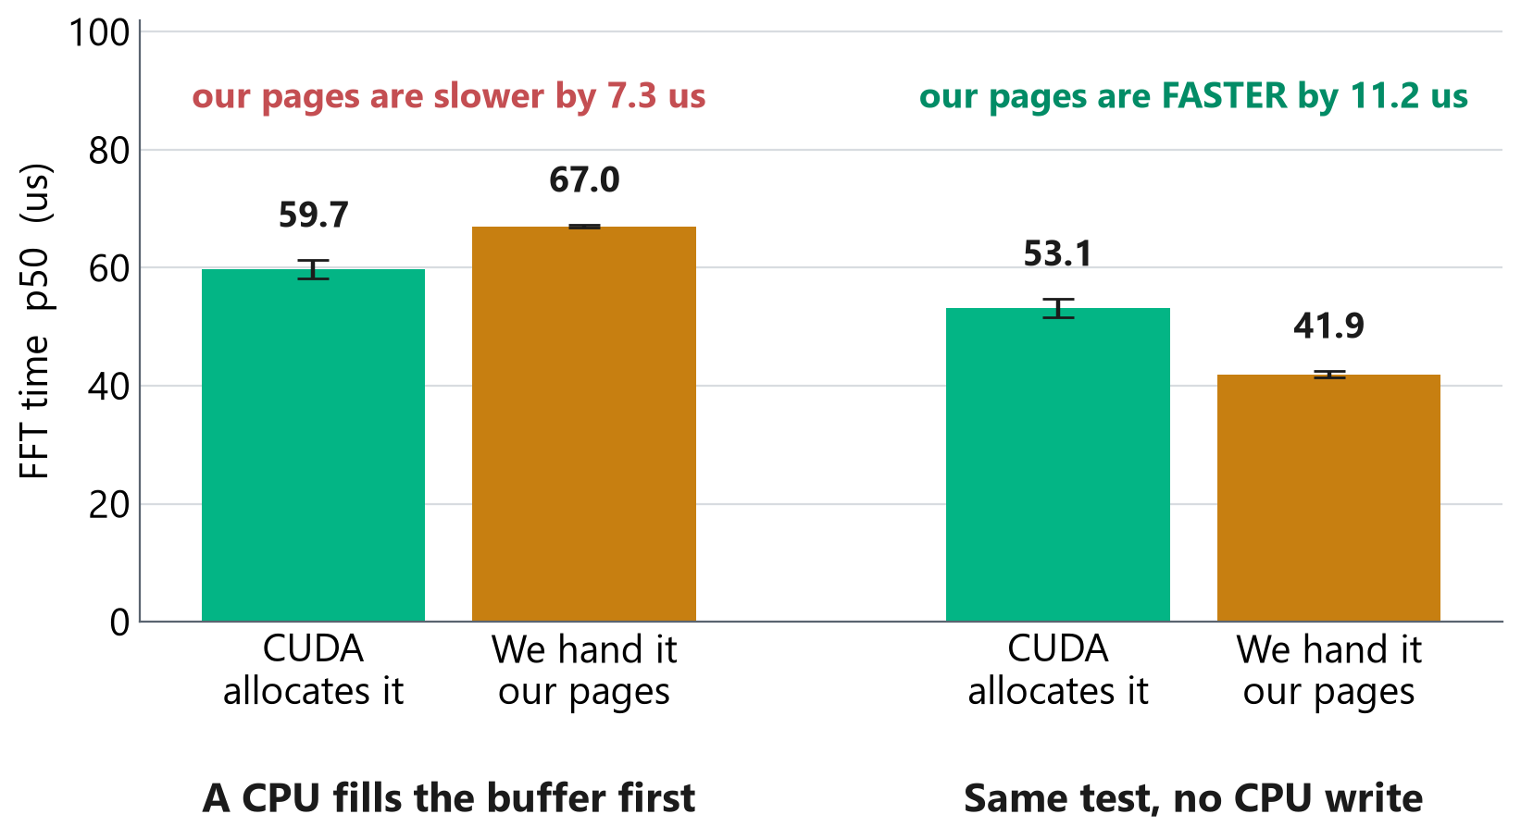
PART 3: CLOSING THE GAP
A result I had trusted inverted when I removed one step
The GPU can read host memory by letting CUDA set the pages, or hand it pages the program already owns.
The way it was done in gRPC was slower by 7 to 11 microseconds
Then I removed the CPU write that had been filling the buffer, then it came out 11 microseconds faster.
Both measurements were right about what they measured. The mistake available was carrying one into a setup it had never measured, which was a network card filling the buffer and no CPU touches it.
Notes:
There are two ways to get host memory a GPU can read. Let CUDA allocate the pages, or hand CUDA pages your program already owns.
Ours measured slower every way I tried it, by 7 to 11 microseconds, fifteen runs out of fifteen. That result is why I built the RDMA receiver the way I did.
Then I removed one thing from the test: the CPU loop that filled the buffer. The sign flipped. Ours came out 11 microseconds faster.
So I went and measured it in the setup that actually ships, where a network card fills the buffer and no CPU ever touches it. There the two are indistinguishable.
Both of the earlier measurements were correct about what they measured. The mistake on offer was carrying one of them into a configuration it had never seen. I nearly did.

Slide 12
PART 3: CLOSING THE GAP
What I built: the card writes into memory the GPU reads
Instrument chassis
One allocation is registered twice, once with the network card and once with CUDA. Both of them address the same bytes.
The card writes into it directly. The FFT reads it in place. There is no staging copy anywhere on this path.
This is the path that runs at 98 percent of line rate in Part 1.
▼
50 Gb/s RDMA link
▼
One buffer, registered with the card and with CUDA
▼
The FFT reads it where it landed
Notes:
This is what I built.
On this chip, GPUDirect, where the card writes straight into GPU memory, isn't available. So the supported route is one host buffer registered twice: once with the network card, once with CUDA. Same bytes, two owners.
The card writes into it directly. cuFFT reads it where it landed. Nothing is staged anywhere. On a machine without GPUDirect that is the shortest path there is. There is no version of this that copies less.
It is the only one of the four that can cross a machine boundary. The other three need the sender and the receiver in the same box. Shared memory has no answer to 'the instrument is over there.'
And DAQiri needs CUDA at both ends. The instrument chassis has no NVIDIA GPU in it. So on the topology we actually ship, the comparison is not 83 against 66. It is 83 against not possible.
It reaches 98 percent of line rate, so the ceiling is the hardware's and not ours. Put a faster link under it and the same code follows the link up.

Slide 13
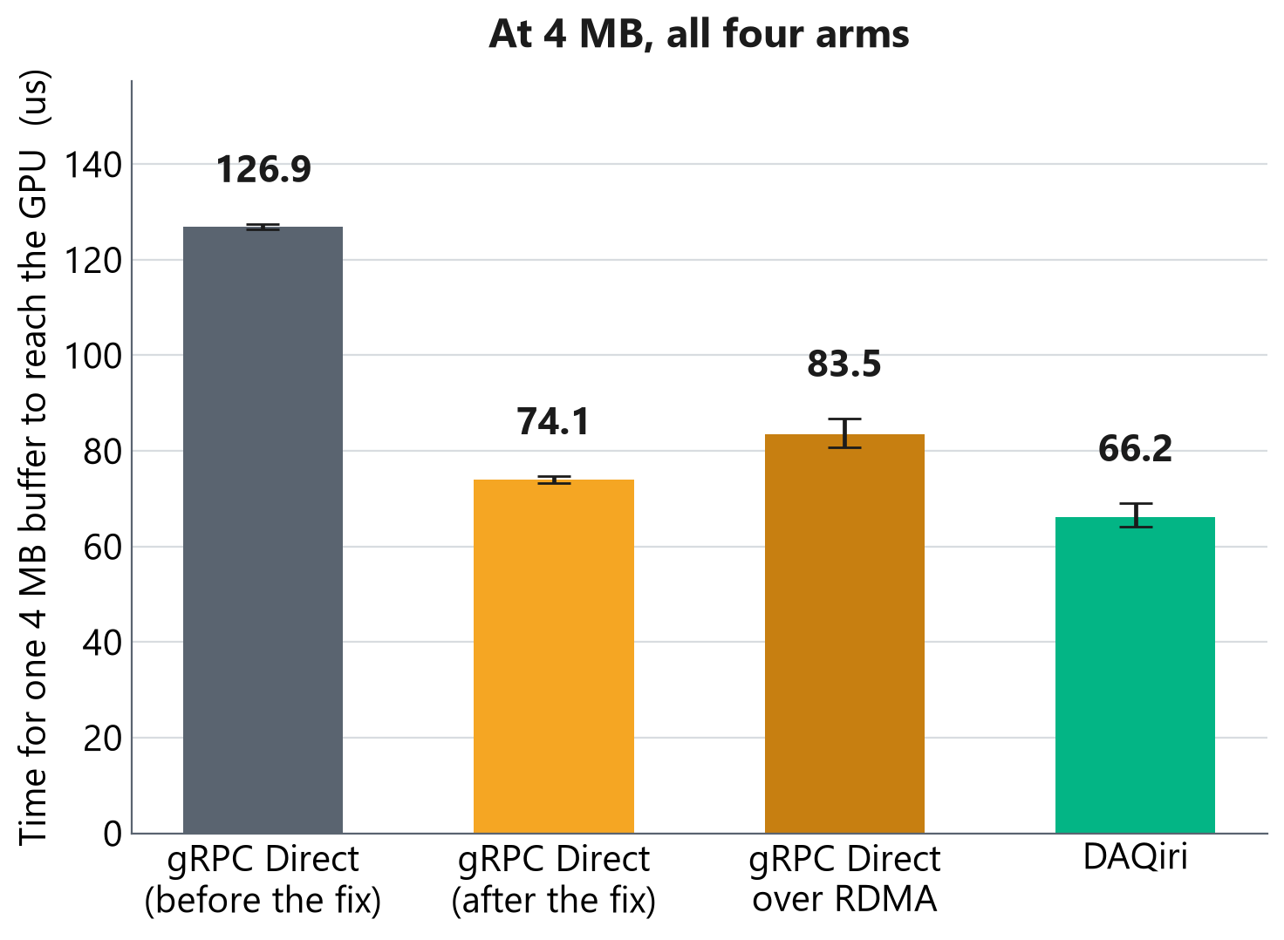
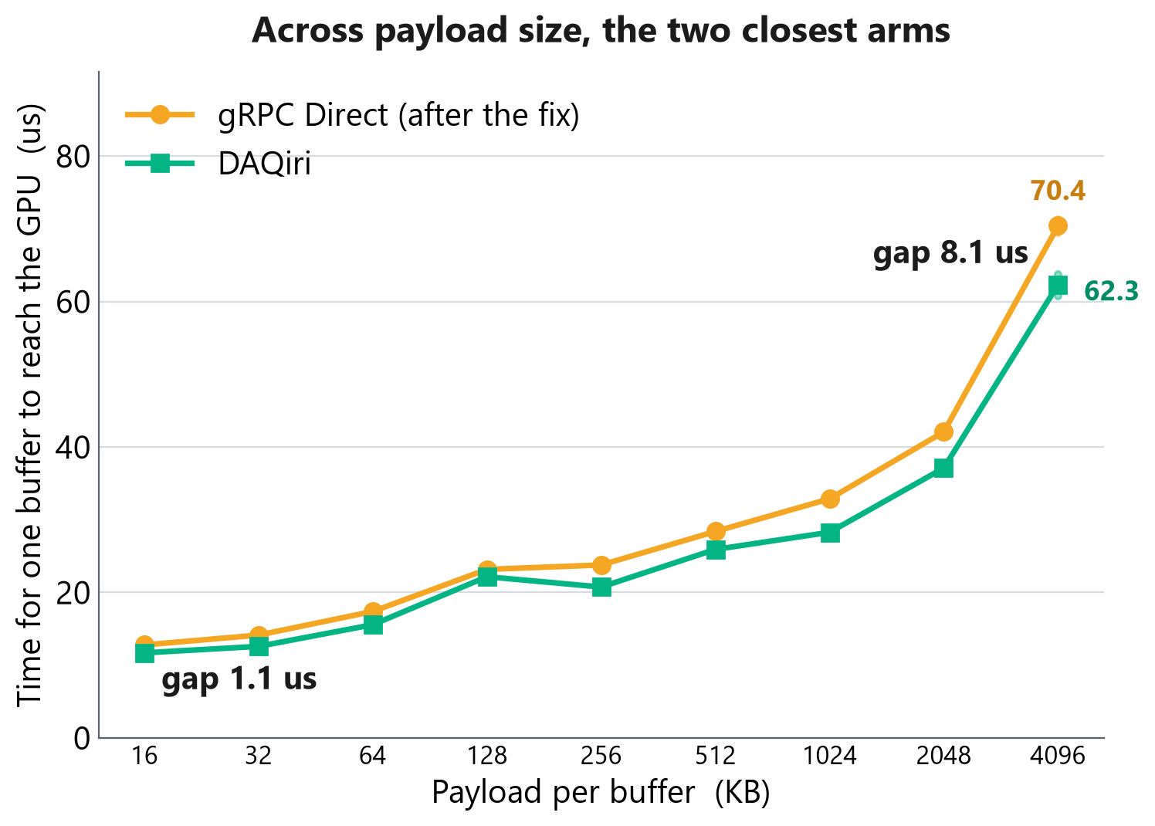
PART 3: CLOSING THE GAP
Where it ended: 1.71 times faster, and 7 microseconds behind DAQiri
Left: 12 repetitions per bar, whiskers are a 95% confidence interval on the median. Right: a separate nine-size run, 2 repetitions each, which is why its 4 MB points read 70.4 and 62.3 rather than 74.1 and 66.2. Read it for shape.
All four arms run on one machine, so these are receive-side software costs. Time on the wire is not in these numbers.
Open item: across a 200-fold change in data rate the RDMA arm moves 23 microseconds and nothing else moves 2.
Notes:
Two charts. Left is one payload size with the full treatment.
Right is all nine sizes, and only the two arms that take the same route into the GPU, because those are the pair where a difference tells you something.
Left first. Four transports, 4 megabyte buffers
gRPC Direct is 1.71 times faster than it started and sits about 7 microseconds behind
Now the right chart, and this is here because one payload size is a fair thing to object to. 4 megabytes could be the one width where those two happen to land like that. They do not. The gap grows with the payload, from about 1 microsecond at 16 kilobytes to 8 at 4 megabytes, which in proportion is a steady 5 to 16 percent behind across a 256-fold range.
The two charts are separate runs, and I labelled the right one's 4 megabyte points so you can see that. It measured 70.4 and 62.3 where the bars say 74.1 and 66.2. Two reps a point against twelve. They agree on the shape, and I would not quote the right one's decimals.
why the RDMA bar is higher than the shared memory bar: it is the only arm that can leave the machine, and it is the only arm the instrument chassis can run, because that chassis has no NVIDIA GPU in it. Slower than a route you cannot take is still the fastest route available.
One thing I cannot explain yet: the RDMA arm moves 23 microseconds between those two data rates and nothing else moves 2. That is the open question I am handing over.
All four run on one machine, so this is software cost with the wire taken out.

Slide 14
Summary: moving data faster lets the GPU act in real time
Up to 281 times lower latency and about four times the throughput while still using the same gRPC API.
gRPC Direct over RDMA carries 98 percent of the 50 gigabit line rate
In the GPU pipeline, gRPC Direct is now 1.71 times faster than it was before and is 7 microseconds behind DAQiri
Now we have an in house network protocol that enables faster inference for live hardware data.
Notes:
Where this leaves us.
Same application code, a much faster path underneath it. A transport that reaches 98 percent of line rate from a chassis with no GPU in it, which the alternative cannot do at all.
In the GPU pipeline, a real root cause worth 1.71 times, and the remainder localized to inside the FFT library rather than the transport.
I did not close the gap to DAQiri, we were able to make a rdma path that is able to go from pxi to spark without any special drivers, or gpus, or cuda kernals, something that daqiri can’t do.
Happy to take questions.

