Slide 1
Network Security in
Cloud-base file hosting service
By Alex Xiao Cai & Tien Dinh
axiaocai@uoregon.edu & tvd@uoregon.edu

Slide 2
Introduction
About:
Design a web application that mimics the functionalities of cloud storage and file sharing services such as Google Drive, DropBox, Microsoft OneDrive, etc.
Functionalities:
Availability
Accessibility
Reliability
Security Methods:
Authentication
Encryption
Access Control

Slide 3
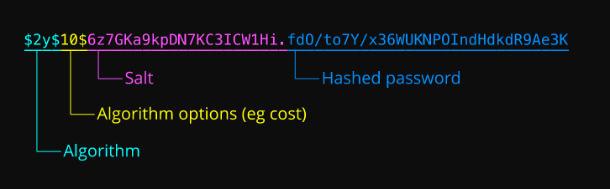
1. Authentication
Server
Grant access to the database
Database
Stores information
Bcrypt
Encryption method

Slide 4
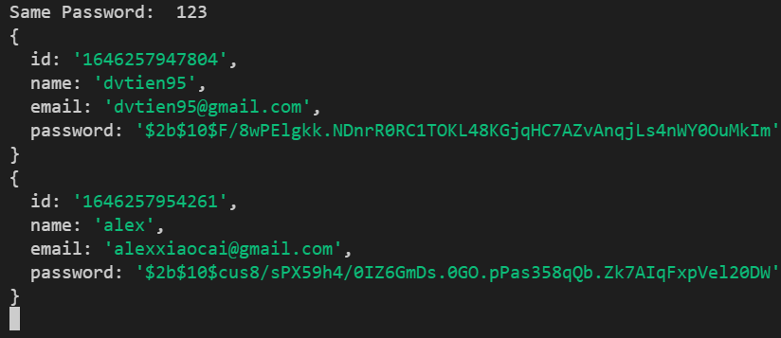
1. Hashing a same password

Slide 5
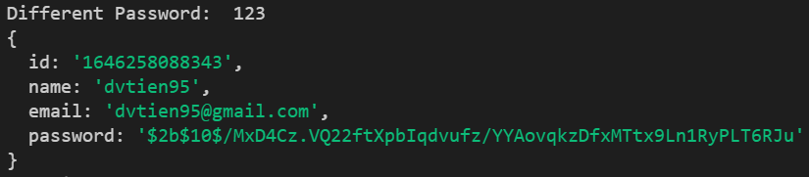
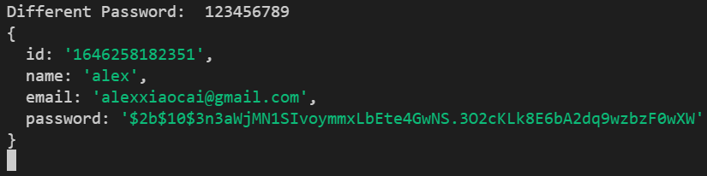
1. Hashing different passwords

Slide 6
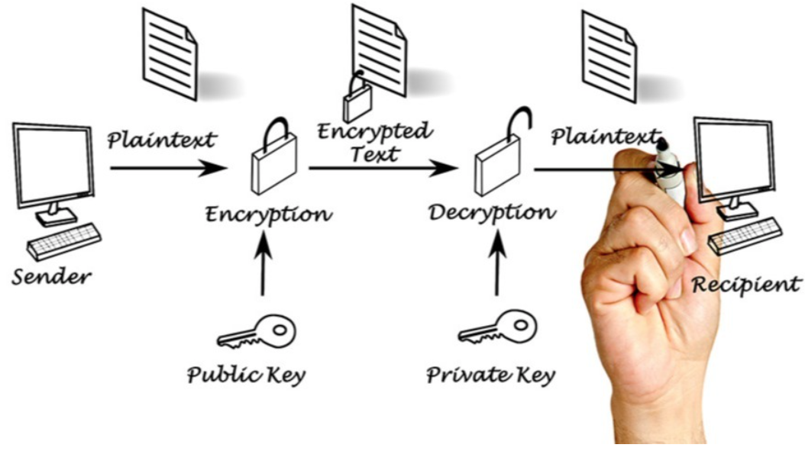
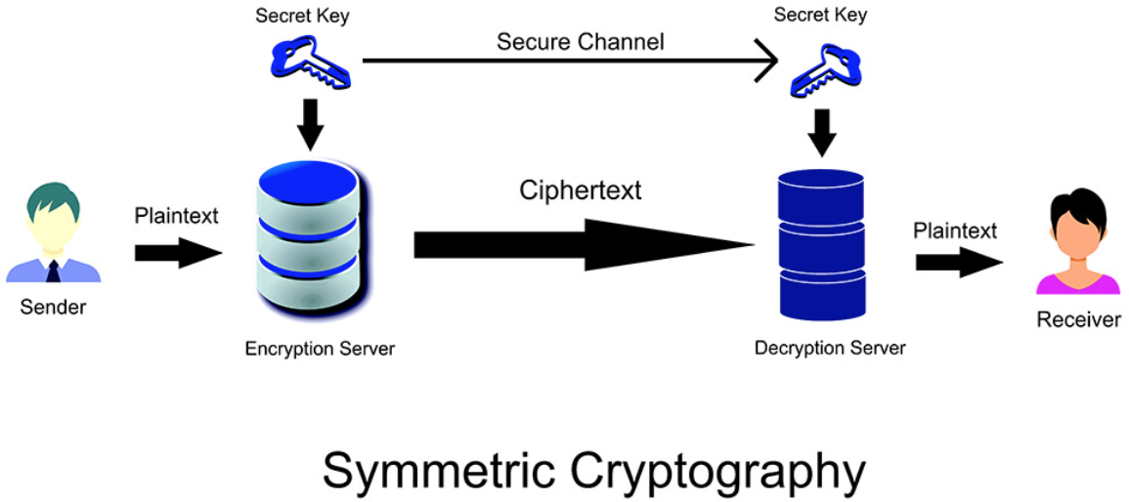
2. Encryption
- Ex: Advanced Encryption Standard (AES-128, AES-256)
- Symmetric Encryption: Shared secret key
- Encrypt and decrypt with the shared key
- Ex: Rivest–Shamir–Adleman (RSA)
- Asymmetric Encryption: Public/Private key pair
- Encrypt with public key, decrypt with private key

Slide 7
2. Common practice
Google Drive:
File encryption: 128-bit Advanced Encryption Standard (AES)
File transfer: 256-bit Secure Socket Layer(SSL)/Transport Layer Security (TLS) protocol
Dropbox:
File encryption: 256-bit AES
File transfer: 128-bit SSL/TLS protocol
AES algorithm is resistant to attack, but the secret key must be exchanged in a secured way
Combine AES and RSA algorithm:
Use AES secret key to encrypt the data
Use RSA public key to encrypt the key

Slide 8
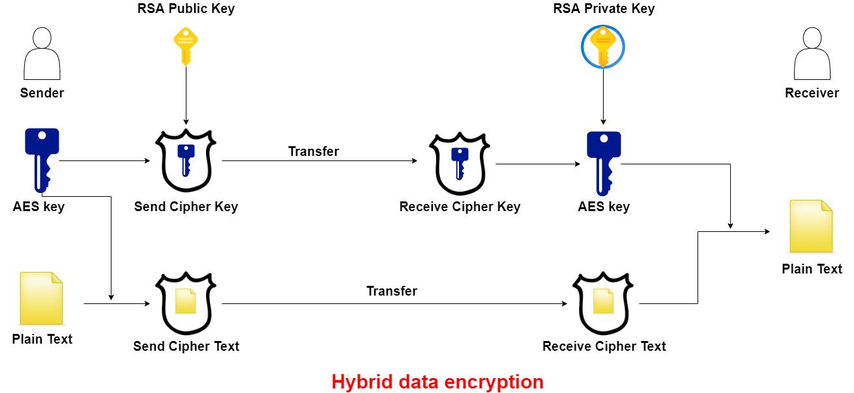
2. Combination of AES and RSA algorithm

Slide 9
3. Access Control
Authentication:
User must be authenticated to access the content
Use Node Passport.js package to check isAuthenticated for every request
Authorization:
Private upload:
Only owner and shared user can access the file
Public upload:
Anyone can view and download the file
Permission:
Read: Can view and download
Write: Read permission + change the content
Admin: Read & Write permission + move + delete the content

Slide 10
Future work
Deploy our server on https://www.heroku.com/
Test https, SSL/TLS configuration
Test website performance
File size + upload speed
Compare with other file hosting service: Google Drive, Dropbox

Slide 11
Questions

Slide 12
