Slide 1
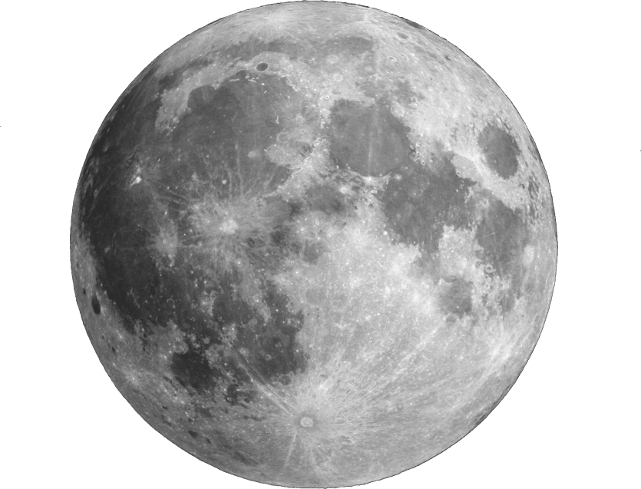
MOON QUAKE

Slide 2
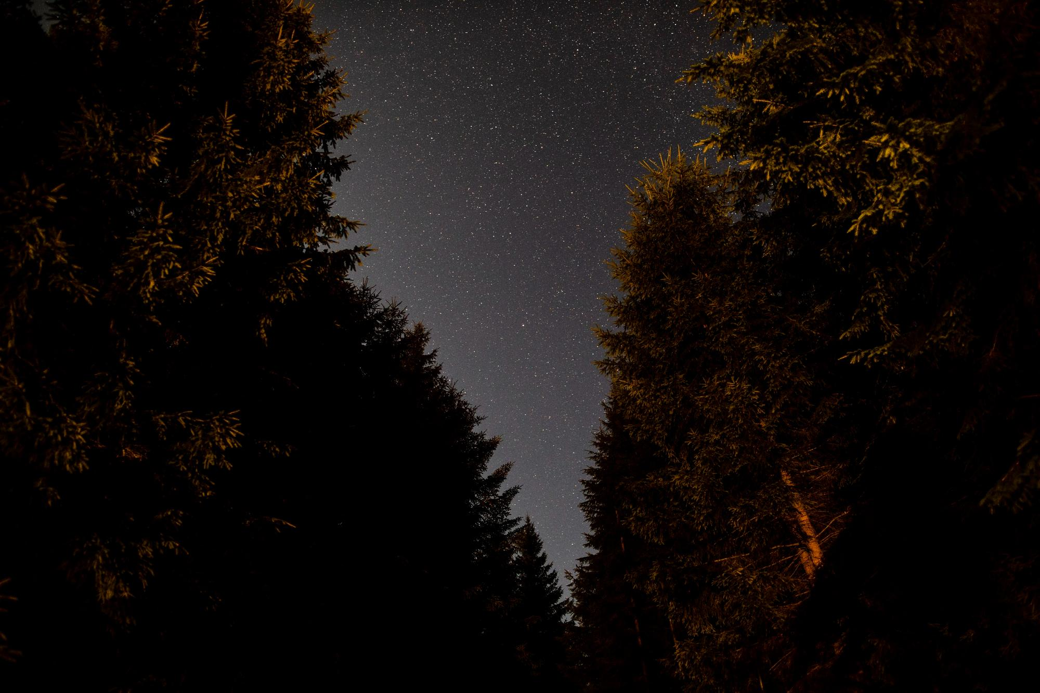
WHY DO MOONQUAKES HAPPENS
Moonquakes happen on the moon because of the shifting of tectonic plates
They can be caused by the tidal pull of Earth on the moon, meteor impacts, or the change in temperature on the surface of the moon
Moonquakes can last up to 10 minutes or more, and smaller trembles can last for hours afterwards.

Slide 3
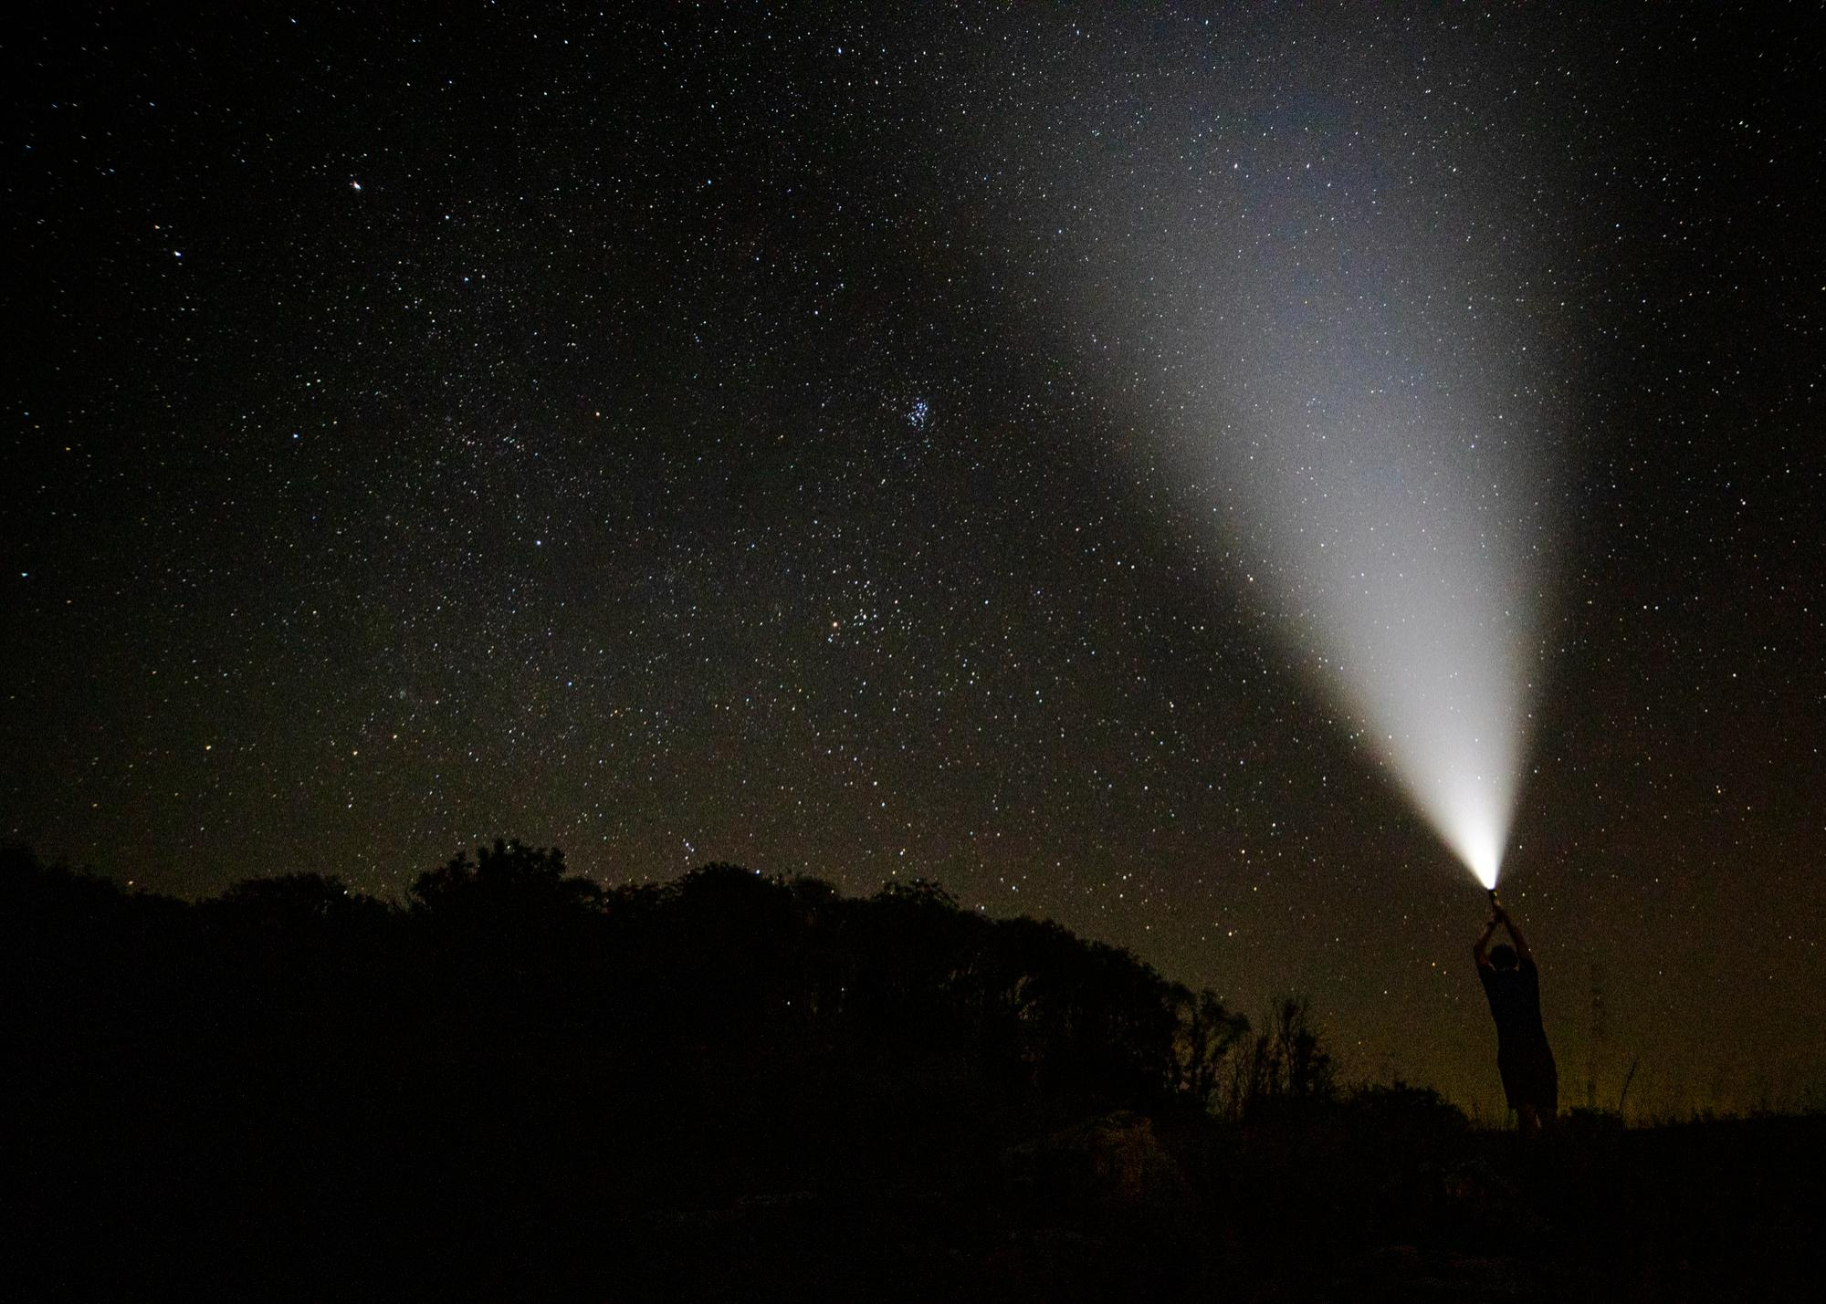
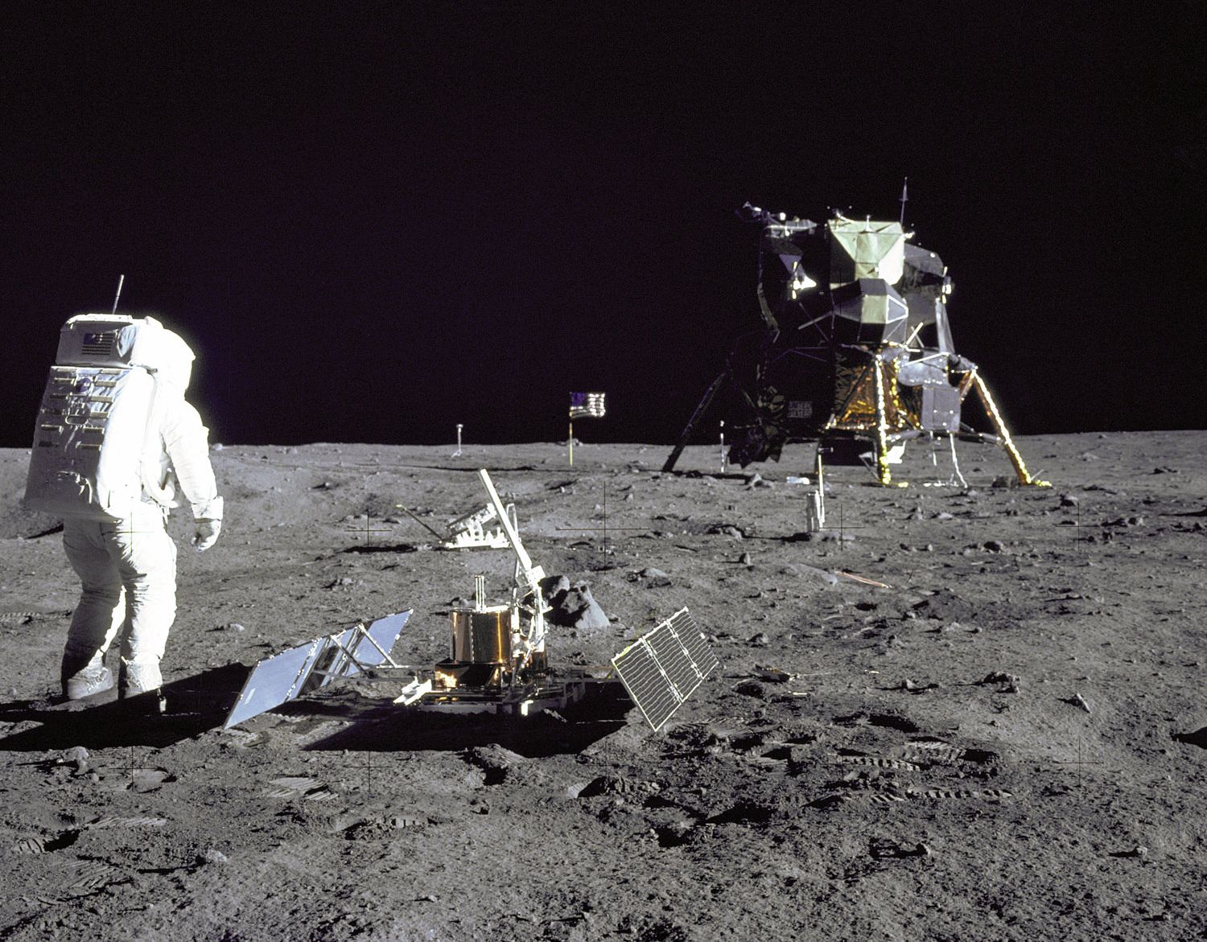
TYPES OF MOONQUAKE
01
02
METEROS IMPACT
DEEP MOONQUAKES
03
04
SHALLOW MOONQUAKE
THERMAL MOONQUAKE
NO ATMOSHPHERE SO SMALL METEROS CREATE DAMAGE AND CAUSE MOONQUAKE
BELOW 700KM OF THE SURFACE MOSTLY CAUSED BY TIDES
REPEAT AFTER 27DAYS
MOST POWERFUL AND WORST REASON IS UNKNOWN
CAUSE BY MOON TEMP, COLD REGION REACH TO -240
AND AFTER COMING IN SUNLIGHT IT CA REACH TO +250

Slide 4
HISTORY :THE APOLLO MISSION
Starting in 1969 during the Apollo 12 mission, 6 seismic stations were installed
In the next 10 years, thousands of small scale (2-3) earthquakes were recorded
These earthquakes have Since been classified into deep and shallow moonquakes

Slide 5
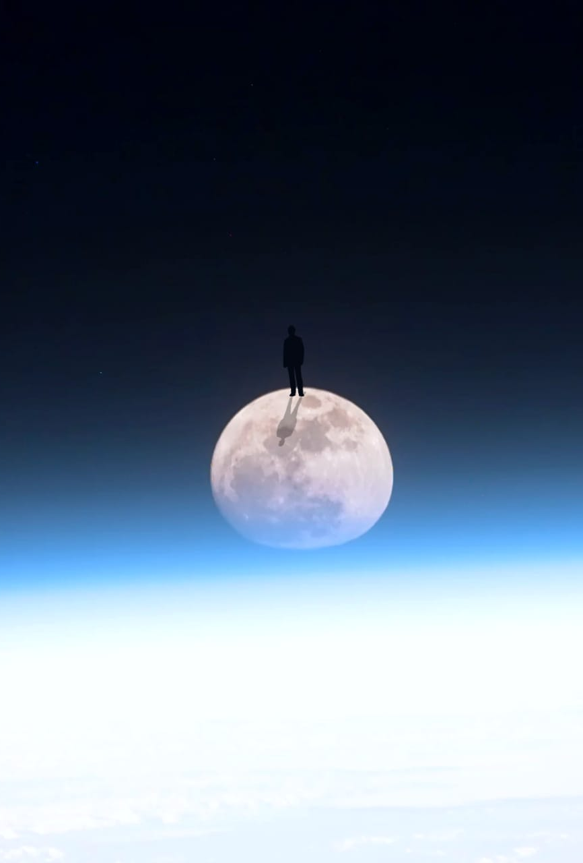
MOON SAVER APPS
THIS WOULD BE A REVOLUTIONARY APP
WHICH WILL TELL ABOUT MOON, ABOUT THERE MISSIONS AND SPECIALLY IT WOULD LOCATAE
MOONQUAKES

Slide 6
FEATURES OF APP
3D MODEL
SEISMOLOGY
THERMAL VISION
MISSION AND QUAKES OF MOON
3D MODEL WITH LOCATIONS AND PIN POINTS(MOONQUAKES)
GET DATA IN SISMOGRAPH WITH LIVE VIBRATION IN MODEL
SEE MOON IN THERMAL VISION FOR BETTER UNDERSTANDING OF CREST, TROUGH, MONTAINS ETC..
GET ALL THE INFORMATION JUST IN ONE CLICK IN 3D VISIUAL MODE

Slide 7
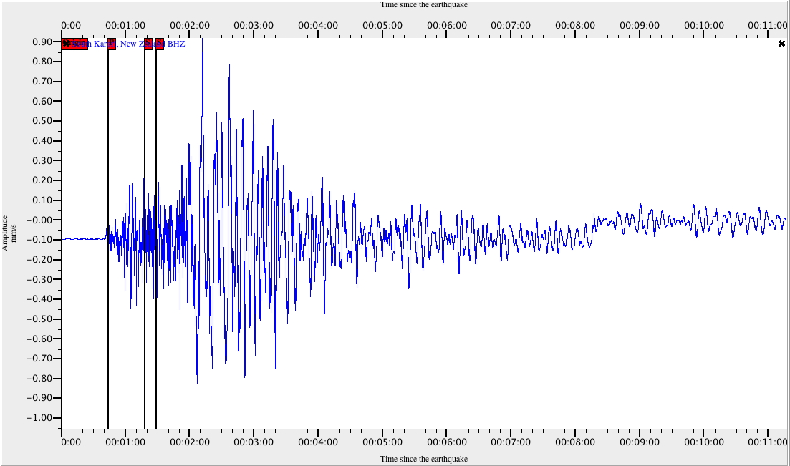
3D VIBRATION
1ST APP
TO HAVE 3D VIBRATION
MORE MAGINTUIDE
MORE VIBRATION EFFECT
REAL TIME
MOONQUAK UPDATE
This Photo by Unknown Author is licensed under CC BY-NC-ND

