Slide 1


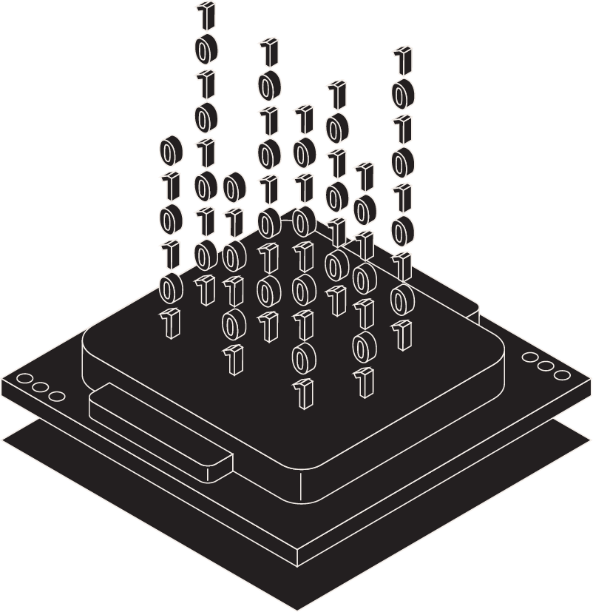
AI FOR WORKPLACE: HEALTH AND SAFETY
VAHNINETRA
TEAM AREA51
DHRUVRAJSINH VANSIA
DISHA KAPADIA
VISHWA PATEL

Slide 2
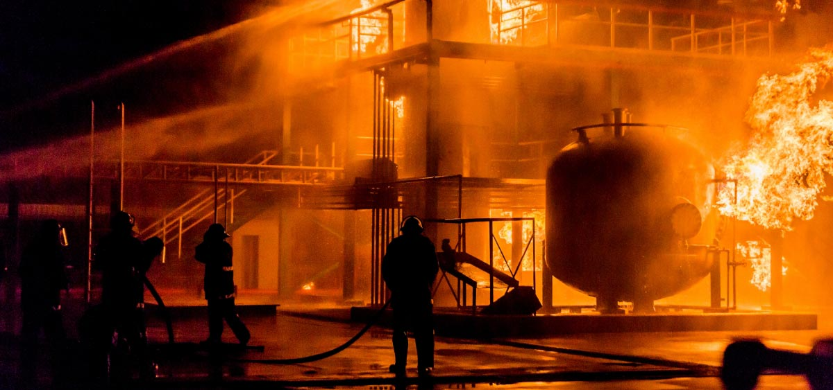
PROBLEM STATEMENT:-
The primary issue is the susceptibility to delayed alarms, which can lead to complacency and diminished trust in the alarm system, potentially resulting in inappropriate responses.
PROPOSE SOLUTION:-
VAHNINETRA

Slide 3

Contents
01
04
02
05
03
06
Fire & Smoke Alarm System
Model Evaluation
Dataset and its Parameters
Why
VahniNetra?
Classifier Models
Applications

Slide 4

Fire & Smoke Alarm System
Fire in commercial spaces, especially manufacturing plants, are serious accidents that can cause unprecedented loss of goods, company assets and human life.
Smart fire & smoke detectors are built using artificial intelligence and machine learning models to detect smoke emissions in an industrial setting and send real-time alerts to help control fire and its hazardous effects.
Implementing smart fire & smoke detectors for industries is an effective solution for improving fire safety. With advanced features such as remote monitoring, accuracy and reliability compared to previous-generation detectors, this technology is a necessity for modern industrial environments.

Slide 5
Dataset and Parameters
Data can be taken from sensors which can directly be uploaded on CLOUD, and can be instantly interfaced with our model.
Parameters:-
Temperature (C)
Humidity (%)
Total Volatile Organic Compounds- TVOC (ppb)
CO2 Equivalent Concentration- eCO2 (ppm)
Raw Hydrogen
Raw Ethanol
Pressure (hPa)
Particulate Matter- PM
Concentration of PM- NC
Count- CNT
Fire Alarm (0/1)

Slide 6
SPS30 Sensor
Robocraze BME680 Sensor
Vernier Ethanol Sensor
VAHNINETRA MODEL
Trigger Alarm
Send Emergency Message

Slide 7
Classifier Models
Logistic Regression
01
02
03
Support Vector Machines
Bernoulli Naïve Bayes
04
05
06
K- Nearest Neighbour
Random Forest
Gaussian Naïve Bayes

Slide 8
Model Evaluation
Logistic Regression
Support Vector Machines
Bernoulli Naïve Bayes
R2 Score= -0.40
MAE= 28.6%
MSE= 28.6%
Accuracy= 71.3%
R2 Score= -0.40
MAE= 28.6%
MSE= 28.6%
Accuracy= 71.3%
(More Time Taken)
R2 Score= -0.29
MAE= 26.5%
MSE= 26.5%
Accuracy= 73.4%
Gaussian Naïve Bayes
K- Nearest Neighbour
Random
Forest
R2 Score= 0.153
MAE= 17.3%
MSE= 17.3%
Accuracy= 82.6%
R2 Score= 0.99
MAE= 0.015%
MSE= 0.015%
Accuracy= 99.98%
R2 Score= 1.0
MAE= 0%
MSE= 0%
Accuracy= 100%

Slide 9
Why VahniNetra?
1) Our Model is more accurate and reliable than traditional fire & smoke detectors, which often fail to detect smoke on time or are triggered by false alarms.
2) The advent of AI-powered wireless technology in smoke detectors has encouraged small-medium businesses to invest in fire safety systems.
3) Our model can provides remote monitoring and remote alerting to specified field operator.
4) Traditional fire and Smoke detectors lacks in detection of small fires and fumes (typically caused by raw hydrogen).
5) Compared to traditional fire and smoke detectors,our model can provide live data about atmospheric conditions.
6) In industries, The traditional detectors are installed at high ceiling causing delay in detection of fire and smoke.

Slide 10
Industries Space Craft Huge Malls & Multiplexes Textiles & Factories
Applications

Slide 11
THANK YOU
NAVATECH Groups MSBC Group HOLBOXAI
GOOGLE DEVELOPERS

