Slide 1
FITDECK PROJECT UPDATE
Daphne Williams
Shane Trentham

Slide 2
FitDeck: A fitness mobile application that will ALLOW A USER TO CREATE A PROFILE FIT WITH WORKOUTS THAT THEY THEMSELVES CREATE OR SELECT FROM predetermined routines

Slide 3
OUTLINE
Changes made to the project
Completed features
Partially completed features
Incomplete Features
Updated Class Diagram

Slide 4
Changes
Not much has been needed to be changed as far as the UI is concerned.
I may plan to add a default image for the user profile since it looks a little barren.

Slide 5
Changes
Added a PreDeterminedRoutines_Workouts table
Added a PreDetermineWorkouts_Exercised table
Added a UserCreatedRoutines_Workouts table
Added a UserCreatedWorkouts_Exercises table

Slide 6
Completed
The first few screens are either completely finished or mostly finished.
Opening screen
Profile Creation Screens

Slide 7
COMPLETED
Classes listed in the class diagram
User
Exercise, Workout, Workouts
Daily Stats, Weekly Stats

Slide 8
COMPLETED
The database tables
Web API
Models
Identity
Services

Slide 9
Partially COMPLETED
Profile Screen
Only lists:
Profile information
Space for graphs/Statistics
Cells for Workouts list

Slide 10
Partially Complete
Login Screen
Barely set up but the opening screen does link to it via a button
This won't take long to complete, just a matter of adding the input boxes and using a call to the Server to login

Slide 11
Partially Complete
User registration and login
The controllers for the Api
Currently only have the controllers for /Register and /Login for the User accounts
Still need some stored procedures for the database

Slide 12
Incomplete
Displaying any workouts
Displaying exercises
Displaying graphs or statistics

Slide 13
Incomplete
Buttons pertaining to other screens from the Profile Screen
Edit Workouts
Add Workouts
Add Rest Day(s)
Certain classes
Rest Day
Predetermined Workouts

Slide 14
INCOMPLETE
PreDeterminedRoutine/Workout Data
Web Api Repositories for
Routines
Workouts

Slide 15
Issues
Still haven't met with the ExRx API guys to gain access to the API
Set up meeting Saturday but nothing came of it
We plan to meet this evening

Slide 16
Issues
Initially, I was trying to code in VS with a single-view app.
Instead, chose to use Xamarin Forms, cross-platform development

Slide 17
Issues
System.Aggregate Exception when building the web Api

Slide 18
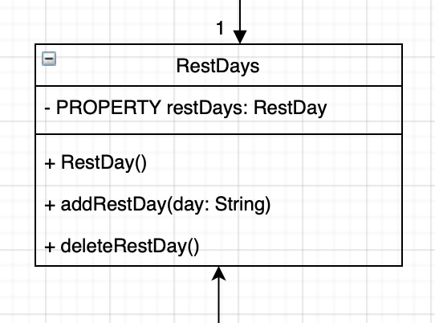
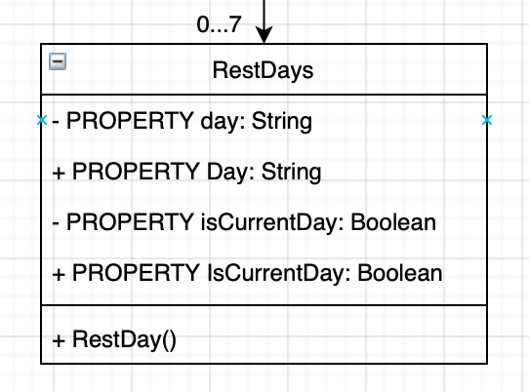
Class Diagram Update

Slide 19
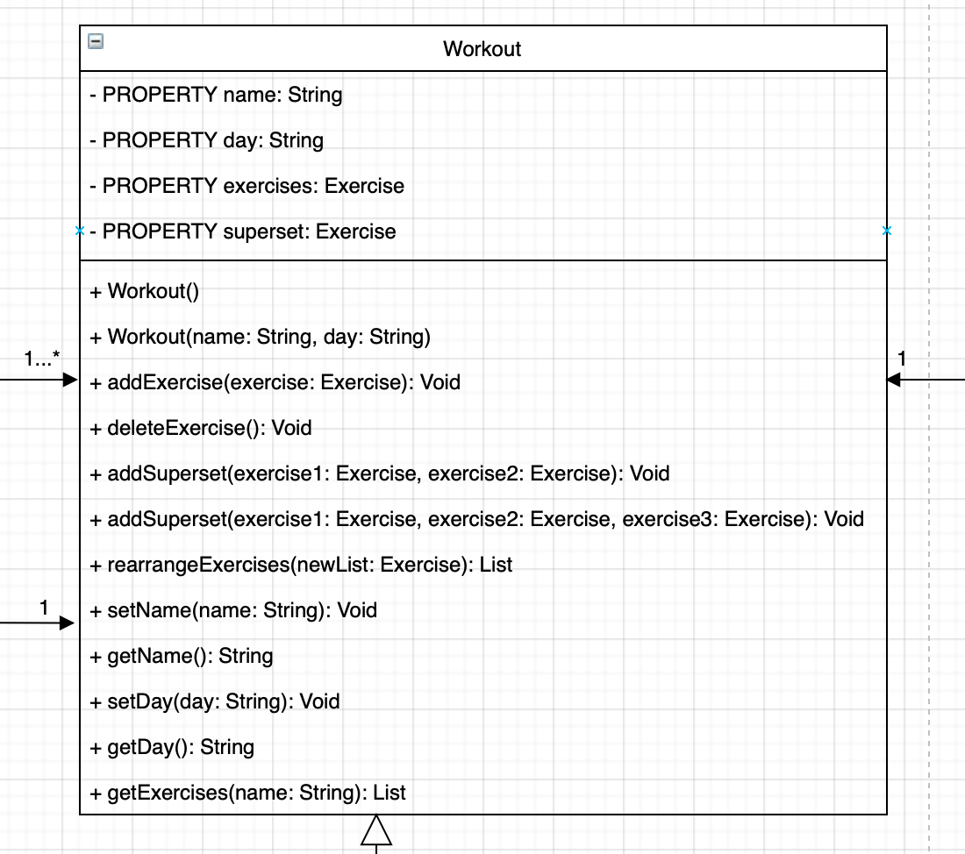
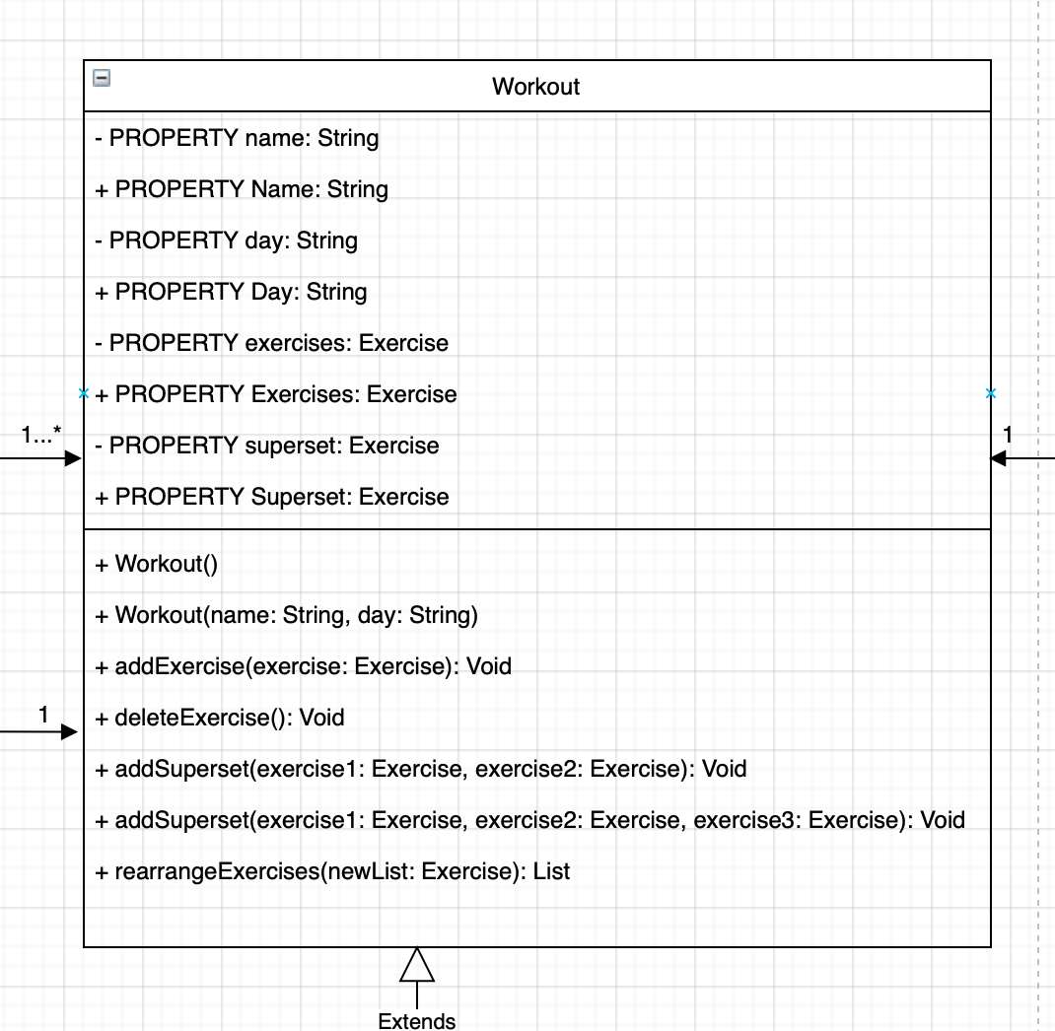
Class Diagram Update

Slide 20
In Closing
Still much to be done
Quickly integrate ExRx API
Major issues need to be handled for the project to be successful

