Slide 1
FitDeck Final Report
Daphne Williams
Shane Trentham

Slide 2
We Will:
Purpose
Technologies
Design Description
How to Deploy System
Known Bugs
How we would Improve our System

Slide 3
Introduction
Application that allows a user to enter personal information to create a workout profile. They will be able to add workouts that are created by them or predetermined by us.

Slide 4
Technology
VS 19 Xamarin Forms
ExRx Api
Attempted Syncfusion
Microsoft Azure

Slide 5
Design
Classes
User, Workout(s), Exercise, Stats, Restday(s)
Added Classes for APIs
Database Tables
User
UserCreatedWorkout
UserCreatedWorkout_Exercises

Slide 6
Design cont.
PreDeterminedWorkout
PreDeterminedWorkout_Exercise
UserCreatedRoutine
UserCreatedRoutine_Workouts
PreDeterminedRoutine
PreDeterminedRoutine_Workouts
DailyStats
WeeklyStats

Slide 7
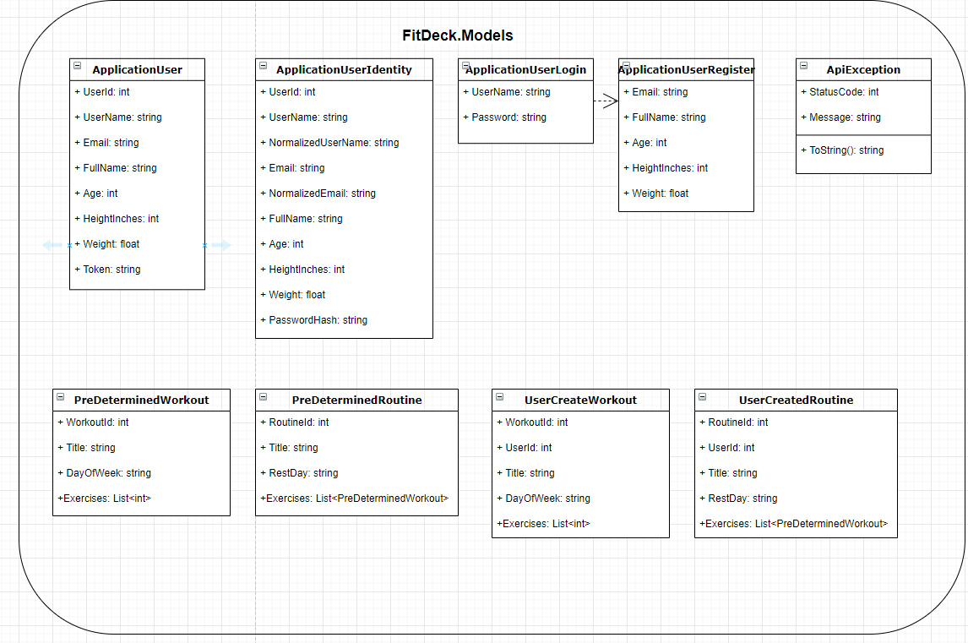
Design WebApi
FitDeck.Models

Slide 8
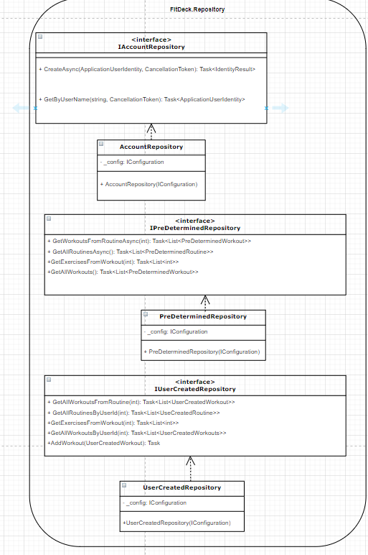
WebApi Design
FitDeck.Repository

Slide 9
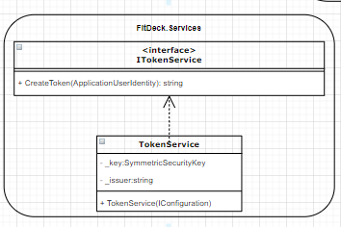
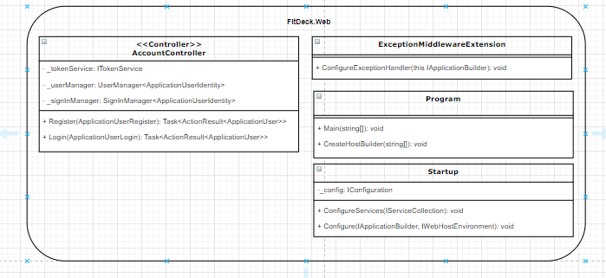
WebApi
FitDeck.Services
FitDeck.Web

Slide 10
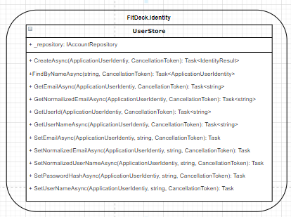
WebApi Design
FitDeck.Identity

Slide 11
How to Deploy
Currently the only way to deploy is to connect your phone to the debugger through visual studio
Connect to computer with usb cable
Choose your phone in the drop down in visual studio

Slide 12
Known Bugs
Graphs/Stats
Images
API setbacks (not necessarily a bug)

Slide 13
Future Work
Fix all bugs
Add Profile Images
Add heart rate monitoring

Slide 14
Conclusion
Accomplished some of our goals
Still needs work

