Slide 1
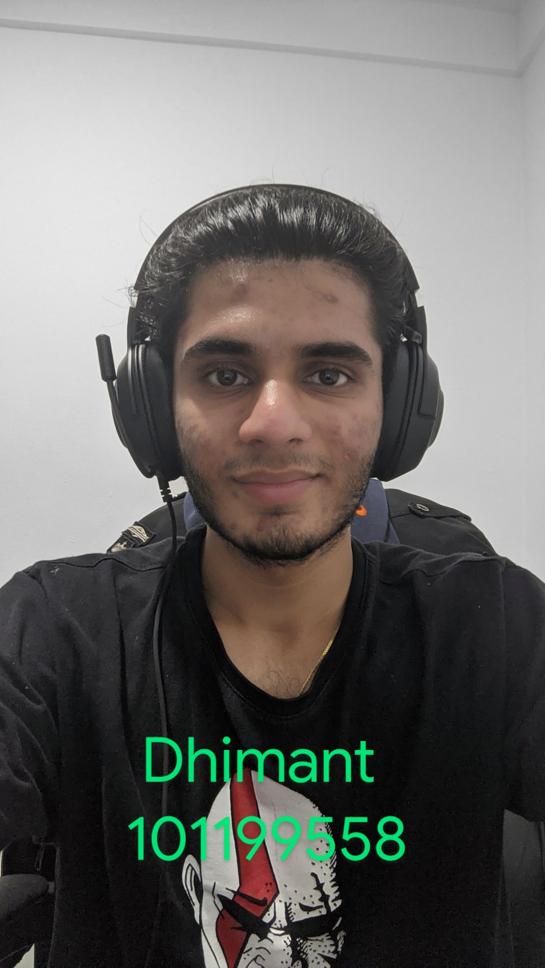
GAME2014 – Mobile Game Development I F2020
Final Exam
Dhimant Vyas
101199558

