Slide 1
Superposition Game
Dylan Zaragoza

Slide 2
Concept: Superposition
“Two places at once”
Implemented as a puzzle game
Navigate two objects simultaneously to reach a goal

Slide 3
Objective
Blocks
Goals

Slide 4
Obstacles
Holes
Walls

Slide 5
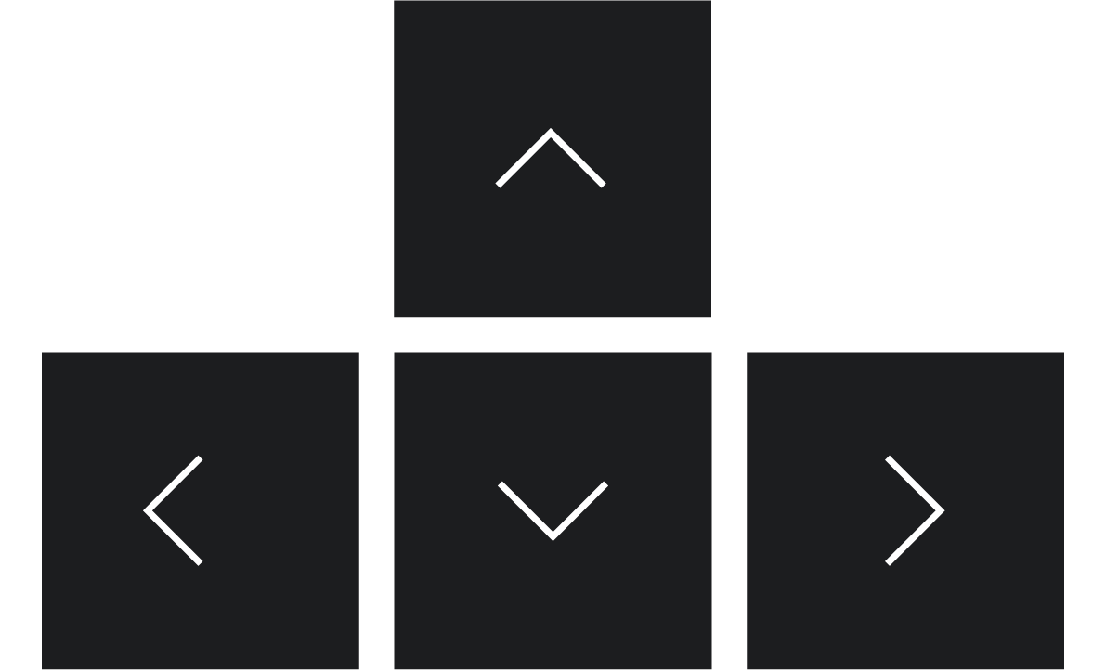
Input

Slide 6
Demo

Slide 7
Future Development
Sliding animation
Easier to see movement
Proper textures for objects
Give the game context
3-Dimensional Transition
Add “forward” and “backward”
“Create-A-Level”
Read in data/via GUI?

