Slide 1
Introduction to ROS
2020. 03. 30. ~ 2020.04.10

Slide 2
Contents
Introduction to ROS
ROS Core Concepts
Node, Message, Topic, ROS Master, Parameter Server
ROS Basic Commands
roscore, rosrun, rosnode, rostopic
Tutorials: WritingPublisherSubscriber
ROS Installation
Practice with RRBot
Experiments Guideline

Slide 3

Introduction to ROS
What is ROS?
ROS is an open-source robot operating system
A set of software libraries and tools that help you build robot applications that work across a wide variety of robotic platforms
Originally developed in 2007 at the Stanford Artificial Intelligence Laboratory and development continued at Willow Garage
Since 2013 managed by OSRF (Open Source Robotics Foundation)

Slide 4
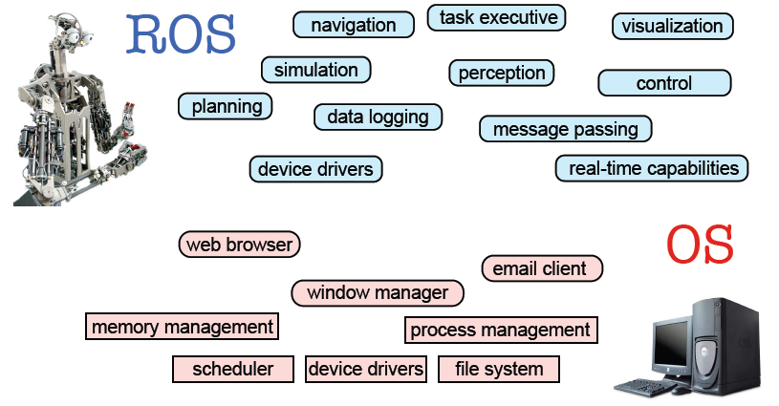
Introduction to ROS
ROS Main Features
The operating system side, which provides standard operating system services such as
hardware abstraction
low-level device control
implementation of commonly used functionality
message-passing between processes
package management
A suite of user contributed packages that implement common robot functionality such as SLAM, planning, perception, vision, manipulation, etc.

Slide 5
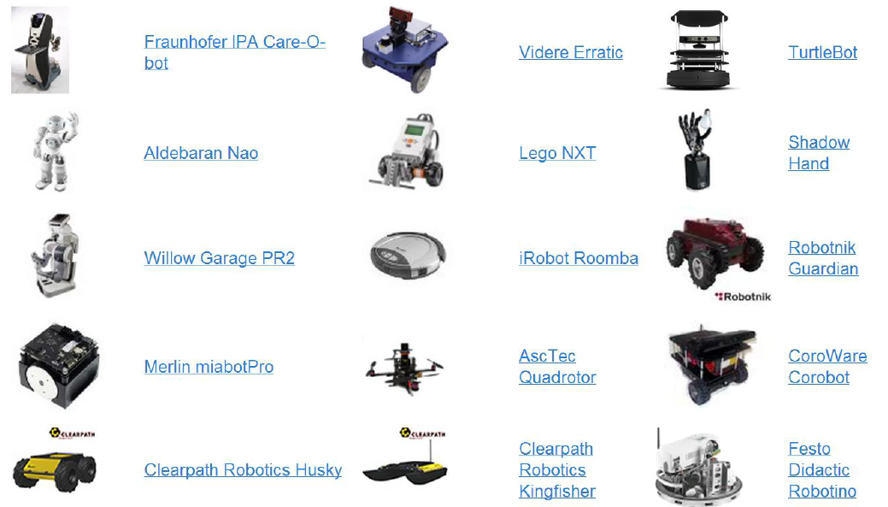
Introduction to ROS
Robots using ROS

Slide 6
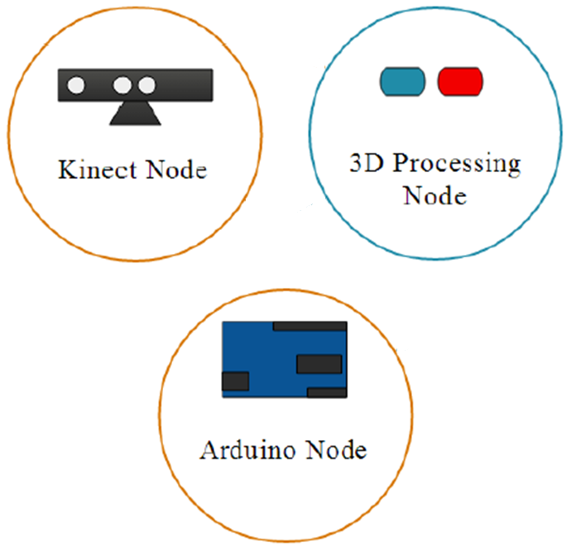
ROS Core Concepts
ROS Nodes
Single-purposed executable programs
sensor driver, actuator driver, mapper, planner, UI, etc
Individually compiled, executed, and managed
Nodes are written using a ROS client library
roscpp – C++ client library
rospy – python client library
Nodes can publish or subscribe to a Topic
Nodes can also provide or use a Service

Slide 7
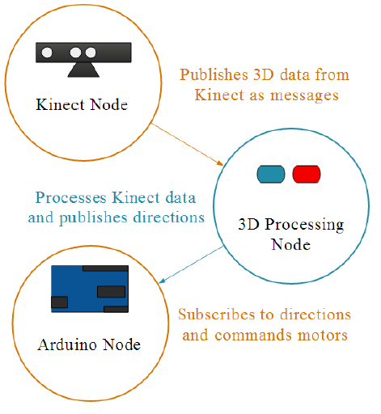
ROS Core Concepts
ROS Topics
A topic is a name for a stream of messages with a defined type
e.g., data from a laser range-finder might be sent on a topic called scan, with a message type of LaserScan
Nodes communicate with each other by publishing messages to topics
Publish/Subscribe model: 1-to-N broadcasting

Slide 8
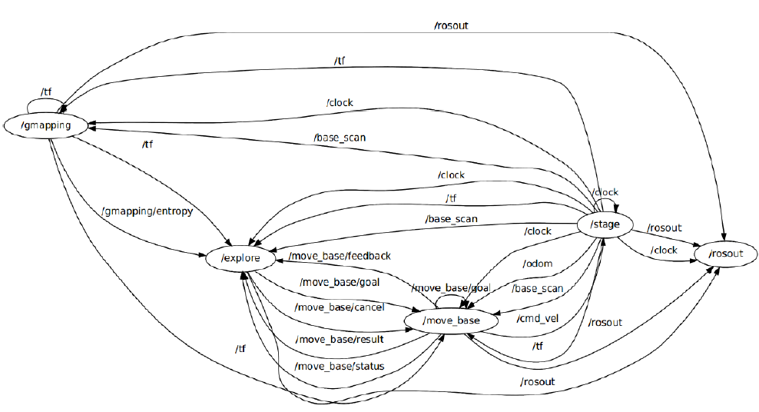
ROS Core Concepts
ROS Graph

Slide 9
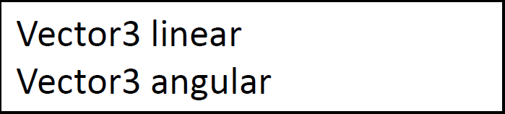
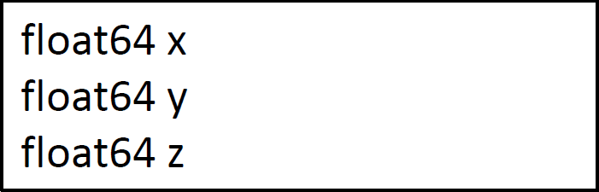
ROS Core Concepts
ROS Messages
Strictly-typed data structures for inter-node communication
For example, “geometry_msgs/Twist” is used to express velocity commands:
Vector3 is another message type composed of:

Slide 10
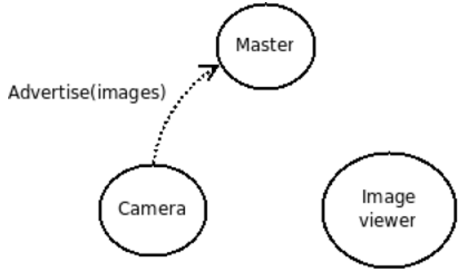
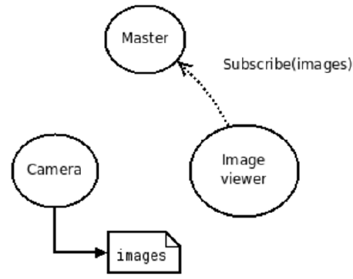
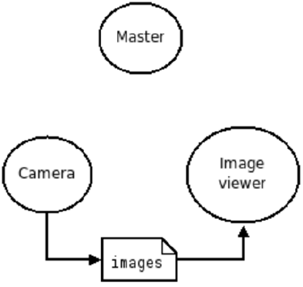
ROS Core Concepts
ROS Master
Provides connection information to nodes so that they can transmit messages to each other
Every node connects to a master at startup to register details of the message streams they publish, and the streams to which that they to subscribe
When a new node appears, the master provides it with the information that it needs to form a direct peer-to-peer connection with other nodes publishing and subscribing to the same message topics
1. “Camera” node initialization
2. “Image viewer” node initialization
3. Start transferring images to Image viewer node

Slide 11
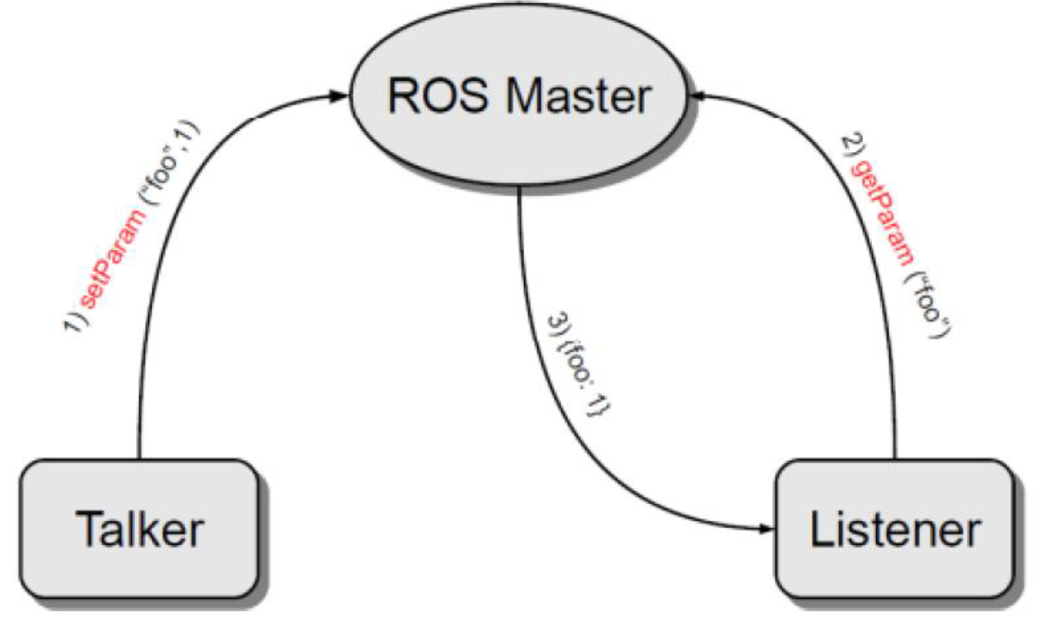
ROS Core Concepts
Parameter Server
A shared, multi-variate dictionary that is accessible via network APIs
Nodes use this server to store and retrieve parameters at runtime.
Runs inside the ROS master

Slide 12
ROS Basic Commands
“roscore”
“roscore” is the first thing you should run when using ROS
Usage:
“roscore” will start up:
A ROS Master
A ROS parameter server
A rosout for logging node

Slide 13
ROS Basic Commands
“rosrun”
“rosrun” allows you to run a node
Usage:
Example:

Slide 14
ROS Basic Commands
Demo - Turtlesim

Slide 15
ROS Basic Commands
“rosnode”
Displays debugging information about ROS nodes, including publications, subscriptions and connections
Command | Function
rosnode list | List active nodes
rosnode list | Test connectivity to node
rosnode info | Print information about a node
rosnode kill | Kill a running node
rosnode machine | List nodes running on a particular machine

Slide 16
ROS Basic Commands
“rostopic”
Gives information about a topic and allows to publish messages on a topic
Command | Function
rostopic list | List active topics
rostopic echo /topic | Prints messages of the topic to the screen
rostopic info /topic | Print information about a topic
rostopic type /topic | Prints the type of messages the topic publishes
rostopic pub /topic type args | Publishes data to a topic

Slide 17
ROS Basic Commands
Publish to ROS topic
Use the rostopic pub command to publish messages to a topic
For example, to make the turtle move forward at a 0.2m/s speed, you can publish a “cmd_vel” message to the topic “/turtle1/cmd_vel”:
For example, to make the turtle turn in circles continuously, type:

Slide 18
ROS Basic Commands
Publish to ROS topic
Use the rostopic pub command to publish messages to a topic
For example, to make the turtle move forward at a 0.2m/s speed, you can publish a “cmd_vel” message to the topic “/turtle1/cmd_vel”:
For example, to make the turtle turn in circles continuously, type:

Slide 19
Catkin Build System
“catkin” Build System
“catkin” is the ROS build system
The set of tools that ROS uses to generate executable programs, libraries and interfaces
The original ROS build system was “rosbuild”
Still used for older packages
Implemented as custom CMake macros along with some Python code

Slide 20
Catkin Build System
“catkin” Workspace
A a set of directories in which a set of related ROS code lives
You can have multiple ROS workspaces, but you can only work in one of them at any one time
Contains the following spaces:
Source Space | contains the source code of catkin packages. Each folder within the source space contains one or more catkin packages.
Build Space | is where CMake is invoked to build the catkin packages in the source space. CMake and catkin keep their cache information and other intermediate files here.
Development Space (Devel) | is where built targets are placed prior to being installed
Install Space | Once targets are built, they can be installed into the install space by invoking the install target.

Slide 21
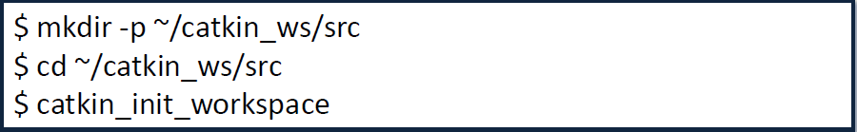

Catkin Build System
Creating a “catkin” Workspace
Creating a workspace
Building “catkin” Workspace
“catkin_make” command builds the workspace and all the packages within it

Slide 22
Catkin Build System
Creating a ROS Package
Change to the source directory of the workspace
“catkin_create_pkg” creates a new package with the specified dependencies
For example, create a “first_pkg” package:
Building “catkin” Workspace
“catkin_make” command builds the workspace and all the packages within it

Slide 23
Tutorials: WritingPublisherSubscriber
“ros::Publisher”
Manages an advertisement on a specific topic
Created by calling “NodeHandle::advertise()”
Registers this topic in the master node
Example for creating a publisher:
First parameter is the topic name
Second parameter is the queue size
To publish a message on a topic call “publish()”
The message’s type must agree with the type given as a template parameter to the “advertise<>()” call

Slide 24
Tutorials: WritingPublisherSubscriber
Talker and Listener
We’ll now create a package with two nodes:
“Talker” publishes messages to topic “chatter”
“Listener” reads the messages from the topic and prints them out to the screen
First create the package “chat_pkg”
Add a C++ source files named “Talker.cpp” and “Listener.cpp”
Copy the following code into it

Slide 25
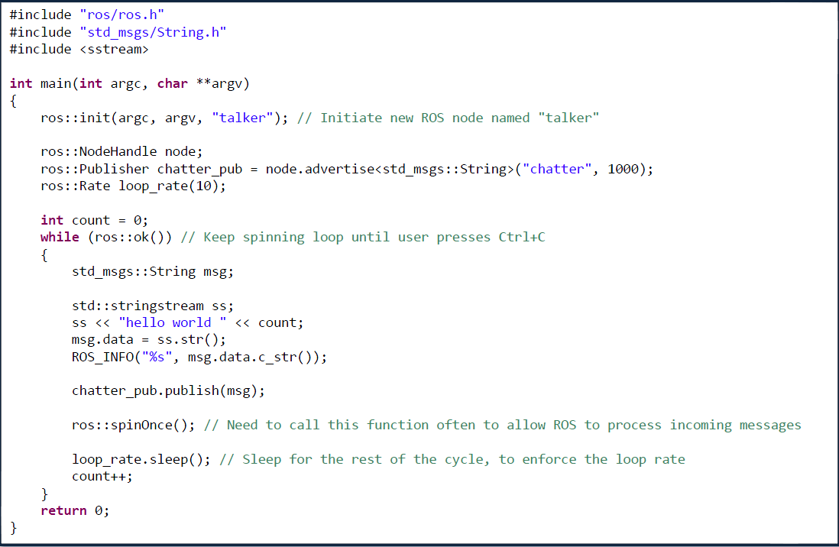
Tutorials: WritingPublisherSubscriber
“Talker.cpp”

Slide 26
Tutorials: WritingPublisherSubscriber
Subscribing to a Topic
To start listening to a topic, call the method “subscribe()” of the node handle
This returns a Subscriber object that you must hold on to until you want to unsubscribe
Example for creating a subscriber:
1st parameter is the topic name
2nd parameter is the queue size
3rd parameter is the function to handle the message

Slide 27
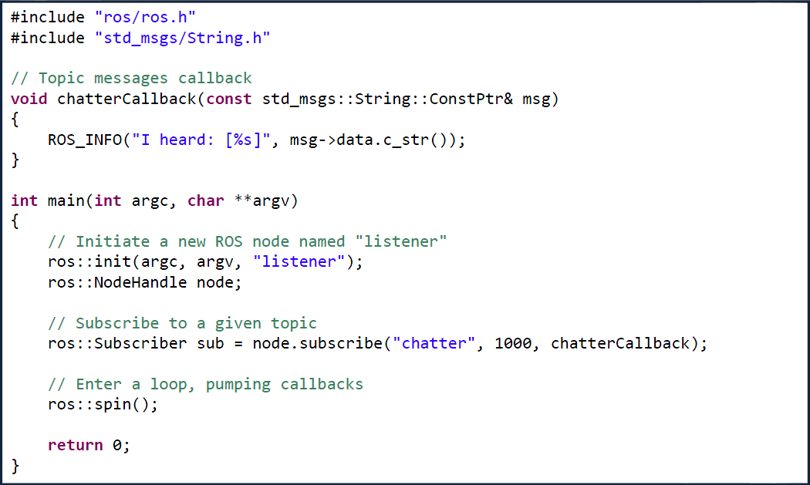
Tutorials: WritingPublisherSubscriber
“Listener.cpp”

Slide 28
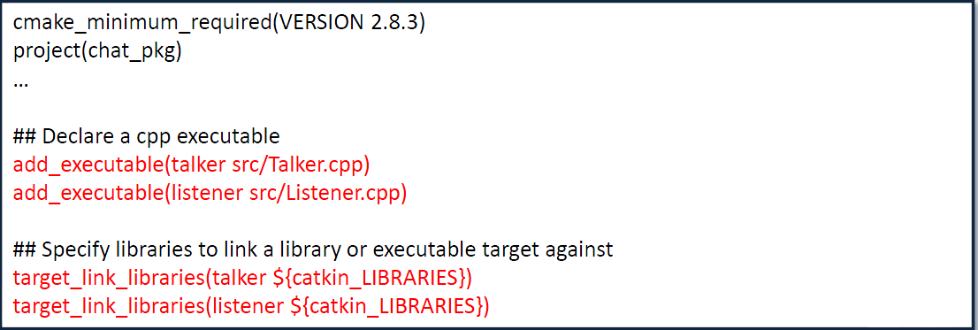
Tutorials: WritingPublisherSubscriber
Compile the Nodes
Add the following to the package’s “CMakeLists.txt” file
Now build the package and compile all the nodes using the “catkin_make” tool:
This will create two executables, “talker” and “listener”, at “~/catkin_ws/devel/lib/chat_pkg”

Slide 29
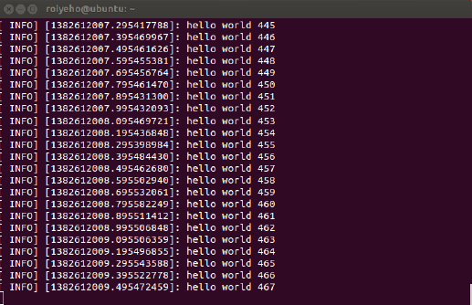
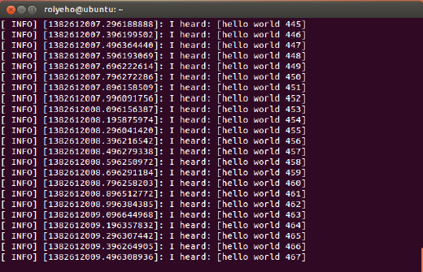
Tutorials: WritingPublisherSubscriber
Running the Nodes From Terminal
Run “roscore”
Run the nodes in two different terminals:
talker
listener

Slide 30
Tutorials: WritingPublisherSubscriber
“rqt_graph”
“rqt_graph” creates a dynamic graph of what's going on in the system
Use the following command to run it:

Slide 31


ROS Installation
Install ROS
Ubuntu 16.04 : install ROS Kinetic
http://wiki.ros.org/kinetic/Installation/Ubuntu
Ubuntu 18.04 : install ROS melodic
http://wiki.ros.org/melodic/Installation/Ubuntu
!Only python2.7 version is compatible with ROS.
Set default python version to 2.7
Configuring Your ROS Environment
Install ROS control package
http://wiki.ros.org/ros_control
sudo apt-get install ros-[kinetic or melodic]-ros-control ros-[kinetic or melodic]-ros-controllers sudo apt install ros-[kinetic or melodic]-controller-manager sudo apt-get install ros-[kinetic or melodic]-gazebo-ros-pkgs ros-[kinetic or melodic]-gazebo-ros-control

Slide 32
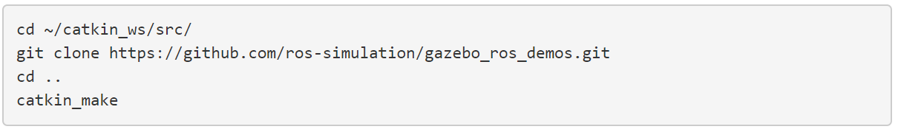

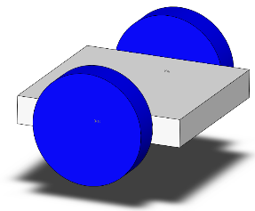
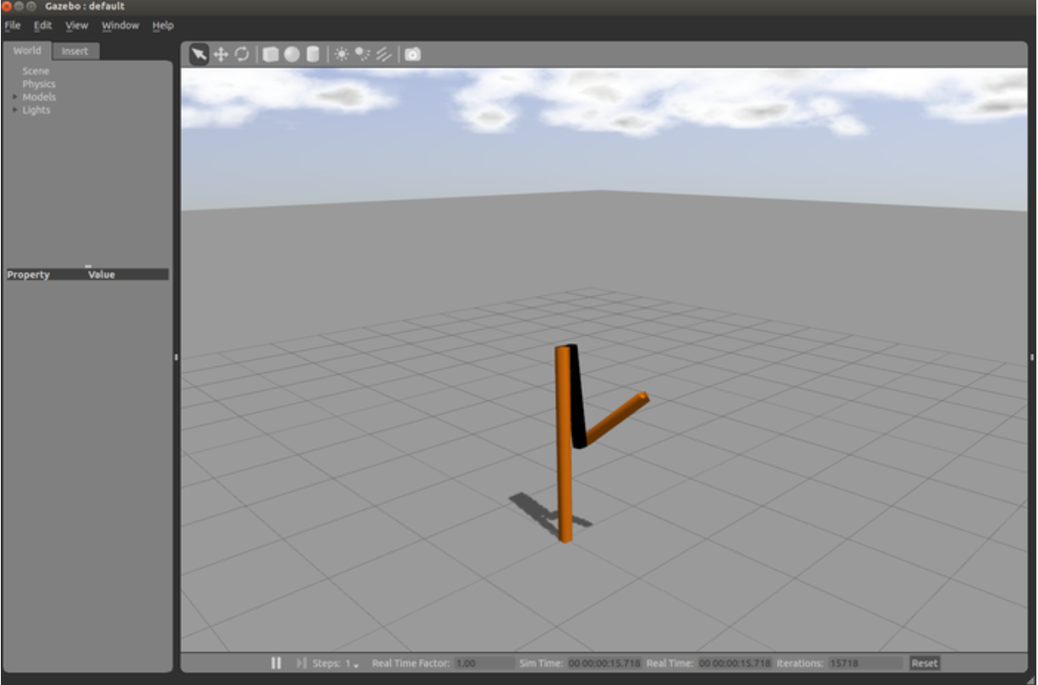
Practice with RRBot
URDF (Univeersal Robotic Description Format)
URDF is an XML file format used in ROS to describe all elements of a robot
detail information of URDF : http://gazebosim.org/tutorials/?tut=ros_urdf
Getting RRBot
Examine the RRBot URDF
Define your own robot model by referring this file
View in Gazebo
 | metric
Wheel Radius | 0.1m
Wheel Width | 0.05m
Wheel Separation | 0.35m
Base Frame | 0.3m x 0.3m x 0.05m

Slide 33
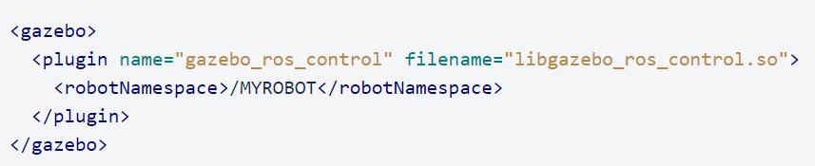
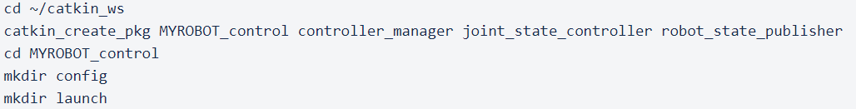
Practice with RRBot
Add the gazebo_ros_control_plugin
The default plugin XML should be added to your URDF
detail information of controller setting: https://bitbucket.org/osrf/gazebo_tutorials/src/default/ros_control/tutorial.md
Create a ros_controls package

Slide 34
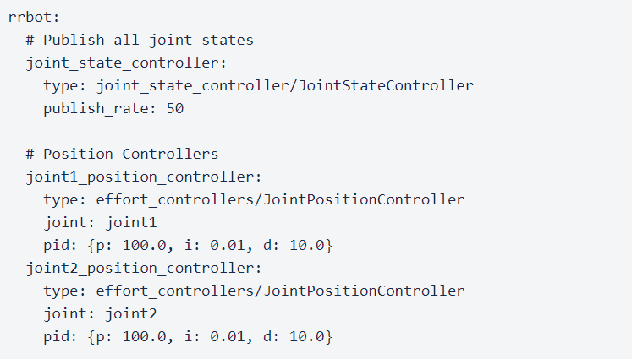
Practice with RRBot
Create a .yaml config file
In the config folder of your MYROBOT\_control package, adapt the following RRBot example to your robot as MYROBOT_control/config/rrbot_control.yaml:

Slide 35
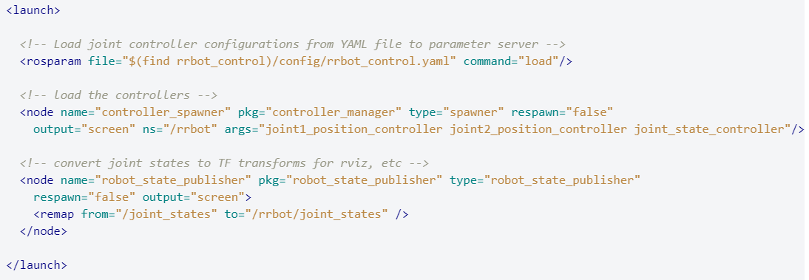
Practice with RRBot
Create a roslaunch file
Within the launch folder create a MYROBOT_control/launch/MYROBOT_control.launch file and adapt the following RRBot example to your robot:

Slide 36

Practice with RRBot
Start the controllers using roslaunch
Start the RRBot simulation:
Load the controllers for the two joints by running the second launch file:
Send example joint commands to them for testing:

Slide 37
Experiments Guideline
1. Create URDF Model of below mobile robots
Guideline
cd ~/catkin_ws/src
mkdir mobilerobot && cd mobilerobot
catkin_create_pkg mobilerobot_description
cd ~/catkin_ws/src/mobilerobot/mobilerobot_description/
mkdir urdf && cd urdf
[construct your model.urdf]
To check urdf models
sudo apt-get install liburdfdom-tool
check_urdf model.urdf
urdf_to_graphiz model.urdf
 | metric
Wheel Radius | 0.1m
Wheel Width | 0.05m
Wheel Separation | 0.35m
Base Frame | 0.3m x 0.3m x 0.05m

Slide 38
Experiments Guideline
2. Adapt URDF model to gazebo simulation
Guideline
cd ~/catkin_ws/src/mobilerobot
catkin_create_pkg mobilerobot_gazebo
cd mobilerobot_gazebo
mkdir launch && cd launch
[construct your mobilerobot_urdf.launch]
3. Create controller
Guideline
cd ~/catkin_ws/src/mobilerobot
catkin_create_pkg mobilerobot_control controller_manager joint_state_controller robot_state_publisher
cd mobilerobot_control
mkdir config && mkdir launch
[create a .yaml file in config folder & create roslaunch file in launch folder]

Slide 39
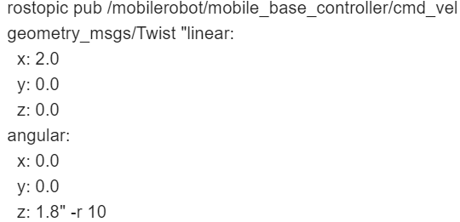
Experiments Guideline
4. Control mobile robot
Guide line
cd ~/catkin_ws
catkin_make
source devel/setup.bash
Terminal 1 : roslaunch mobilerobot_gazebo mobilerobot_urdf.launch
Terminal 2 : roslaunch mobilerobot_control mobilerobot_control.launch
Terminal 3 :

Slide 40
Experiments Guideline
Submit Results & Reports
Results
Compress and submit your own ROS package (compress mobilerobot folder)
Mobile robot controller video (wmv, encoding to 10MB or less)
Reports
(Description of robot control method and manufactured package) within 6 pages
Reports should be as detailed as possible (Introduction, experimental process, results, conclusions)
submit e-mail : tjsong@rit.kaist.ac.kr (assistant : TaekJin Song)
submit e-mail in title : [RE510]Student_number-Name (ex : [RE510]20187022-송택진)
submit file_name : StudentNumber_Name.zip (ex : 20187022_송택진.zip)
- Submission deadline : 2020.04.10

