Slide 1
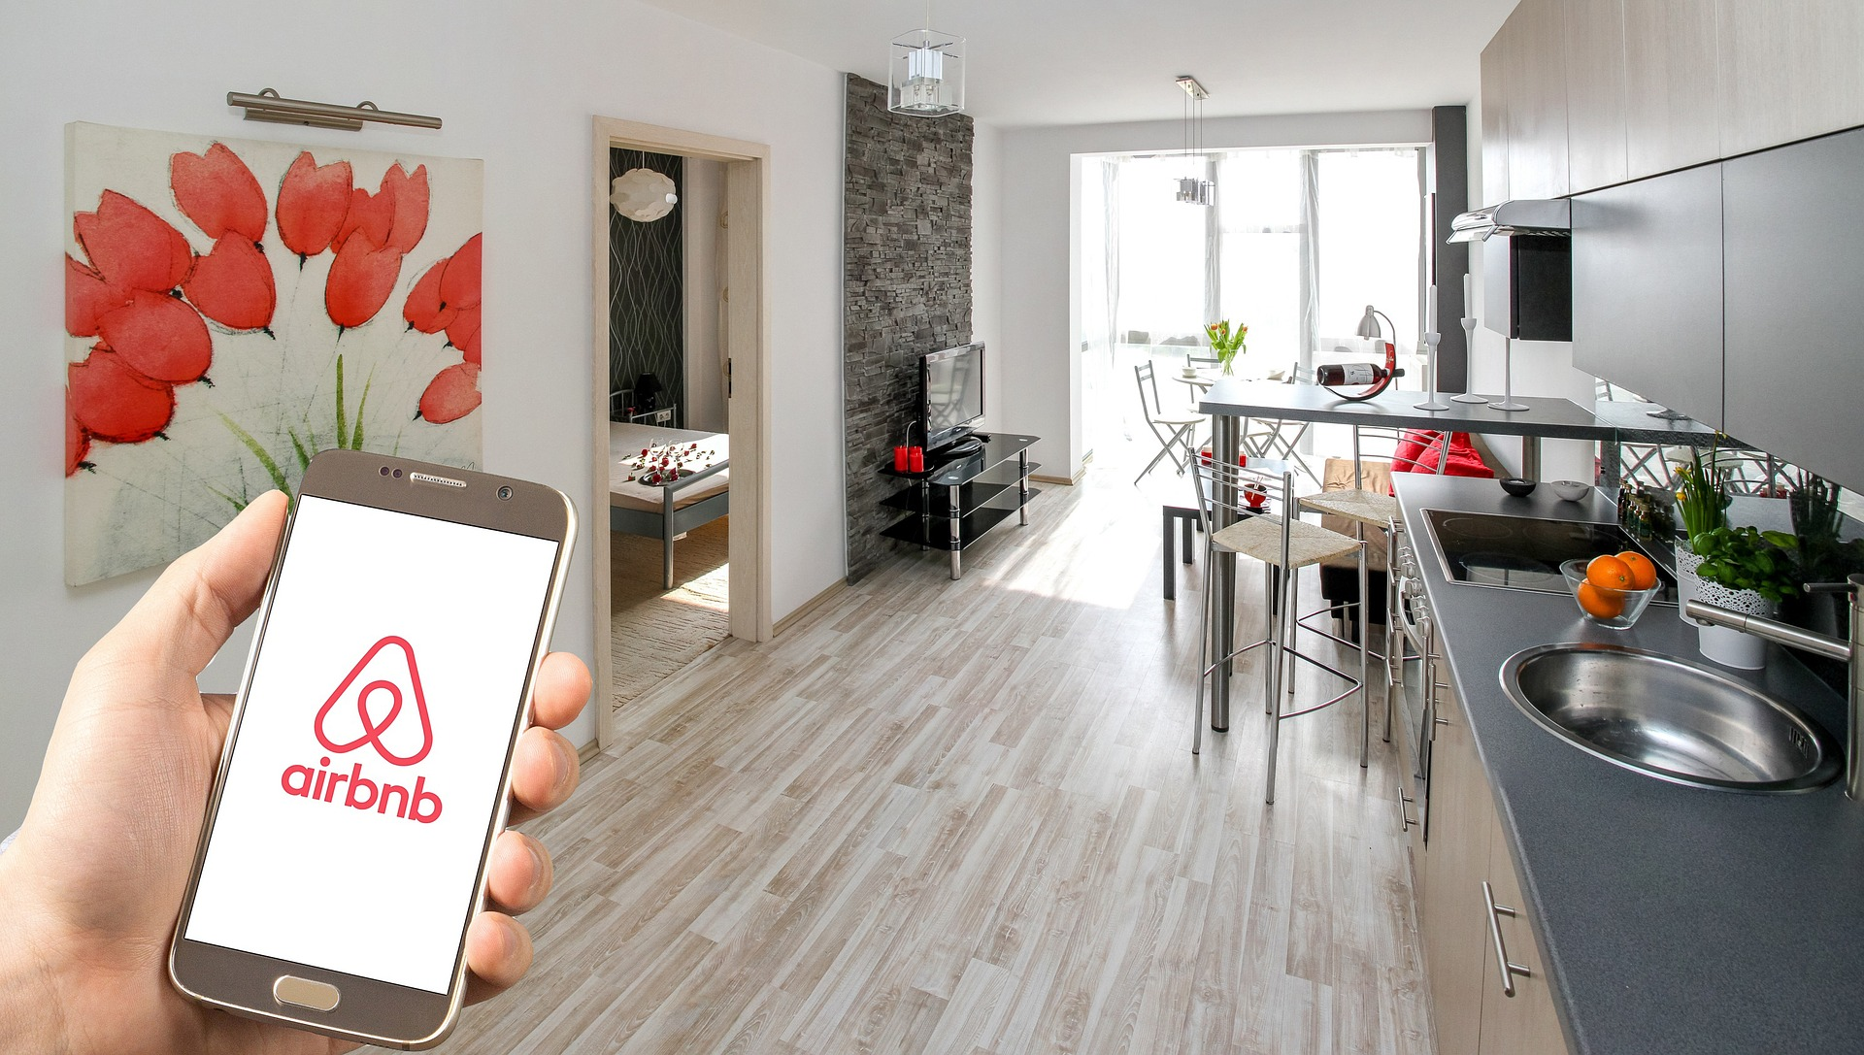
Airbnb Visualization Project
By:
Leila Zintsem
Anna Chee
Dan Waehmer
Peter Sparks

