Slide 1
The TTC 2023 KMEHR to FHIR Case
Dennis Wagelaar

Slide 2





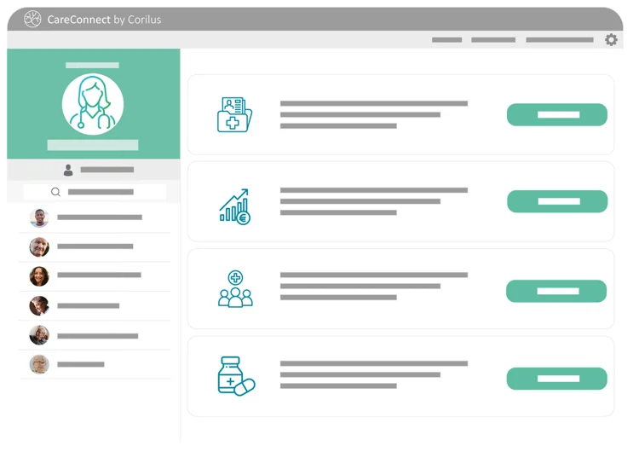





Background: Corilus
Software for first-line healthcare providers

Slide 3
Outline
Context: KMEHR & FHIR
Case structure
Task description
Benchmark framework & evaluation

Slide 4
Context
KMEHR

Slide 5
Context: KMEHR
Kindly Marked-up Electonic Healthcare Record
  Belgian medical data standard introduced in 2002
  Exchange of structured clinical information
  Lead to the specification of about 20 specific XML messages
Summarized Electronic Health Record (SumEHR)
  KMEHR message used for the exchange of medical information
  Summarizes minimal data a physician needs to understand medical status of the patient and to ensure the continuity of care
  Introduced in 2005
  Belgian medical software should be capable of exporting a SumEHR message for any given patient

Slide 6
Context: SumEHR header
<kmehrmessage>
<header>
<standard>
<cd S="CD-STANDARD" SV="1.0">20161201</cd>
</standard>
<id S="ID-KMEHR" SV="1.0">14296612004.20160520005759598</id>
<date>2016-05-20</date><time>00:57:59</time>
<sender>
<hcparty>
<id S="ID-HCPARTY" SV="1.0">14296612004</id>
<cd S="CD-HCPARTY" SV="1.10">persphysician</cd>
<firstname>Leonard</firstname>
<familyname>McCoy</familyname>
</hcparty>
</sender>
<recipient>...</recipient>
</header>
...
“CD” coding element
coding system & version
“ID” identifier element
NIHII number of physician

Slide 7
Context: SumEHR body
...
<folder><id S="ID-KMEHR" SV="1.0">1</id>
<patient>
<id S="INSS" SV="1.0">49112002395</id>
<firstname>JAN</firstname>
<familyname>JANSSENS</familyname> ...
</patient>
<transaction>
<id S="ID-KMEHR" SV="1.0">1</id>
<cd S="CD-TRANSACTION" SV="1.9">sumehr</cd>
<date>2016-05-20</date><time>00:57:59</time>
<author>...</author>
<item>
<id S="ID-KMEHR" SV="1.0">2</id>
<cd S="CD-ITEM" SV="1.11">contactperson</cd>
<cd S="CD-CONTACT-PERSON" SV="1.0">father</cd>
<content><person>...</person></content>
</item> …
</transaction>
</folder>
</kmehrmessage>
“ID” identifier element
INSS social security nr
KMEHR transaction type
SumEHR
Medical content
e.g. contactperson, problem, medication, vaccine, allergy, ...

Slide 8
Context
FHIR

Slide 9
Context: FHIR
Fast Healthcare Interoperability Resources
  International standard by Health Level 7 (HL7) introduced in 2011
  Builds on previous data format standards, e.g. HL7 v.2.x and HL7 v.3.x.
  Supports profiles (https://www.hl7.org/fhir/profiling.html)
International Patient Summary (IPS)
  FHIR profile
  Electronic health record extract containing essential healthcare information about a subject of care
  FHIR equivalent of SumEHR

Slide 10
Context: FHIR IPS header
Document identifier
<Bundle xmlns="http://hl7.org/fhir">
<type value="document"/>
<entry>
<fullUrl value="urn:uuid:070e65cc-68ed-4373-a323-eb245dac94dd"/>
<resource>
<Composition>
<id value="070e65cc-68ed-4373-a323-eb245dac94dd"/>
<identifier>
<system value="urn:oid:2.16.724.4.8.10.200.10"/>
<value value="070e65cc-68ed-4373-a323-eb245dac94dd"/>
</identifier>
<type>
<coding>
<system value="http://loinc.org"/>
<code value="60591-5"/>
<display value="Patient summary Document"/>
</coding>
</type>
...
Header is contained in a “Composition” element, which also contains a significant part of the medical data payload (body)
Oid code for FHIR IPS
LOINC code for FHIR IPS

Slide 11
Context: FHIR IPS body (1)
...
<subject>
<reference value="Patient/b675e3d9-5471-4037-8b56-0df5c8060f32"/>
</subject>
<author><reference value="Practitioner/e7c5ec10-d4a1-4fa8-a44f-80dec4d722ea"/></author>
<custodian><reference value="Practitioner/7122e278-6205-4ad5-b185-5da2a20f29bc"/></custodian>
<section>
<title value="Medication"/>
<code>
<coding>
<system value="http://loinc.org"/>
<code value="10160-0"/>
<display value="History of Medication use Narrative"/>
</coding>
</code>
<entry>
<reference value="Medication/ec60b2e6-dc2f-4ced-ba3a-ea64715aeb2d"/>
</entry> ...
</section> ...
</Composition>
</resource>
</entry>
...
Administrative elements are referenced from inside the Composition
Composition element serves as a table of contents
Medical elements are referenced from inside the Composition

Slide 12
Context: FHIR IPS body (2)
...
<entry>
<fullUrl value="urn:uuid:ec60b2e6-dc2f-4ced-ba3a-ea64715aeb2d"/>
<resource>
<Medication>
<id value="ec60b2e6-dc2f-4ced-ba3a-ea64715aeb2d"/>
<code>
<coding>
<system value="https://www.ehealth.fgov.be/standards/fhir/medication/NamingSystem/cnk-codes"/>
<code value="0895540"/>
<display value="MEDROL COMP 20X32MG"/>
</coding>
</code>
<status value="active"/>
</Medication>
</resource>
</entry> ...
</Bundle>
Medical elements details are enumerated after the Composition element
This TTC case copies the medication coding system from KMEHR for simplicity, but FHIR IPS should include an international coding system to be of use abroad
e.g. ATC: http://www.whocc.no/atc

Slide 13
Case structure

Slide 14

Case structure
KMEHR XML schema
FHIR XML schema
kmehr.ecore
fhir.ecore
KMEHRtoFHIR.atl
libKMEHRtoFHIR.atl
sumehr_example.kmehr
sumehr_example.fhir

Slide 15
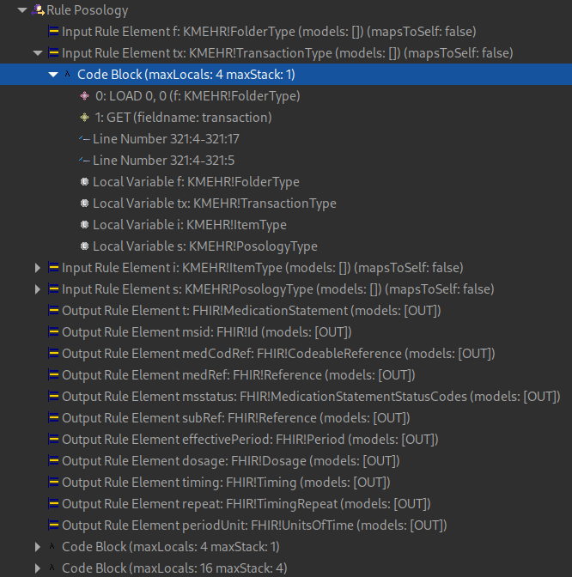
Case structure
rule Posology {
from
f : KMEHR!FolderType,
tx : KMEHR!TransactionType,
i : KMEHR!ItemType,
s : KMEHR!PosologyType (
i.posology = s and
tx.item->includes(i) and
f.transaction->includes(tx) and
i.isMedication
)
to
t : FHIR!MedicationStatement mapsTo s (
id <- msid,
medication <- medCodRef,
status <- msstatus,
subject <- subRef,
effectivePeriod <- effectivePeriod,
dosage <- Sequence{dosage}
), ...
Reference ATL solution showcases EMFTVM 4.8.0 local search plan compiler

Slide 16
Task description

Slide 17
Task description
Mandatory task:
  Re-implement/improve original transformation
  In a way that lends itself better to after-the-fact consistency checking
Optional task
  Define the reverse transformation that translates the generated FHIR IPS document back to SumEHR.

Slide 18
Benchmark framework & evaluation

Slide 19
Benchmark framework
Based on TTC 2017 Smart Grid case
Three phases
  Initialization, Load, Run
Solution requirements
  Output in CSV
    Tool, Source, Target, RunIndex, PhaseName, MetricName
  Solution.ini file tells framework how to run solution
Running the benchmark
  Requires Python >= 3.3

Slide 20
Evaluation
Criteria
  How efficient is the approach in time and space (memory)?
  How understandable is the transformation code for domain experts to review and validate?
  From the task description: How well does the approach lend itself better to after-the-fact consistency checking?
  Was the optional task implemented, and did the chosen tool provide support to make this easier?

Slide 21
Thank you
For submitting your solution to this case!

