Slide 1


Slide 2

Title:- ANALYSIS AND COMPARISON OF THE CRIME DATA WITH MACHINE LEARNING MODELS USING JUPYTER NOTEBOOK
Submitted to: Dr. Jinan Fiaidhi
Project By: Bharadwaj Varma Chennamraju (0864476)

Slide 3
Introduction
Crime is one of the major issues which is continuing to grow in intensity and complexity.
To find the pattern or behavior of crime, significant data plays a vital role.
Data analysis is a process of obtaining raw data and converting it into useful information.
Machine learning performs effectively on a specific task without using explicit instructions, relying on patterns and inferences instead. It mainly focuses on prediction models, based on known properties learned from the training data.

Slide 4
Motivation
Solving a real world problem: Crime
To analyze the major crime incidents occurred over the years.
To find an efficient Machine learning model to achieve high accuracy.

Slide 5
Problem Statement
The effect of crimes on victims is enormous.
A victim might experience several kinds of effects such as emotional effect, physical injury, and mental injury.
The most common types of crimes are theft, assault, battery, robbery, and homicides.
Analysis of crime data would help in solving a real-world issue.
For comparison, Toronto, Ireland, Chicago, Indore, and crime videos posted in YouTube are used.

Slide 6
Jupyter Notebook
Jupyter Notebook is a non-profit, open-source software that allows the user to run the code, look at the outcome, visualize the data, and see the results without leaving the environment.
It also helps in handling the data by making a handy tool for performing an end to end data science.
Data cleaning, transforming, statistical modeling, building, visualizing, and training machine learning models can be done by all kind of machine learning users.

Slide 7
Life Cycle of Data Science Project
Data Acquisition
Data Cleaning
Data Visualization
Data Modelling

Slide 8
Data Acquisition
Toronto
Chicago
Indore
Ireland – Garda Stations
YouTube – Crimes videos

Slide 9
Data Cleaning
As the datasets were taken from the government websites, there was not much cleaning required to do as they were updated perfectly.
Some of the attributes in a few datasets were not taken into consideration. Different datasets had different attributes that were not needed for data analysis.

Slide 10
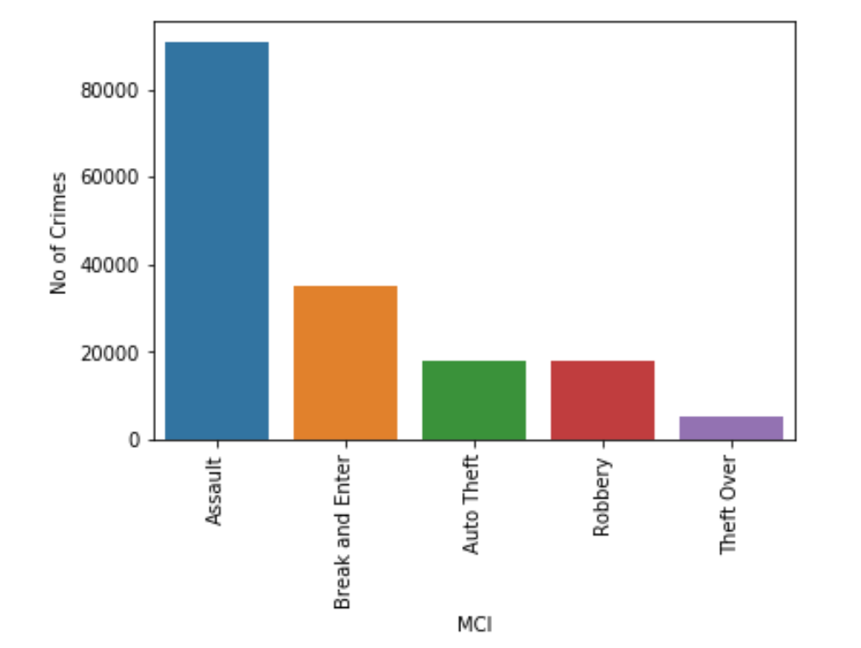
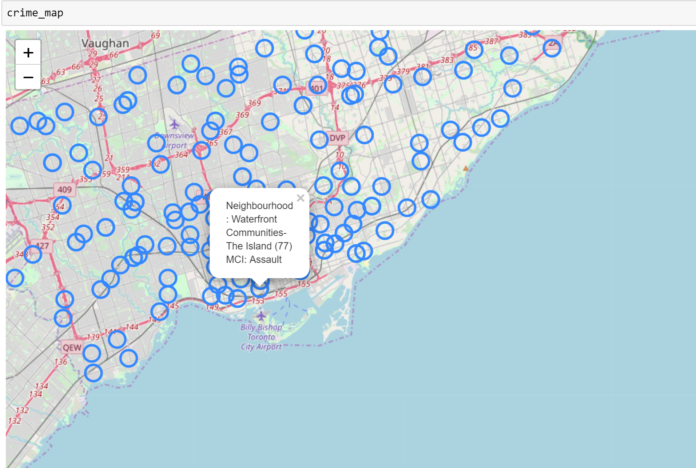
Data Visualization
Toronto Dataset

Slide 11
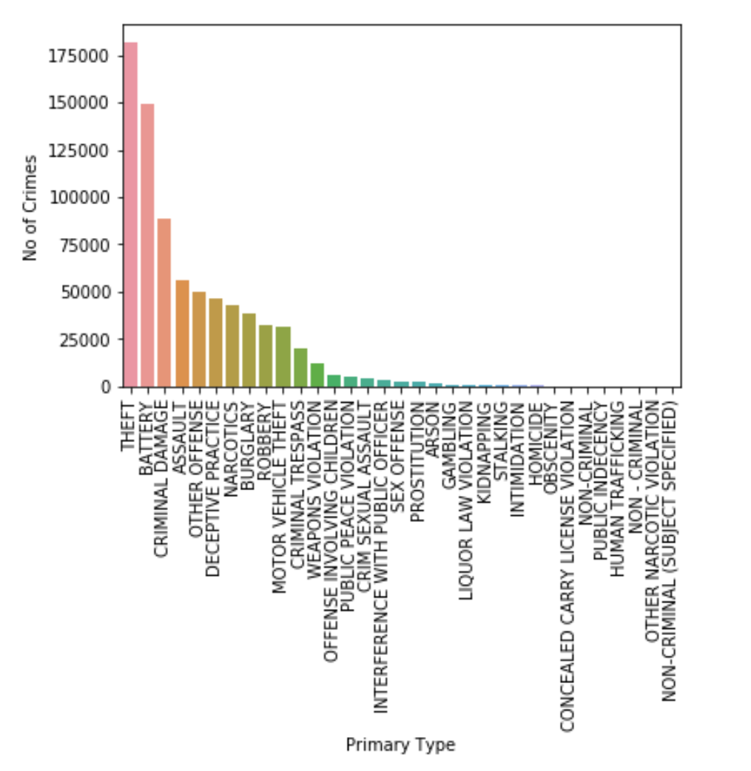
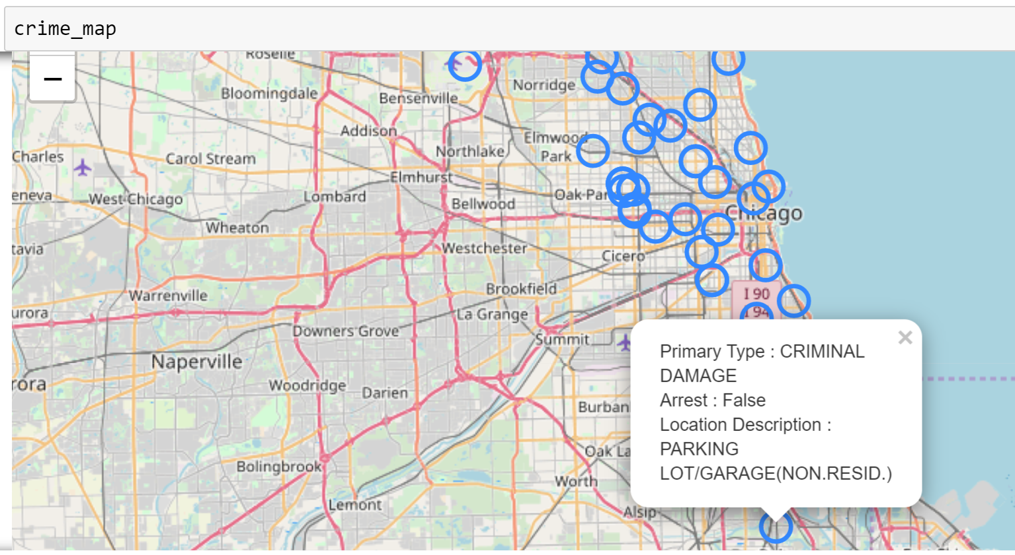
Chicago Dataset

Slide 12
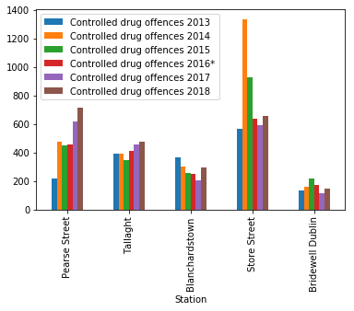
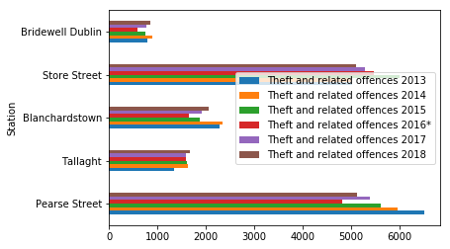
Ireland Dataset – Garda Stations

Slide 13
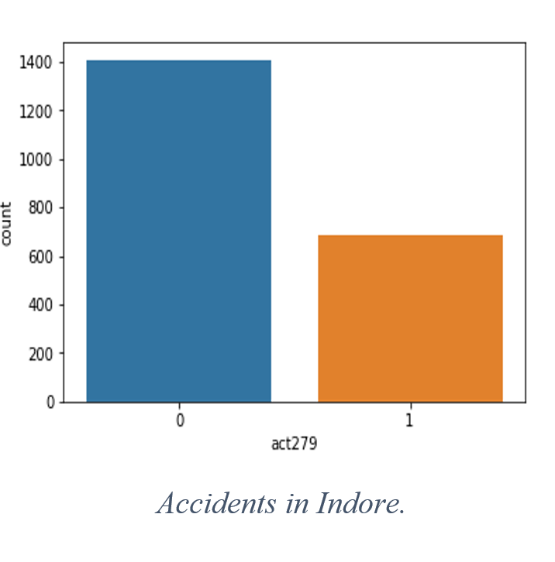
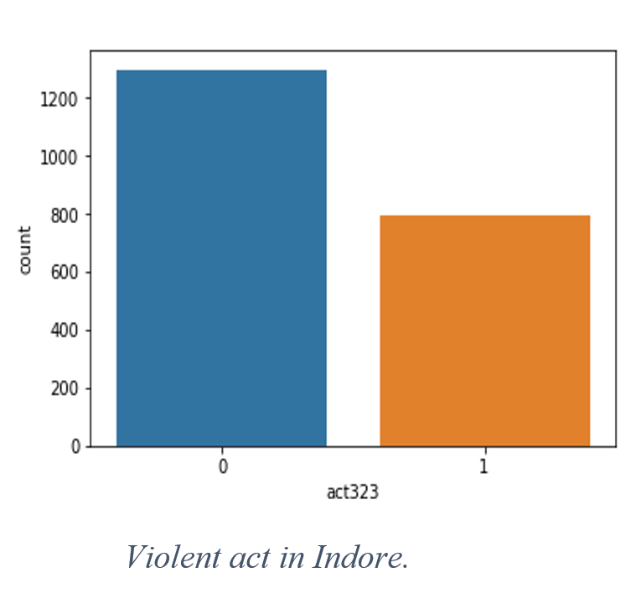
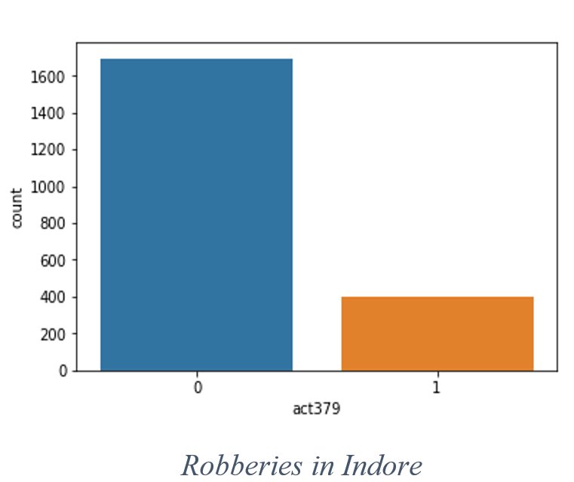
Indore dataset

Slide 14
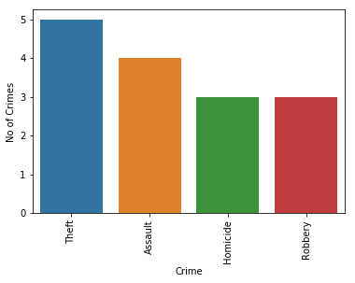
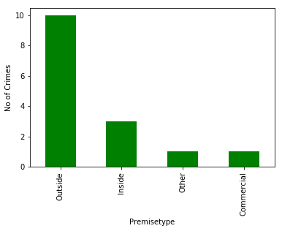
YouTube Dataset

Slide 15
Data Modeling
Classification Predictive Models
Decision Tree
K-Nearest Neighbor
Random Forest

Slide 16
DEMO

Slide 17
Conclusion
On comparing the datasets, theft and assault crimes occurred more when compared to other crimes. Also, outside crimes are more than an apartment or in any commercial area.
According to this analysis, Church-Yonge Corridor area and North State Street has the highest crime rate in Toronto and Chicago, respectively when compared to other regions.
In Ireland, Pearse station has high crime rate of assault, fraud, and theft while Tallaght station has high crime rate of burglary.

Slide 18
Conclusion (contd.)
On comparing the predictive models, Random Forest predictive model outperformed K-Nearest Neighbor and Decision Tree classification models.
Random forest obtained an accuracy of 65.225% in Toronto, 74.944% in Chicago, and 98.067% in Indore crime dataset.
The future scope of this project is linking the analysis to a real-time application to analyze the crime-prone areas and alerting through the app when passing through an area helps an individual to be more cautious.

Slide 19
References
Easton, Mark (17 June 2010). "What is crime?". BBC News. Archived from the original on 27 February 2013. Retrieved 10 June 2013.
Nurul Hazwani Mohd Shamsuddin, Nor Azizah Ali, Razana Alwee, “An overview on crime prediction methods”, 6th ICT International Student Project Conference, 2017.
Suhong Kim, Param Joshi, Parminder Singh Kalsi, and Pooya Taheri, “Crime Analysis Through Machine Learning”, IEEE 9th Annual Information Technology, Electronics and Mobile Communication Conference (IEMCON), 2018.

Slide 20
References(contd.)
Iqbal, Rizwan and Azmi Murad, Masrah Azrifah and Mustapha, Aida and Panahy, Payam Hassany Shariat and Khanahmadliravi, Nasim (2013) “An experimental study of classification algorithms for crime prediction.” Indian Journal of Science and Technology, 6 (3). pp. 4219-4225. ISSN 0974-6846; ESSN: 0974-5645.
Eugenio Cesario, Charlie Catlett, Domenico Talia, “Forecasting Crimes using Autoregressive Models”, IEEE 14th Intl Conf on Dependable, Autonomic and Secure Computing, 14th Intl Conf on Pervasive Intelligence and Computing, 2nd Intl Conf on Big Data Intelligence and Computing and Cyber Science and Technology Congress (DASC/PiCom/DataCom/CyberSciTech), 2016.

Slide 21
Thank You

