Slide 1
OpenCafe Training
Part 2 – Project Overview

Slide 2

Unittest Concepts

Slide 3
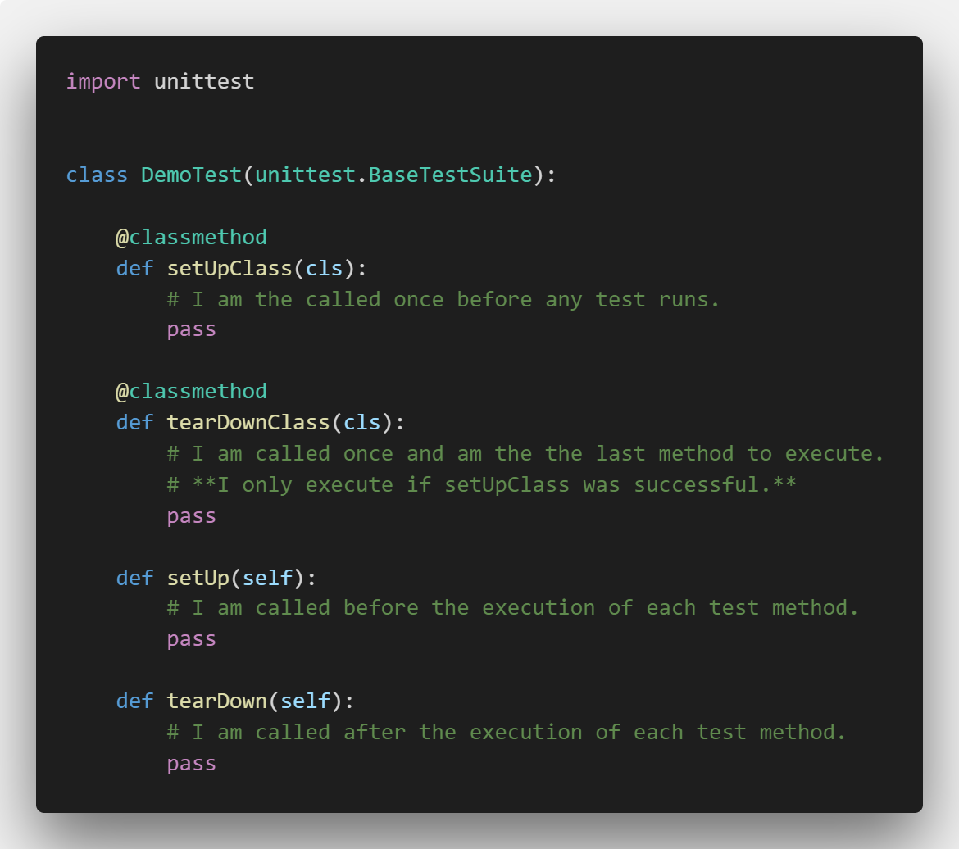
Unit Test Fixtures

Slide 4
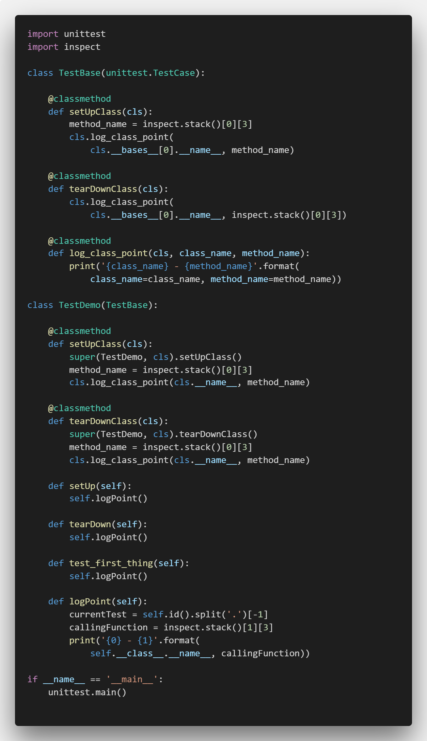
Inheritance + Fixtures = Fun with Ordering!
Calling super on a method that has an implementation in the base class means the base class method will be executed first
When should you do this?
Demo

Slide 5
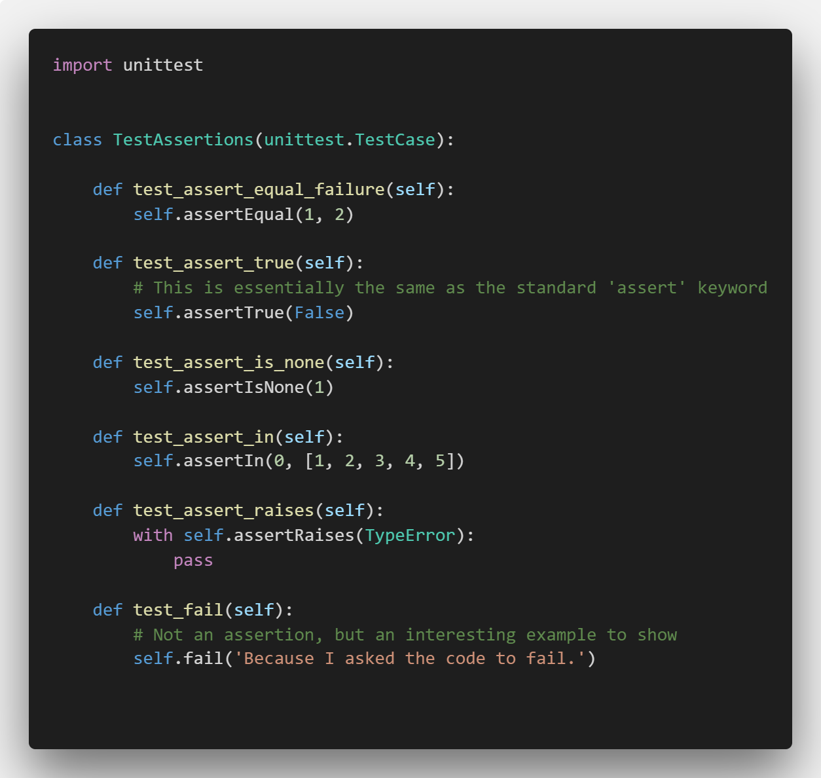
Unittest Assertions
Extensive list at https://docs.python.org/2/library/unittest.html#assert-methods
Most optionally take a message parameter
This is often used to provide more detail about what a test failure means (two items not being equal may not be sufficient context to understand what happened)

Slide 6
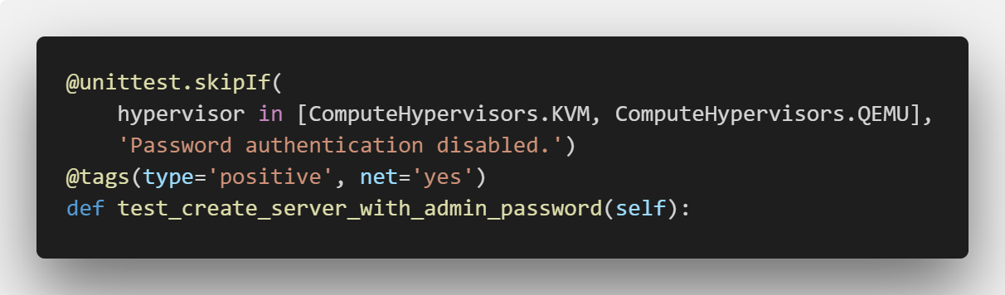
Test Decorators
skipIf – skips test based on Boolean condition
Tags – metadata that can be used during test selection
Tag conventions are usually project specific

Slide 7
Data-Driven Tests

Slide 8
Test Execution and Debugging

Slide 9
Review – OpenCafe Conventions

Slide 10
Engine.config
Sets
Base log directory
Base config directory
Base test repository

Slide 11
cafe-runner – Basic commands
List tests
List configurations
Dry run
Parallel

Slide 12
cafe-runner – Test Selection
Runs from the installed packages, not your local code
Can use dotted paths to drill-down through packages
Run by
Package
Module
Method
Tag
Combinations of the above

Slide 13
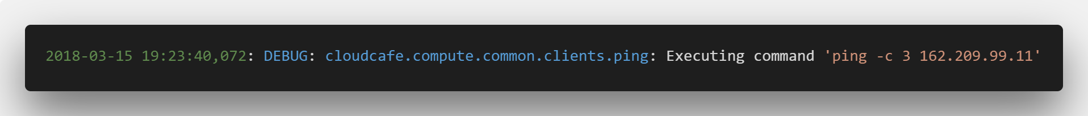
Log Format
Time Stamp
Python Class
Log Level
Command

Slide 14
Log Directory Structure
Compute
DateTime1
cafe.master.log
TestClass1
DateTime2
cafe.master.log
Products
Test Runs
Logs
TestClass2

Slide 15
Logging
Generated Files
Master log
One log per test class
Primary Log Entries
Test Fixture Headers
HTTP requests
SSH connections
Configuration Notifications
Not all errors are impactful, just informative

Slide 16
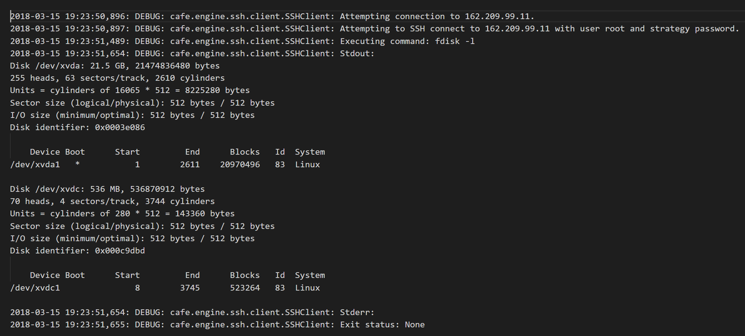
HTTP Logging Example

Slide 17
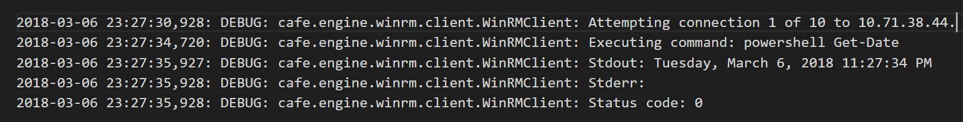
WinRM Logging

Slide 18
Traiging
Tail log files for long running jobs when you think something has gone wrong

Slide 19
Links
Python Unittest Flow
https://docs.python.org/2/library/unittest.html
http://pythontesting.net/framework/unittest/unittest-fixtures/
http://pythontesting.net/framework/unittest/when-unittest-fixtures-fail/
Presentation Materials
https://github.com/dwalleck/opencafe-training

