Slide 1

Test Implementations With OpenCafe
Daryl Walleck
Senior Software Developer in Test
OpenCafe Maintainer

Slide 2
Overview
Python Unittest Review
Test Configuration and Execution
OpenCafe Logging
Triaging Tests

Slide 3
Unittest Concepts

Slide 4
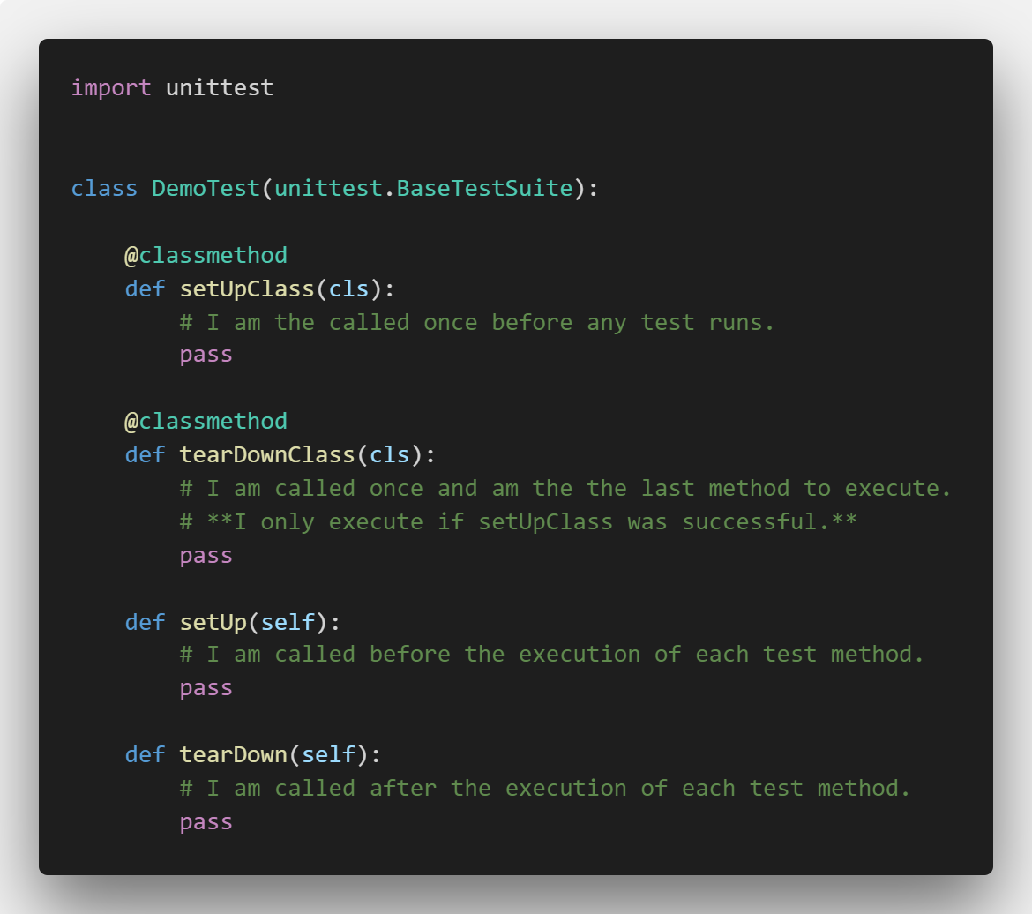
Unit Test Fixtures
Notes:
python -m unittest -q test_fixtures_order

Slide 5
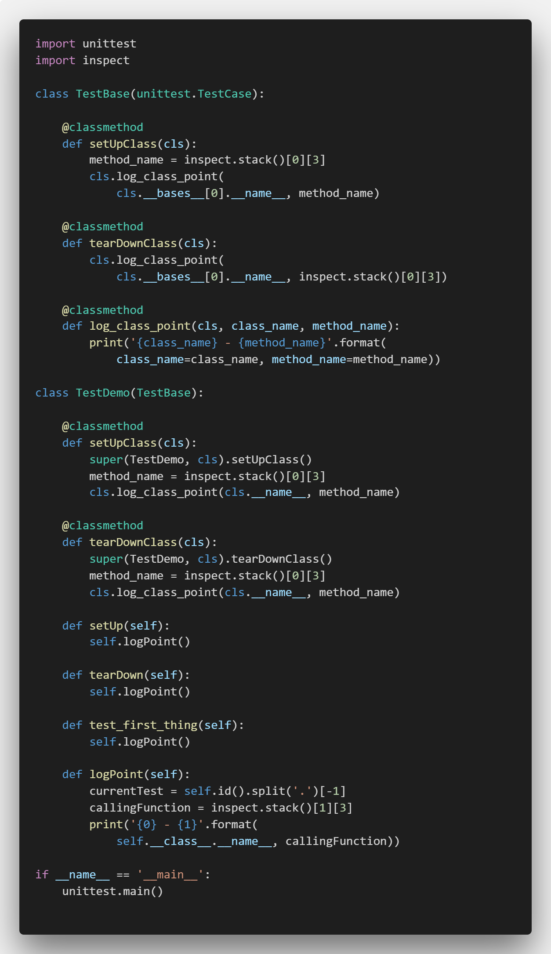
Inheritance + test Fixtures = Fun with Ordering!
Calling super on a method that has an implementation in the base class means the base class method will be executed first
When should you do this?
Notes:
python -m unittest -q test_fixture_inheritance

Slide 6
Test Inheritance In Practice
BaseTestFixture
ComputeFixture
ObjectStorageFixture
ImagesFixture
FlavorsTest
ImageListTest
ContainerSmokeTest
ImageOperationsSmoke
…
…
…
…
Notes:
Show ComputeFixture. Product level fixtures instantiate composites and contain functions that can commonly be used in all a products tests

Slide 7
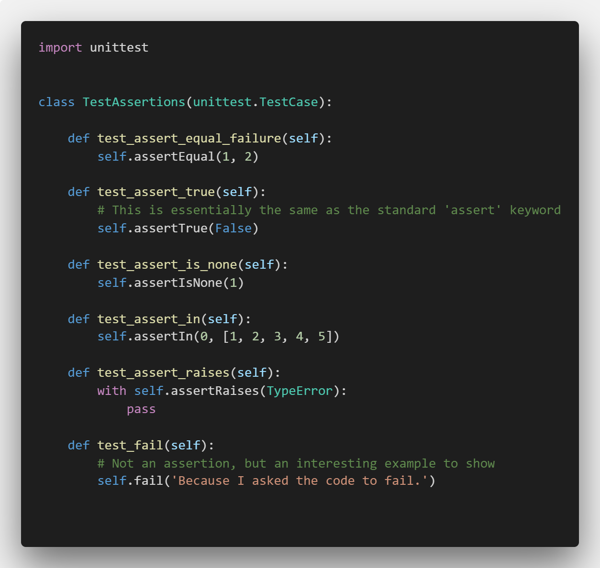
Unittest Assertions
Extensive list at https://docs.python.org/2/library/unittest.html#assert-methods
Most optionally take a message parameter
This is often used to provide more detail about what a test failure means (two items not being equal may not be sufficient context to understand what happened)
Notes:
python -m unittest -q test_assertion_failures
Use examples from test_create_server:
Expected disk to be {0} GB, was {1} GB
self.assertTrue(remote_client.can_authenticate(), msg="Cannot connect to server using public ip")
Expected hostname to be {0}, was {1}

Slide 8
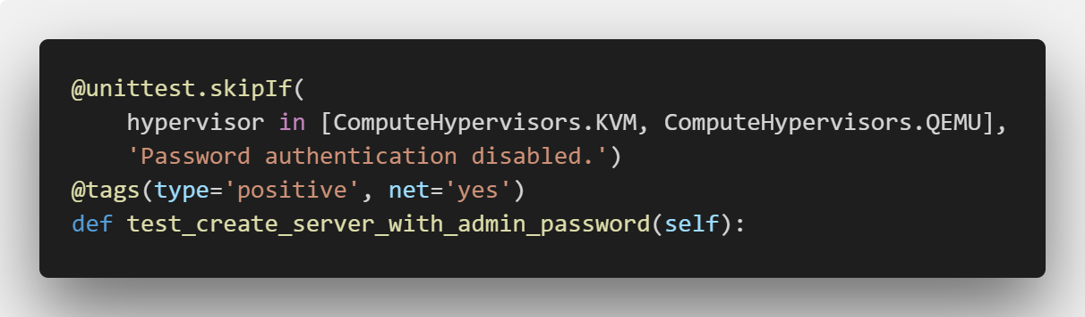
Test Decorators
skipIf – skips test based on Boolean condition
Tags – metadata that can be used during test selection
Tag conventions are usually project specific
Notes:
Explain use of skipIf for hypervisors and net for tags

Slide 9
Test Configuration and Execution

Slide 10
Review – OpenCafe Conventions

Slide 11
Engine.config
Sets
Base log directory
Base config directory
Base test repository

Slide 12
cafe-runner Basic commands
List tests
List configurations
Dry run
Parallel

Slide 13
cafe-runner – Test Selection
Runs from the installed packages, not your local code
Can use dotted paths to drill-down through packages
Run by
Package
Module
Method
Tag
Combinations of the above

Slide 14
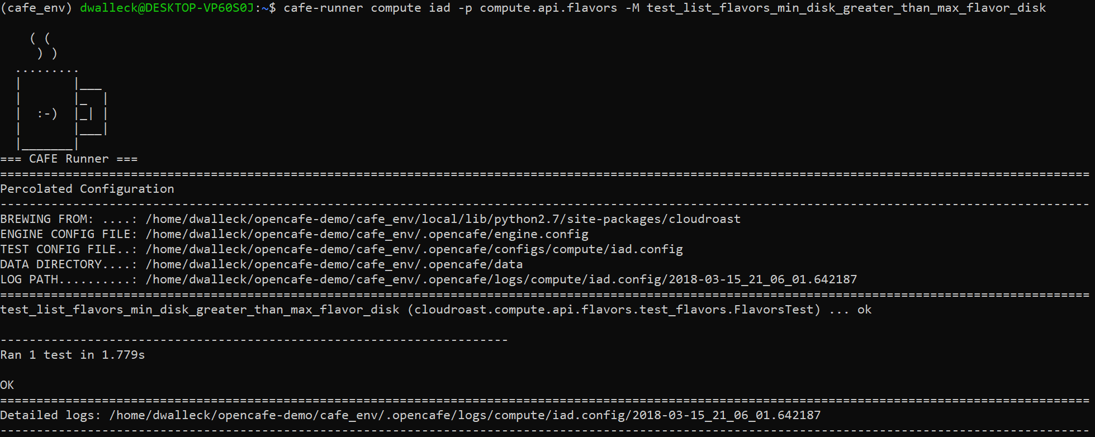
Test Run Output
Where to set test repository
Test Repository
Config location
Test Run log directory

Slide 15
OpenCafe Logging

Slide 16
Log Directory Structure
Compute
DateTime1
cafe.master.log
TestClass1
DateTime2
cafe.master.log
Products
Test Runs
Logs
TestClass2
For each product
For each test run
A master log
One log per test class executed

Slide 17
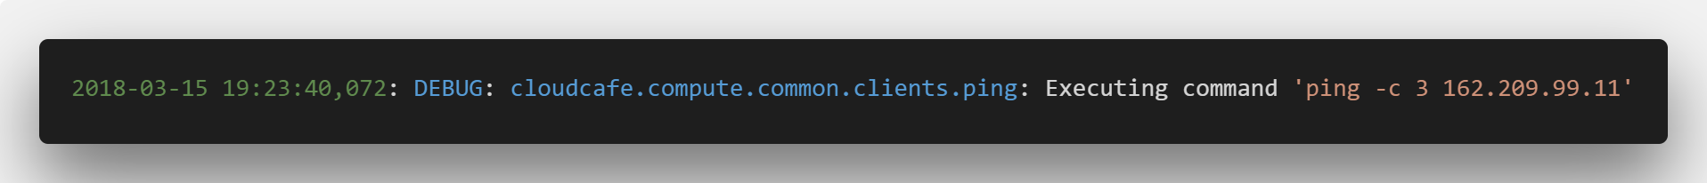
Log Format
Time Stamp
Python Class
Log Level
Command

Slide 18
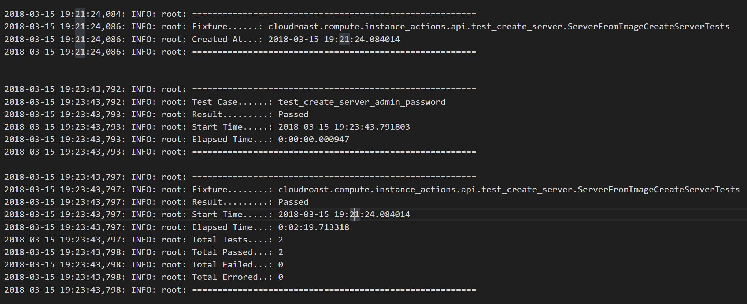
Fixture Logging

Slide 19
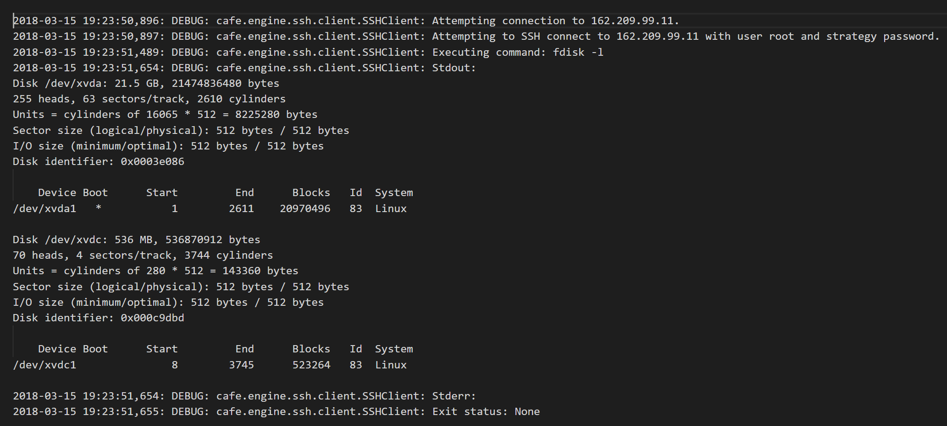
HTTP Logging

Slide 20
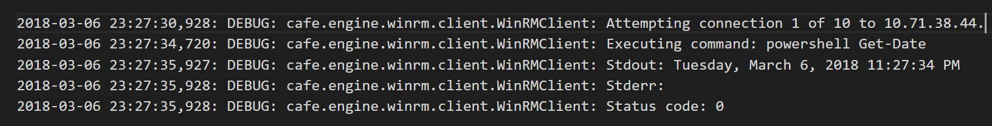
WinRM Logging

Slide 21
Configuration Warnings

Slide 22
Triaging Tips

Slide 23
Triaging Tips
Tail log files for long running jobs when you think something has gone wrong
Request ids or resource ids from a failed test run simplify tracing issues
Check logs when an action times out for unexpected state changes
Use a JSON viewer to make raw responses readable

Slide 24
Questions?

Slide 25
Links
Python Unittest Flow
https://docs.python.org/2/library/unittest.html
http://pythontesting.net/framework/unittest/unittest-fixtures/
http://pythontesting.net/framework/unittest/when-unittest-fixtures-fail/
Presentation Materials
https://github.com/dwalleck/opencafe-training

Slide 26
Data-Driven Tests

