Slide 1
OpenCafe Training
Part 2 – Project Overview

Slide 2

Unittest Concepts

Slide 3
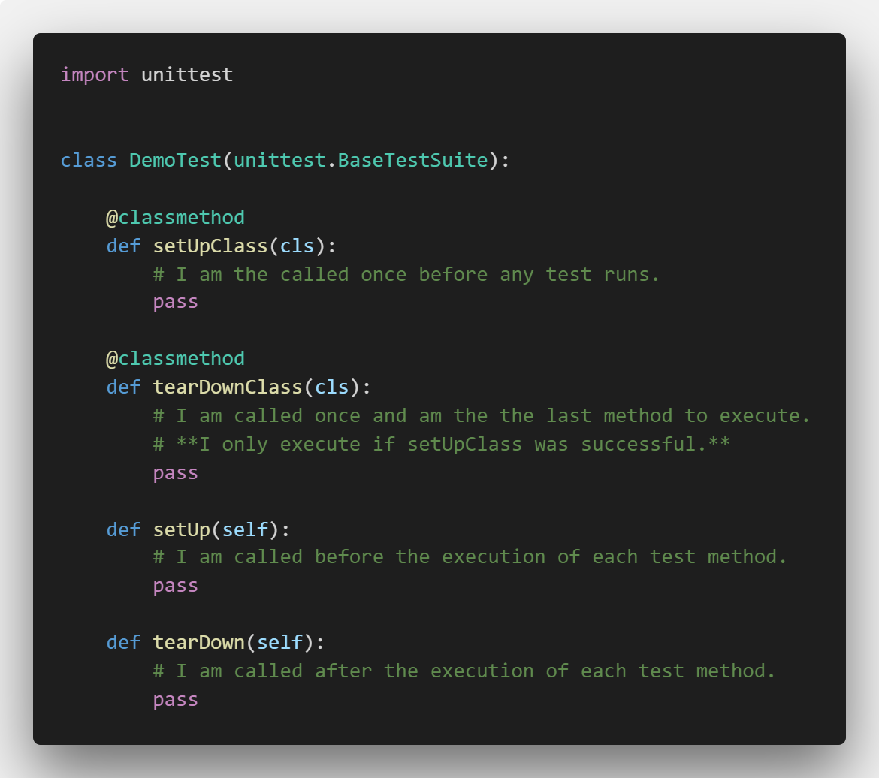
Unit Test Fixtures

Slide 4
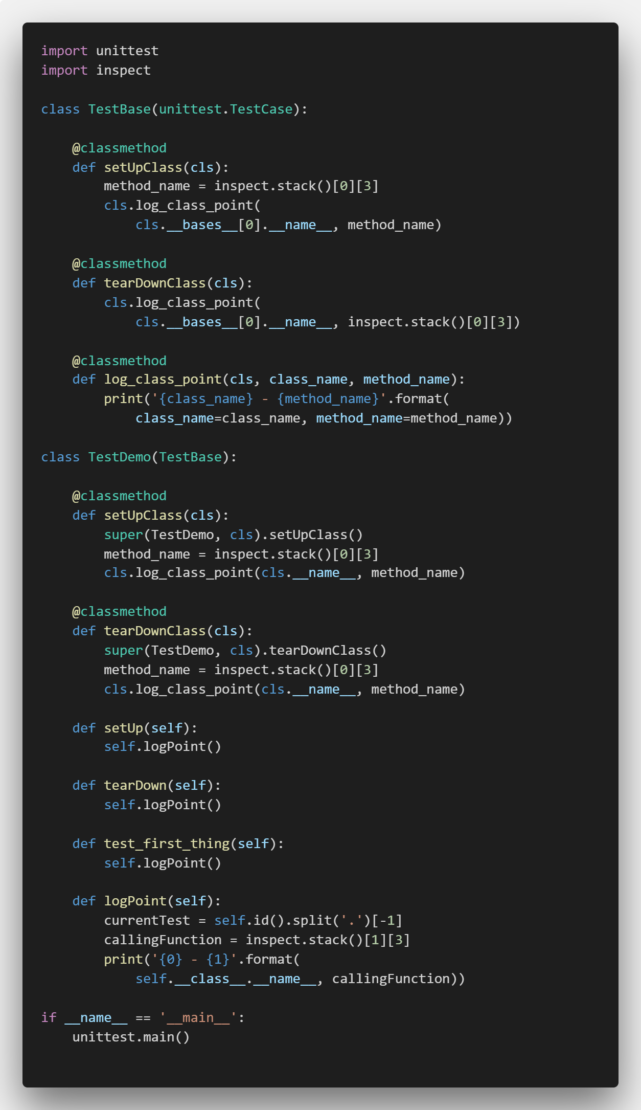
Inheritance + Fixtures = Fun with Ordering!
Calling super on a method that has an implementation in the base class means the base class method will be executed first
When should you do this?
Demo

Slide 5
Unittest Assertions
Extensive list in Python docs
All assertions optionally take a message parameter
This is often used to provide more detail about what a test failure means (two items not being equal may not be sufficient context to understand what happened)

Slide 6
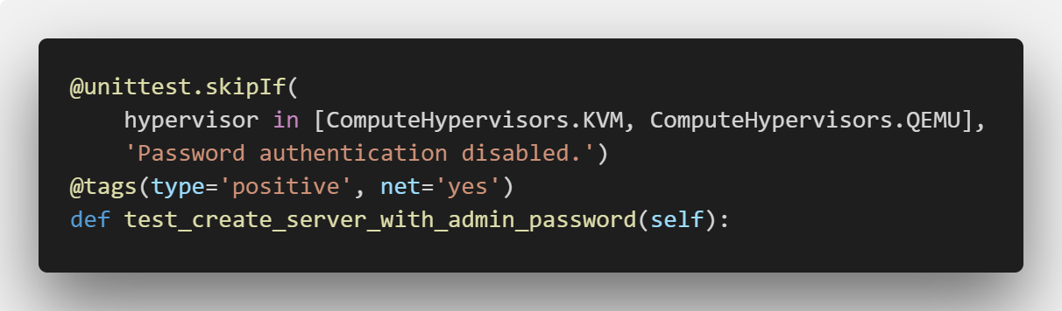
Test Decorators
skipIf – skips test based on Boolean condition
Tags – metadata that can be used during test selection
Tag conventions are usually project specific

Slide 7
Data-Driven Tests

Slide 8
Test Execution and Debugging

Slide 9
Show conventions damn it

Slide 10
Engine.config
Sets
Base log directory
Base config directory
Base test repository

Slide 11
cafe-runner – Basic commands
List tests
List configurations
Dry run
Parallel

Slide 12
cafe-runner – Test Selection
Runs from the installed packages, not your local code
Can use dotted paths to drill-down through packages
Run by
Package
Module
Method
Tag
Combinations of the above

Slide 13
Logging - HTTP

Slide 14
Logging – SSH & WinRM

Slide 15
Links
Python Unittest Flow
https://docs.python.org/2/library/unittest.html
http://pythontesting.net/framework/unittest/unittest-fixtures/
http://pythontesting.net/framework/unittest/when-unittest-fixtures-fail/
Presentation Materials
https://github.com/dwalleck/opencafe-training

