Slide 1
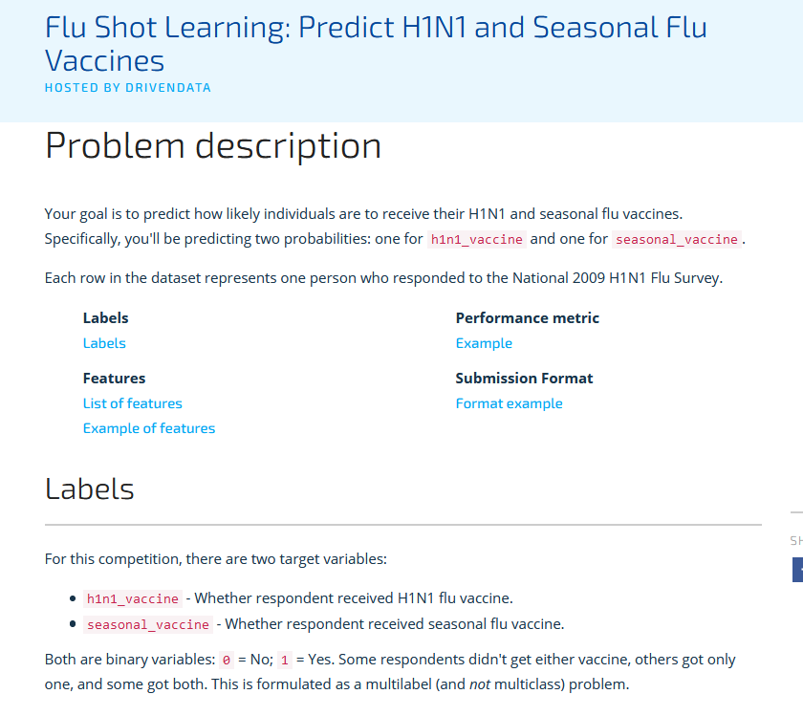
https://www.drivendata.org/competitions/66/flu-shot-learning/page/211/

Slide 2
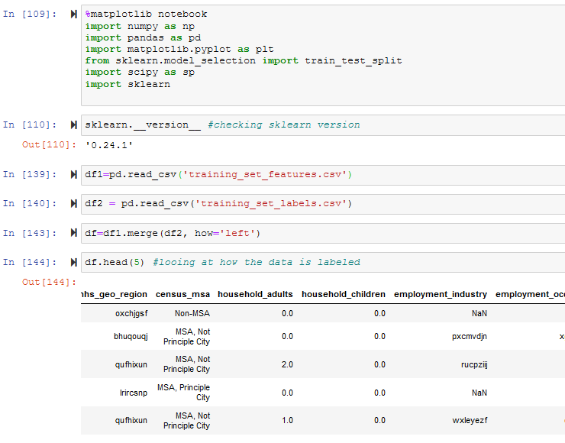
Here I am taking a CSV file and inserting it into a Data Frame. Also, looking at the columns and data they contain
Notes:
Here I am taking a CSV file and inserting it into a DataFrame. Also, looking at the columns and data they contain

Slide 3
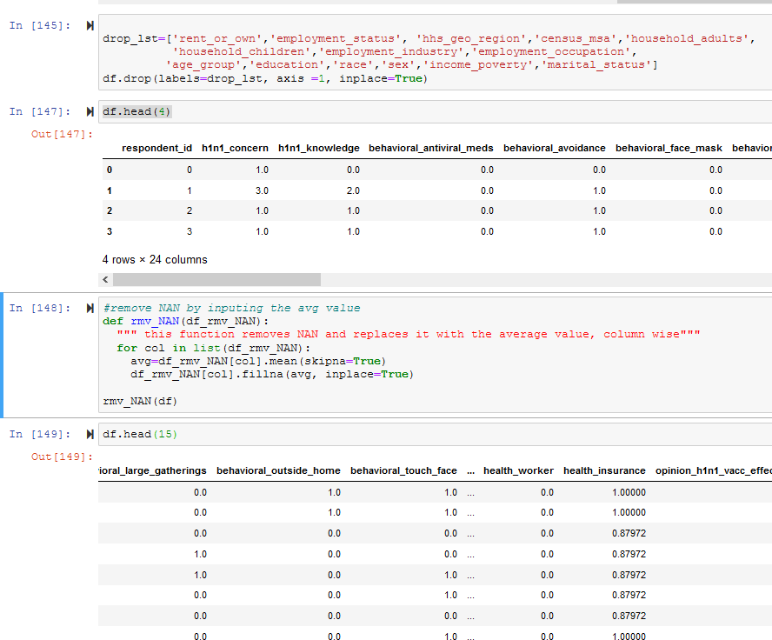
I created a list of data to drop with frivolous data. For logistic regression this is critical. rmv_NAN removes NAN and replaces it with the average value
Notes:
I created a list of data to drop with frivolous data. For logistic regression this is critical. rmv_NAN removes NAN and replaces it with the average value

Slide 4
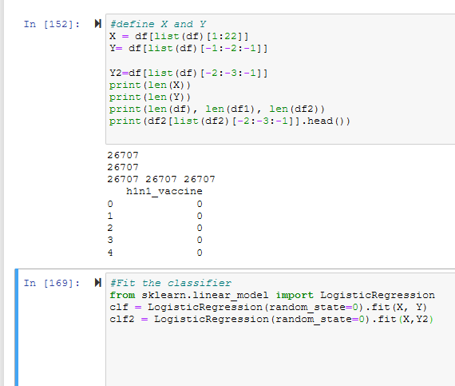
Define x , y and y2. there are 2 label columns. Y is the first label (0). Y2 is the second label (1). Y and Y2 are independent of each other. Also, fitting to logistic regression
Notes:
Define x , y and y2. there are 2 label columns. Y is the first label (0). Y2 is the second label (1). Y and Y2 are independent of each other. Also, fitting to logistic regression

Slide 5
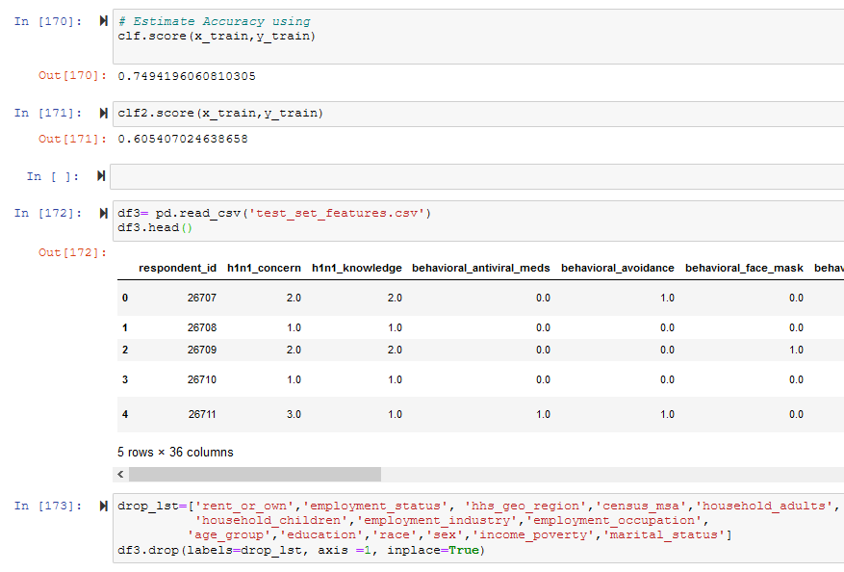
The score for label 0 is 75 percent. And 60 percent for a label of 1. the test data, which is not labeled, is put into df3. the same preprocessing of column removal and NAN replacement was performed again (not shown).
Notes:
The score for label 0 is 75 percent. And 60 percent for a label of 1. the test data, which is not labeled, is put into df3. the same preprocessing of column removal and NAN replacement was performed again (not shown).

Slide 6
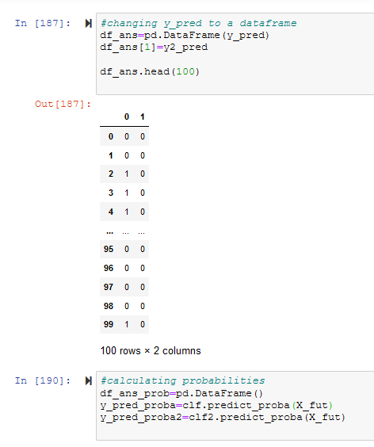
“Predict_proba” gives you the percentage of 0 or 1, respectively, instead of the categorical labels. This data was put into a data frame and exported as output.csv.
Notes:
“Predict_proba” gives you the percentage of 0 or 1, respectively, instead of the categorical labels. This data was put into a dataframe and exported as output.csv.

Slide 7
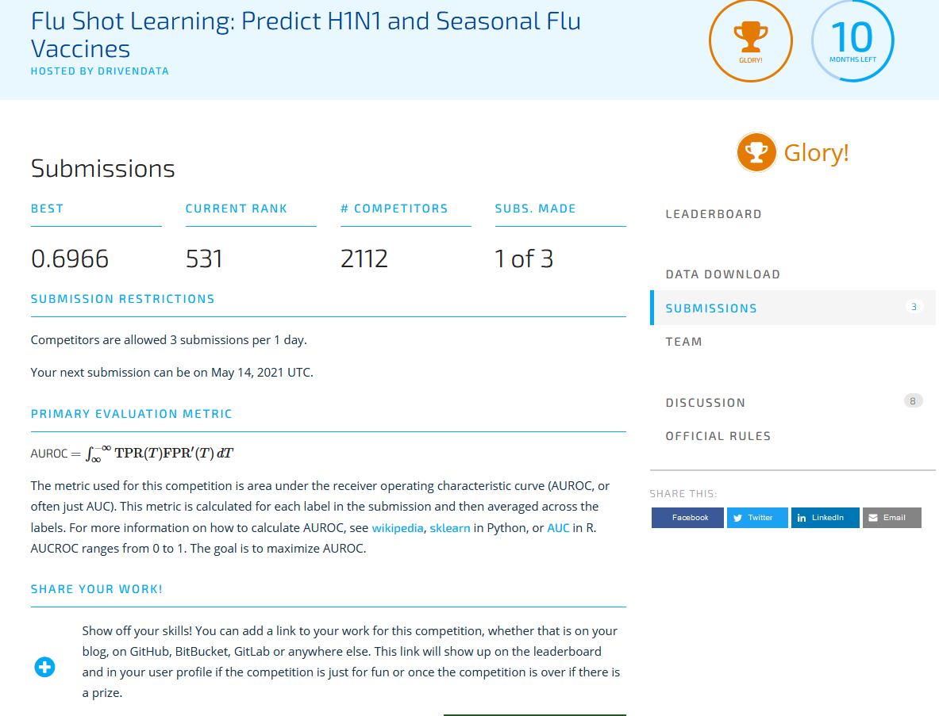
My submission to Driven Data

