Slide 1
Gas Turbine Emissions
By
D. Kelley

Slide 2
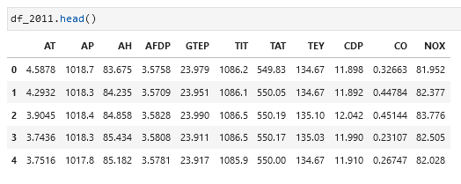
About this Dataset. And the Assumptions made.
This dataset has 11 sensors which are used as 10 attributes. The
Ambient temperature (AT)
Ambient pressure (AP)
Ambient humidity (AH)
Air filter difference pressure (AFDP)
Gas turbine exhaust pressure (GTEP)
Turbine inlet temperature (TIT)
Turbine after temperature (TAT)
Compressor discharge pressure (CDP)
Turbine energy yield (TEY)
Carbon monoxide (CO)
Nitrogen oxides (NOx)
The Turbine energy yield is used as the target.
Can this be estimated based on the other 10 inputs
Location: https://archive.ics.uci.edu/ml/datasets/Gas+Turbine+CO+and+NOx+Emission+Data+Set

Slide 3
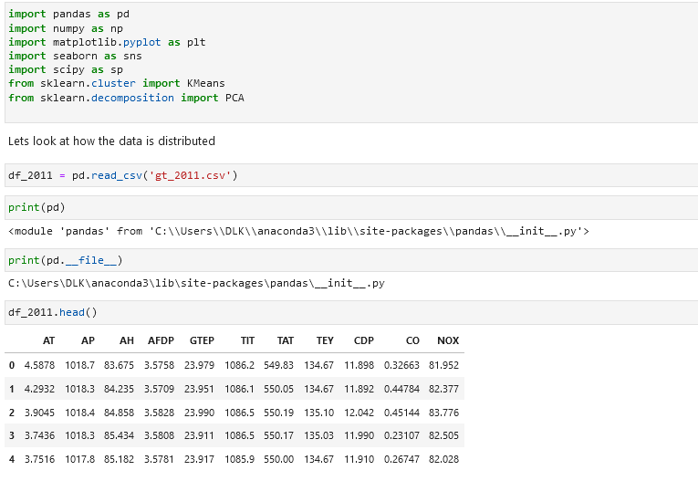
Import libraries and Data as a DataFrame

Slide 4
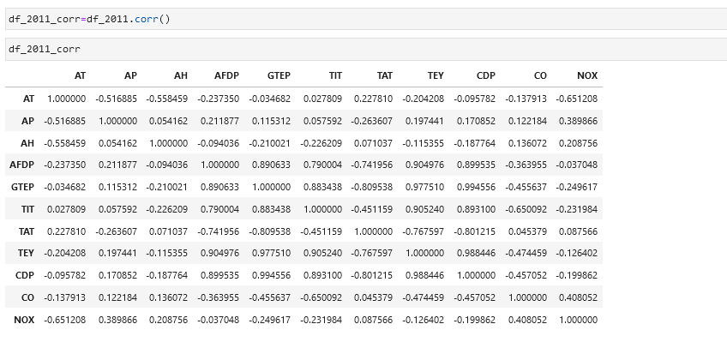
Correlation matrix
This matrix will look for linear relation ships.

Slide 5
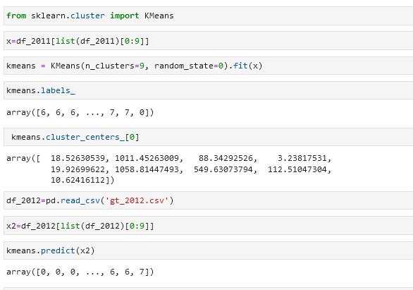
KMeans implementation
Clustering with Kmeans

Slide 6
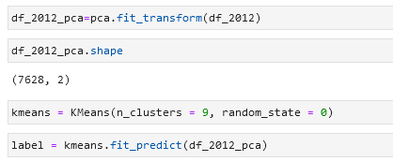
PCA
Dimensionality reduction for 2-D graphing.

Slide 7
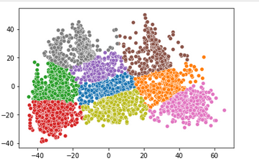
Clusters Modeled
This is the clusters modeled

Slide 8
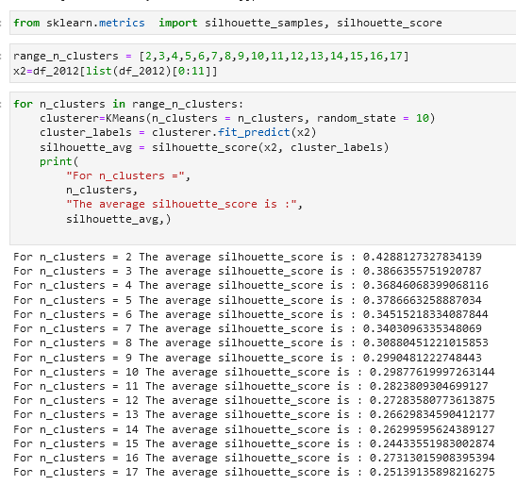
Silhouette Score
Testing the accuracy of the model. Here clusters 2-17 were attempted and scored.
.42 was the best score and that is below standard.

Slide 9
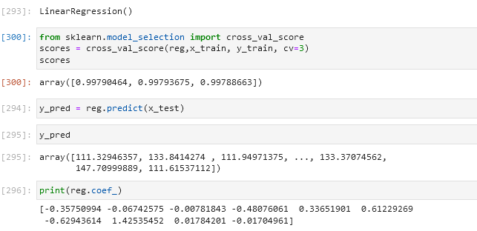
Linear regression
Attempting Least Squares Fit.

Slide 10
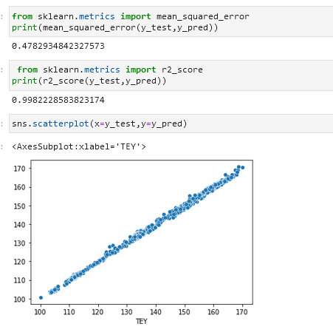
Successful prediction

Slide 11
Final Conclusions
Final classifier (Linear Regression) worked within 99 percent
Cross-validation was successful for linear regression.
This approach became an evident strong possibility based on the correlation matrix. That matrix indicated a strong linear relationships
The Clustering attempted may have been partially unsuccessful due to dimensionality reduction. This could have caused the loss of important data.
Moving forward the coefficients generated by SKlearn can be used as an estimator. Also, further research can be done. This equation can lead to other insights:
Maximization
and Minimalization

Slide 12
Works Cited
Klosterman, Stephan. Data Science Projects with Python, Packt Publishing, 2019, Online at O’Reilly Media.
Dua, D. and Graff, C. (2019). UCI Machine Learning Repository [http://archive.ics.uci.edu/ml]. Irvine, CA: University of California, School of Information and Computer Science.
Scikit-learn: Machine Learning in Python, Pedregosa et al., JMLR 12, pp. 2825-2830, 2011.
Garbade, Michael (2018), Understanding K-means Clustering in Machine Learning. https://towardsdatascience.com/understanding-k-means-clustering-in-machine-learning-6a6e67336aa1
Versloot, Christian 2020, https://www.machinecurve.com/index.php/2020/05/05/how-to-visualize-support-vectors-of-your-svm-classifier/

