Slide 1
Preventative Maintenance

Slide 2
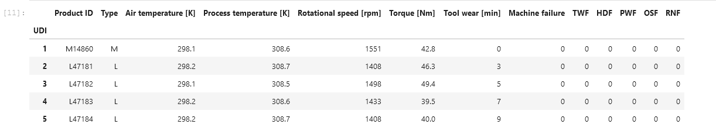
This Data consist of
3 types of machines (L,M, H)
4 features (Air temp, Process temp, Rotational speed, Torque, Tool Wear)
Tool wear is just a measure of time in minutes
There are 5 failure modes, machine failure occurs if any failure mode occurs.
The failure modes are Binary in nature. (0 for operational, and 1 for failure)

Slide 3
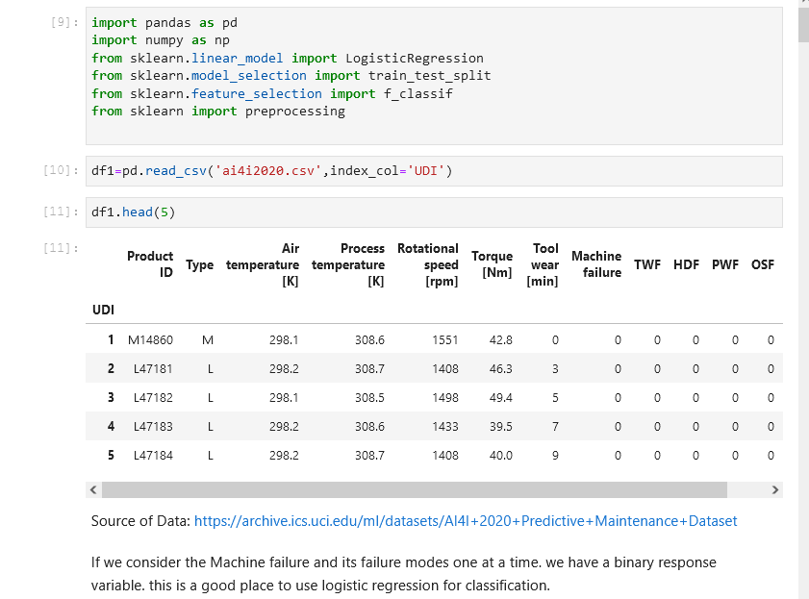
Modules and Data Insertion
Shows the source of the data and modules needed

Slide 4
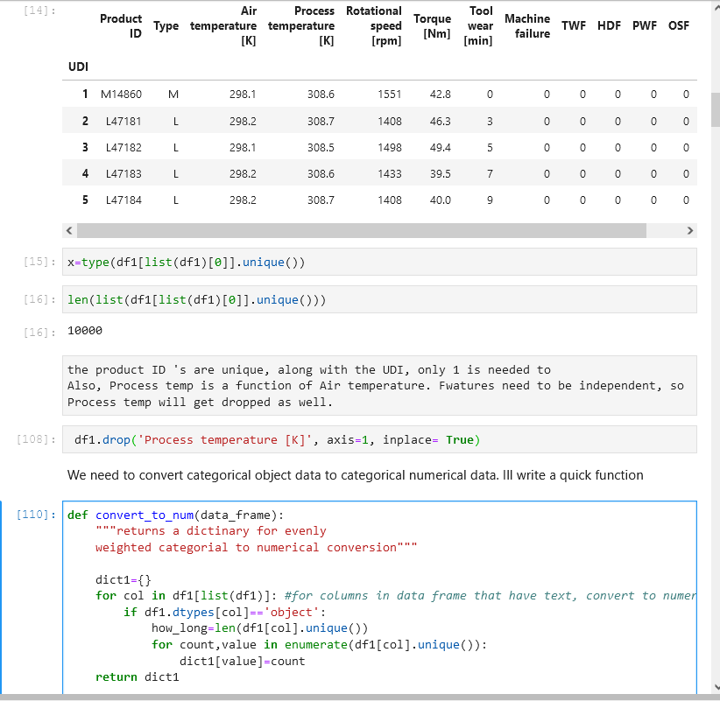
Data Cleanup
Here unneeded information is dropped, and a function is created to generate a dictionary.
This dictionary is used to define a replacement of strings to numerical values

Slide 5
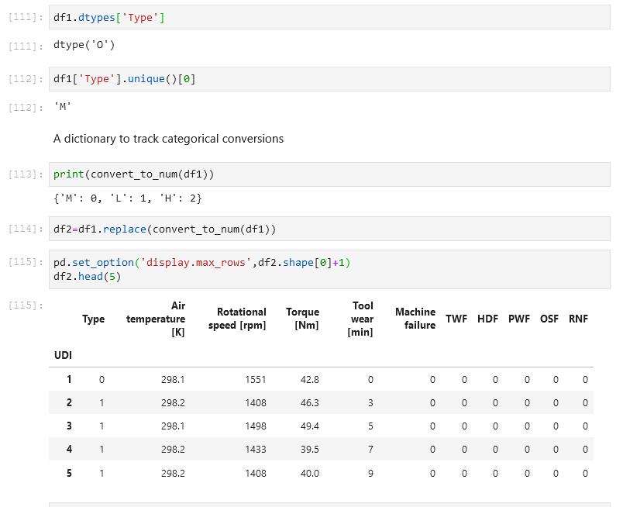
Minor Data Wrangling
The replace function is performed and the type of machine is now numerical. This allows the logistic function to operate.

Slide 6
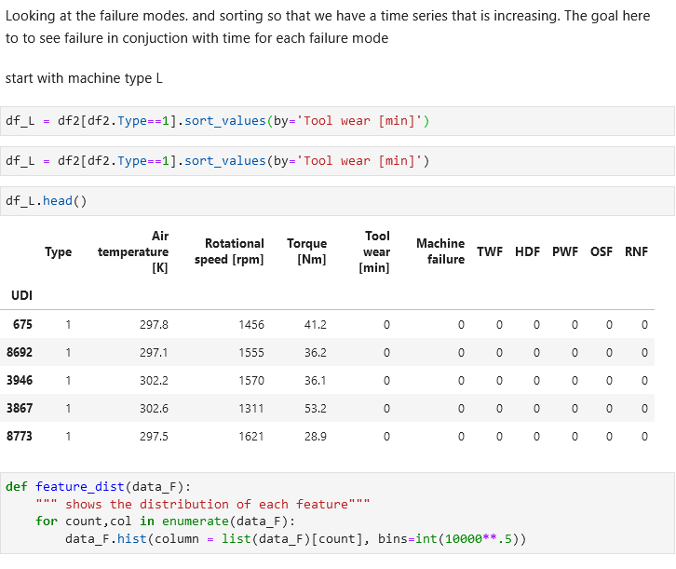
Organizing the Dataset
Working with Machine type L and increasing time

Slide 7
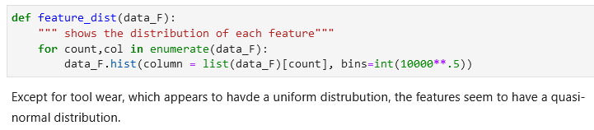
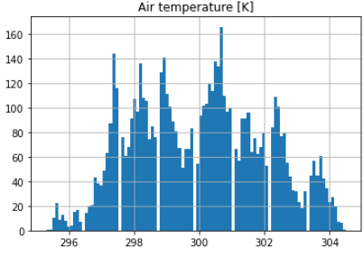
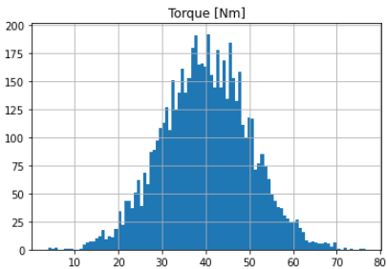
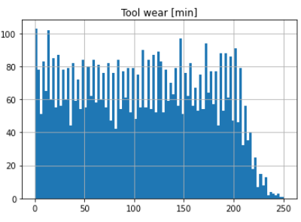

Slide 8
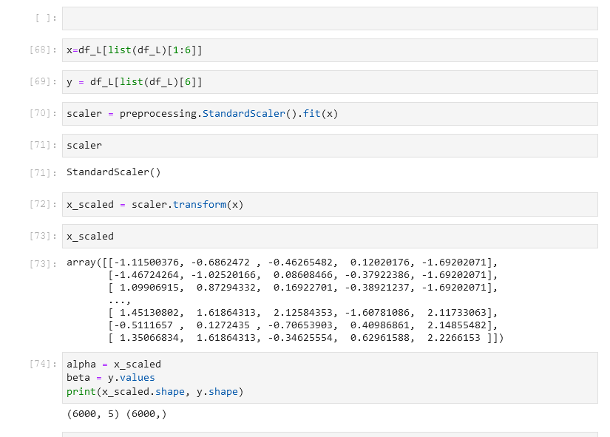
Normal Distribution
Preprocessing the data to ensure it has a normal distribution. Then running an ANOVA F Test.

Slide 9
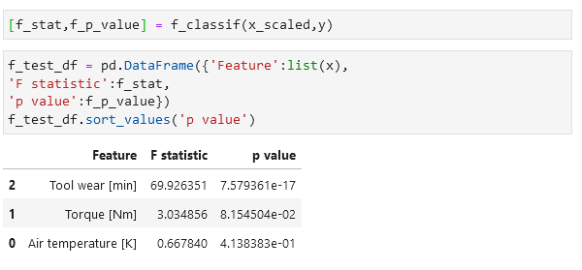
F Statistic
Results of the F test showing that Torque has the greatest effect on failures, regardless of Mode

Slide 10
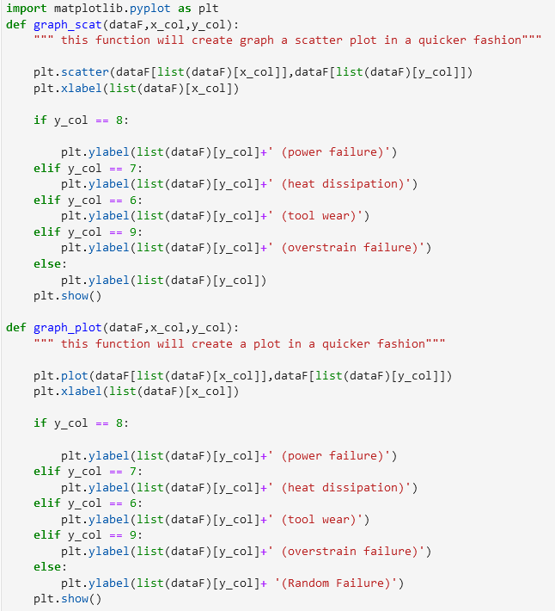

Graph Customizing
Here I am comparing features with failure modes one at a time. The functions take a dataframe, x column index and y column index.
Below the graphs that show a trend are shown.
Recall that the Failure modes are binary (0 and 1)

Slide 11
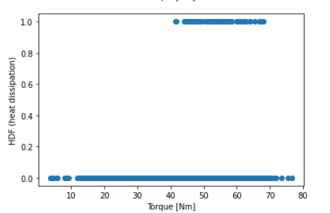
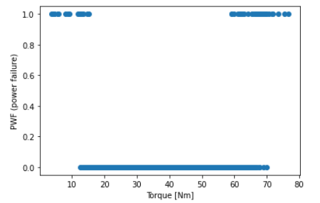
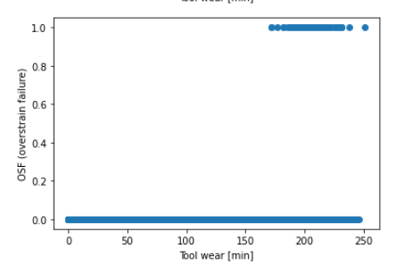
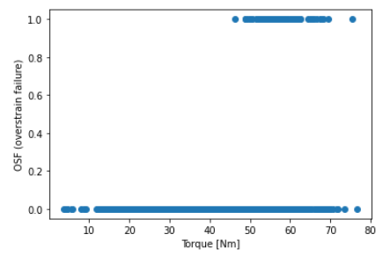

Slide 12
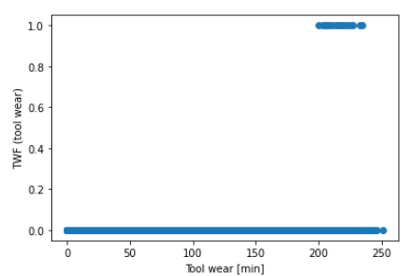
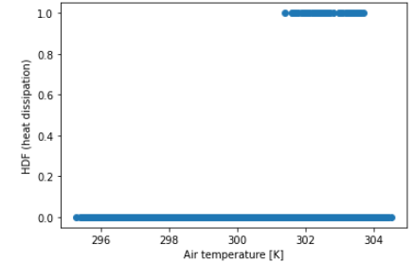

Slide 13
Graphical Conclusion:
More errors occur under the current conditions:
High and Low Rotational speeds

Slide 14
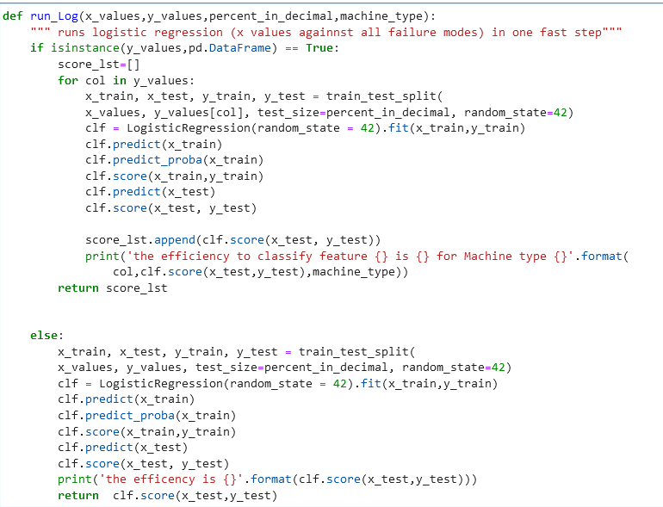
Simplify classification
Using a custom function to generate the classifiers.

Slide 15
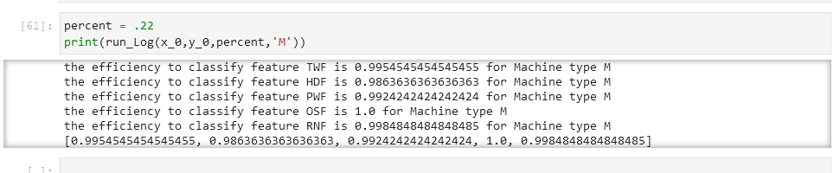
Results of the classifier

Slide 16
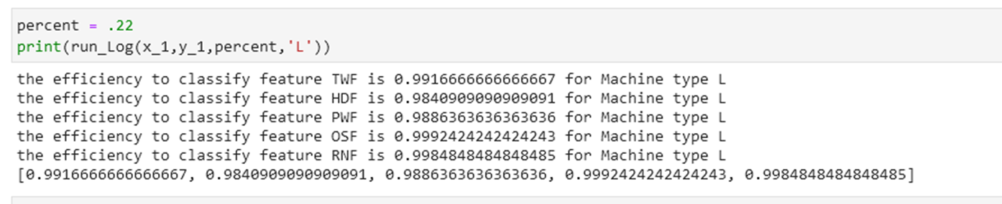
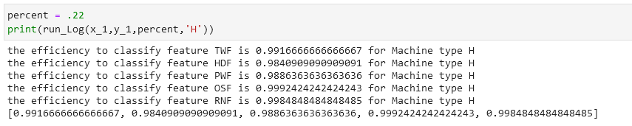
Results continued

Slide 17
Final Conclusions
The classifiers all work within 98-99 percent.
Those classifiers are have the same results, regardless of the quality of the machine.
During this experiment machines L, M, and H were treated as 3 different machines
The quality wear time difference was ignored for this effort.
For further please see please see Reliability.pptx

