Slide 1
Preventative Maintenance

Slide 2
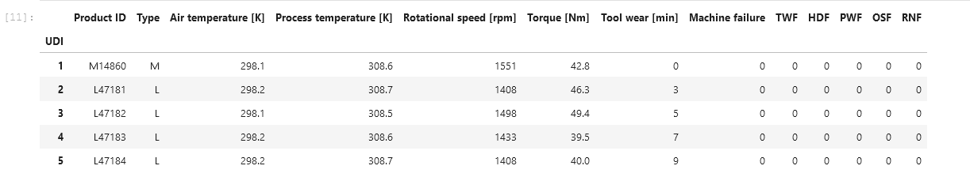
About This Dataset and the Assumptions made:
This Data Set is right censored. This has been neglected due to the lack of information required.
3 quality indices for on machine (L,M, H). Treated as 3 different machines
3 features (Air temp, Torque, Tool Wear). The others were removed due to lack of linear independence
Tool wear is just a measure of time in minutes
There are 5 failure modes :
TWF – Tool Wear Failure
HDF-Heat D Failure ,
PWF-Power W Failure,
OSF-Overstrain Failure and
RNF-Random Failure –Not considered here
Machine failure occurs if any failure mode occurs.
The failure modes are Binary in nature. (0 for operational, and 1 for failure)
The reliability calculations were performed

Slide 3
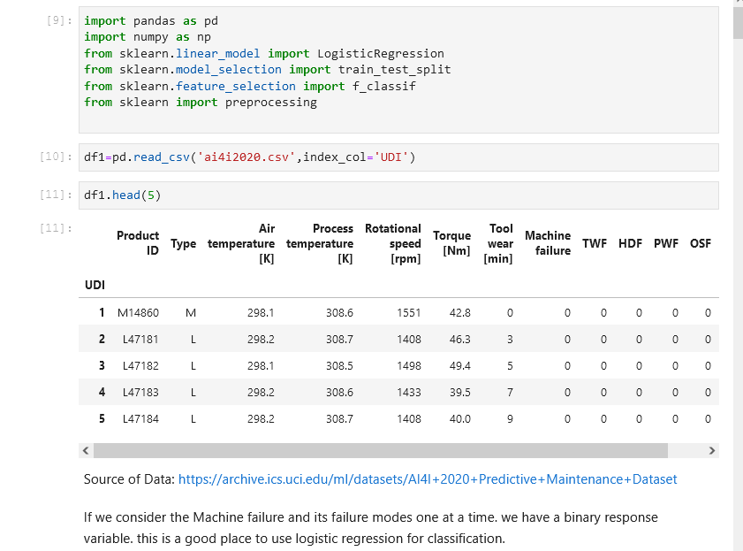
Modules and Data Insertion
Shows the source of the data and modules needed

Slide 4
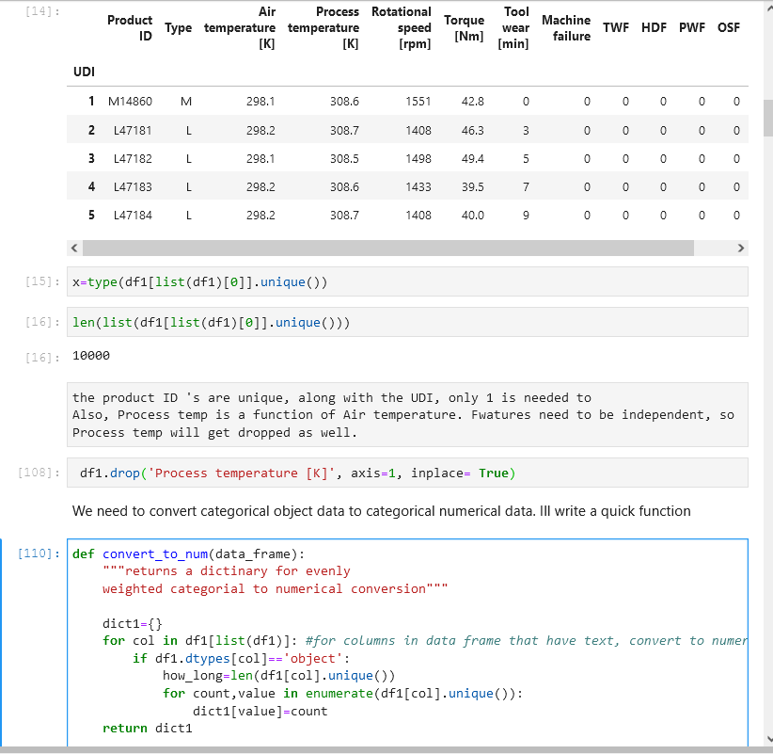
Data Cleanup
Here unneeded information is dropped, and a function is created to generate a dictionary.
This dictionary is used to define a replacement of strings to numerical values

Slide 5
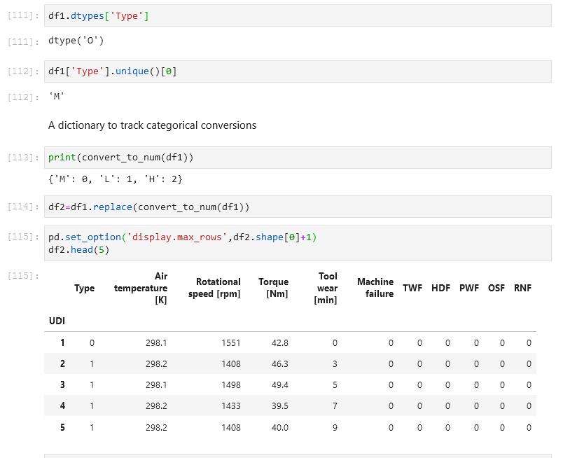
Minor Data Wrangling
The replace function is performed and the type of machine is now numerical. This allows the logistic function to operate.

Slide 6
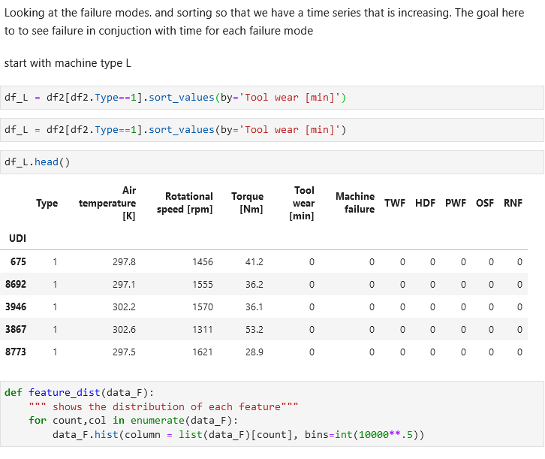
Organizing the Dataset
Working with Machine type L and increasing time

Slide 7
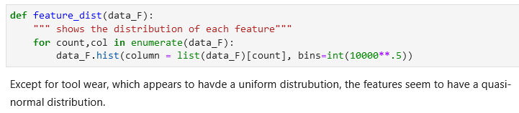
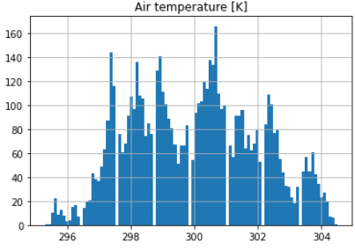
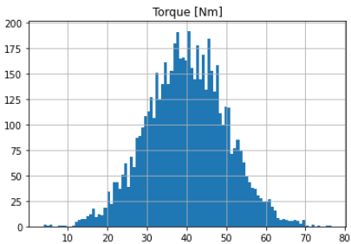
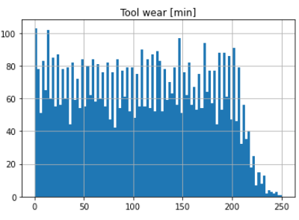

Slide 8
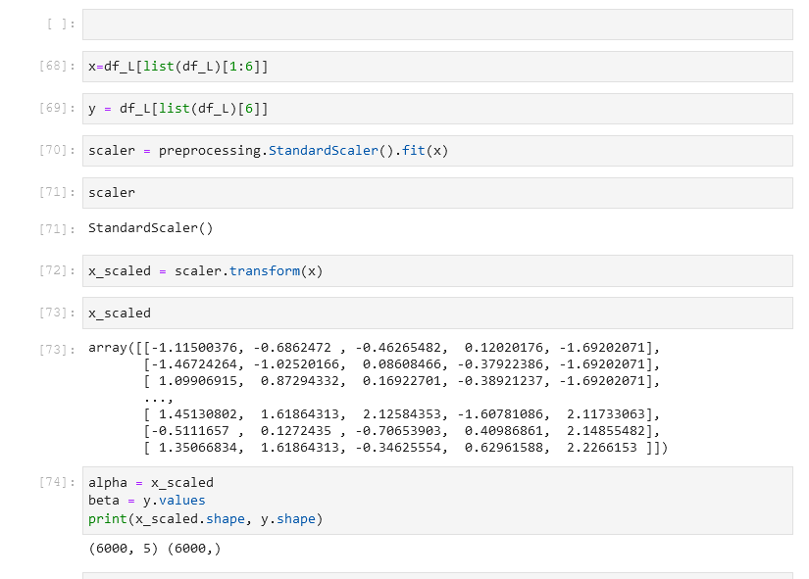
Normal Distribution
Preprocessing the data to ensure it has a normal distribution. Then running an ANOVA F Test.

Slide 9
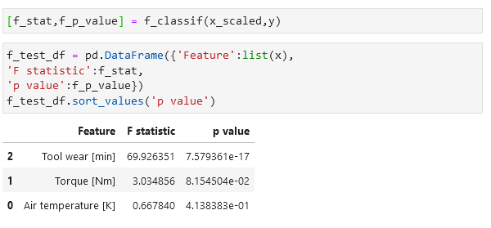
F Statistic
Results of the F test showing that Torque has the greatest effect on failures, regardless of Mode

Slide 10
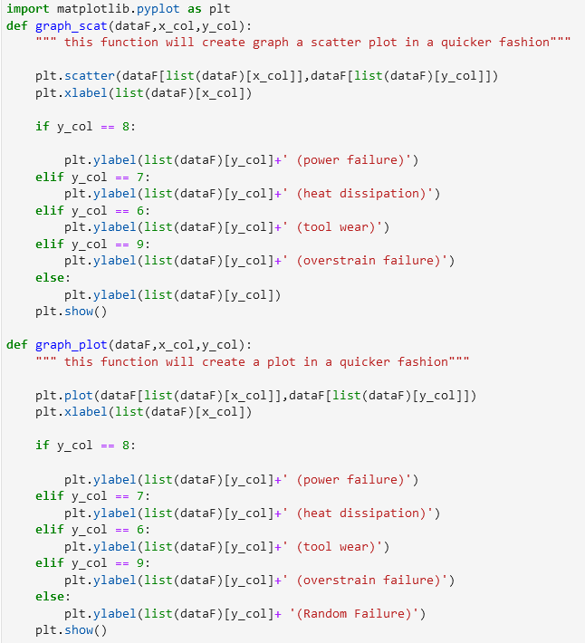

Graph Customizing
Here I am comparing features with failure modes one at a time. The functions take a dataframe, x column index and y column index.
Below the graphs that show a trend are shown.
Recall that the Failure modes are binary (0 and 1)

Slide 11
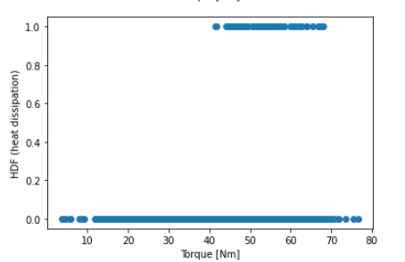
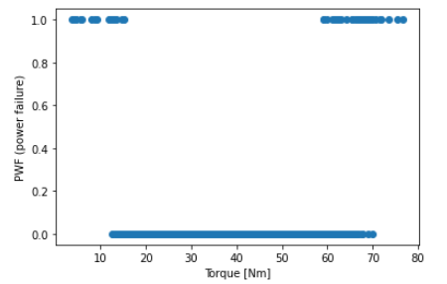
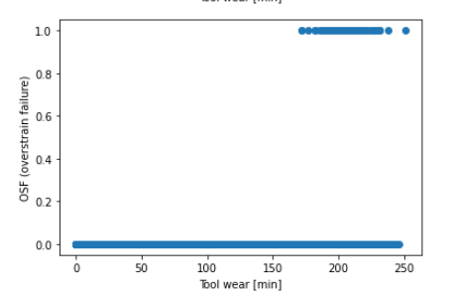
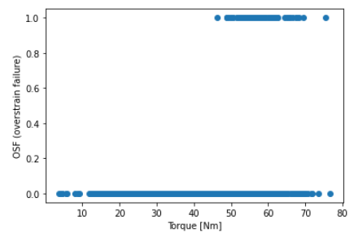

Slide 12
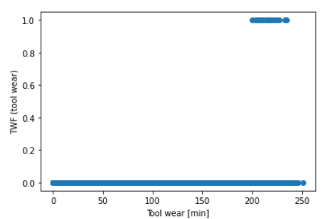
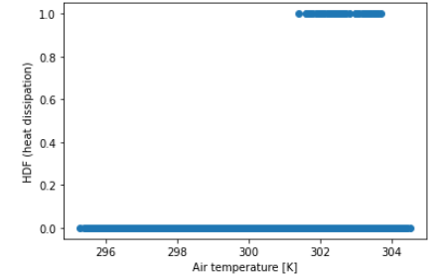

Slide 13
Graphical Conclusion:
More errors occur under the current conditions:
High and Low Rotational speeds

Slide 14
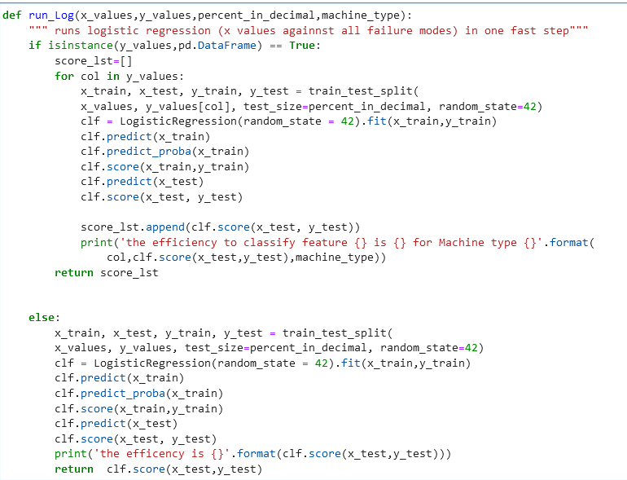
Simplify classification
Using a custom function to generate the classifiers.

Slide 15
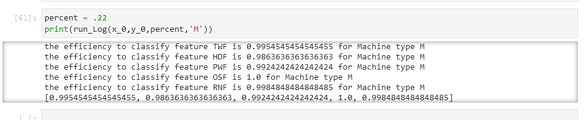
Results of the classifier

Slide 16
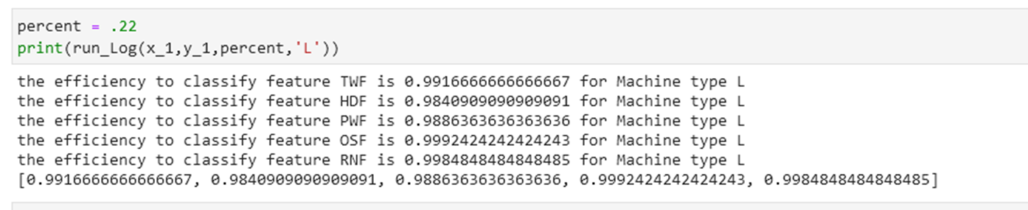
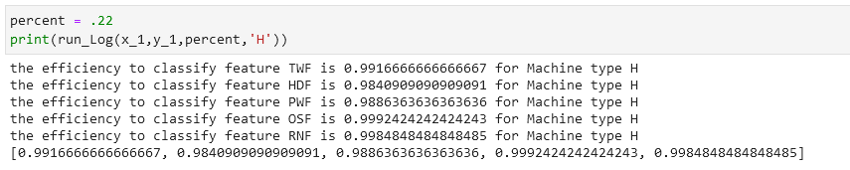
Results continued

Slide 17
Final Conclusions
The classifiers all work within 98-99 percent.
Those classifiers have the same results, regardless of the Type of the machine.
Quality can be improved by
changing design parameter such that the temperature does not go as high. A way to do this could be improved cooling.
Limitations on Torque could be improved as to reduce the chance of Overstrain.
These changes could allow for longer tool wear out periods and better warranty for the machines

Slide 18
Works Cited
Klosterman, Stephan. Data Science Projects with Python, Packt Publishing, 2019, Online at O’Reilly Media.
Dua, D. and Graff, C. (2019). UCI Machine Learning Repository [http://archive.ics.uci.edu/ml]. Irvine, CA: University of California, School of Information and Computer Science.
Scikit-learn: Machine Learning in Python, Pedregosa et al., JMLR 12, pp. 2825-2830, 2011.
Dovivh, Robert and Wartman, Bill Certified Reliability Engineer Primer, Indiana Council of quality, 2014

