Slide 1
Quality Control Charts by Dwan Kelley

Slide 2
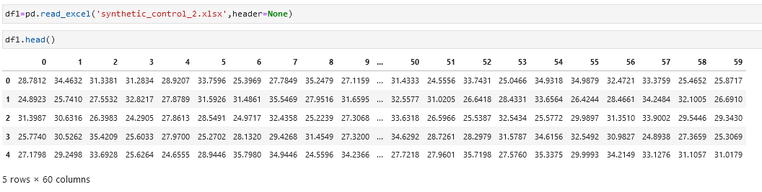
About This Dataset and the Assumptions made:
There are 600 samples of quality control chart data, with 6 labels
The data is configured such that row:
1-100 Normal 101-200 Cyclic 201-300 Increasing trend 301-400 Decreasing trend 401-500 Upward shift 501-600 Downward shift 1-100 rows are Normal
Data Source:
https://archive.ics.uci.edu/ml/datasets/synthetic+control+chart+time+series

Slide 3
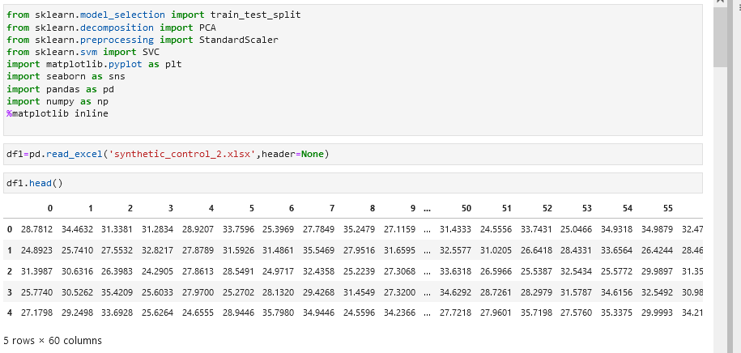
Initialization
Libraries and data insertion

Slide 4
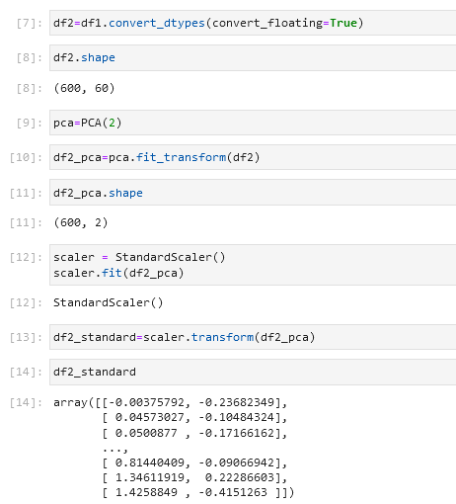
Normalizing the data and reducing dimensions
Dimensions are reduced so we can see the clustering graphically

Slide 5
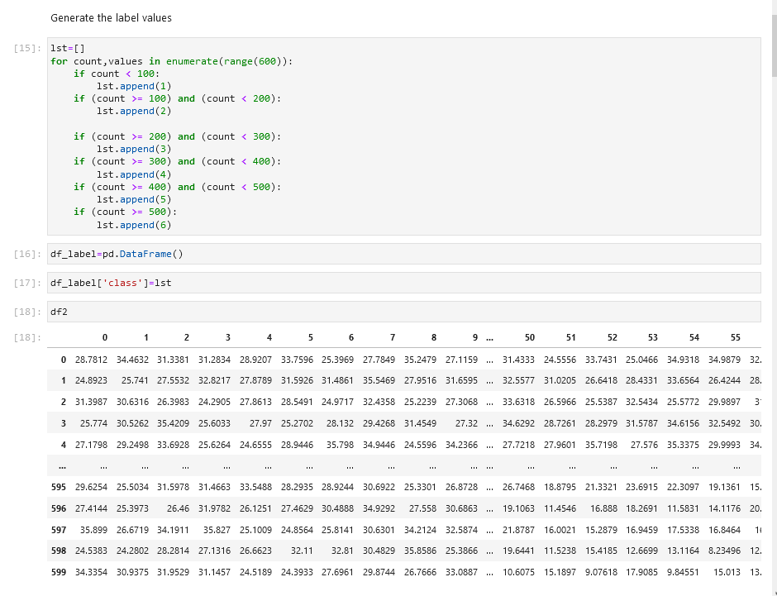
Generating labels
The labels are 1-6

Slide 6
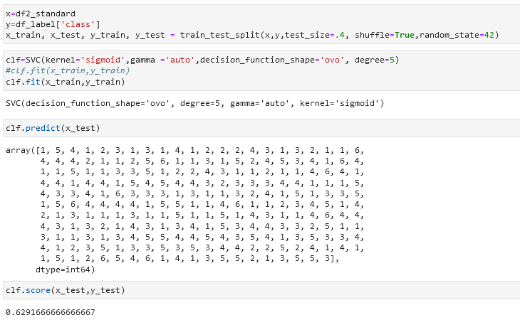
Support Vector Machine Classifier
The SVM performs at 62 percent accuracy. Not too well for a classifier

Slide 7
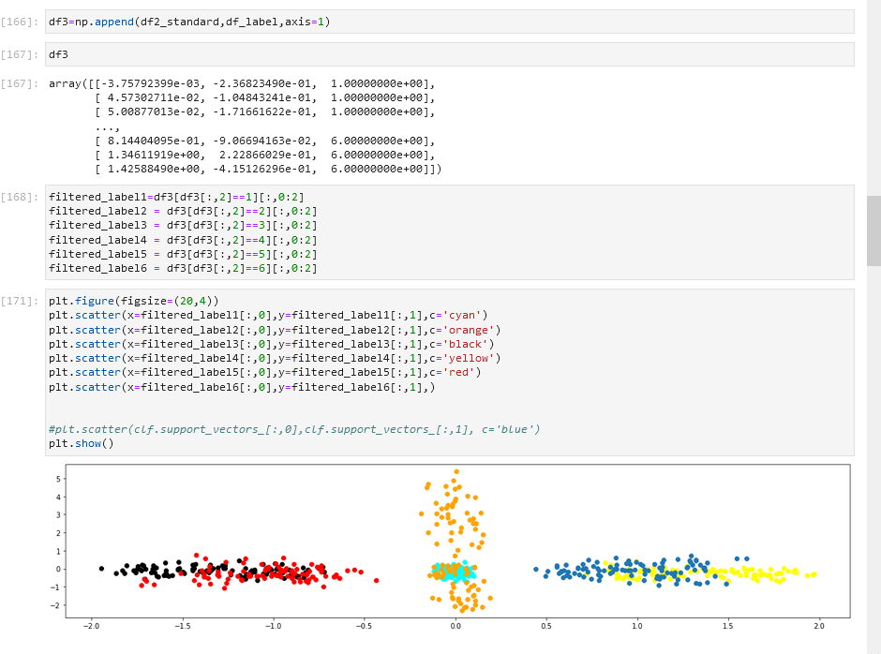
Graphing of clusters
Using reduced dimensionality to graph the clusters. There is confusion between some of the clusters, as shown with the overlap below. This explains the 62 percent accuracy.

Slide 8
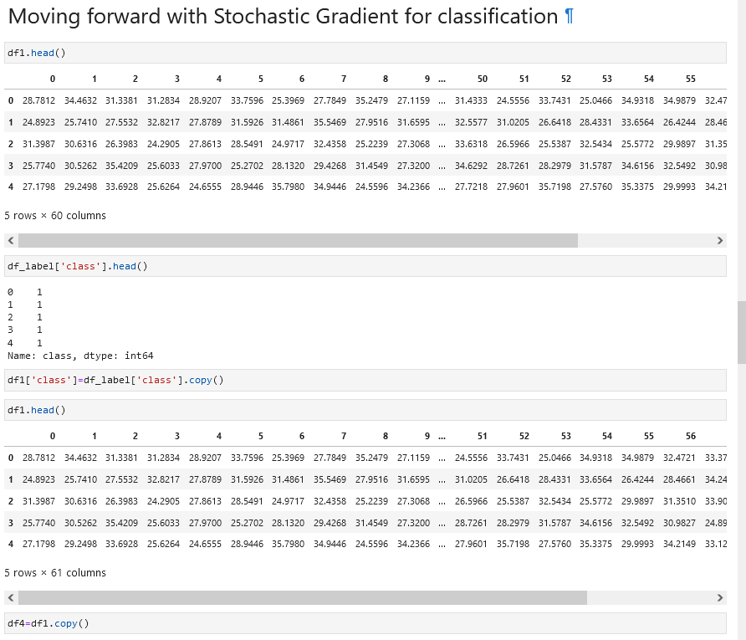
STG Classification
The Stochastic Gradient is a typically used as a step in classification to find a minimum/maximum as a part of Gradient Descent.

Slide 9
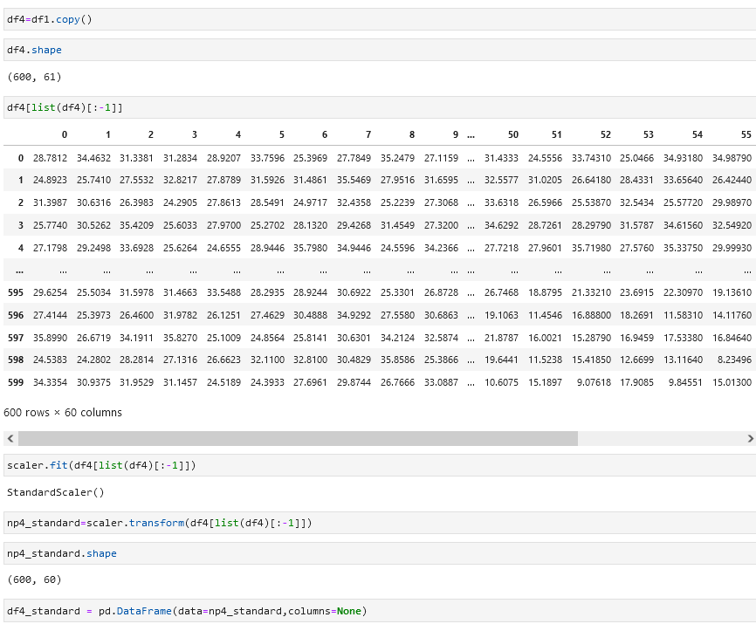
Standardization
Again, the data is standardized.

Slide 10
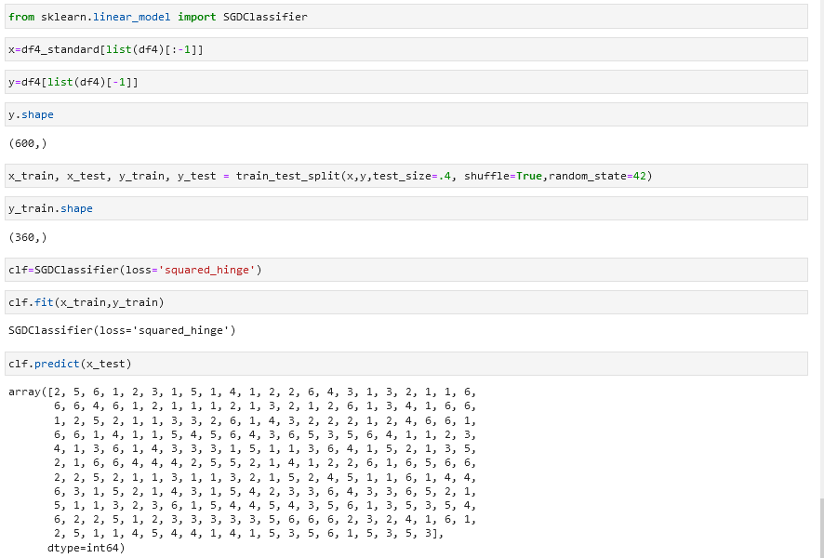
STG Score
Performs at 92 percent accuracy

Slide 11
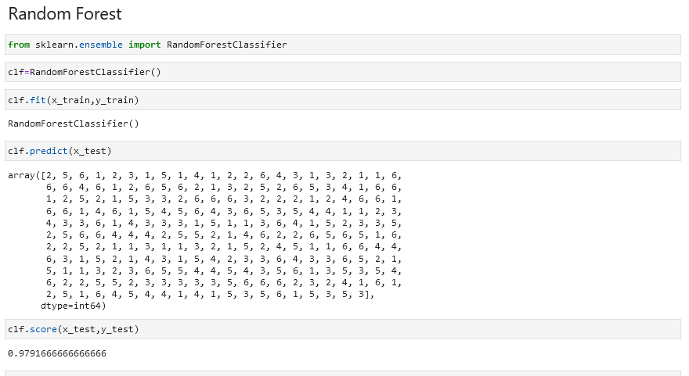
Random Forest
Performs at 98.9 percent accuracy

Slide 12
Final Conclusions
Support vector machines only had an accuracy of 62 percent, this may be due to the dimensionality reduction incorporated.
Stochastic Gradient Descent performed at 92 percent.
Random Forest performed at 97 percent. As an Ensemble method it normally outperforms many classifiers.
Cross-validation for the random forest classifier was successful at 95 to 97 percent.

Slide 13
Works Cited
Dua, D. and Graff, C. (2019). UCI Machine Learning Repository [http://archive.ics.uci.edu/ml]. Irvine, CA: University of California, School of Information and Computer Science.
Scikit-learn: Machine Learning in Python, Pedregosa et al., JMLR 12, pp. 2825-2830, 2011.
Garbade, Michael (2018), Understanding K-means Clustering in Machine Learning. https://towardsdatascience.com/understanding-k-means-clustering-in-machine-learning-6a6e67336aa1
Versloot, Christian 2020, https://www.machinecurve.com/index.php/2020/05/05/how-to-visualize-support-vectors-of-your-svm-classifier/

