Slide 1
Quality Control Charts By Dwan Kelley

Slide 2
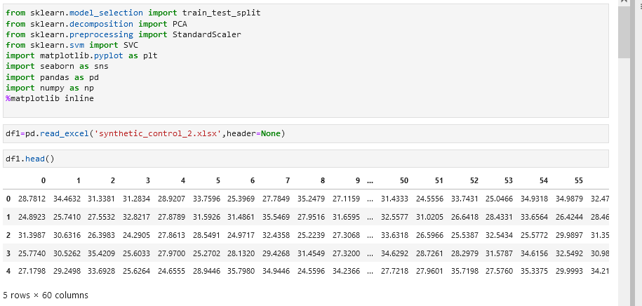

Slide 3
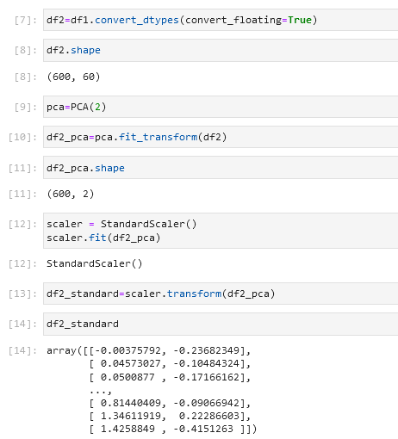
Normalizing the data and reducing dimensions

Slide 4
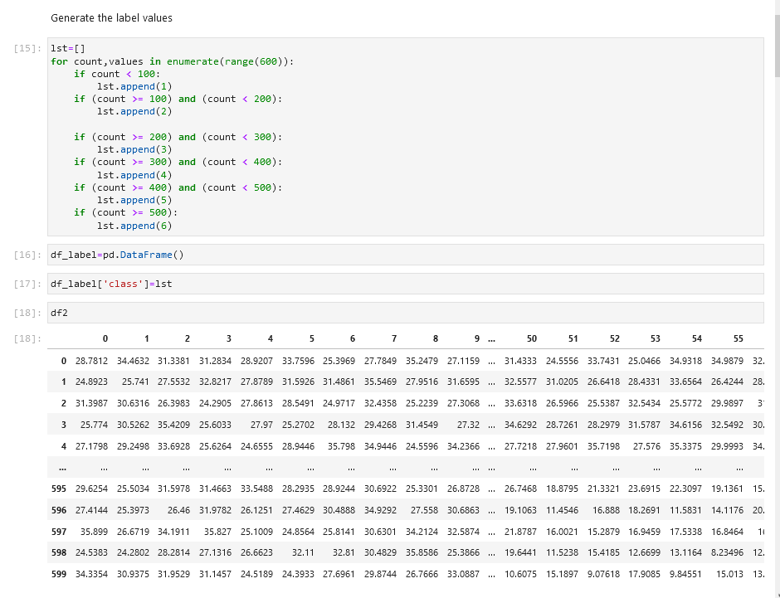
Generating labels

Slide 5
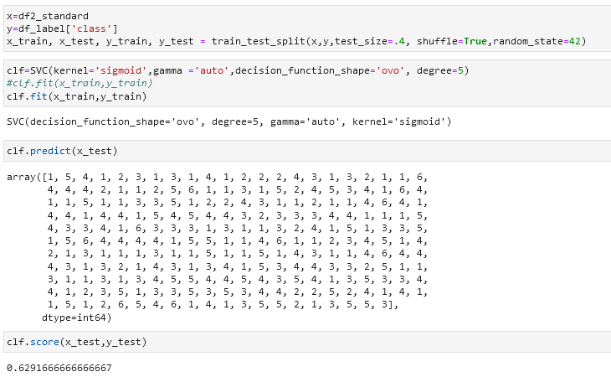

Slide 6
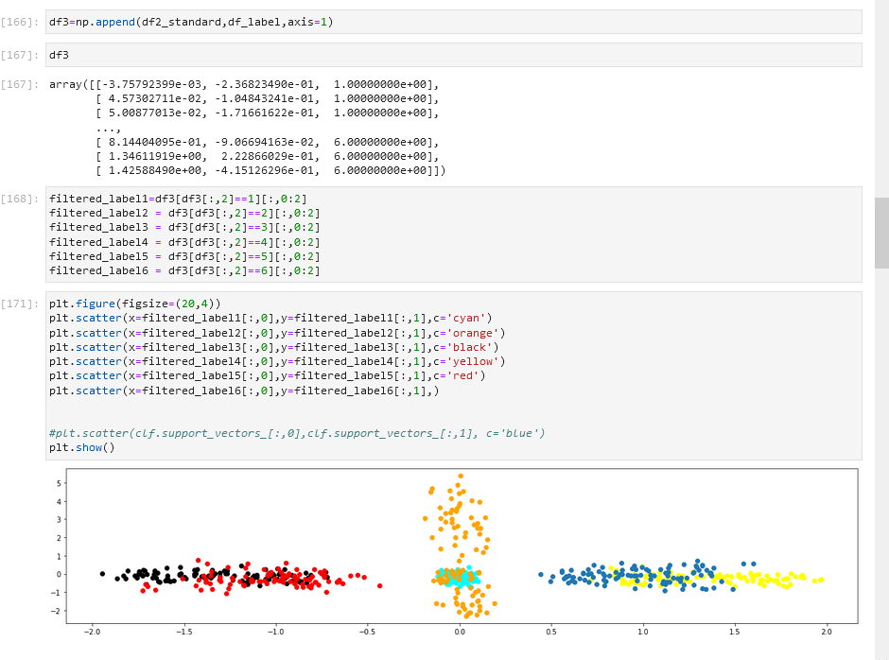
Graphing of clusters
Using reduced dimesionality to graph the clusters. There is confusion

Slide 7
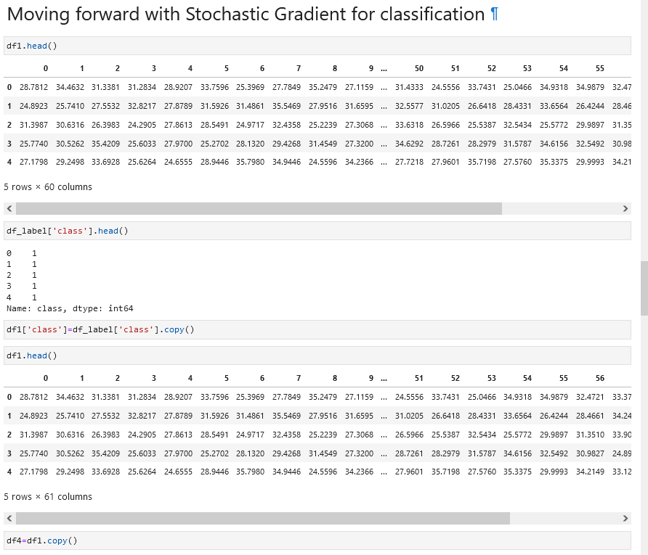

Slide 8
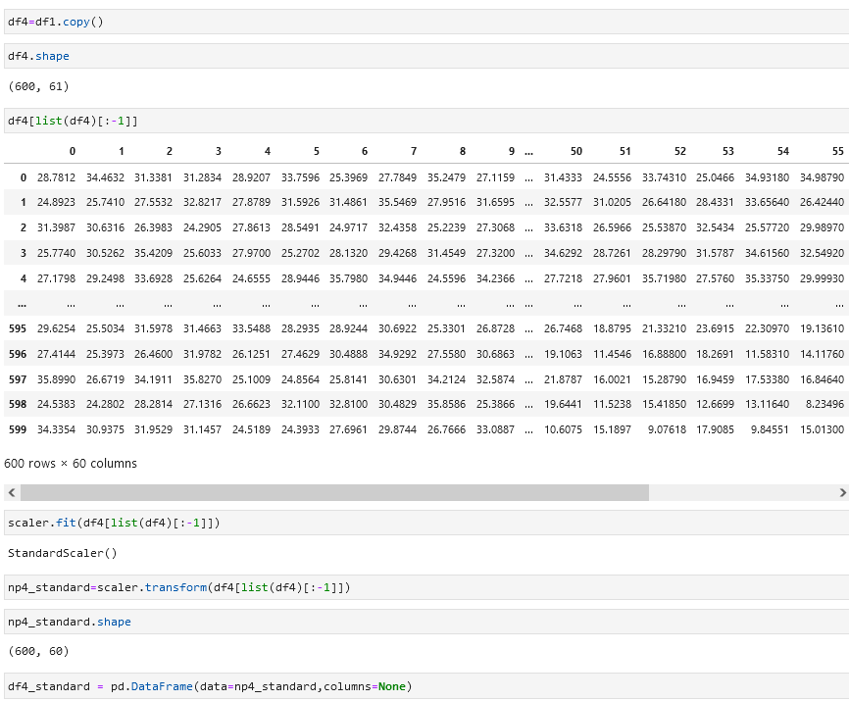

Slide 9
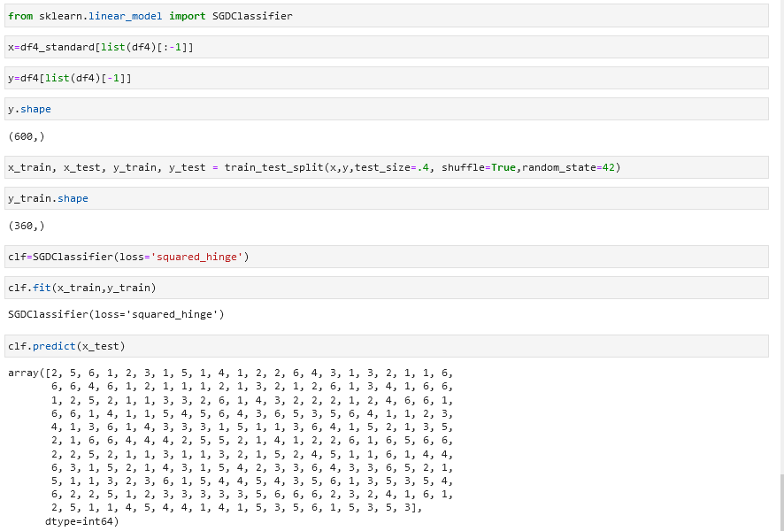

Slide 11
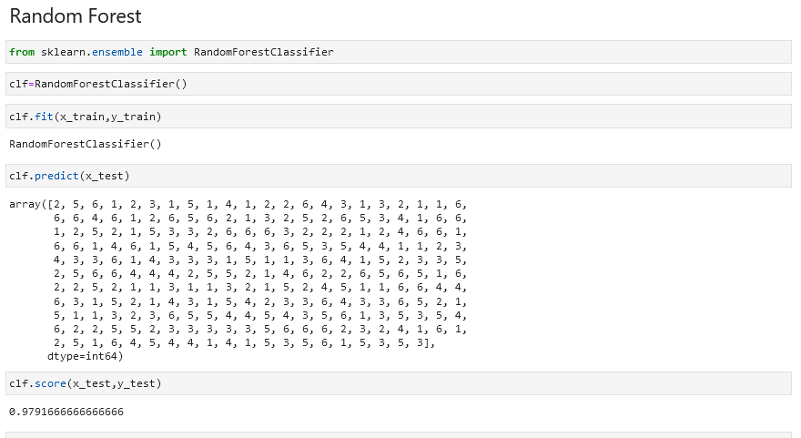
Random Forest

Slide 12
Works Cited
Dua, D. and Graff, C. (2019). UCI Machine Learning Repository [http://archive.ics.uci.edu/ml]. Irvine, CA: University of California, School of Information and Computer Science.
Scikit-learn: Machine Learning in Python, Pedregosa et al., JMLR 12, pp. 2825-2830, 2011.
Garbade, Michael (2018), Understanding K-means Clustering in Machine Learning. https://towardsdatascience.com/understanding-k-means-clustering-in-machine-learning-6a6e67336aa1
Versloot, Christian 2020, https://www.machinecurve.com/index.php/2020/05/05/how-to-visualize-support-vectors-of-your-svm-classifier/

