Slide 1
Reliability Engineering

Slide 2
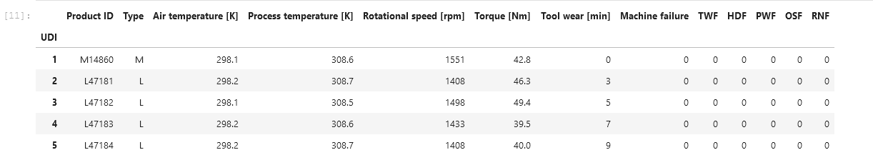
About This Dataset
3 types of machines (L,M, H)
3 features (Air temp, Torque, Tool Wear)
Tool wear is just a measure of time in minutes
There are 5 failure modes (TWF,HDF,PWF,OSF and RNF), machine failure occurs if any failure mode occurs.
The failure modes are Binary in nature. (0 for operational, and 1 for failure)

Slide 3
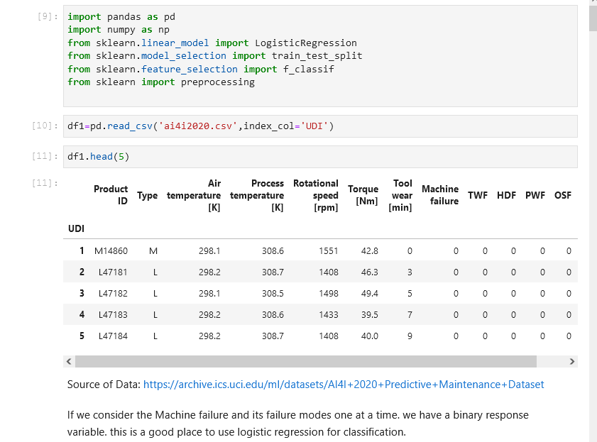
Modules and Data Insertion
Shows the source of the data and modules needed

Slide 4
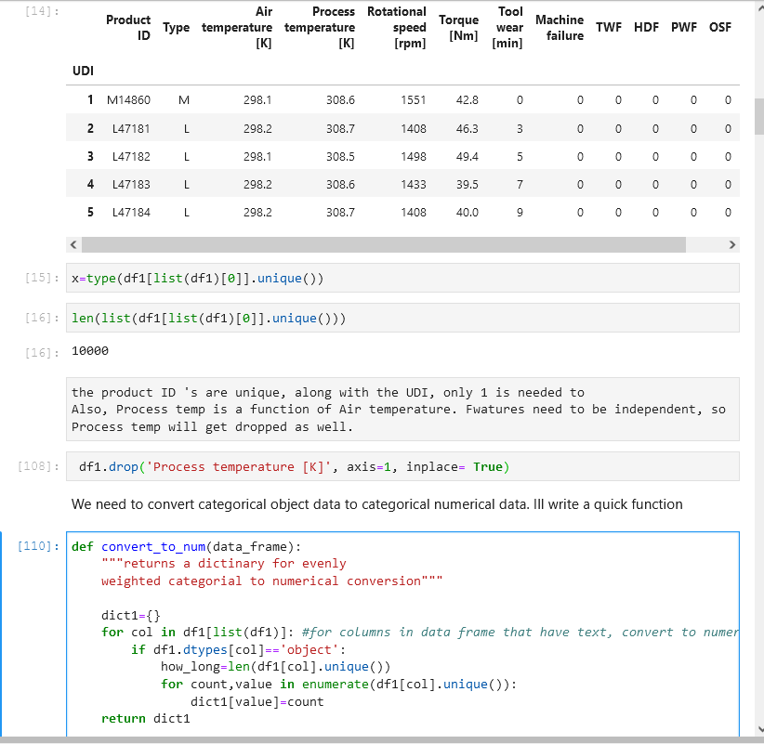
Data Cleanup
Here unneeded information is dropped, and a function is created to generate a dictionary.
This dictionary is used to define a replacement of strings to numerical values

Slide 5
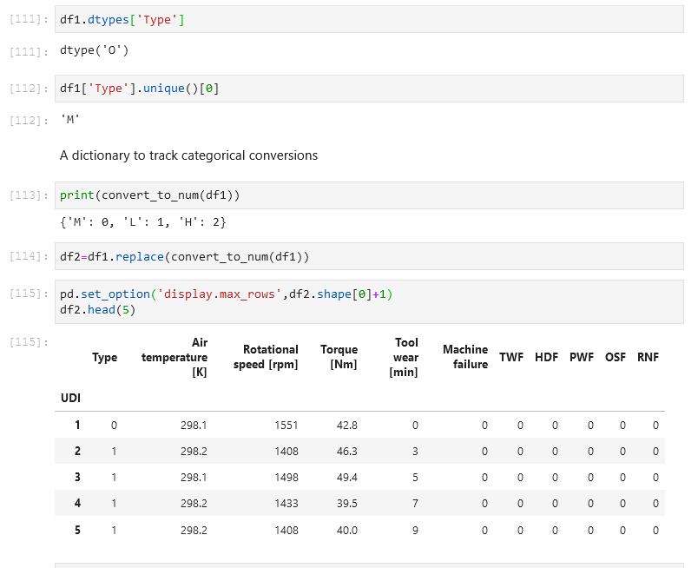
Minor Data Wrangling
The replace function is performed and the type of machine is now numerical. This allows the logistic function to operate.

Slide 6
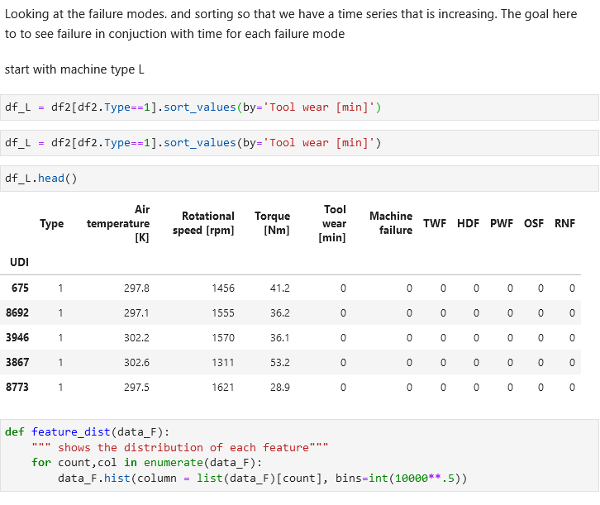
Organizing the Dataset
Working with Machine type L and increasing time

Slide 7
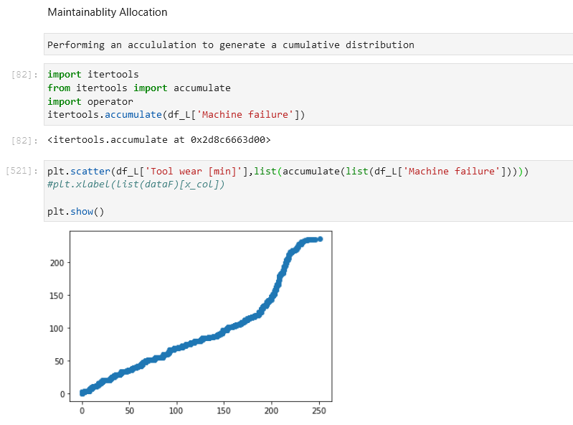
Cumulative Distribution Function for machine L
Time vs Machine Failures (ALL failure modes)

Slide 8
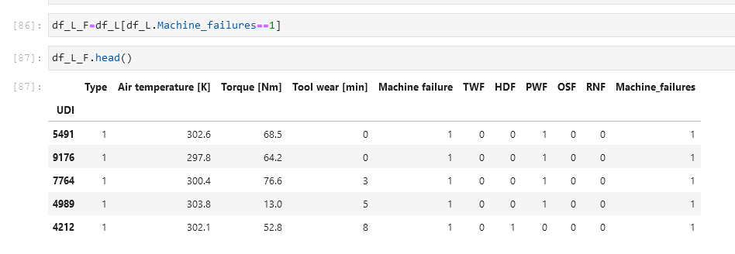
A Data Frame with strictly failures times.
Creation of df_L_F where we can focus on failures only.
This allows for a Time to Failure calculation later.

Slide 9
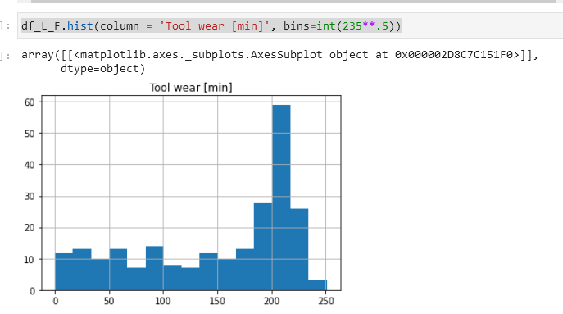
Tool wear distribution
Tool wear in relation to machine failures and the Probability Mass Function shown with a Histogram

Slide 10
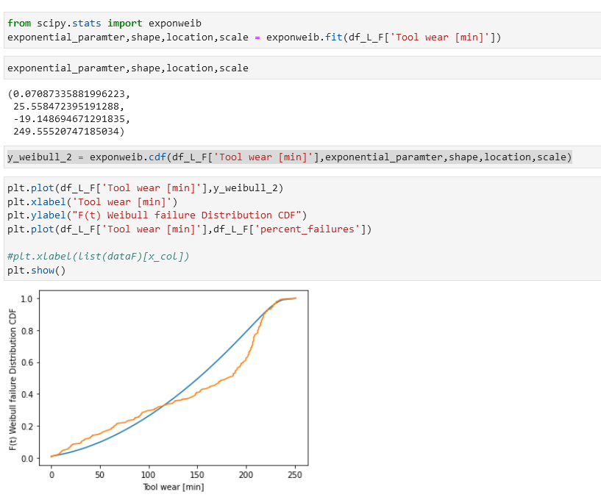
Fitting a Weibull Distribution
Used Scipy to estimate Weibull parameters,
Then used those parameters to create a graph.
As shown the Blue is Weibull and the Orange is Tool Wear vs the CDF (percent failures from the Data)

Slide 11
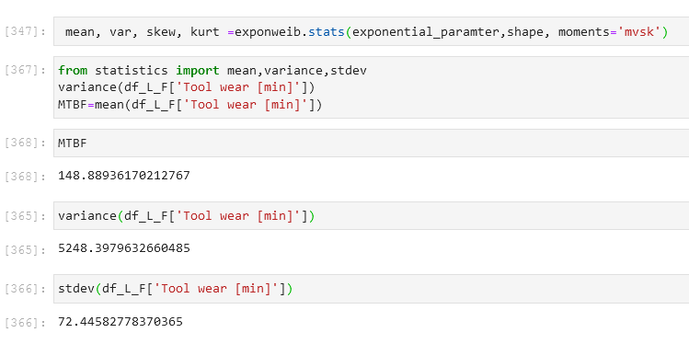
Reliability Stats
Using Scipy to get the statistics. Here MTBF is mean time between failures

Slide 12
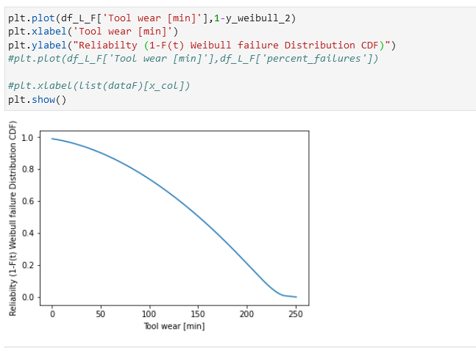
Reliability (survival function)
Torque has a relationship with the PWF failure mode. this will require further investigation in the future.
High torque has an effect on HDF failure and OSF
Tool wear has an effect on OSF and TWF
Air temp has a relationship with HDF failure

Slide 13
Conclusions:
There are

Slide 14
Works Cited
Klosterman, Stephan. Data Science Projects with Python, Packt Publishing, 2019, Online at O’Reilly Media.
Dua, D. and Graff, C. (2019). UCI Machine Learning Repository [http://archive.ics.uci.edu/ml]. Irvine, CA: University of California, School of Information and Computer Science.
Scikit-learn: Machine Learning in Python, Pedregosa et al., JMLR 12, pp. 2825-2830, 2011.
Dovivh, Robert and Wartman, Bill Certified Reliability Engineer Primer, Indiana Council of quality, 2014

