Slide 1
Reliability Engineering By D. Kelley

Slide 2
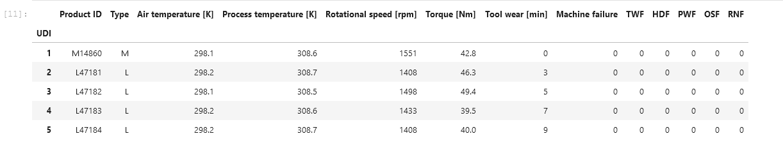
About This Dataset and the Assumptions made:
This Data Set is right censored. This has been neglected due to the lack of information required.
3 quality indices for on machine (L,M, H). Treated as 3 different machines
3 features (Air temp, Torque, Tool Wear). The others were removed due to lack of linear independence
Tool wear is just a measure of time in minutes
There are 5 failure modes :
TWF – Tool Wear Failure
HDF-Heat D Failure ,
PWF-Power W Failure,
OSF-Overstrain Failure and
RNF-Random Failure –Not considered here
Machine failure occurs if any failure mode occurs.
The failure modes are Binary in nature. (0 for operational, and 1 for failure)
The reliability calculations were performed

Slide 3
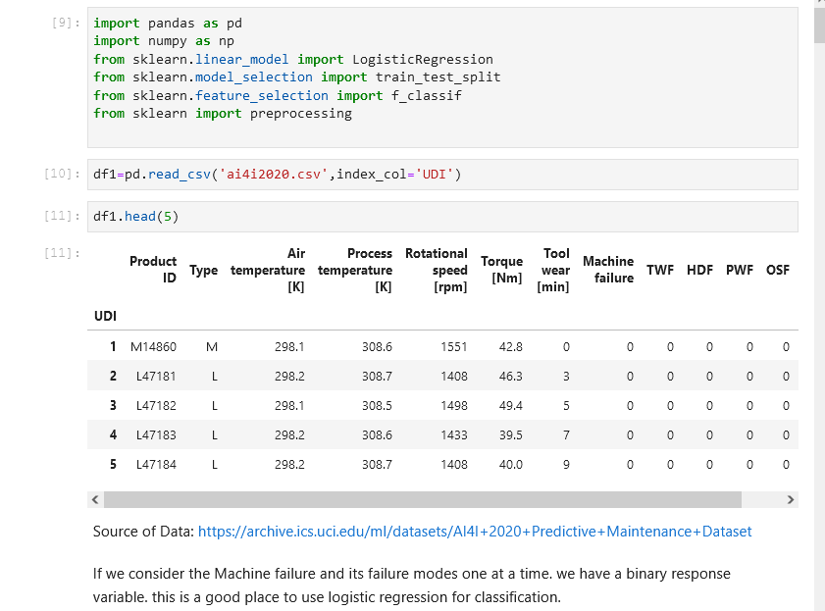
Modules and Data Insertion
Shows the source of the data and modules needed

Slide 4
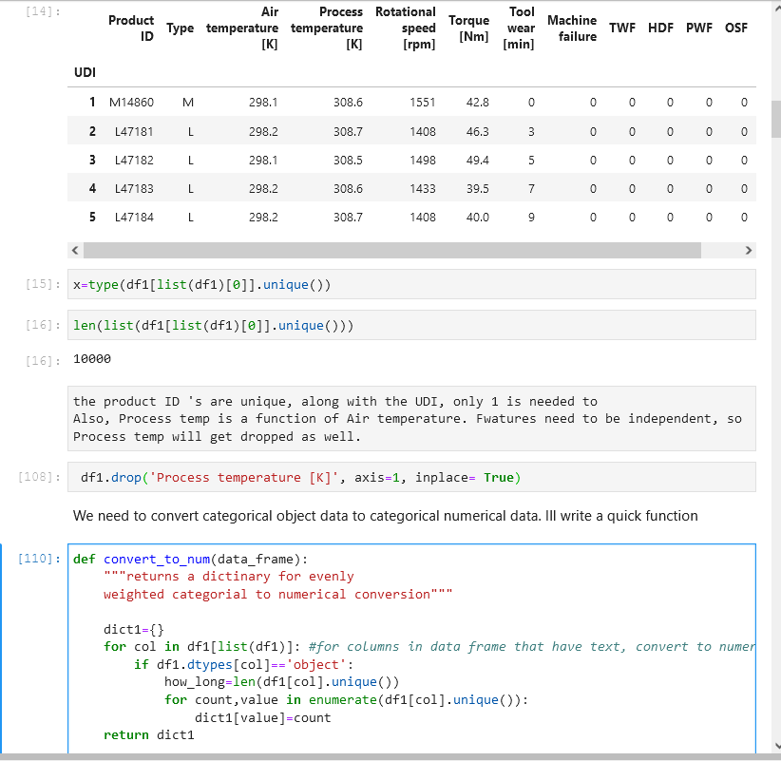
Data Cleanup
Here unneeded information is dropped, and a function is created to generate a dictionary.
This dictionary is used to define a replacement of strings to numerical values

Slide 5
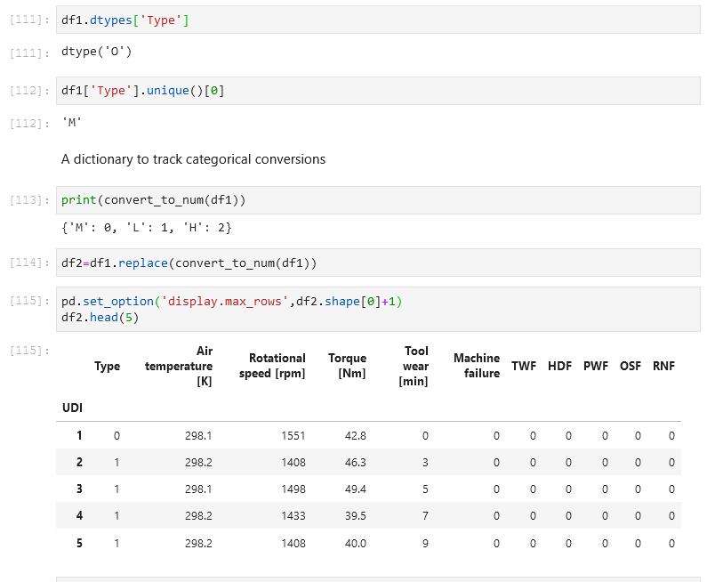
Minor Data Wrangling
The replace function is performed and the type of machine is now numerical. This allows the logistic function to operate.

Slide 6
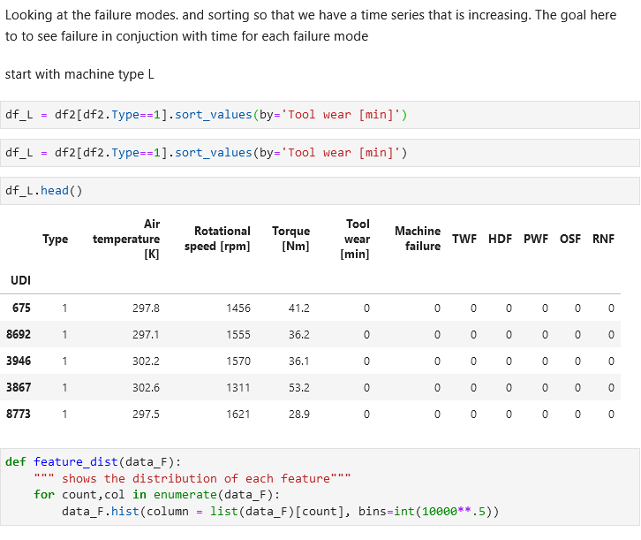
Organizing the Dataset
Working with Machine type L and increasing time

Slide 7
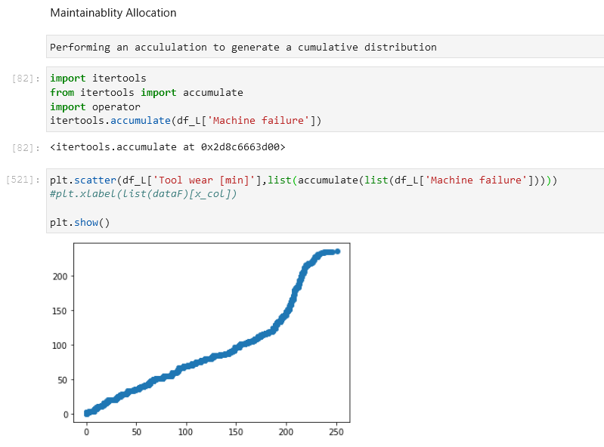
Cumulative Distribution Function for machine L
Time vs Machine Failures (ALL failure modes)

Slide 8
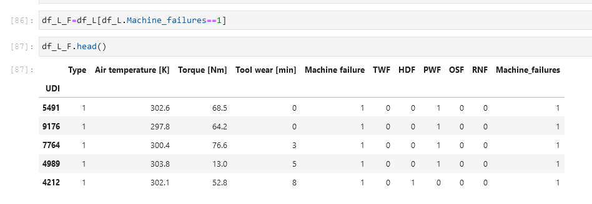
A Data Frame with strictly failures times.
Creation of df_L_F where we can focus on failures only.
This allows for a Time to Failure calculation later.

Slide 9
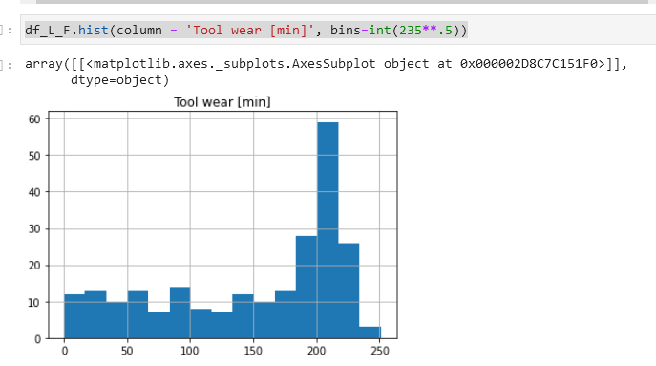
Tool wear distribution
Tool wear in relation to machine failures and the Probability Mass Function shown with a Histogram

Slide 10
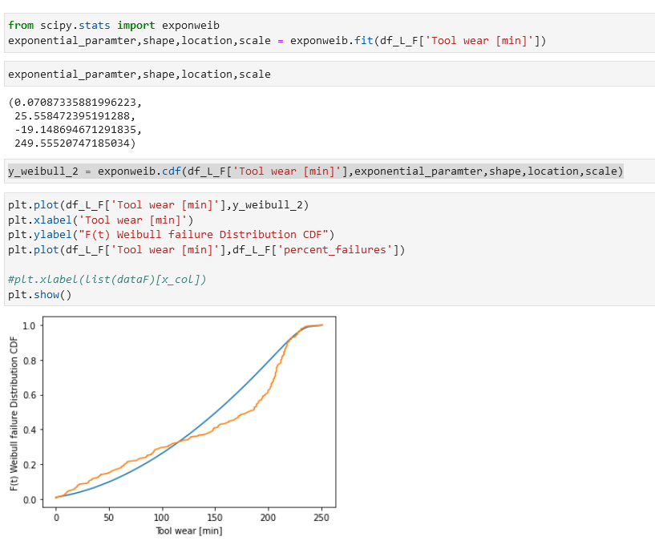
Fitting a Weibull Distribution
Used SciPy to estimate Weibull parameters,
Then used those parameters to create a graph.
As shown the Blue is Weibull and the Orange is Tool Wear vs the CDF (percent failures from the Data)

Slide 11
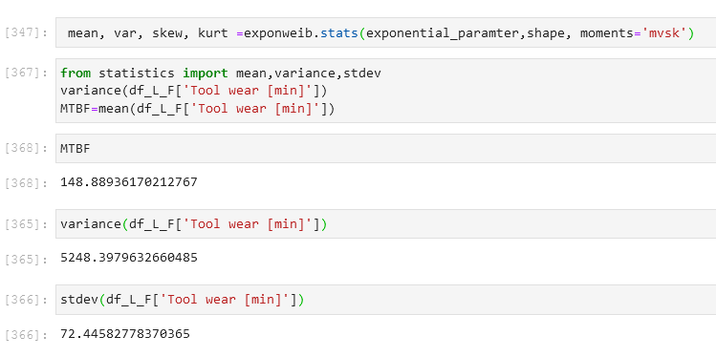
Reliability Stats
Using Scipy to get the statistics. Here MTBF is mean time between failures

Slide 12
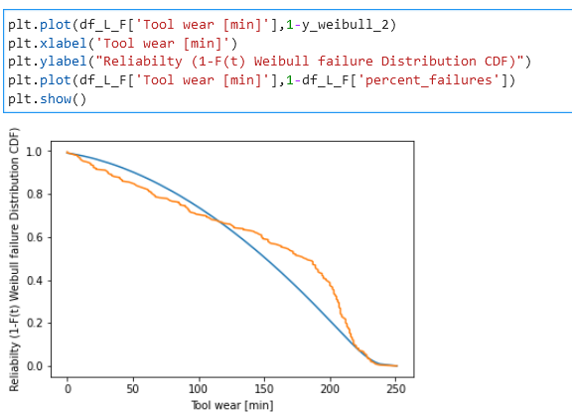
Reliability (survival function)
Torque has a relationship with the PWF failure mode. this will require further investigation in the future.
High torque has an effect on HDF failure and OSF
Tool wear has an effect on OSF and TWF
High air temp can cause an HDF failure

Slide 13
Final Conclusions
The reliability seems to be 0 near the 255-minute mark.
The biggest indicator of failure is Time.
To improve performance design needs to be adjusted to lengthen time
Survivability can be improved by
changing design parameters such that the temperature does not go as high. A way to do this could be improved cooling.
Limitations on Torque could be improved as to reduce the chance of Overstrain.
Perform more experiments and allow them to run until they fail. This removes censored data and possibly shows the reliability to be greater than the current calculations.
These changes could allow for longer tool wear out periods and better warranty for the machines

Slide 14
Works Cited
Klosterman, Stephan. Data Science Projects with Python, Packt Publishing, 2019, Online at O’Reilly Media.
Dua, D. and Graff, C. (2019). UCI Machine Learning Repository [http://archive.ics.uci.edu/ml]. Irvine, CA: University of California, School of Information and Computer Science.
Scikit-learn: Machine Learning in Python, Pedregosa et al., JMLR 12, pp. 2825-2830, 2011.
Dovivh, Robert and Wartman, Bill Certified Reliability Engineer Primer, Indiana Council of quality, 2014
Pauli Virtanen, Ralf Gommers, Travis E. Oliphant, Matt Haberland, Tyler Reddy, David Cournapeau, Evgeni Burovski, Pearu Peterson, Warren Weckesser, Jonathan Bright, Stéfan J. van der Walt, Matthew Brett, Joshua Wilson, K. Jarrod Millman, Nikolay Mayorov, Andrew R. J. Nelson, Eric Jones, Robert Kern, Eric Larson, CJ Carey, İlhan Polat, Yu Feng, Eric W. Moore, Jake VanderPlas, Denis Laxalde, Josef Perktold, Robert Cimrman, Ian Henriksen, E.A. Quintero, Charles R Harris, Anne M. Archibald, Antônio H. Ribeiro, Fabian Pedregosa, Paul van Mulbregt, and SciPy 1.0 Contributors. (2020) SciPy 1.0: Fundamental Algorithms for Scientific Computing in Python. Nature Methods, 17(3), 261-272.

Slide 15
Works Cited Continued
US government, NIST Statistical handbook https://www.itl.nist.gov/div898/handbook/apr/section1/apr162.htm , https://www.itl.nist.gov/div898/handbook/apr/section4/apr47.htm
Zaiontz, C. (2020) Real Statistics Using Excel. www.real-statistics.com , 11/27/2021

