Slide 1
Demonstration
Dwan Kelley Candidate

Slide 2
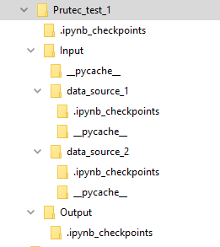
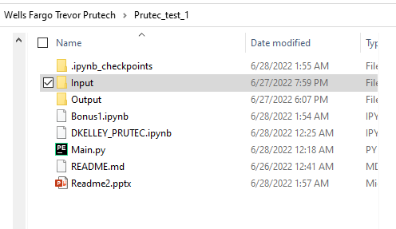
The main function runs the basic program. It calls functions from other folders
File structure

Slide 3
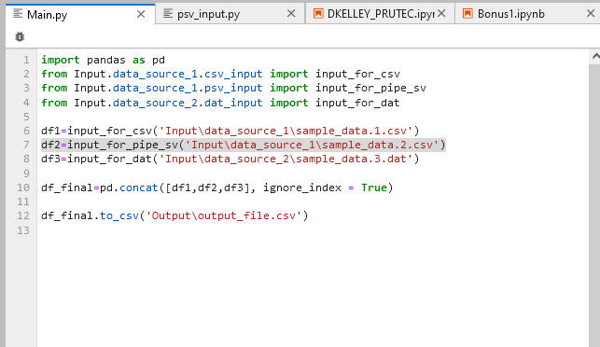

Slide 4
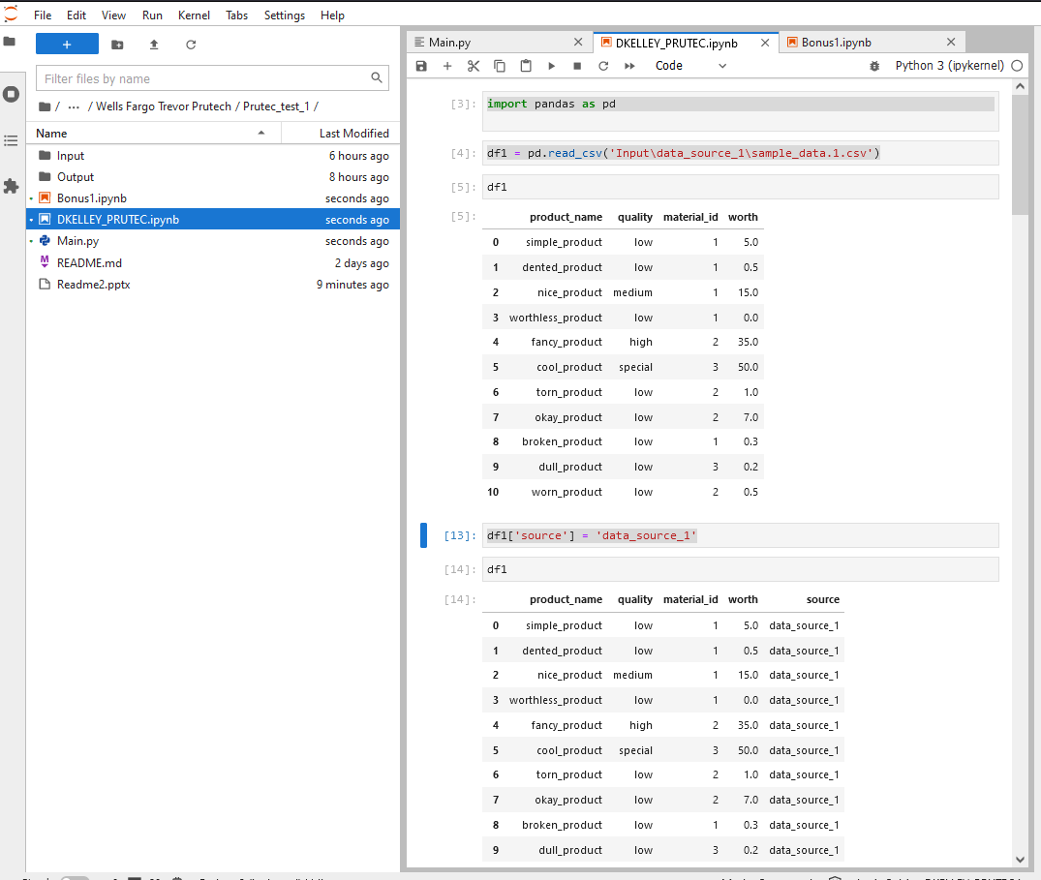
The DKELLEY_PRUTEC file is more of a worksheet. That’s better as a reference for the programmer. IT shows my initial thought process before refinement.

Slide 5
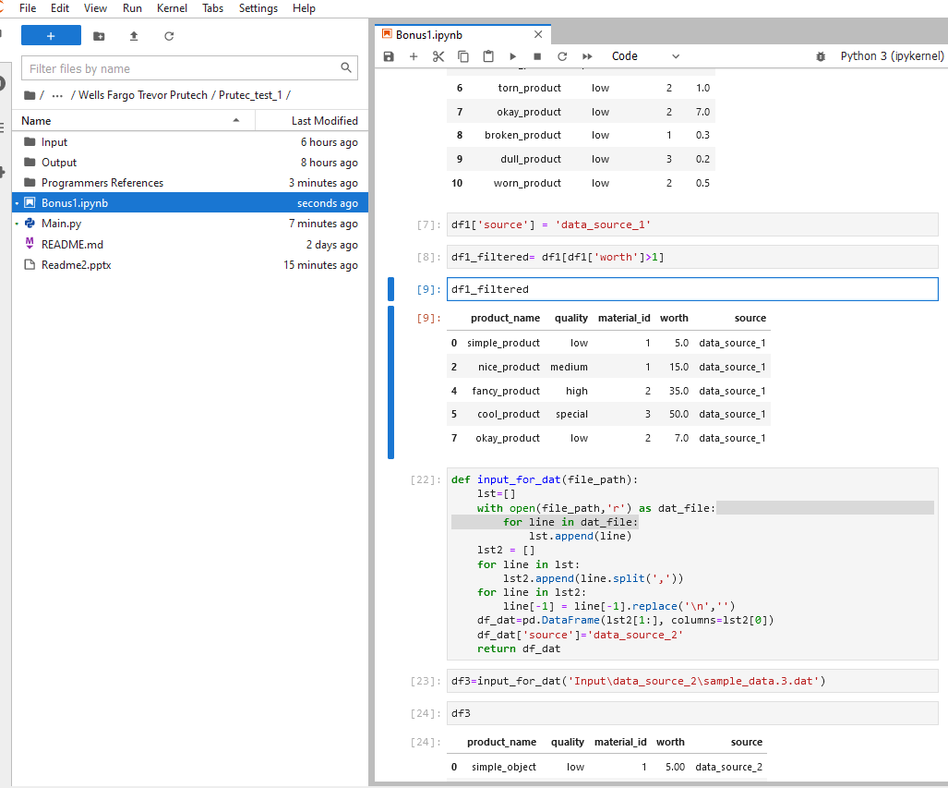
Bous 1 has its own file.

Slide 6
Thank You

