Slide 1

Lending loan case study
Dwaraganathan DK
SUGANYA T

Slide 2
The Problem
What is the problem?
Lending loan company wants to understand the driving factors behind loan default, i.e. the variables which are strong indicators of defaulters.
Who has this problem?
Lending loan companies
Why should this problem be solved?
To learn which consumers can be risky
How will I know this problem has been solved?
Loans could be provided to non-risky applicants

Slide 3

Problem Statement
In this case study, we will use EDA to understand how consumer attributes and loan attributes influence the tendency of default. The aim is to identify patterns which indicate if a person is likely to default, which may be used for taking actions such as denying the loan, reducing the amount of loan, lending (to risky applicants) at a higher interest rate, etc.
1. Does a higher interest rate or loan amount influence the defaulters
2. What factors affect the defaulters in nature?
3. Which consumers become defaulters?

Slide 4
Workable Solutions
Solution #1
Using the 3 factors Loan Characteristics, Demographic Variables and Behavioral Variables, we can analyze using EDA to find out the driving factors of defaulters
Solution #2
Using Consumer credit risk which can be measured by the five Cs: credit history, capacity to repay, capital, the loan's conditions, and associated collateral, we can analyze using EDA to find out the driving factors of defaulters
Solution #3
Using Fico score or Cibil score, we can analyze using EDA to find out the driving factors of defaulters

Slide 5
Approach
The EDA steps followed for this case study are
Data Initialization Overview (Distribution of Loans)
Data Cleaning (Missing Values, Standardize Data, Outlier Treatment, Fixing Rows and Columns, Fix Invalid Values, Filtering data)
Metrics Derivation (Month and Year)
Univariate Analysis (Categorical/Continuous Features)
Bivariate Analysis (Joint Plot, Box Plots, Scatter Plots, Bar Plots)
Multivariate Analysis (Correlation, Pair Plots, Line Chart, Stacked Bar)

Slide 6
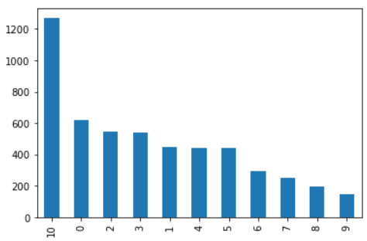
Solution
Based on the Employment length, consumers who has more than 10 years of experience are tend to become the defaulters

Slide 7
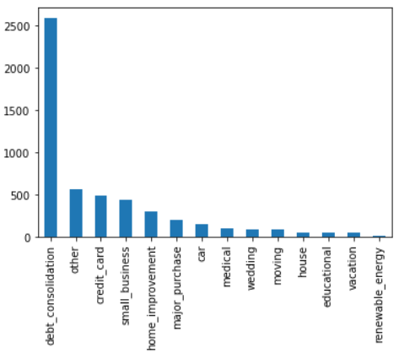
Solution
Based on the purpose of the loan, consumers who bought the loan for debt_consolidation are tend to become defaulters. These consumers are having debt loan already and they tend to become defaulters

Slide 8
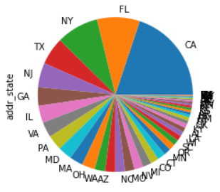
Solution
Consumers who belongs to state CA, FL, NY, TX and NJ are major defaulters. So while lending loan, to the consumers from these states we need to verify

Slide 9
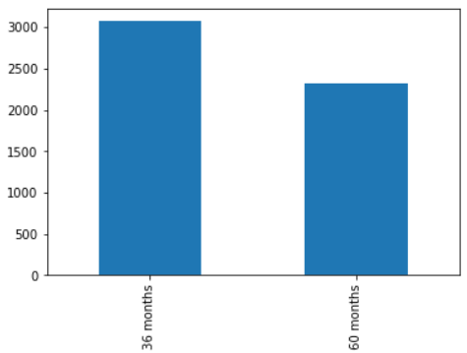
Solution
Consumers who go for lesser term tend to be defaulters

Slide 10
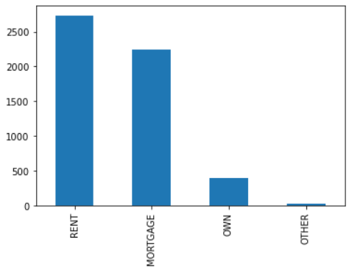
Solution
Consumers who are paying rent or who have mortgage loan, tend to be defaulters

Slide 11
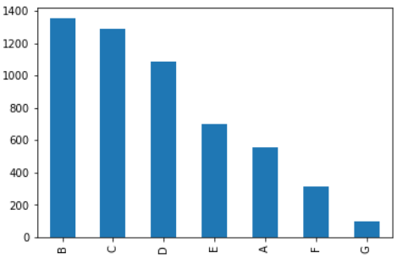
Solution
Consumers who are in lower grade between B to D are tend to become defaulters

Slide 12
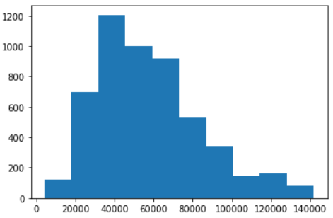
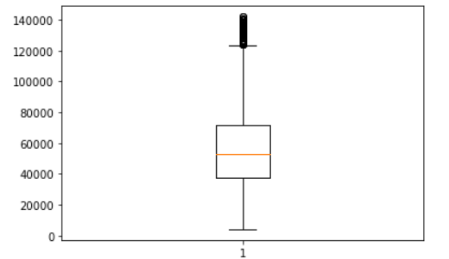
Solution
Consumers whose annual income in the range between 40,000-70,000 are defaulters

Slide 13
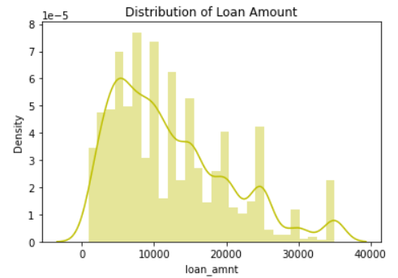
Solution
Using loan amount field, we could see that defaulters are more when the loan amount is in the lower range

Slide 14
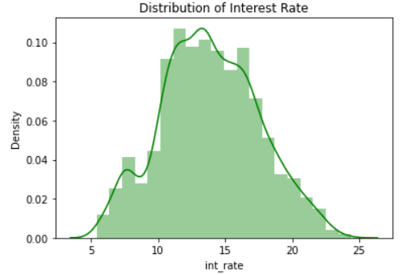
Solution
With distribution plot, we see that interest rate in between 12-17% density is more, and the consumers tend to be defaulters.

Slide 15
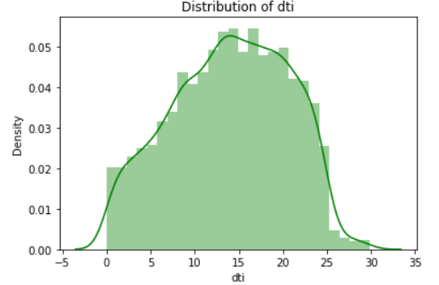
Solution
With distribution plot for the dti field we could see that defaulters are more in the range of ratio 10-22.5%

Slide 16
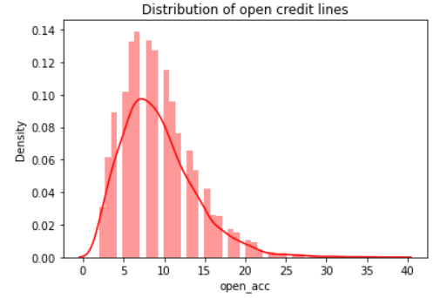
Solution
With distribution plot for the open credit line, we could see more defaulters are when they have lower range of credit line.

Slide 17
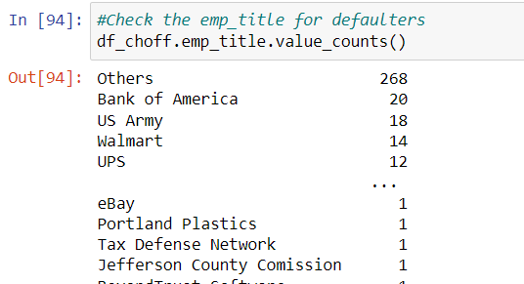
Solution
Using the details below, we see that consumers from Bank of America, US Army, Walmart, UPS are in the defaulter list.

Slide 18
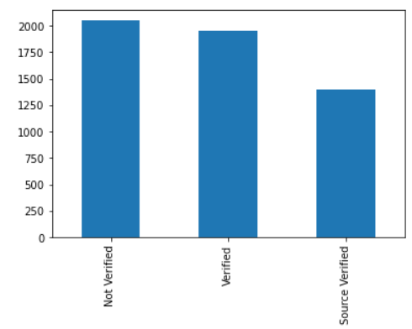
Solution
From the bar chart we can see that equal number of defaulters are in both cases "Not Verified" and "Verified". So, this factor doesn't tend for the defaulter.

Slide 19
CONCLUSION
The consumer who has been working for over 10 years is more likely to default, based on his or her Employment length.
The purpose of the loan determines how likely consumers are to default. Consumers who consolidate their debts are more likely to default. Since these consumers already have debt, they tend to default.
Majority of defaulters are from California, Florida, New York, Texas and New Jersey. When lending money to consumers from these states, we must verify their credit status.
Customers opting for shorter terms tend to default more often.
Paying rent or having a mortgage loan tends to put consumers at risk of default.
In lower grades between B and D, consumers are more likely to default.
Consumers whose annual income is in the range of 40,000-70,000 are at a greater risk of default
As we can see from the loan amount, default rates are higher when loan amounts are lower.
We can see that interest rates between 12-17% tend to be more dense, and the consumers tend to default.
In the distribution plot for the dti field, we see defaulters are more in the range of 10-22.5%
We can see from the distribution plot for the open credit line that defaulters are more likely to occur when the credit line is lower.
Consumers from Bank of America, US Army, Walmart, and UPS are listed as defaulters.
We can see that the percentage of defaulters is equal in both cases. As a result, this factor does not favor the defaulter.

