Slide 1
Literature Review
Stochastic Unit Commitment

Slide 2
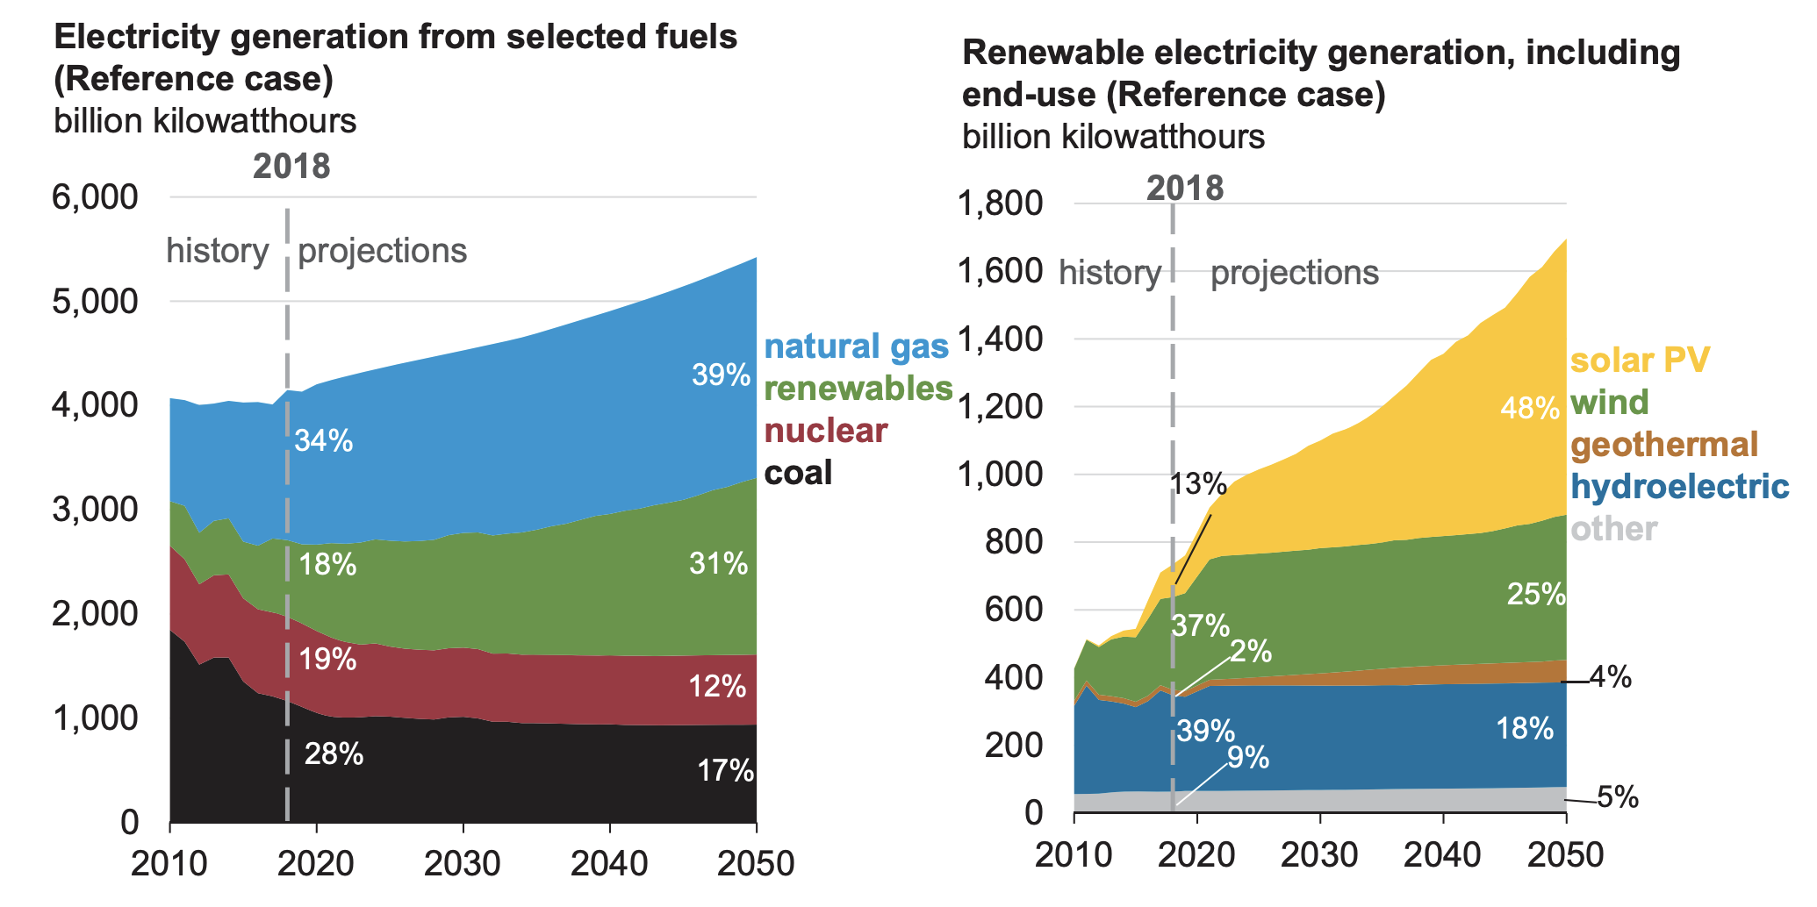
Electricity Generation
Source: EIA Annual Energy Outlook 2019
Notes:
﻿recent challenges caused by the increasing penetration of renewable generation have drawn a tremendous amount of interest worldwide in improving UC models and algorithms. ﻿Due to the significant uncertainty and variability from renewable generation, high levels of renewable generation increase the flexibility requirements of the system in response to fast and large variations in load and renewable energy output. Since many conventional generators such as coal-fired and nuclear units have limited flexibilities (e.g., ramping and minimum on/off times), novel power system operational methods are required to schedule the generating units more efficiently in order to accommodate the large fluctuations in renewable generation outputs while main- taining power system reliability.

Slide 3
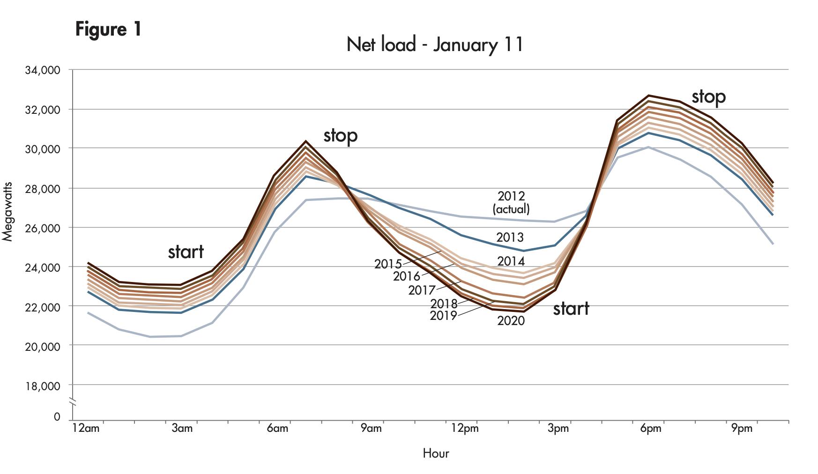
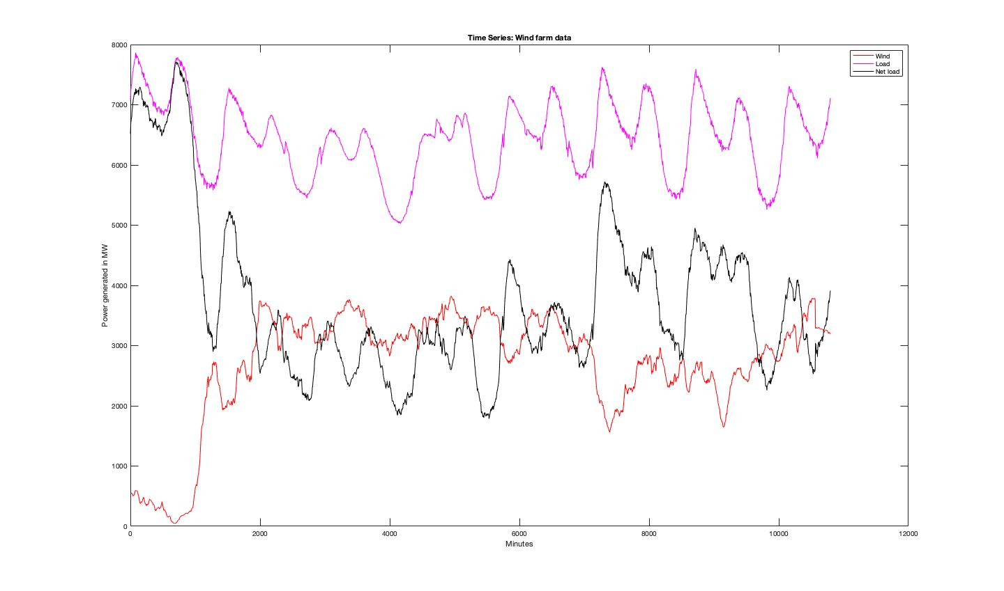
Electricity Generation
Solar power¹
Wind power²
¹ http://www.caiso.com
² Pecan street data
Notes:
These graphs are just to show you the ramping capabilities of solar and wind power.

Slide 4
Uncertainties in Electricity Generation
High Renewable generation
Failures of power system components
Deregulated energy markets
Demand variations
Notes:
In the past demand variations represent load forecasting but now it means load forecasting and demand response programs.

Slide 5
How to Improve Operation and Planning?
﻿ Balancing area consolidation
Demand side management
Use of Storage devices such as hydro pump, batteries etc.
Stochastic methods
Q. P. Zheng, J. Wang and A. L. Liu, "Stochastic Optimization for Unit Commitment—A Review," in IEEE Transactions on Power Systems, vol. 30, no. 4, pp. 1913-1924, July 2015.
Notes:
﻿Although stochastic methods including stochastic optimization (SO) have advantages in accounting for uncertainty and risks in many other fields [7], questions and barriers for their application to UC remain. System.

Slide 6
Outline
What is stochastic unit commitment?
Existing techniques in SO based UC
Future work

Slide 7
What is Stochastic UC?
﻿ What is Stochastic in broad sense?
What is Stochastic Unit commitment?
Notes:
Stochastic is random or uncertain. Stochastic does not mean varying quantity. Eg: The pattern of the sun is not stochastic, even though it varies but the solar radiance is stochastic since it depends on the cloud cover.
The idea is to make decisions to schedule generators tomorrow and then you observe the wind/solar power for all day tomorrow and then decide how much power each generator should generate after seeing the information about wind/solar power

Slide 8
Objective of Stochastic UC
Minimize the operating costs of energy production in the day ahead market in the presence of high renewable penetration (uncertainty)
Notes:
The on/off status of conventional generators will be decided by the hourly forecast of load and wind power.

Slide 9
Existing Methods in SO-UC
Uncertainty modeling
Problem formulations
Solution algorithms
Notes:
Steps involved in solving SOUC. Uncertainty modeling depends on problem formulation. These 3 are dependent.

Slide 10
Uncertainty Modeling
Scenarios
Uncertainty sets
Probabilistic constraints
Notes:
﻿Depending on the specific SO techniques used, the representation and modeling of uncertainty can be quite different. Uncertainty can be modelled by one of the above three methods.

Slide 11
Scenario Generation
What is a scenario?﻿
Parallel scenarios in two-stage SO problem
Decision trees in multi-stage SO problem
Notes:
Most commonly used technique. Solar power generation depend on cloud cover and temperature which are stochastic in nature. What is a scenario? Each scenario represents a possible realization of the underlying uncertain factors. (Eg: temperature, cloud cover)

Slide 12
How to generate scenarios?
Monte Carlo simulation – based on PDF learned from historical data (Two Stage SO)
Scenario tree composed of random paths
Notes:
Usually forecasting errors are modelled as normal distribution but wind speed can be directly modelled using Weibull distribution or normal distribution. Discrete probability functions are also used to represent wind power output

Slide 13
How many scenarios?
As number of scenarios increases, quality of solution increases as you get the holistic picture about the future. This also increases the computation power.
Scenarios beyond a threshold can lead to only marginal improvements in solution.
What is the trade-off?
Scenarios reduction techniques
Notes:
Trade off between computational requirements and number of scenarios. Scenario reduction techniques based on probabilistic metrics to bundle similar scenarios. ﻿
The goal is to reduce the number of scenarios without sacrificing their accuracy to a large extent.

Slide 14
Probabilistic Forecasting
Robust optimization - overconservative
Range/band needs to be defined to represent upper and lower bounds of the uncertainty
Quantiles represent probabilistic levels of forecasting
Notes:
Range or band means, wind speed range and solar irradiance range. ﻿Probabilistic forecasting is a natural fit in such problems, because it can predict the level of a forecast output at a certain probability.
probabilistic forecasts assign a probability to each of a number of different outcomes

Slide 15
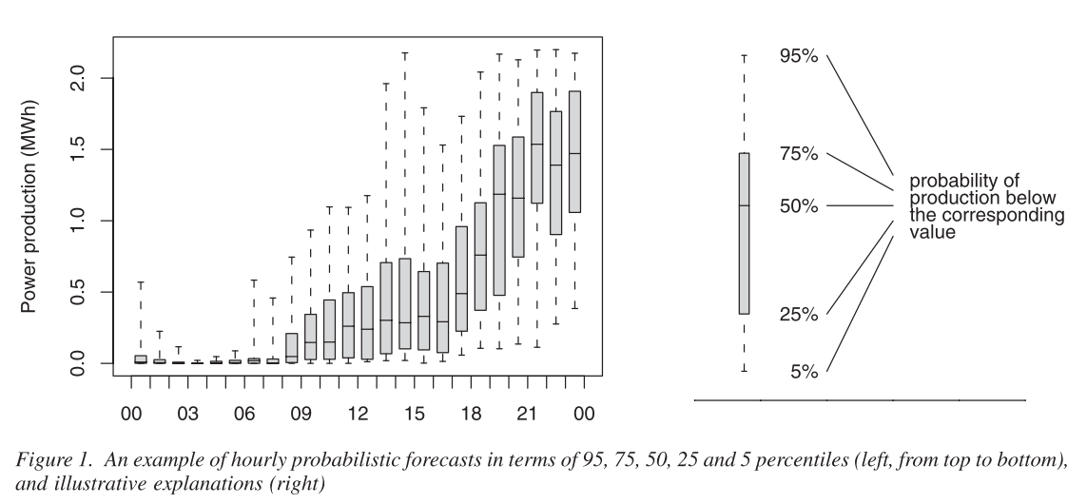
Probabilistic Forecast based on Quantile
Bremnes, J. B. (2004). Probabilistic wind power forecasts using local quantile regression. Wind Energy, 7(1), 47–54.
Notes:
﻿Although stochastic methods including stochastic optimization (SO) have advantages in accounting for uncertainty and risks in many other fields [7], questions and barriers for their application to UC remain. System.

Slide 16
Uncertainty Sets
Box intervals
It is represented using expected value, variance and quantiles of random variable
Notes:
﻿Although stochastic methods including stochastic optimization (SO) have advantages in accounting for uncertainty and risks in many other fields [7], questions and barriers for their application to UC remain. System.

Slide 17
Problem formulation
Stochastic programming
Robust optimization
Stochastic dynamic programming
Notes:
﻿Although stochastic methods including stochastic optimization (SO) have advantages in accounting for uncertainty and risks in many other fields [7], questions and barriers for their application to UC remain. System.

Slide 18
Stochastic Programming
Scenario based uncertainty representation in UC
Two Stage SO technique (Monte Carlo simulation)
Multistage SO technique
Notes:
﻿Although stochastic methods including stochastic optimization (SO) have advantages in accounting for uncertainty and risks in many other fields [7], questions and barriers for their application to UC remain. System.

Slide 19
Deterministic vs Stochastic Solution
Total expected cost
Expected value of perfect information
EVPI= Perfect forecast solution – stochastic solution
Value of stochastic solution
Notes:
﻿Although stochastic methods including stochastic optimization (SO) have advantages in accounting for uncertainty and risks in many other fields [7], questions and barriers for their application to UC remain. System.

Slide 20
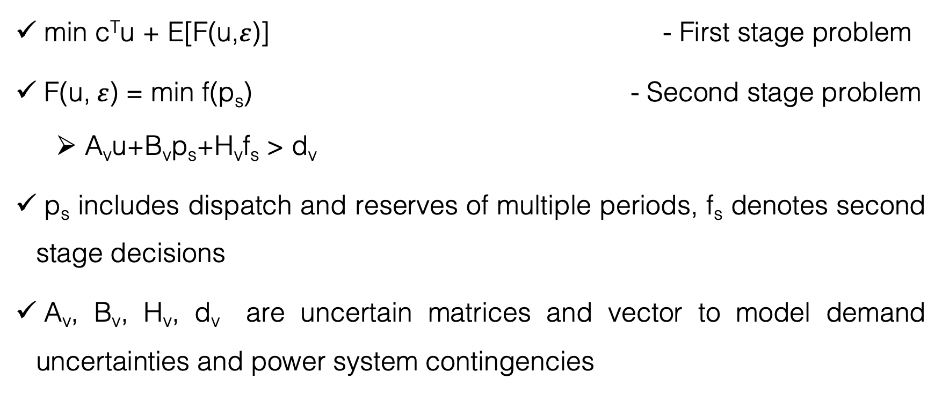
Two Stage SO Technique
min c^{T}u + E[F(u,$ε$)] - First stage problem
F(u, $ε$) = min f(p_{s}) - Second stage problem
A_{v}u+B_{v}p_{s}+H_{v}f_{s} > d_{v}
p_{s} includes dispatch and reserves of multiple periods, f_{s} denotes second stage decisions
A_{v}, B_{v}, H_{v}, d_{v} are uncertain matrices and vector to model demand uncertainties and power system contingencies
Q. P. Zheng, J. Wang and A. L. Liu, "Stochastic Optimization for Unit Commitment—A Review," in IEEE Transactions on Power Systems, vol. 30, no. 4, pp. 1913-1924, July 2015.
Notes:
﻿f(.) can be quadratic or piece wise linear. Second stage decisions are hydro, battery storage constraints etc. where the capacity is minimum.

Slide 21
Two Stage SO Technique
Benders decomposition – second stage linear program
Integer L-shaped method, disjunctive cuts
Cutting plane method
Lagrangian relaxation
Bundle method
Branch and bound based method
Q. P. Zheng, J. Wang and A. L. Liu, "Stochastic Optimization for Unit Commitment—A Review," in IEEE Transactions on Power Systems, vol. 30, no. 4, pp. 1913-1924, July 2015.
Notes:
﻿Although stochastic methods including stochastic optimization (SO) have advantages in accounting for uncertainty and risks in many other fields [7], questions and barriers for their application to UC remain. System.

Slide 22
Barriers
﻿ Complexity and transparency
High computational requirements
Q. P. Zheng, J. Wang and A. L. Liu, "Stochastic Optimization for Unit Commitment—A Review," in IEEE Transactions on Power Systems, vol. 30, no. 4, pp. 1913-1924, July 2015.
Notes:
﻿Although stochastic methods including stochastic optimization (SO) have advantages in accounting for uncertainty and risks in many other fields [7], questions and barriers for their application to UC remain. System.

Slide 23
Robust Optimization
No need of PDF’s but requires uncertainty sets.
Minimizes the total worst case cost.
Computationally, it can avoid large number of scenarios.
Over-conservative solution.
Notes:
Over- conservative means more cautious solution. ﻿First, it may be difficult to identify an accurate probability distribution of the uncertainty.

Slide 24
Robust Optimization
Computationally, it can avoid large number of scenarios.
By choosing uncertainty set appropriately, we can get less conservative solution.
Notes:
﻿Although stochastic methods including stochastic optimization (SO) have advantages in accounting for uncertainty and risks in many other fields [7], questions and barriers for their application to UC remain. System.

Slide 25
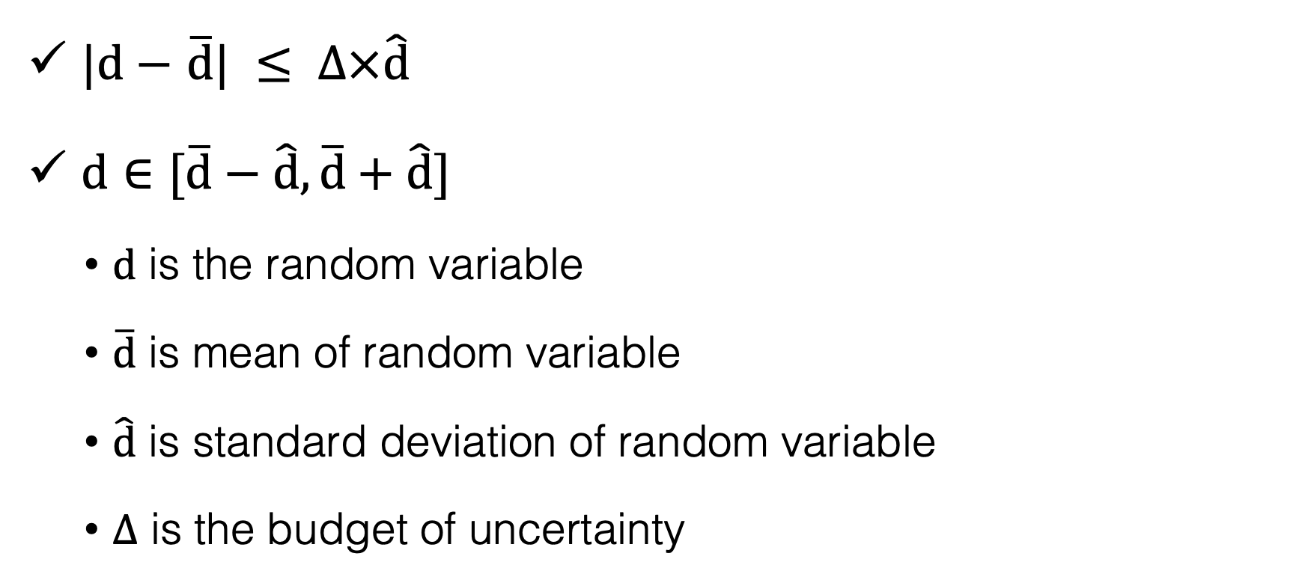
How to choose uncertainty set?
$|d−$ $\overline{d}| ≤ ∆×\hat{d}$
$d∈$ $[\overline{d}−\hat{d},\overline{d}+\hat{d}]$
$d$ is the random variable
$\overline{d}$ is mean of random variable
$\hat{d}$ is standard deviation of random variable
$∆$ is the budget of uncertainty
D. Bertsimas, E. Litvinov, X. A. Sun, J. Zhao and T. Zheng, "Adaptive Robust Optimization for the Security Constrained Unit Commitment Problem," in IEEE Transactions on Power Systems, vol. 28, no. 1, pp. 52-63, Feb. 2013.
Notes:
Random variable can take values within the closed bracket set.

Slide 26
Two Stage Robust Optimization
min{ c^{T}u + max [F(u,v)]}*
u is the commitment of generators
v is the uncertainty parameter, deterministic uncertainty set
F(u,v) = min q^{T}p
A_{v}u+B_{v}p+H_{v}f > d_{v}
A_{v}, B_{v}, H_{v}, d_{v} are uncertain matrices and vector to model demand uncertainties and power system contingencies
* Q. P. Zheng, J. Wang and A. L. Liu, "Stochastic Optimization for Unit Commitment—A Review," in IEEE Transactions on Power Systems, vol. 30, no. 4, pp. 1913-1924, July 2015.
Notes:
﻿Although stochastic methods including stochastic optimization (SO) have advantages in accounting for uncertainty and risks in many other fields [7], questions and barriers for their application to UC remain. System.

Slide 27
Stochastic vs Robust Optimization
﻿ Requires moderate information about the underlying uncertainty.
﻿Updates the uncertainty model as more information is obtained in time.
﻿ The robust model constructs an optimal solution that immunizes against all realizations of the uncertain data within a deterministic uncertainty set.
D. Bertsimas, E. Litvinov, X. A. Sun, J. Zhao and T. Zheng, "Adaptive Robust Optimization for the Security Constrained Unit Commitment Problem," in IEEE Transactions on Power Systems, vol. 28, no. 1, pp. 52-63, Feb. 2013.
Notes:
RUC requires only ﻿mean and the standard deviation of the uncertain data. Probability distribution is hard to obtain when compared to the uncertainty set.

Slide 28
Future Research
Co-optimizing energy and ancillary service using robust optimization for the day ahead market.
Data driven, distributionally robust optimization, decision rule approximation method are better in overcoming challenging data issues.
Notes:
﻿Although stochastic methods including stochastic optimization (SO) have advantages in accounting for uncertainty and risks in many other fields [7], questions and barriers for their application to UC remain. System.

Slide 29
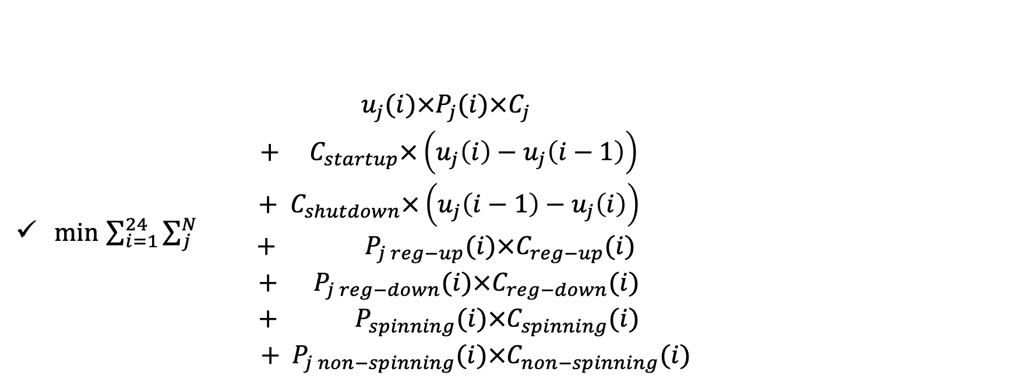
Co-Optimization Formulation
min $\sum_{i=1}^{24}{\sum_{j}^{N}{\begin{aligned} u_{j}(i)×P_{j}(i)×C_{j} \\ {+ C}_{startup}×\left(u_{j}\left(i\right)−u_{j}\left(i−1\right)\right) \\ + { C}_{shutdown}×\left(u_{j}\left(i−1\right)−u_{j}\left(i\right)\right) \\ + P_{j reg−up}(i)×C_{reg−up}(i) \\ + { P}_{j reg−down}(i)×C_{reg−down}(i) \\ +{ P}_{spinning}(i)×C_{spinning}(i) \\ { + P}_{j non−spinning}(i)×C_{non−spinning}(i)\end{aligned}}}$
Generation constraints
Transmission constraints
Fuel storage constraints
Reliability and security constraints
Regulatory constraints (contracts, must take)
Load-generation balance
Coordination with other systems
Notes:
Joint dispatch method is capable of handling appropriate interactions among energy and ancillary service dispatch

Slide 30
References
Ding, T., Wu, Z., Lv, J., & Member, S. (2016). Robust Co-Optimization to Energy and Ancillary Service Joint Dispatch Considering Wind Power Uncertainties in Real-Time Electricity Markets. IEEE Transactions on Sustainable Energy, 7(4), 1547–1557.
Q. P. Zheng, J. Wang and A. L. Liu, "Stochastic Optimization for Unit Commitment—A Review," in IEEE Transactions on Power Systems, vol. 30, no. 4, pp. 1913-1924, July 2015.
D. Bertsimas, E. Litvinov, X. A. Sun, J. Zhao and T. Zheng, "Adaptive Robust Optimization for the Security Constrained Unit Commitment Problem," in IEEE Transactions on Power Systems, vol. 28, no. 1, pp. 52-63, Feb. 2013.
Bremnes, J. B. (2004). Probabilistic wind power forecasts using local quantile regression. Wind Energy, 7(1), 47–54.
Notes:
﻿

