Slide 1
Natural Language Processing (NLP)
with Deep NLP
from Zero to Hero
FAHAD HUSSAIN
MCS, MSCS, DAE(CIT)
Computer Science Instructor of well known international Center
Also, Machine Learning and Deep learning Practitioner
For further assistance, code and slide https://fahadhussaincs.blogspot.com/
YouTube Channel: https://www.youtube.com/channel/UCapJpINJKHzflWwCQ8Kse2g/playlists

Slide 2
Prerequisite
for
Natural language processing
Python
Basic Concept of Machine Learning and Deep Learning

Slide 3
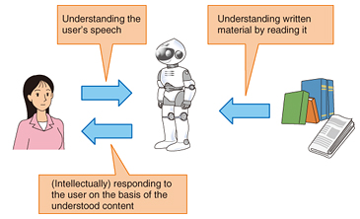
Natural language processing

Slide 4
Natural language processing
Natural language processing (NLP) is a subfield of linguistics, computer science, information engineering, and artificial intelligence concerned with the interactions between computers and human (natural) languages, in particular how to program computers to process and analyze large amounts of natural language data.
Challenges in natural language processing frequently involve speech recognition, natural language understanding, and natural language generation.
Fahad Hussain Tutorial
Fahad Hussain Tutorial
Fahad Hussain Tutorial
For further assistance, code and slide https://fahadhussaincs.blogspot.com/
YouTube Channel: https://www.youtube.com/channel/UCapJpINJKHzflWwCQ8Kse2g/playlists

Slide 5
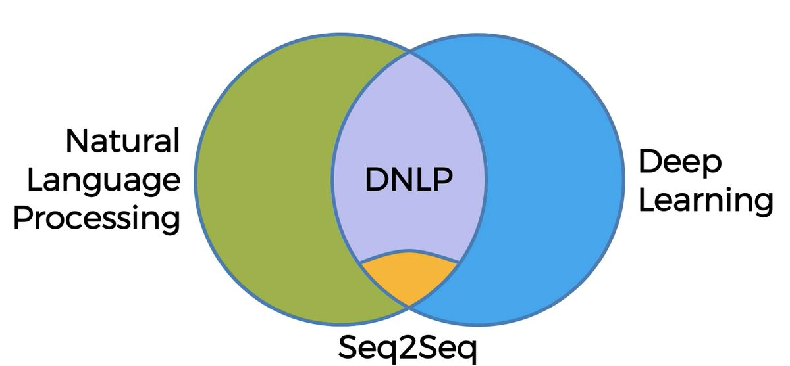
Types of NLP
Fahad Hussain Tutorial
Fahad Hussain Tutorial
Fahad Hussain Tutorial
For further assistance, code and slide https://fahadhussaincs.blogspot.com/
YouTube Channel: https://www.youtube.com/channel/UCapJpINJKHzflWwCQ8Kse2g/playlists

Slide 6
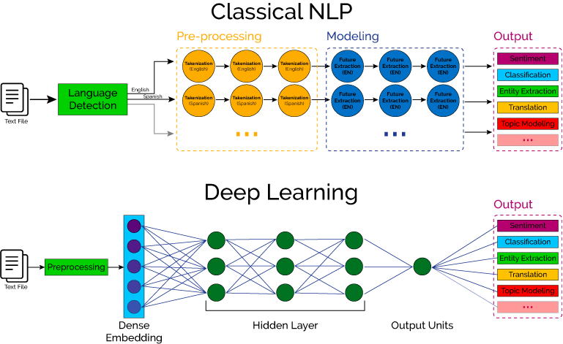

Slide 7
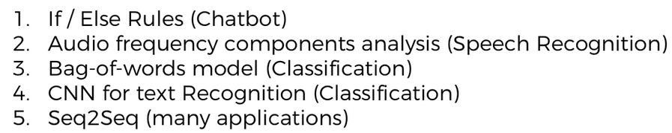
How NLP, DNLP and DL involves in!!!
Fahad Hussain Tutorial
Fahad Hussain Tutorial
Fahad Hussain Tutorial
For further assistance, code and slide https://fahadhussaincs.blogspot.com/
YouTube Channel: https://www.youtube.com/channel/UCapJpINJKHzflWwCQ8Kse2g/playlists

Slide 8
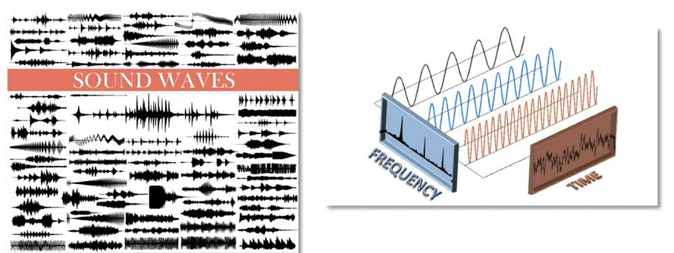
How NLP, DNLP and DL involves in!!!
Fahad Hussain Tutorial
Fahad Hussain Tutorial
Fahad Hussain Tutorial
For further assistance, code and slide https://fahadhussaincs.blogspot.com/
YouTube Channel: https://www.youtube.com/channel/UCapJpINJKHzflWwCQ8Kse2g/playlists

Slide 9
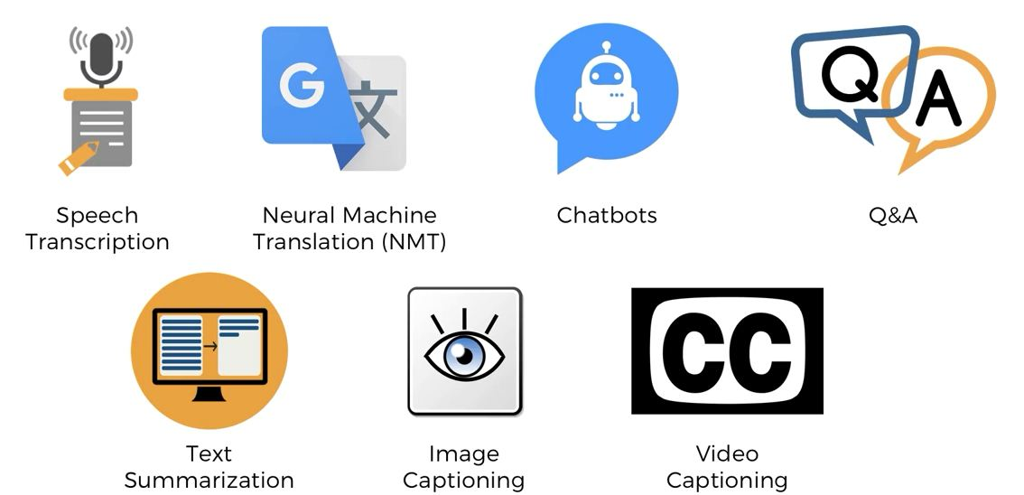
Applications
Fahad Hussain Tutorial
Fahad Hussain Tutorial
Fahad Hussain Tutorial
For further assistance, code and slide https://fahadhussaincs.blogspot.com/
YouTube Channel: https://www.youtube.com/channel/UCapJpINJKHzflWwCQ8Kse2g/playlists

Slide 10
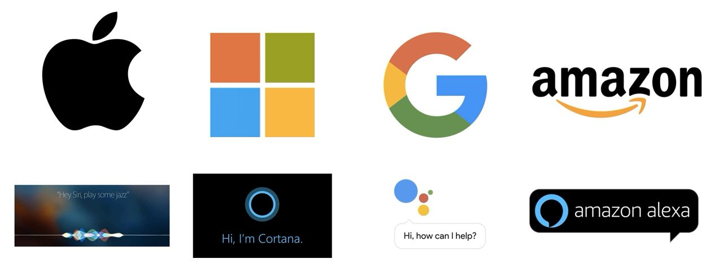
Used by
Fahad Hussain Tutorial
Fahad Hussain Tutorial
Fahad Hussain Tutorial
For further assistance, code and slide https://fahadhussaincs.blogspot.com/
YouTube Channel: https://www.youtube.com/channel/UCapJpINJKHzflWwCQ8Kse2g/playlists

Slide 11
Thanks
Do Subscribe, like and share
next we will discuss about
How NLP work?
For further assistance, code and slide https://fahadhussaincs.blogspot.com/
YouTube Channel: https://www.youtube.com/channel/UCapJpINJKHzflWwCQ8Kse2g/playlists

Slide 12
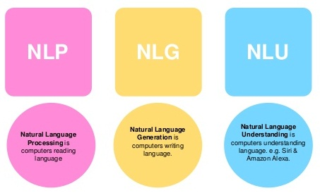
NLP Working
Fahad Hussain Tutorial
Fahad Hussain Tutorial
For further assistance, code and slide https://fahadhussaincs.blogspot.com/
YouTube Channel: https://www.youtube.com/channel/UCapJpINJKHzflWwCQ8Kse2g/playlists

Slide 13
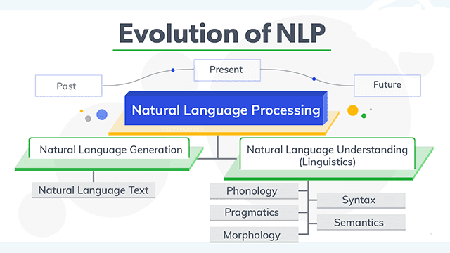
NLP Working
Fahad Hussain Tutorial
Fahad Hussain Tutorial
Fahad Hussain Tutorial
For further assistance, code and slide https://fahadhussaincs.blogspot.com/
YouTube Channel: https://www.youtube.com/channel/UCapJpINJKHzflWwCQ8Kse2g/playlists

Slide 14
Natural Language Understanding
Ambiguity:
Lexical Ambiguity : The Tank is full of water.
Syntactic Ambiguity : ill men and women get to hospital.
Semantic Ambiguity : The Bike hit the pole while it was running.
Pragmatic Ambiguity : The Army is coming.
Phonology – This science helps to deal with patterns present in the sound and speeches related to the sound as a physical entity.
Pragmatics – This science studies the different uses of language.
Morphology – This science deals with the structure of the words and the systematic relations between them.
Syntax – This science deal with the structure of the sentences.
Semantics – This science deals with the literal meaning of the words, phrases as well as sentences.
For further assistance, code and slide https://fahadhussaincs.blogspot.com/
YouTube Channel: https://www.youtube.com/channel/UCapJpINJKHzflWwCQ8Kse2g/playlists

Slide 15
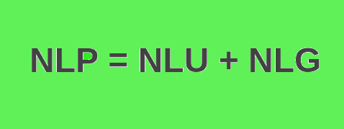
Natural Language Generation
Based on NL-Understanding, it will suggest about:
What should say to user.
Should be Intelligent and Covervational as like human
Usage of Structured data.
With text and Sentence like planning.
Fahad Hussain Tutorial
Fahad Hussain Tutorial
Fahad Hussain Tutorial
For further assistance, code and slide https://fahadhussaincs.blogspot.com/
YouTube Channel: https://www.youtube.com/channel/UCapJpINJKHzflWwCQ8Kse2g/playlists

Slide 16
Thanks
Do Subscribe, like and share
next we will discuss about
Data Processes,
Tokenization?
For further assistance, code and slide https://fahadhussaincs.blogspot.com/
YouTube Channel: https://www.youtube.com/channel/UCapJpINJKHzflWwCQ8Kse2g/playlists

Slide 18
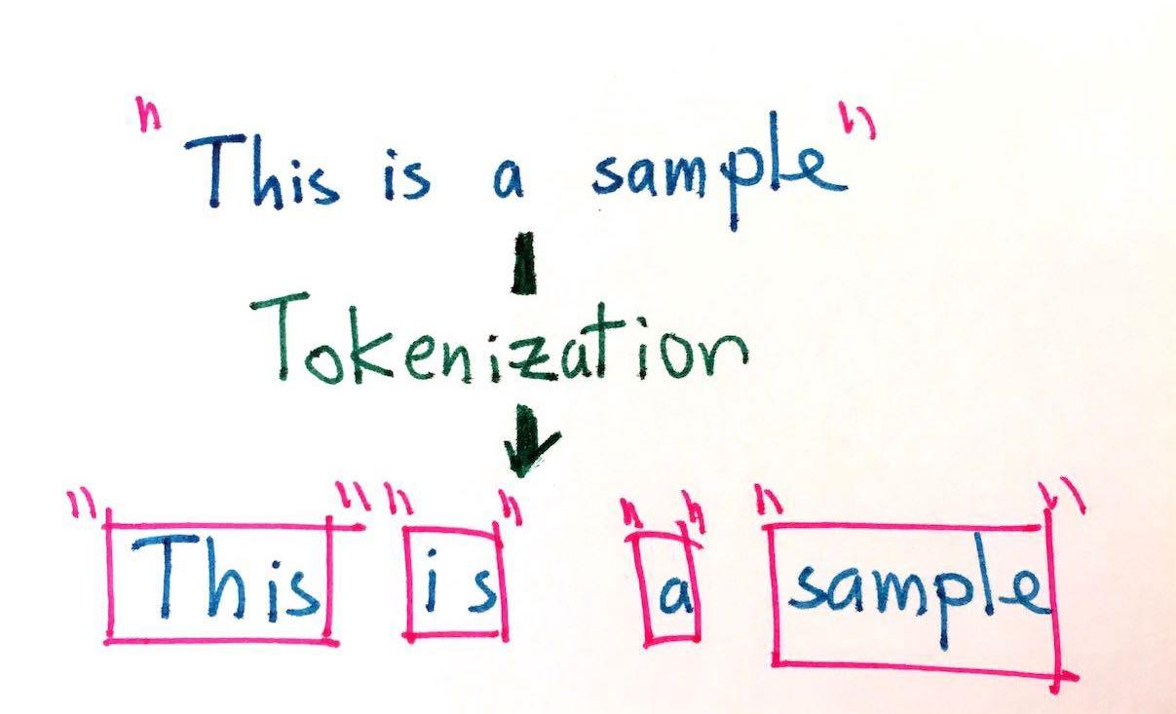
Tokenization
Tokenization is the process of replacing sensitive data with unique identification symbols that retain all the essential information about the data without compromising its security.
Fahad Hussain Tutorial
Fahad Hussain Tutorial
Fahad Hussain Tutorial
For further assistance, code and slide https://fahadhussaincs.blogspot.com/
YouTube Channel: https://www.youtube.com/channel/UCapJpINJKHzflWwCQ8Kse2g/playlists

Slide 19
Tokenization
There are many library / framework for NLP problem solution
1. Natural Language Toolkit (NLTK)
2. TextBlob
3. CoreNLP
4. Gensim
5. spaCy
6. polyglot
7. scikit–learn
8. Pattern
Fahad Hussain Tutorial
Fahad Hussain Tutorial
Fahad Hussain Tutorial
So lets' move to COLAB for practical work...
For further assistance, code and slide https://fahadhussaincs.blogspot.com/
YouTube Channel: https://www.youtube.com/channel/UCapJpINJKHzflWwCQ8Kse2g/playlists

Slide 20
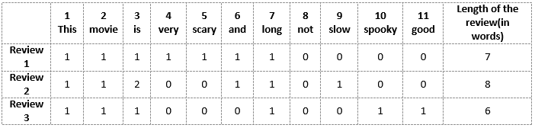
Bag of words
The bag-of-words model is a simplifying representation used in natural language processing and information retrieval (IR). In this, a text (such as a sentence or a document) is represented as the bag (multiset) of its words, disregarding grammar and even word order but keeping multiplicity.
Fahad Hussain Tutorial
For further assistance, code and slide https://fahadhussaincs.blogspot.com/
YouTube Channel: https://www.youtube.com/channel/UCapJpINJKHzflWwCQ8Kse2g/playlists

Slide 21
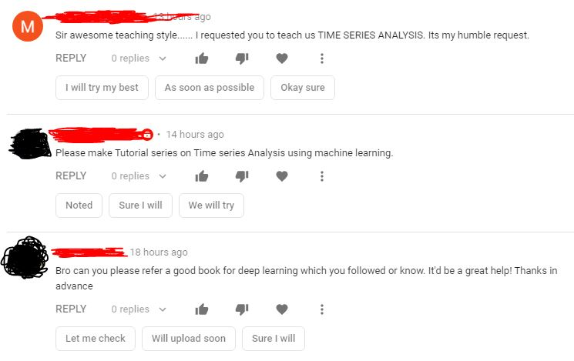
Bag of words
Fahad Hussain Tutorial
For further assistance, code and slide https://fahadhussaincs.blogspot.com/
YouTube Channel: https://www.youtube.com/channel/UCapJpINJKHzflWwCQ8Kse2g/playlists

Slide 22
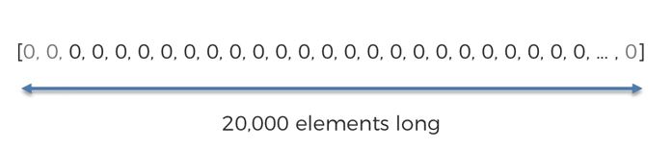
Comments
Are you ready, to start this course to?
Yes No None Don't No
Fahad Hussain Tutorial
For further assistance, code and slide https://fahadhussaincs.blogspot.com/
YouTube Channel: https://www.youtube.com/channel/UCapJpINJKHzflWwCQ8Kse2g/playlists

Slide 23
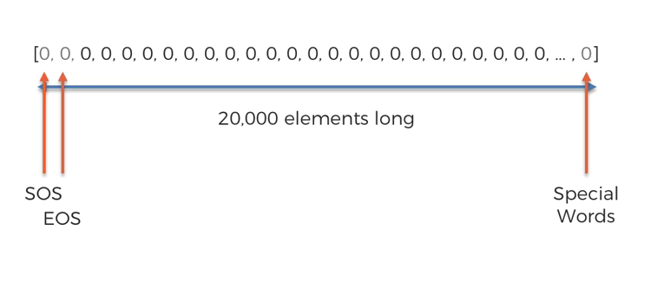
Comments
Are you ready, to start this course to?
For further assistance, code and slide https://fahadhussaincs.blogspot.com/
YouTube Channel: https://www.youtube.com/channel/UCapJpINJKHzflWwCQ8Kse2g/playlists

Slide 24
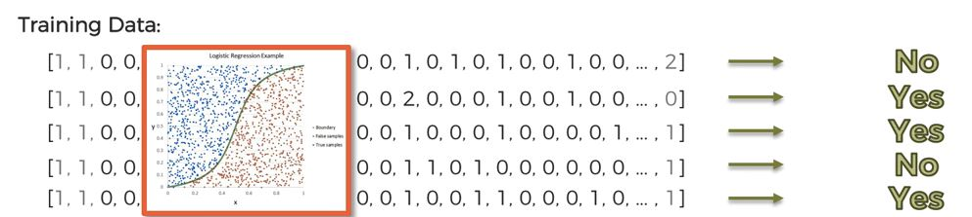
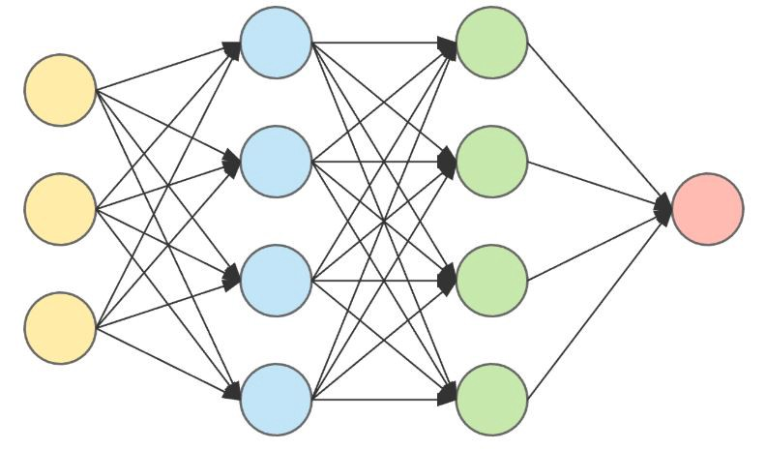
Training and Testing
NLP
Deep NLP
For further assistance, code and slide https://fahadhussaincs.blogspot.com/
YouTube Channel: https://www.youtube.com/channel/UCapJpINJKHzflWwCQ8Kse2g/playlists

Slide 25
Features Extraction in NLP
Frequency: This summarizes how often a given word appears within a document.
Document Frequency: This downscales words that appear a lot across documents.
Inverse Document Frequency (IDF): is a weight indicating how commonly a word is used. The more frequent its usage across documents, the lower its score. The lower the score, the less important the word becomes.
For example, the word the appears in almost all English texts and would thus have a very low IDF score as it carries very little “topic” information. In contrast, if you take the word coffee, while it is common, it’s not used as widely as the word the. Thus, coffee would have a higher IDF score than the.
TF-IDF: is a numerical statistic that is intended to reflect how important a word is to a document in a collection or corpus.
For further assistance, code and slide https://fahadhussaincs.blogspot.com/
YouTube Channel: https://www.youtube.com/channel/UCapJpINJKHzflWwCQ8Kse2g/playlists

Slide 26
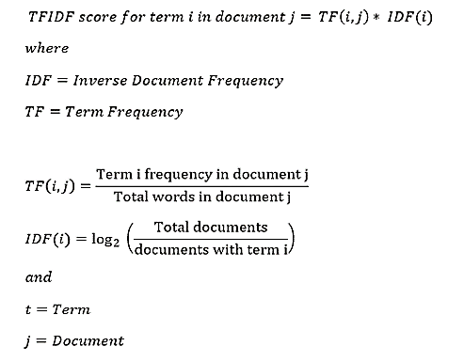
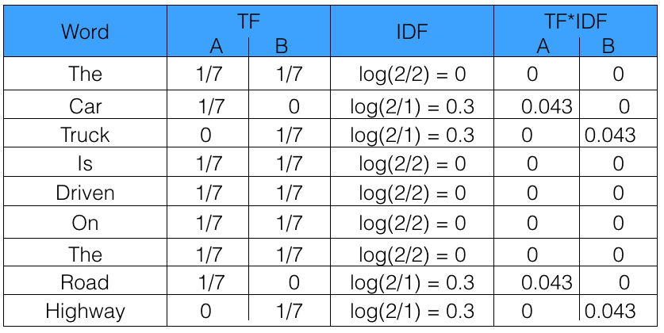
Sentence 1 : The car is driven on the road.
Sentence 2: The truck is driven on the highway.
For further assistance, code and slide https://fahadhussaincs.blogspot.com/
YouTube Channel: https://www.youtube.com/channel/UCapJpINJKHzflWwCQ8Kse2g/playlists

Slide 27
Fair men
Fair women
men women Fair
 | Sent. 1 | Sent. 2 | Sent.3
fair
men
women
words | IDF
men
women
fair
 | f1 | f2 | f3
 | men | women | fair
Sentence 1
Sentence 2
Sentence 3
For further assistance, code and slide https://fahadhussaincs.blogspot.com/
YouTube Channel: https://www.youtube.com/channel/UCapJpINJKHzflWwCQ8Kse2g/playlists

Slide 28
Hashing with HashingVectorizer in NLP
Count Vectorizer: The most straightforward one, it counts the number of times a token shows up in the document and uses this value as its weight.
Hash Vectorizer: This one is designed to be as memory efficient as possible. Instead of storing the tokens as strings, the vectorizer applies the hashing trick to encode them as numerical indexes. The downside of this method is that once vectorized, the features’ names can no longer be retrieved.
TF-IDF Vectorizer: TF-IDF stands for “term frequency-inverse document frequency”, meaning the weight assigned to each token not only depends on its frequency in a document but also how recurrent that term is in the entire corpora. More on that here.
For further assistance, code and slide https://fahadhussaincs.blogspot.com/
YouTube Channel: https://www.youtube.com/channel/UCapJpINJKHzflWwCQ8Kse2g/playlists

Slide 29
Hashing with HashingVectorizer in NLP
Counts and frequencies can be very useful, but one limitation of these methods is that the vocabulary can become very large. This, in turn, will require large vectors for encoding documents and impose large requirements on memory and slow down algorithms. A clever work around is to use a one way hash of words to convert them to integers. The clever part is that no vocabulary is required and you can choose an arbitrary-long fixed length vector. A downside is that the hash is a one-way function so there is no way to convert the encoding back to a word
For further assistance, code and slide https://fahadhussaincs.blogspot.com/
YouTube Channel: https://www.youtube.com/channel/UCapJpINJKHzflWwCQ8Kse2g/playlists

Slide 30
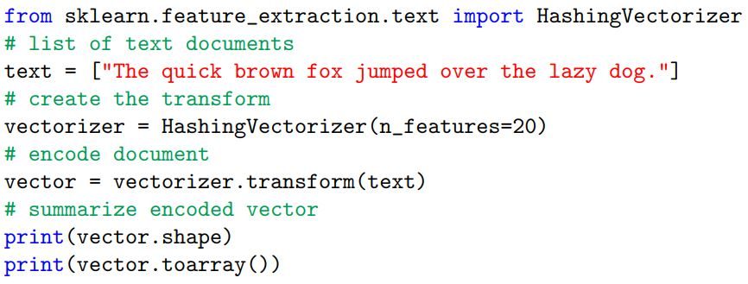
Hashing with HashingVectorizer in NLP
The HashingVectorizer class implements this approach that can be used to consistently hash words, then tokenize and encode documents as needed. The example below demonstrates the HashingVectorizer for encoding a single document. An arbitrary fixed-length vector size of 20 was chosen.
For further assistance, code and slide https://fahadhussaincs.blogspot.com/
YouTube Channel: https://www.youtube.com/channel/UCapJpINJKHzflWwCQ8Kse2g/playlists

Slide 31
How to Prepare Text Data With Keras
Keras is an open-source neural-network library written in Python. It is capable of running on top of TensorFlow, Microsoft Cognitive Toolkit, R, Theano, or PlaidML. Designed to enable fast experimentation with deep neural networks, it focuses on being user-friendly, modular, and extensible. It was developed as part of the research effort of project ONEIROS (Open-ended Neuro-Electronic Intelligent Robot Operating System).
https://keras.io/
For further assistance, code and slide https://fahadhussaincs.blogspot.com/
YouTube Channel: https://www.youtube.com/channel/UCapJpINJKHzflWwCQ8Kse2g/playlists

Slide 32
How to Prepare Text Data with scikit-learn
Lets understand the following topic using Keras;
Split Words with text to word sequence
Encoding with one hot
Hash Encoding with hashing trick
Tokenizer API
For further assistance, code and slide https://fahadhussaincs.blogspot.com/
YouTube Channel: https://www.youtube.com/channel/UCapJpINJKHzflWwCQ8Kse2g/playlists

Slide 33
N-grams in NLP
N-grams of texts are extensively used in text mining and natural language processing tasks. They are basically a set of co-occuring words within a given window and when computing the n-grams you typically move one word forward (although you can move X words forward in more advanced scenarios). For example, for the sentence "The quick brown fox jump over the lazy dog". If N=2 (known as bigrams), then the n-grams would be:
OR
Contiguous sequence of n item from a given sample text.
['The quick',
'quick brown',
'brown fox',
'fox jump',
'jump over',
'over the',
'the lazy',
'lazy dog']
['The quick brown',
'quick brown fox',
'brown fox jump',
'fox jump over',
'jump over the',
'over the lazy',
'the lazy dog']
['The', 'quick', 'brown', 'fox', 'jump', 'over', 'the', 'lazy', 'dog']
For further assistance, code and slide https://fahadhussaincs.blogspot.com/
YouTube Channel: https://www.youtube.com/channel/UCapJpINJKHzflWwCQ8Kse2g/playlists

Slide 34
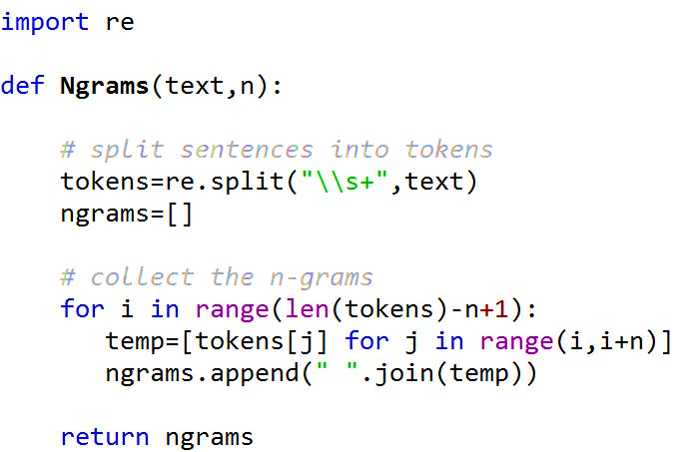
N-grams in NLP
How many N-grams in a sentence?
If X=Num of words in a given sentence K, the number of n-grams for sentence K would be:
For further assistance, code and slide https://fahadhussaincs.blogspot.com/
YouTube Channel: https://www.youtube.com/channel/UCapJpINJKHzflWwCQ8Kse2g/playlists

Slide 35
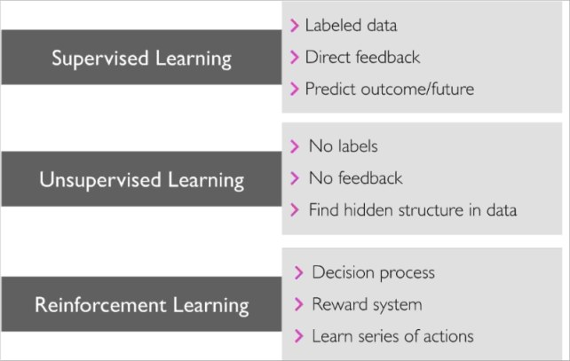
What is Machine Learning
Machine learning is an application of artificial intelligence (AI) that provides systems the ability to automatically learn and improve from experience without being explicitly programmed
For further assistance, code and slide https://fahadhussaincs.blogspot.com/
YouTube Channel: https://www.youtube.com/channel/UCapJpINJKHzflWwCQ8Kse2g/playlists

Slide 36
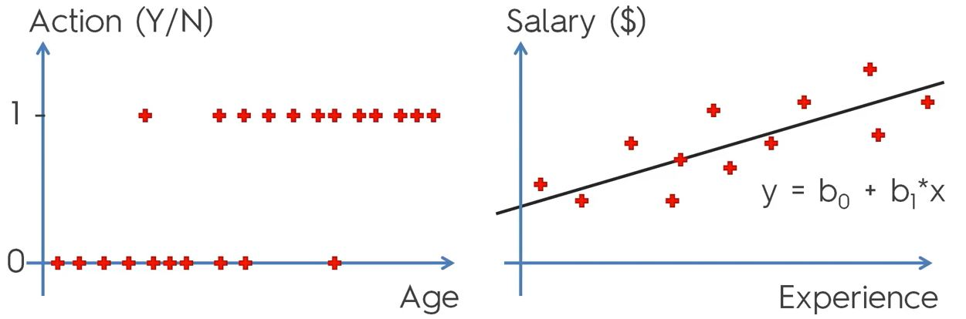
Machine Learning in NLP Logistic Regression
For further assistance, code and slide https://fahadhussaincs.blogspot.com/
YouTube Channel: https://www.youtube.com/channel/UCapJpINJKHzflWwCQ8Kse2g/playlists

Slide 37
Machine Learning in NLP
In linear regression, the outcome (dependent variable) is continuous. It can have any one of an infinite number of possible values.
In logistic regression, the outcome (dependent variable) has only a limited number of possible values.
The dependent variable:
Logistic regression is used when the response variable is categorical in nature. For instance, yes/no, true/false, red/green/blue, 1st/2nd/3rd/4th, etc.
Linear regression is used when your response variable is continuous. For instance, weight, height, number of hours, etc.
Y = mX + C
g(x) = 1 / (1 + e^-x)
For further assistance, code and slide https://fahadhussaincs.blogspot.com/
YouTube Channel: https://www.youtube.com/channel/UCapJpINJKHzflWwCQ8Kse2g/playlists

