Slide 1
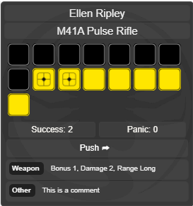
Character name
Roll name
Base dice
Stress dice
Total successes
Total panic results
Push button
Optional inputs

