Slide 1
HOW TO CODE GREAT WEBSITE
WHAT ARE IMPORTANT THINGS WHEN CODE WEBSITE

Slide 2
Main targets
Answer question “What should we do to code HTML and CSS after seeing design?”
Define main variables to use during code
Make everything consistent
Make great website

Slide 3
Contents
Analyze layout
Define main variables
Make website exactly the same design
Make website responsive

Slide 4
Analyze layout
Define type of website layout in our website
Define container width
Separate sections and define it’s type

Slide 5
Define what type of website layout in our website
We have 3 types of Web Design layouts
Fixed
Fluid
Elastic

Slide 6
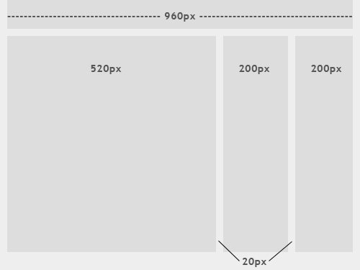

Fixed Layout

Slide 7
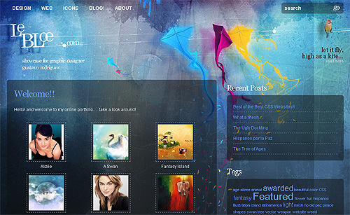

Fixed Layout

Slide 8
Fixed Layout
Pros
Easy to code
Easy to optimize website
Competitive all browsers with width more than 800px
Cons
Create excessive white space for users with larger screen resolutions
Seamless textures, patterns and image will be blurred with large resolutions
Thus upsetting “divine proportion,” the “Rule of Thirds,” overall balance and other design principles.
Not suitable with mobile generation
Horizontal bar

Slide 9
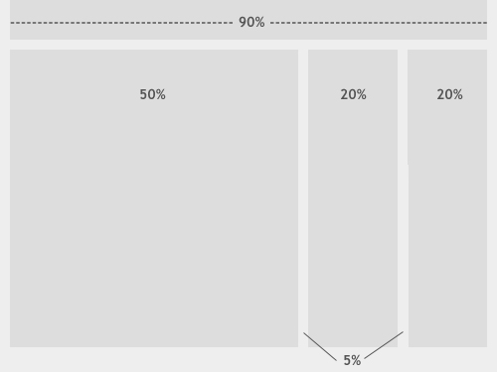
Fluid layout

Slide 10
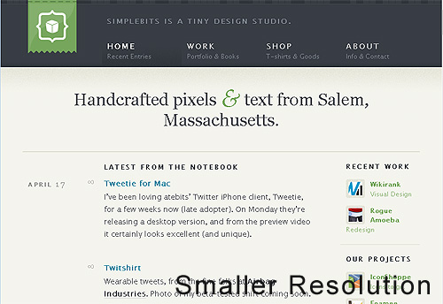
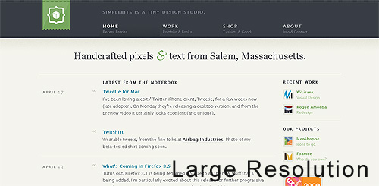
Fluid layout

Slide 11


Fluid layout

Slide 12
Fluid layout
Pros
More user-friendly than fixed layout
The amount of extra white space is similar between all browsers and screen resolutions, which can be more visually appealing.
No horizontal bar
Cons
Media assets need to set multiple width
Diminish aesthetic appeal with large screen resolutions in a lack of content

Slide 13


Elastic layout

Slide 14
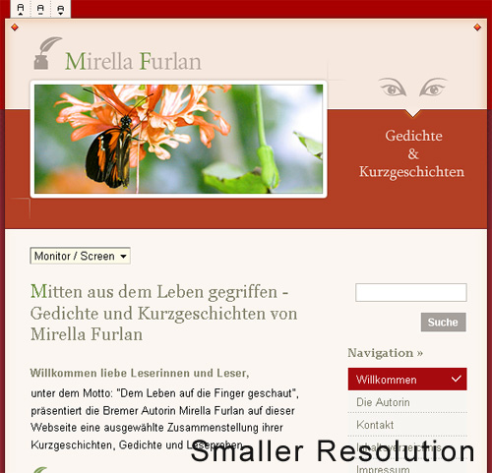
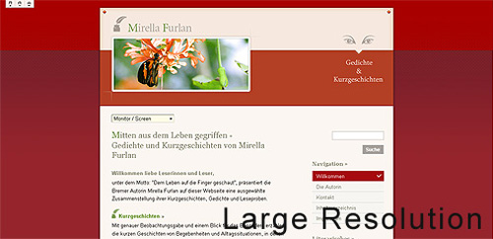
Elastic layout

Slide 15
Define container width
Types of container widths
Almost case
960px
1170px
Any
Full width

Slide 16
Separate sections and define it’s type
Show some websites to demo

Slide 17
Define main variables
Main variables
Grid system
Amount columns
Gutter width
Breakpoints
Container width
2-3 main colors
Font
Font sizes
Text line height
Ratio heading
Spacing

Slide 18
Define main variables in code
With pure CSS
With SASS or LESS

Slide 19
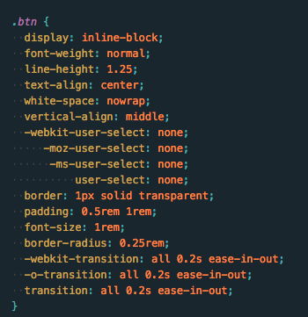
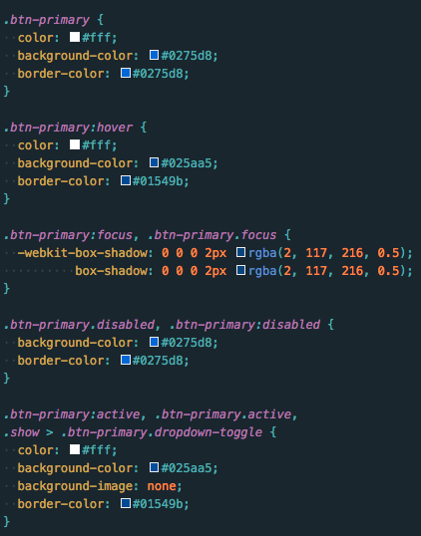
Pure CSS

Slide 20
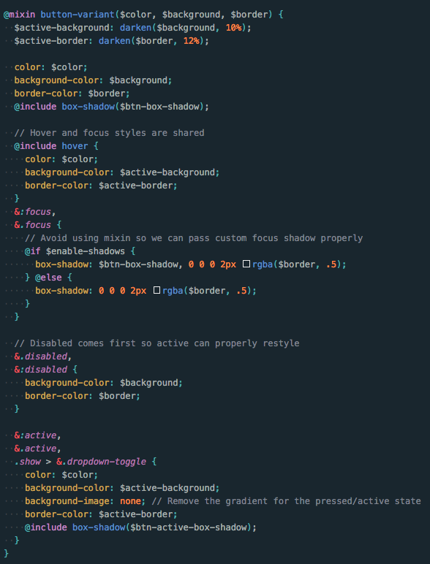
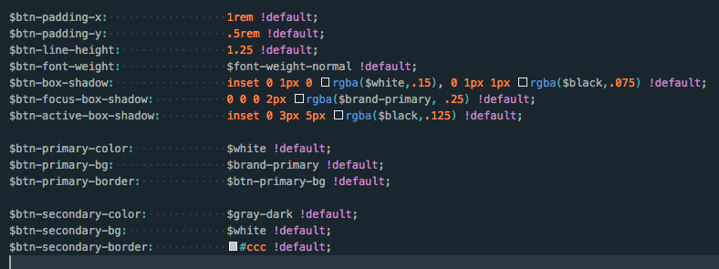
SASS OR LESS

Slide 21
Make website exactly the same design
Work with Sketch
It a piece of cake
Work with PSD files
Crop all icons / logos / images from design with same size
Check more detail about text / box shadow

Slide 22
Make website responsive
Define min-width breakpoints
Super large (ex: 1200px)
Large (ex: 992px)
Medium (ex: 768px)
Small (ex: 576px)
Super small (ex: 0)
Make one breakpoint finish first base on design (desktop first or mobile first)
Check breakpoint to breakpoint to find lack of content is broken to fix
Should be wrapped in this breakpoint
Scale font-size
Reduce spacing

Slide 23
References
https://www.smashingmagazine.com/2009/06/fixed-vs-fluid-vs-elastic-layout-whats-the-right-one-for-you/
http://getbootstrap.com/

