Slide 1
Spinnaker
Open-source Continuous Delivery Platform

Slide 2
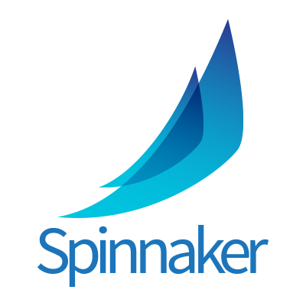
Agenda
What is Spinnaker ?
Concept
Why Spinnaker ?
Demo

Slide 3
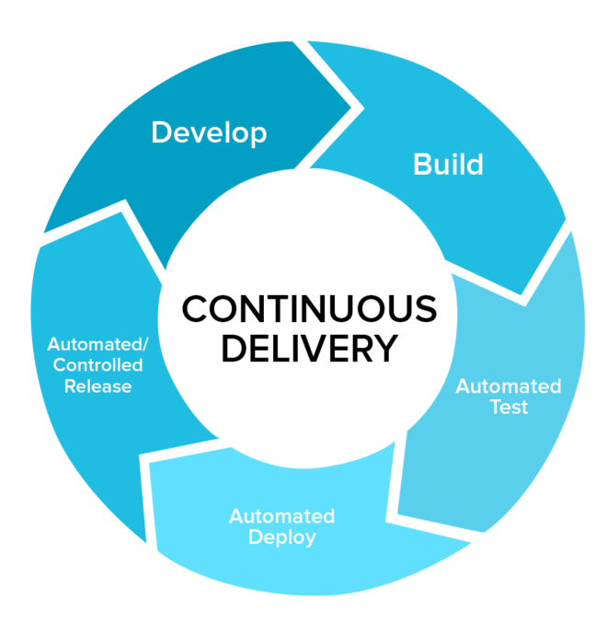
What is Spinnaker ?
Open-source, multi-cloud continuous delivery platform with high velocity and confidence.
Created by Netflix for releasing millions deployment by hundreds of teams.

Slide 4
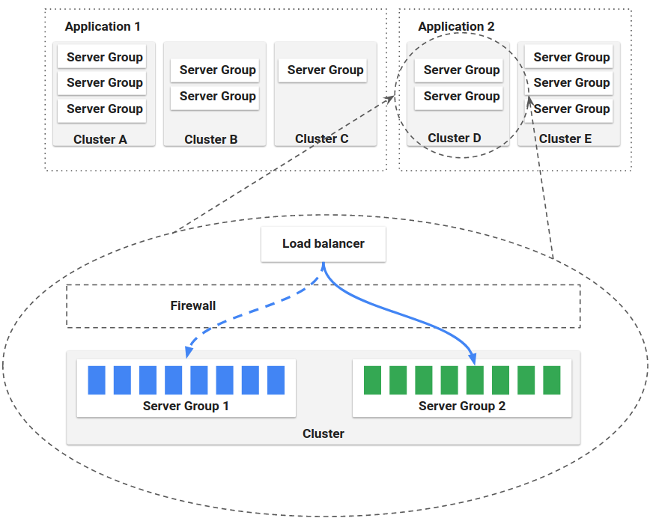
Concept
Application management
Cluster
Server Group
Load Balancer
Firewall

Slide 5
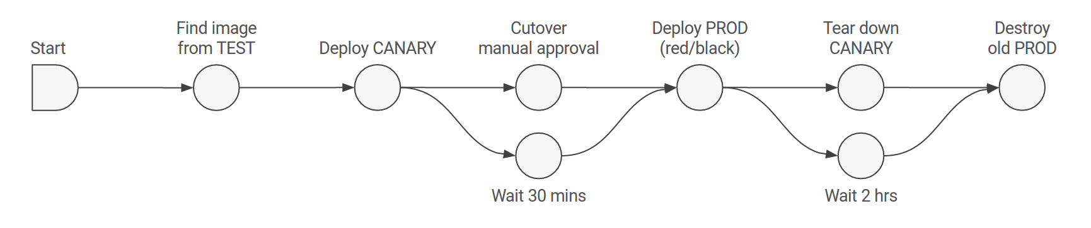
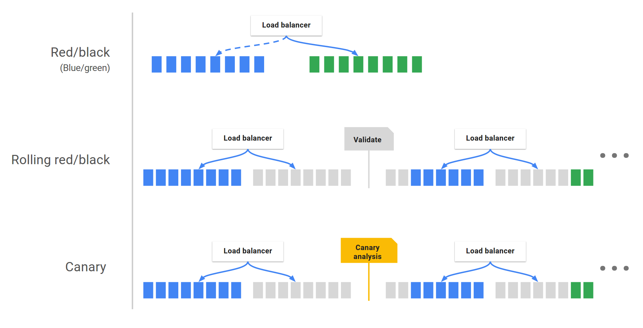
Concept
Application deployment
Pipeline
Stage
Deployment strategies

Slide 6
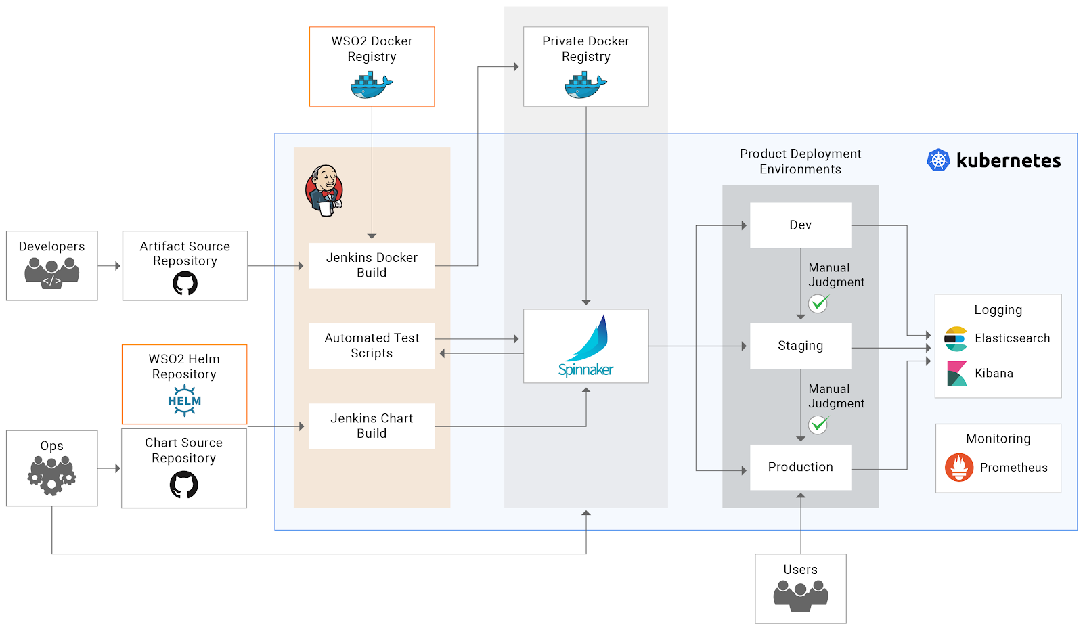
Pipeline

Slide 7
Pipeline
Deploy to multi cloud in a single pipeline
Multi stage with lots of job type (Jenkins, Cloud Build, script) and triggers (webhook, git repo)
Notification: email, Slack, webhook
Zero downtime upgrade

Slide 8
Provider
App Engine
Amazon Web Services
Azure
Cloud Foundry
DC/OS
Google Compute Engine
Kubernetes
Oracle

Slide 9
Why Spinnaker ?
We are mainly doing CD in Gitlab CI which is not an CD

Slide 10
Demo

Slide 11
Reference
Resource
https://www.spinnaker.io/concepts/
https://aws.amazon.com/blogs/opensource/continuous-delivery-spinnaker-amazon-eks/

Slide 12
Thank You

