Slide 1

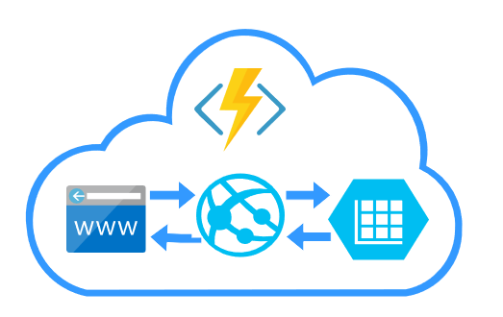







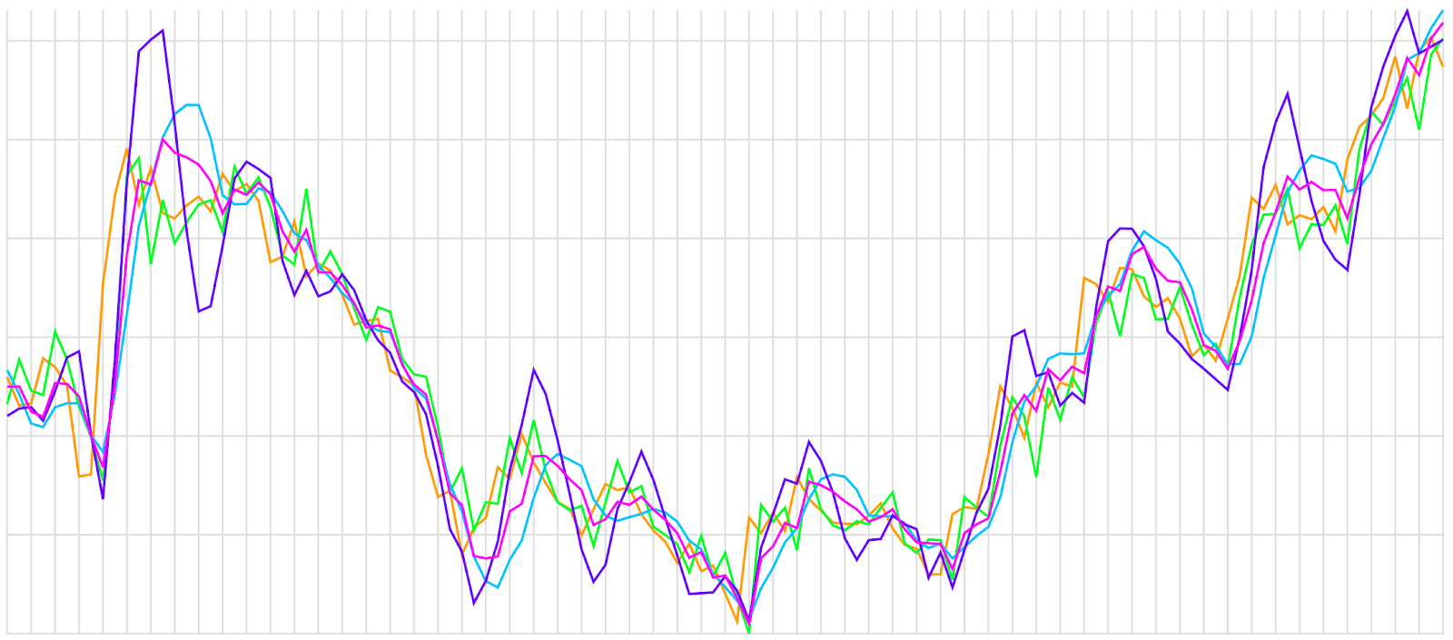











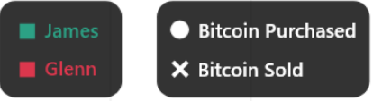
A web-based trading simulation service
The purpose of the website it to provide individuals with a way to experiment with investment ideas on a no-risk basis.
The system is hosted entirely in the cloud using Microsoft Azure.
We have both live and historical data and scenarios can be created using data from any point in time.
Social Media
Primary and secondary research has indicated a link between certain social media statistics and the price of cryptocurrencies. For example, volume of Tweets and Bitcoin price
Python application streams Tweets and provides users with live analysis of Twitter activity relating to each currency
Python function allows users to search Reddit posts between specific dates, and analyses these posts to display to the user
Price prediction
RBF, linear and polynomial regression used to create arithmetic predictions
Machine learning used to calculate an optimised prediction
Deep learning with Keras
Up/Down predictions with confidence rating
Chat System
Global chat system to communicate with other traders/friends using the same trading platform
Quick responses
Provides help/support to users as they can ask questions
Web Crawler Help Page
Python powered web crawler/spider bot
Azure Function that acquires URL’s, definitions and other information from search engines relating to a given search term
Includes a news section which provides news agency URL’s and titles of current events impacting cryptocurrencies and trading
Compare With friends
Brings a competitive vibe to the application
Compare with other users by searching username
Privacy setting can be toggled if they don't want their trading portfolio data to be public
Can be used to improve trading skills in future simulations
Daniel Kingston DK315
Dexter Watson DAW35
Connor Taylor CT401
Mehmet Karauc MK622
Niroshan Suthesan NS577
Rogério de Lemos RDL

