Slide 1
Brainstorming and Selecting an Essay Topic
Before you start writing an essay it is important to consider and think about the topic you are going to write about. When selecting a topic for an essay it is important that the topic meets the requirements of the essay and that the topic you select is something you are interested in. Follow the “I Can” statements below to complete this activity.
I can select three different essay topics I would consider picking for a topic
I can provide 3 different facts about each of the topics
I can use 2 to 3 different sources for each topic
I can pick one of the three topics to write my essay on
LINK TO ASSIGNMENT

Slide 2
Quick and Easy Research Tips
Ask the teacher or instructor for any further explanation of the assignment
Use reliable sources (ask a teacher for clarification if needed)
This means no Wikipedia (except for the exceptions….)
Look for sites that end with .edu, .org, .gov
.com can work but you have to make sure you trust the source
Use multiple sources (books, magazines, and articles)
Use Google or any other reliable search engines and be specific in your search (don’t open every link, skim the writing underneath)
Bookmark anything interesting before you move on
Make a list of key words and use quotations when searching
Turn off social media (check in spurts)
Do not be a thief! (use your own words)
Organize what you find

Slide 3
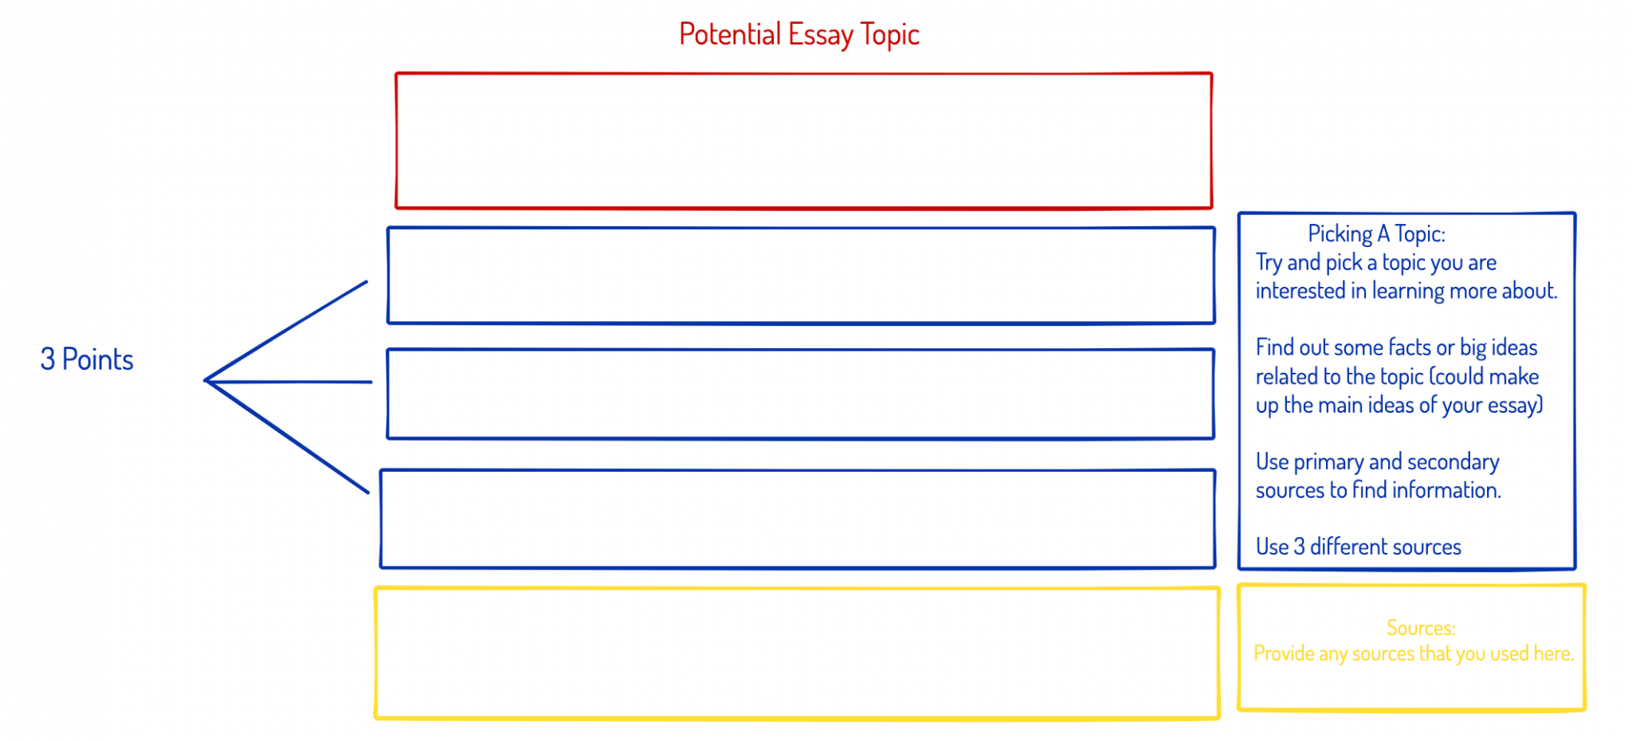

Slide 6
Essay Topic:
Which of the three topics are you going select to write your essay on and why?

