Slide 1
Step 1:Brainstorming
Brainstorm and come up with a topic that you are interested in learning more about. Spend some time looking online to see what kind of information and sources are going to be available. Follow the “I can” statements below to complete this step:
I can select a topic for my essay.
I can select three main ideas/topics that I want to research about.
SEE A COMPLETED EXAMPLE Video Explaining How to Complete

Slide 2
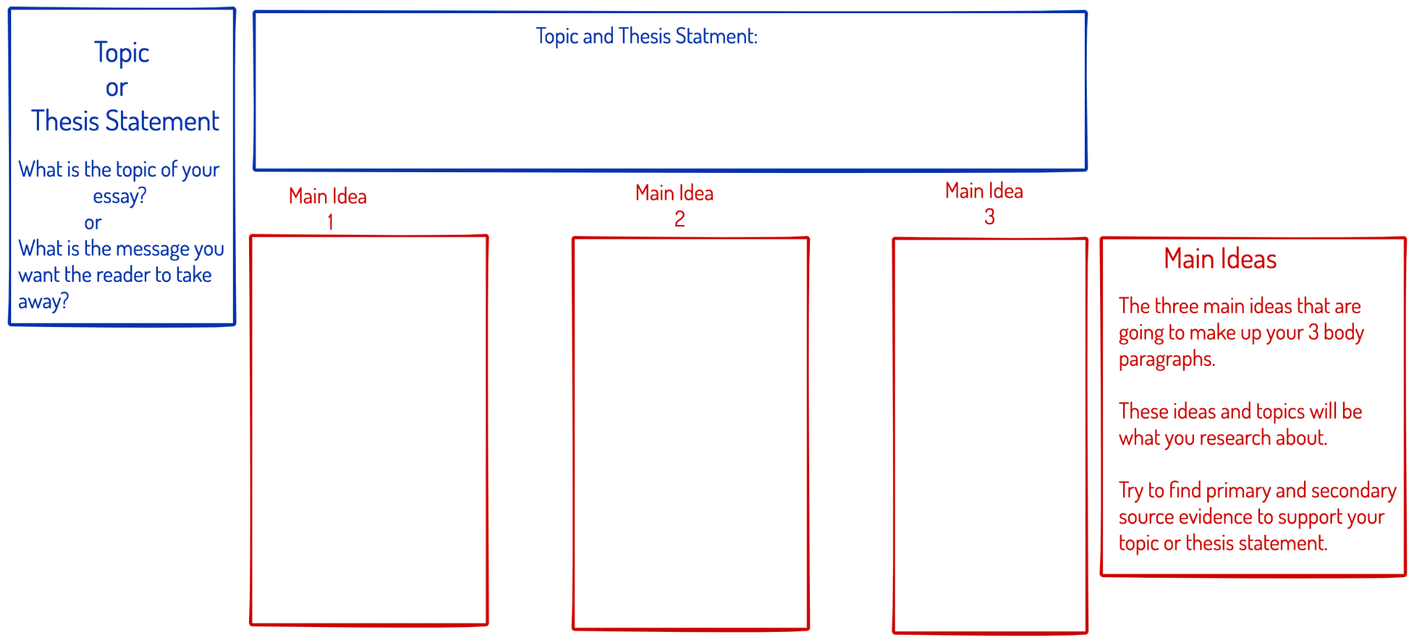

Slide 3
Step 2: Research
For all three of your main ideas/topics, you will need to find three supporting facts. These are the facts you will find from completing your research. Make sure to use primary and secondary sources. Follow the “I can” statements below to complete this section:
I can find three facts for my three main ideas/topics.

Slide 4
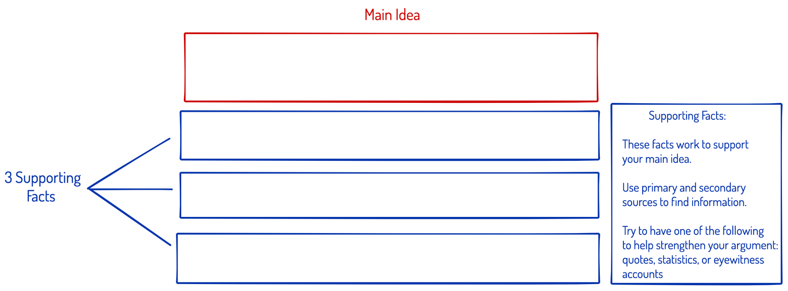

Slide 7
Step 3: Writing Your Draft
Now that you have completed your research it is time to start writing your draft. Follow the tips and instructions on each slide. Use the “I can” statements below to complete this section:
I can write an introduction paragraph
I can write 3 body paragraphs
I can write a conclusion
I can use my research

Slide 8
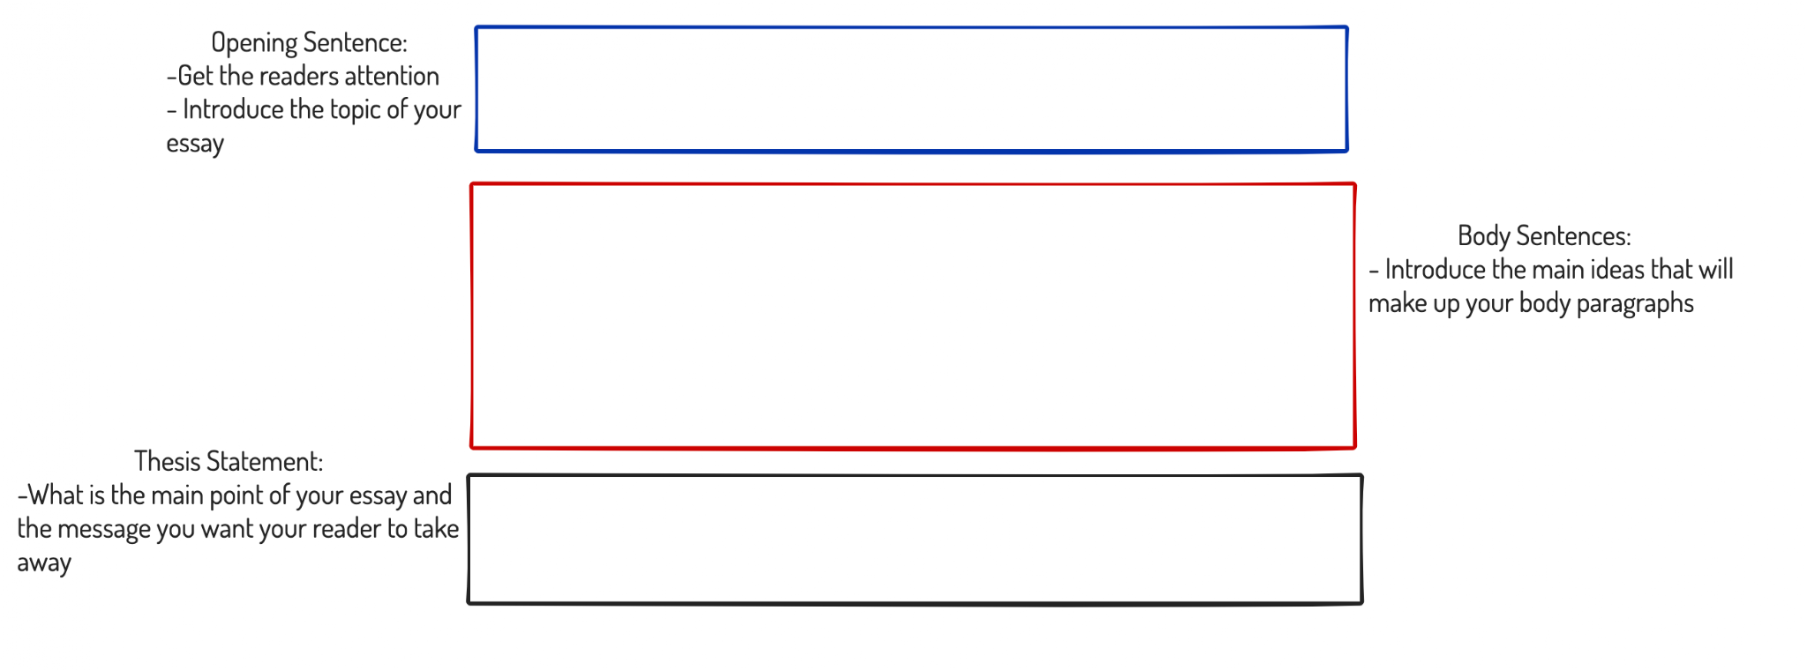
Introduction Paragraph

Slide 9
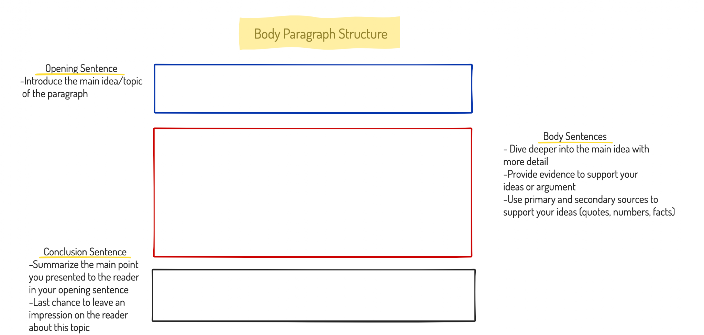
Body Paragraph 1

Slide 10
Body Paragraph 2

Slide 11
Body Paragraph 3

Slide 12
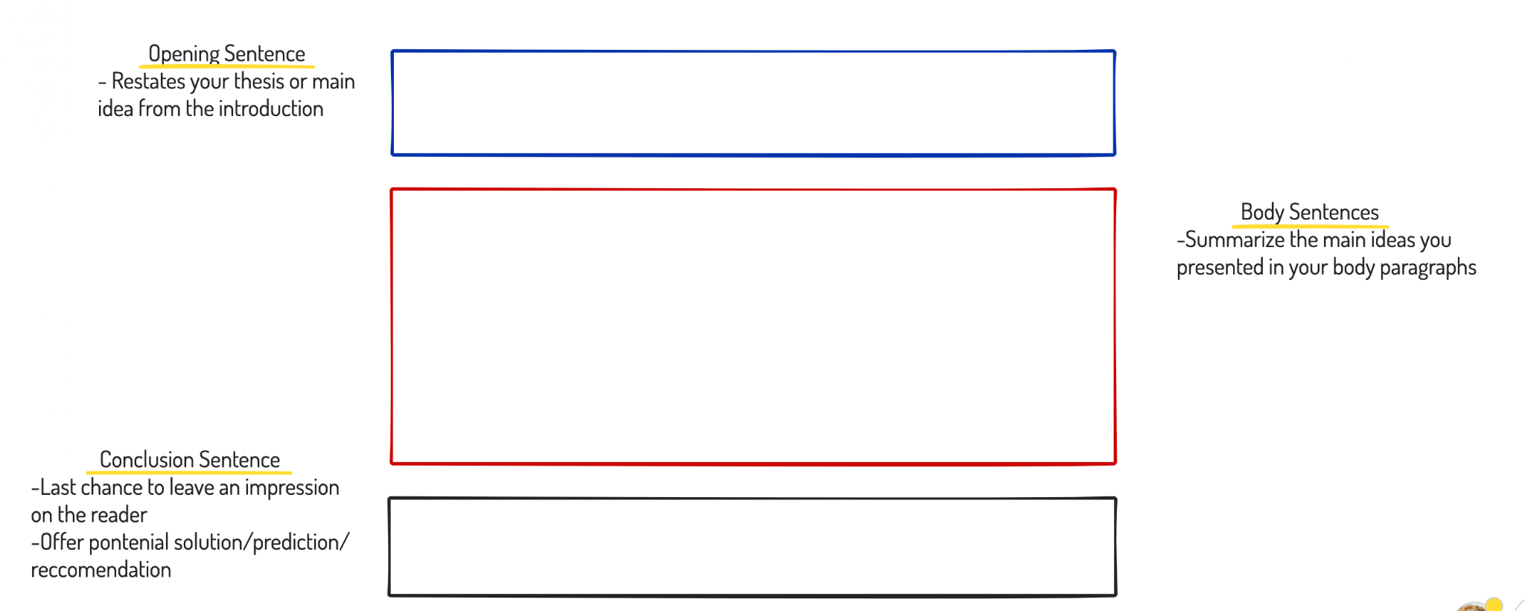
Conclusion Paragraph

