Slide 1
Step 1:Brainstorming
Brainstorm and come up with a topic that you are interested in learning more about. Spend some time looking online to see what kind of information and sources are going to be available. Follow the “I can” statements below to complete this step:
I can select a topic for my essay.
I can select three main ideas/topics that I want to research about.
Video Explanation

Slide 2

Micheal Jordan is the best basketball player of all time.
Team Success
Individual
Success
Global Reach and Legacy

Slide 3
Step 2: Research
For all three of your main ideas/topics, you will need to find three supporting facts. These are the facts you will find from completing your research. Make sure to use primary and secondary sources. Follow the “I can” statements below to complete this section:
I can find three facts for my three main ideas/topics.

Slide 4
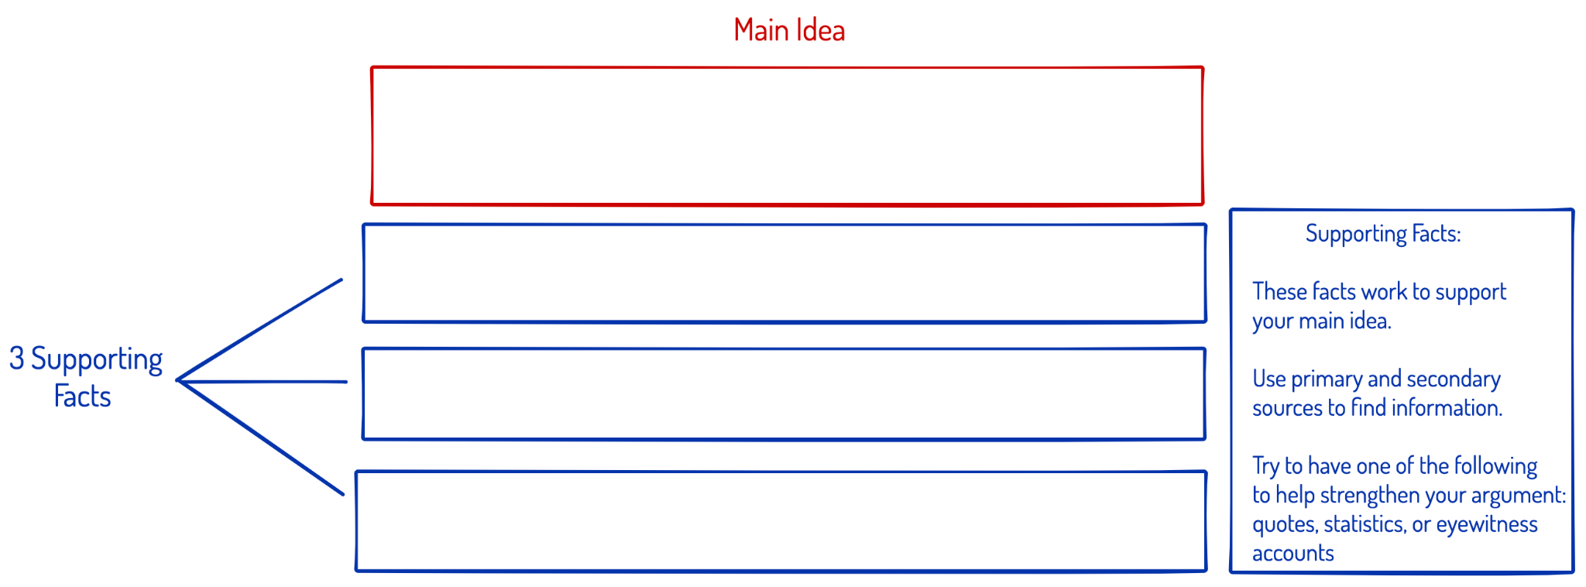
Team Success
Won 6 Championships while he played with the Bulls. Two times he won 3 title in a row. Also 2 Gold Medals for USA Basketball, UNC NCAA
At the time they had the best regular season in history 1995 - 1996 team went 72-10
Bulls went 119- 60 in the playoffs when was with them for a winning percentage .665

Slide 5
Individual Success
Awards - 5 x League MVP, 6 x Finals MVP, 10 x Scoring Championship
Career Average - 30.1ppg, 6.2 trb, 5.3 ast, 49.7 fg%
Greatest Season? 92-93 Per 40 possession numbers
43.0 points, 8.8 boards, 7.2 assists, 1.0 blocks, 3.7 steals. 15 - 4 playoff record on the way to finals MVP

Slide 6
Global Reach and Legacy
Jordan Brand Shoes - Net Worth 1.6 Billion, NBA Team Owner Charlotte
Icon, “Be Like Mike” Ad Campaign and inspired countless basketball players
Space jam, Olympics, global celebrity, Last Dance

Slide 7
Step 3: Writing Your Draft
Now that you have completed your research it is time to start writing your draft. Follow the tips and instructions on each slide. Use the “I can” statements below to complete this section:
I can write an introduction paragraph
I can write 3 body paragraphs
I can write a conclusion
I can use my research

Slide 8
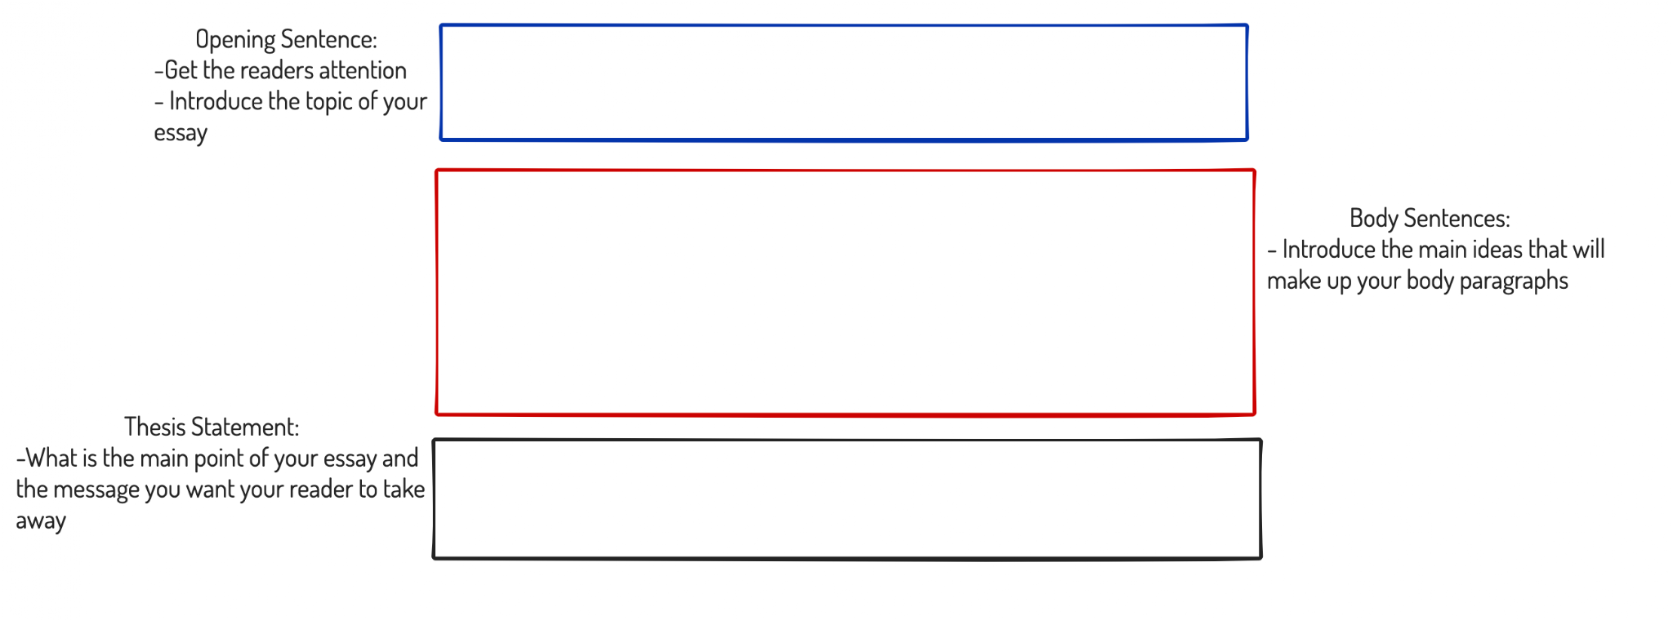
G.O.A.T! Stands for the greatest of all time, when it comes to basketball there can only be one person to claim that title.
Michael Jordan was one of the most feared and greatest basketball players to ever play the game. When you look at the impact he had on his team, the individual success and the legacy he left behind it becomes clear that no player will have the kind of impact that he had.
Micheal Jordan is greatest basketball player of all time.
Introduction Paragraph

Slide 9
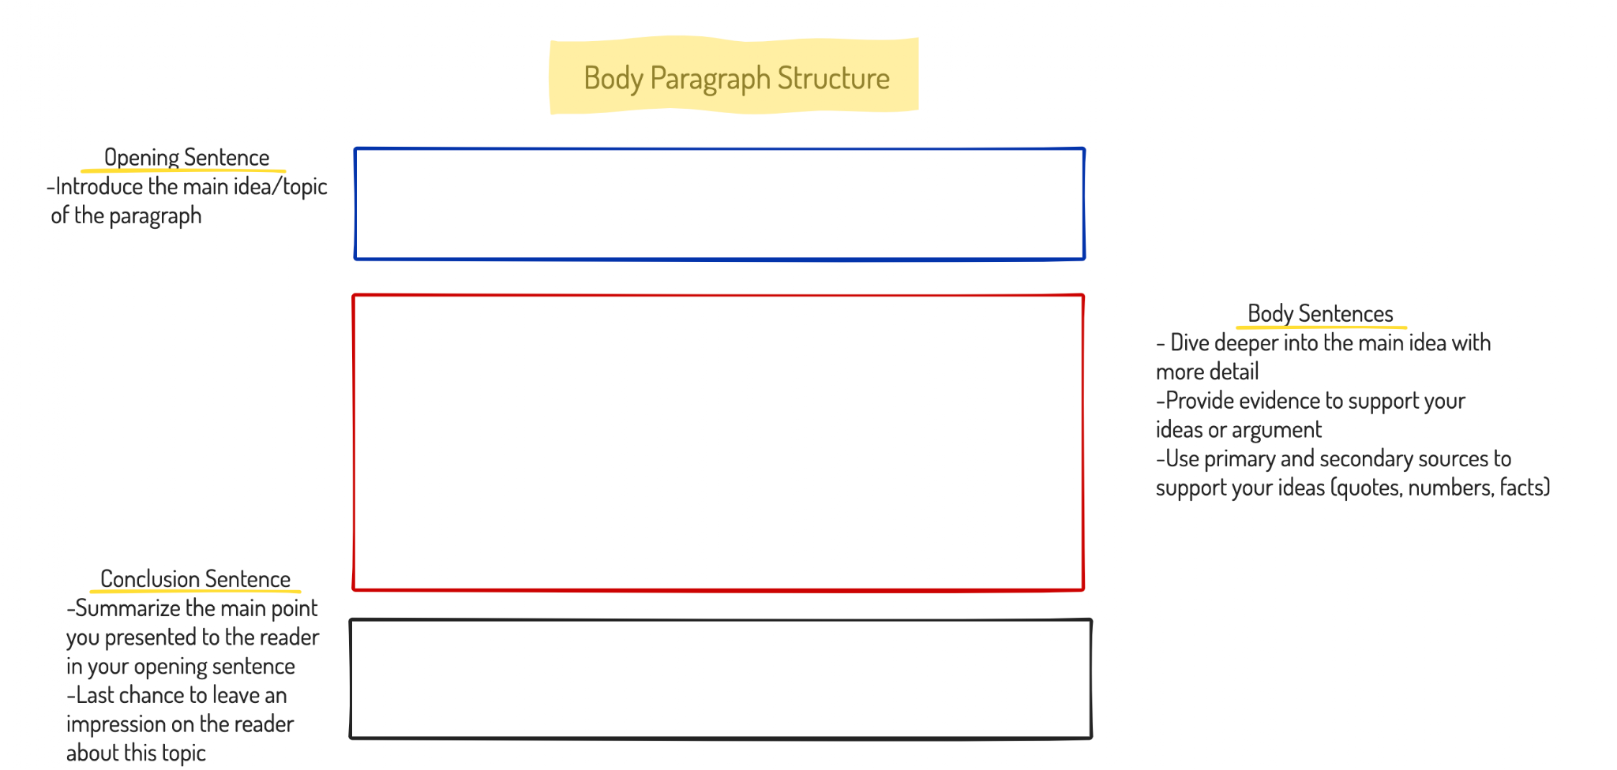
Body Paragraph 1
Basketball is a team sport, so the best way to look at a players impact is by examining how their team did.
While playing for the Chicago Bulls, Michael Jordan won 6 NBA championships, including winning three times in row on two different occasions. Not only did he win with the Bulls he also won two gold medals while playing in the olympics with team USA. Jordan’s Bulls team set the record in the 1995-96 season for having the best regular season in NBA history, with arecord of 72 -10.
As you can see from the numbers if you played on Jordan's team you were probably going to win.

Slide 10
Body Paragraph 2
Jordan was one of the most feared players in the game and was able to dominate individually.
Over the course of his career Jordan won every major individual award that a player could be nominated for. He won league MVP 5 times, finals MVP 6 times, league scoring title 10 times, and was rookie of the year. Over the course of his entire career he was able average over 30 points per game. Jordan’s 1992-93 season is often regarded as one of the greatest of his career.
There have been few players able to dominate the league individually like Jordan has.

Slide 11
Body Paragraph 3
There has been few athletes in history to have the global reach and celebrity status as Michael Jordan.
Jordan over the course of his life has grown is net worth to be 1.3 billion. This is due in large part to the Jordan shoe brand which is famous all over the world. Jordan has been a role model for countless basketball players and his number 23 is the most famous number in basketball. Jordan was able to transcend sports and appear in movies like Space Jam and is known all over the world.
No player has ever have the kind of global impact as Michael Jordan had during his career.

Slide 12
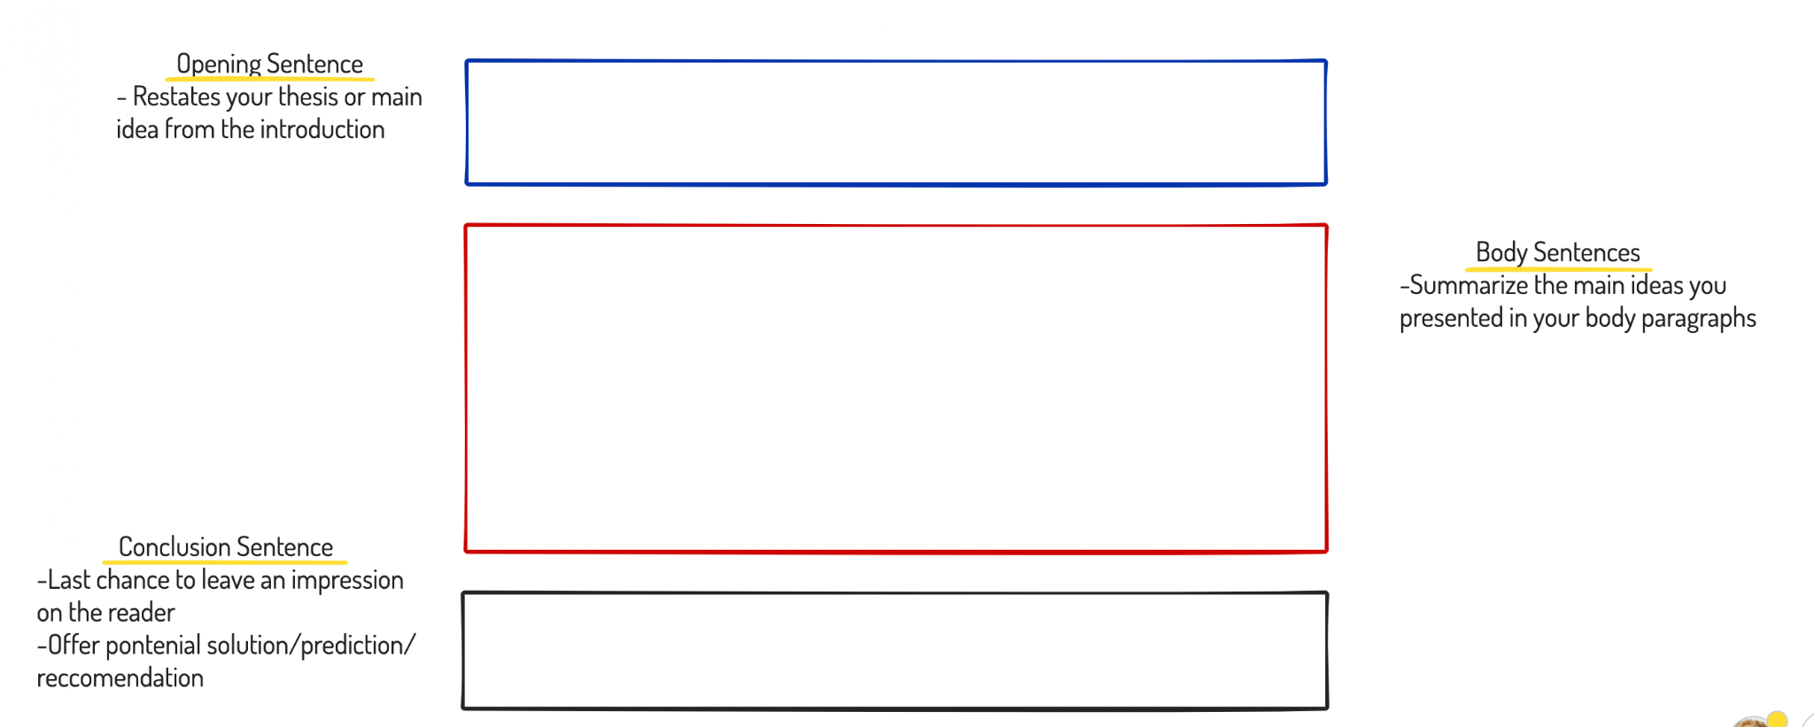
Conclusion Paragraph
There have been no shortage of great basketball players to play professionally.
However when you look at and compare their team success, individual success, and global impact no player comes close to Michael Jordan.
Micheal Jordan is the greatest basketball player of all time.

