Slide 1
Primary Source Analysis Assignment
Primary sources are an important tool that historians use to learn more about what life was like in the past. For this assignment you will be analyzing a letter from World War 2. Follow the “I can” statements below to complete this assignment.
I can complete the primary source vs secondary source check in.
I can make notes on the contents of the letter, identifying any key information about the soldiers experience.
I can present the information from my notes in a clear and creative manner and turn into our Google Classroom.
Learning Goal: To understand the difference between primary and secondary sources.

Slide 2
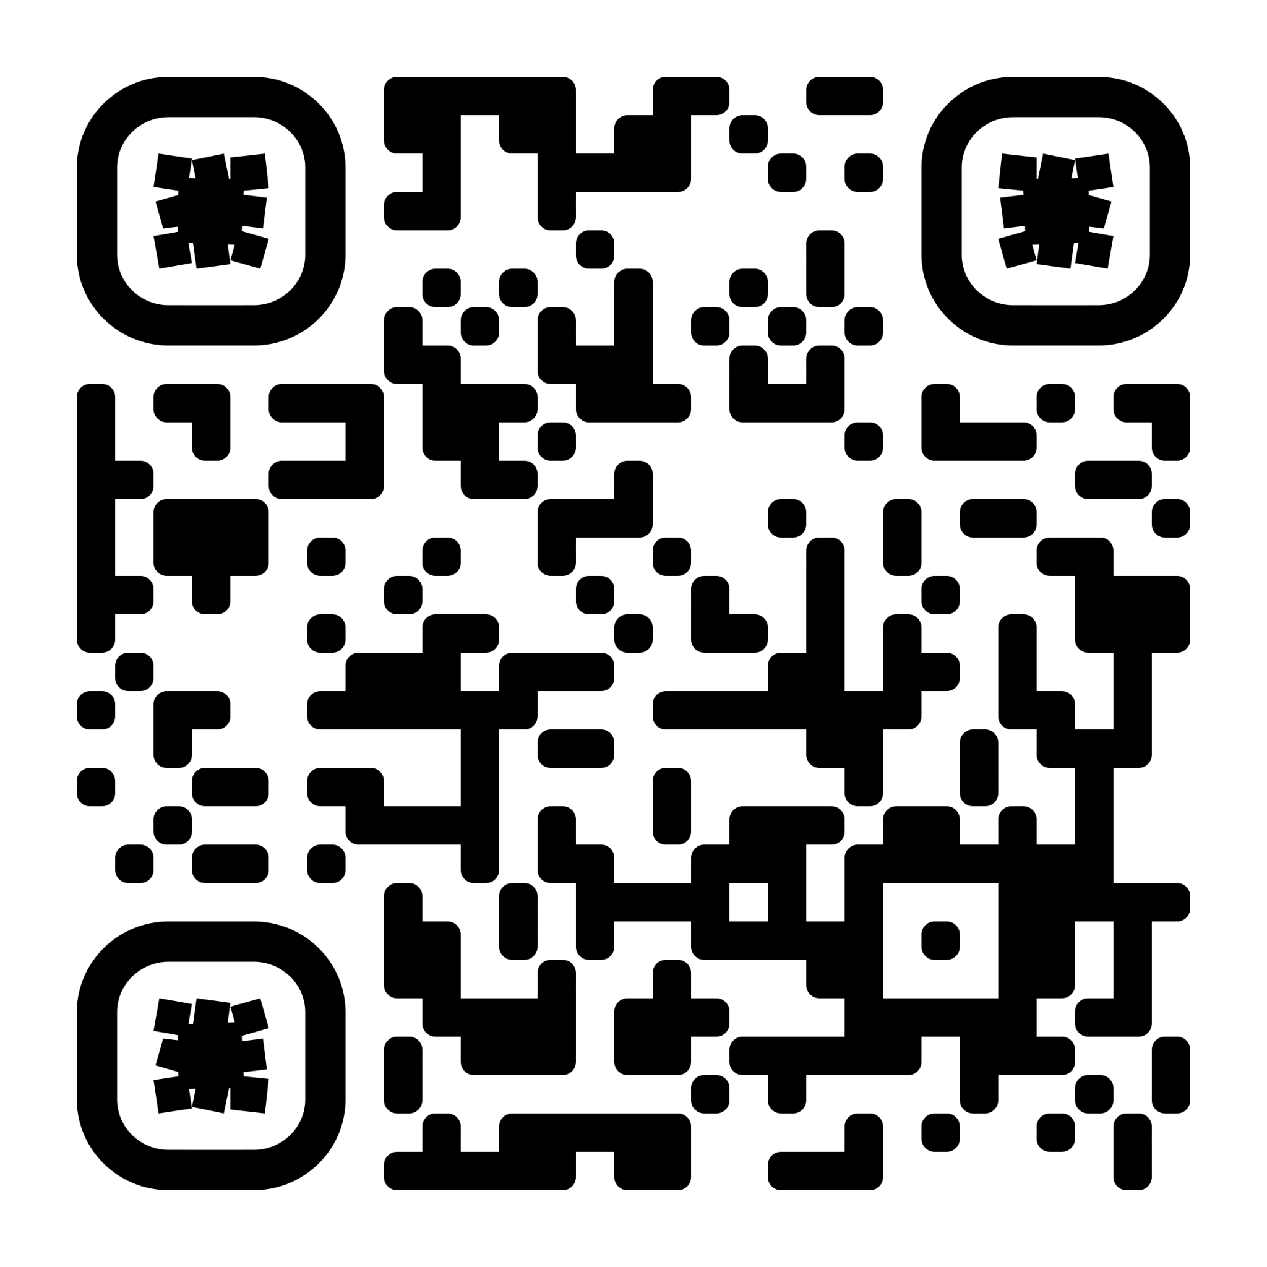
Primary Source vs Secondary Source Check In
Before analyzing the primary source document it is first important to understand the difference between a primary source and a secondary source. Click on or scan the QR Code to complete the check in quiz.
CLICK HERE OR SCAN TO COMPLETE QUIZ

Slide 3
Primary Source Notes
Now that you understand the difference between primary and secondary sources it is time to analyze and make notes on our primary source document. Make notes to the best of your ability on the contents of the letter. Here are some things to keep in mind when creating your notes:
You do not need to write every word down word for word
Focus on important details about what the individual was going through or events described in it
Pay attention for any names, dates, locations (if there are any mentioned)
References to other individuals and their experiences
Link to full PDF or the Primary Source Letter

Slide 4
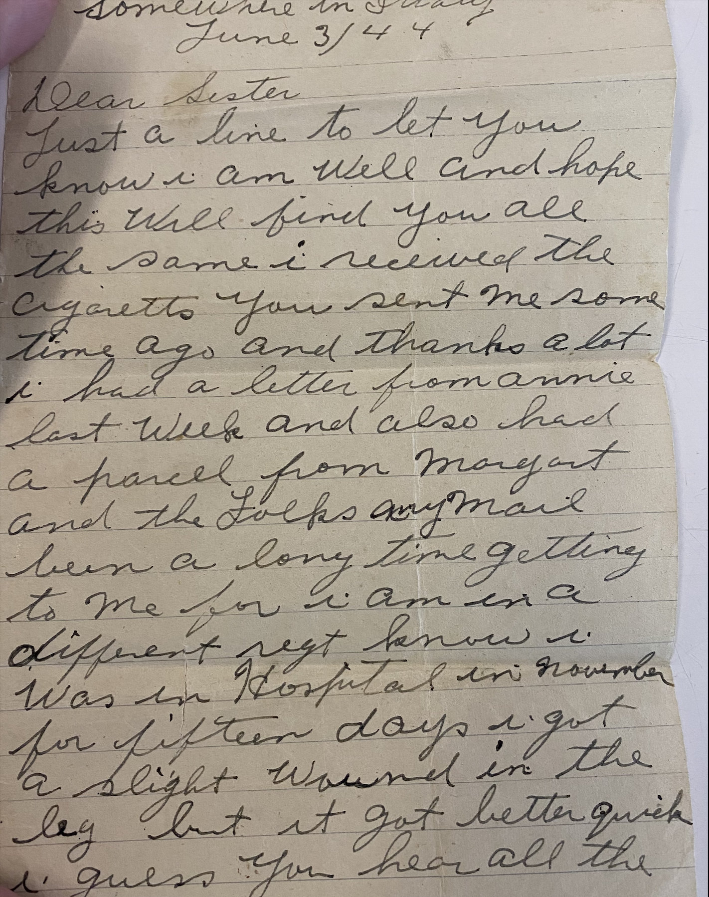
Notes: Location: Somewhere in Italy (Cut off at the top)

Slide 5
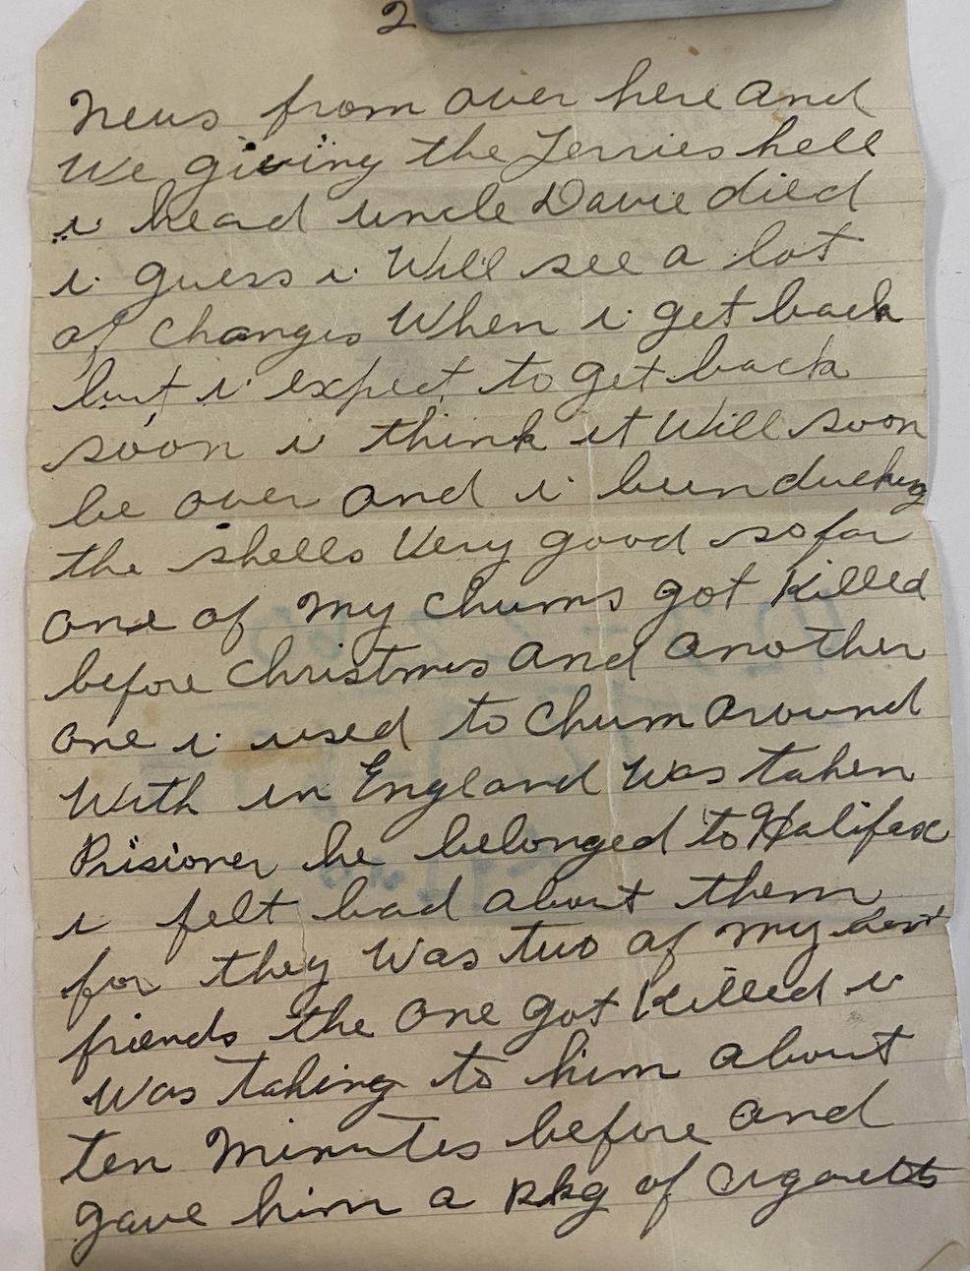
Notes:

Slide 6
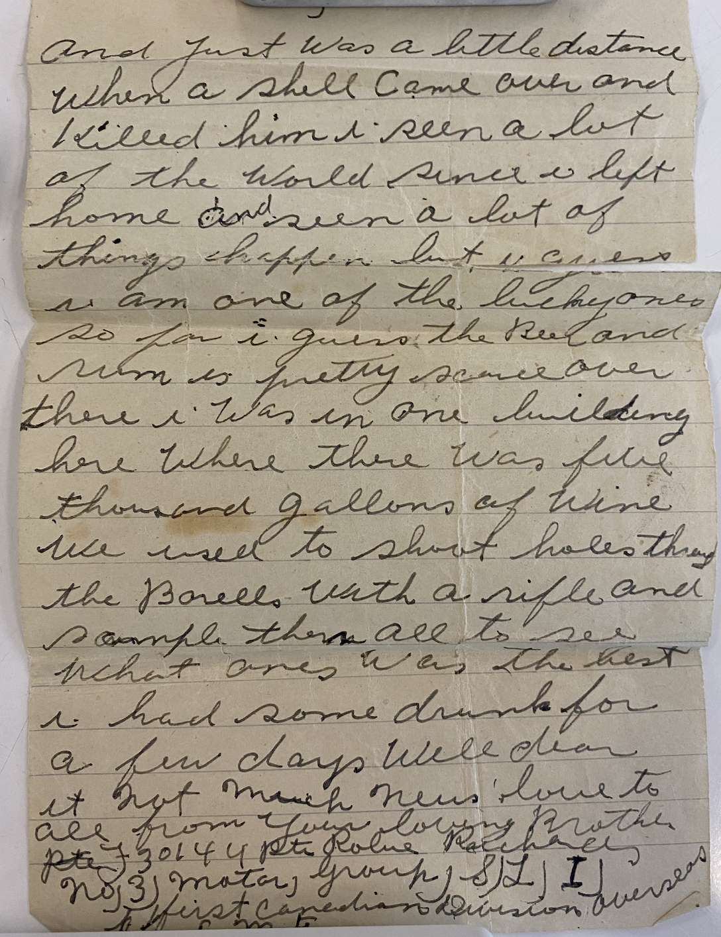
Notes:

Slide 7
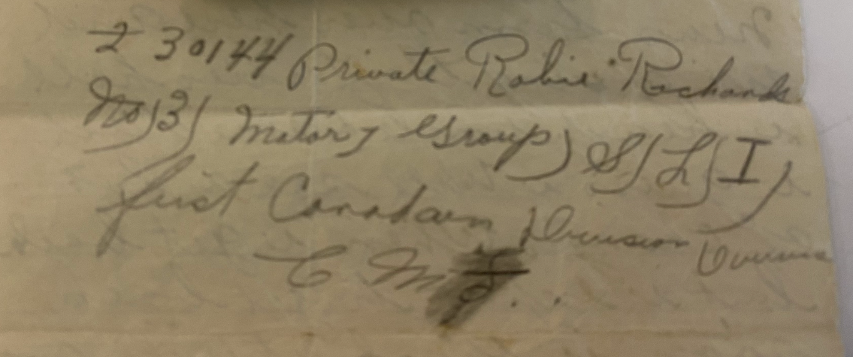
Notes:

Slide 8
Presenting Your Findings
Now that you have completed taking notes on the contents of the primary source it is time to present your findings. Using the information from the notes you took on the primary source, present your findings and what you learned from your analysis of the source. When it comes to presenting your finds you can:
Create a slideshow
Write an essay about your findings
Create a video analyzing the primary source and present your findings
Record a podcast in a small group discussing what you learned from the letter
Create a storyboard or comic to present your findings
Visual or Digital Representation
When finished make sure you submit your notes and final product to our google classroom.

Slide 9
Sources:
Reading for check in:
Whitfield, Kathryn L. . A Changing Canada . Edited by Jill Colyer, Rubicon, 2021.
Primary Source Letter:
Special thank your to Ms Cheryl and her family for sharing this piece of family history to make this assignment possible.

