Slide 1
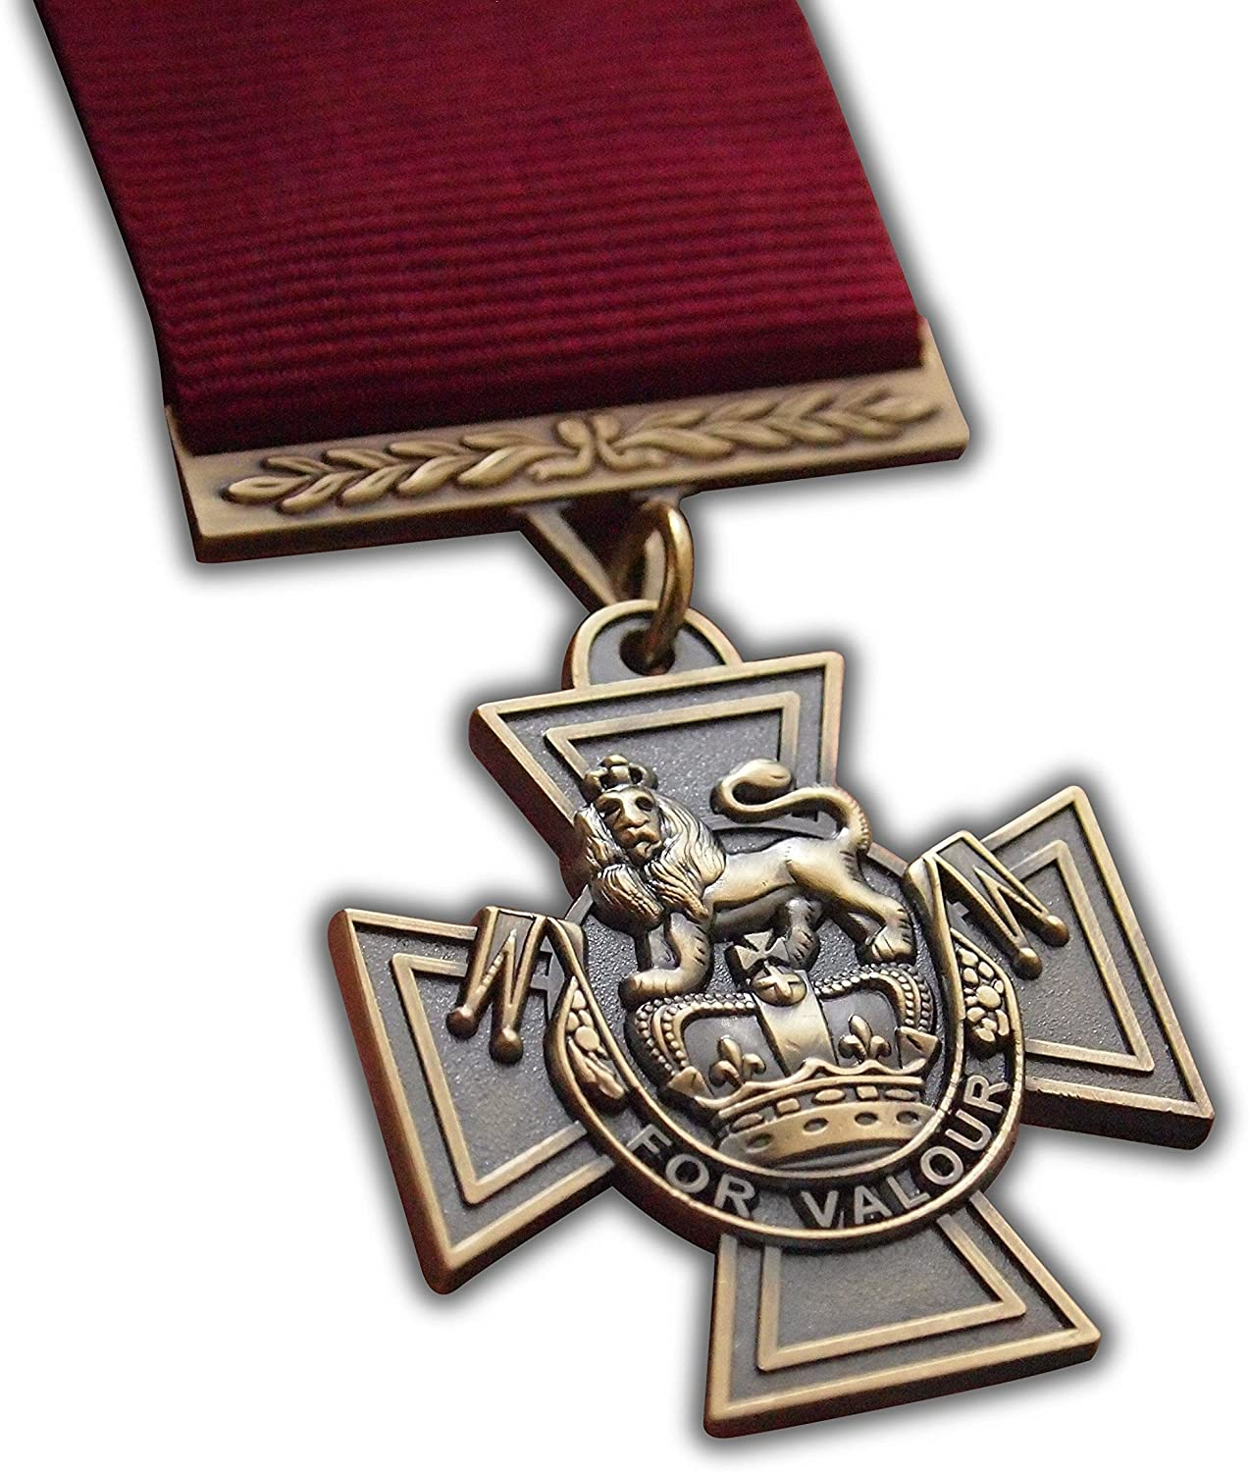
Victoria Cross

Slide 2
Victoria Cross
The Victoria Cross is awarded for bravery or some daring act of valor, self-sacrifice, or extreme devotion to duty in the presence of the enemy
It was introduced on January 29 1856 by Queen Victoria to honor acts of valor during the Crimean War
It is the highest and most prestigious award of the British honors system and has been awarded to 99 Canadians (WW1 - 73, WW2 - 16)
Since WW2 it has only been awarded 15 times. 11 to British soldiers and 4 to Australian soldiers
There is a rumor that the medals are made from old russian cannons that were captured in a famous battle during the Crimean War but historians say they are made out of 1914 cannons from China
The medal was awarded by the british military to any members of the commonwealth (former territory of the British empire)
Canada now has its own Victoria Cross which was established in 1993, but no one has been awarded one yet.

Slide 3
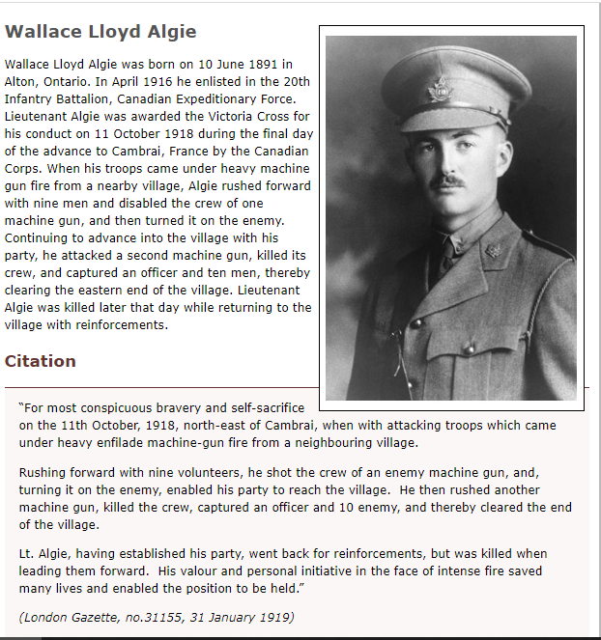
The VC winner I have chosen to look at is Wallace Algie.
1. On Oct 11, 1918, he was able to take on an enemy machine-gun unit.
2. He was able to take over the unit allowing for his party to reach the village.
3. He was able to take another machine gun unit capturing an officer and 10 men.
4. Sadly he would be later killed in battle but his bravery saved many lives.

Slide 4
