Slide 1
Mexico
Drug Cartels & Public Safety
Nolan and Joshua

Slide 2
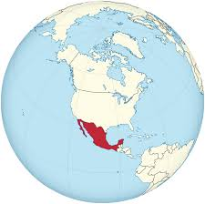
Country background
Mexico on Map:
Mexico is located in North America and is the 13th largest country in the world covering by land mass. Mexico has a population of over 130 million making it the most populous Spanish speaking country, culture and nation with about 10 million of that huge population English speakers. Mexican culture is a vibrant, cultural mosaic shaped by a profound blend of ancient indigenous roots and Spanish colonial influence. Mexico’s economy is the 13th largest globally.

Slide 3
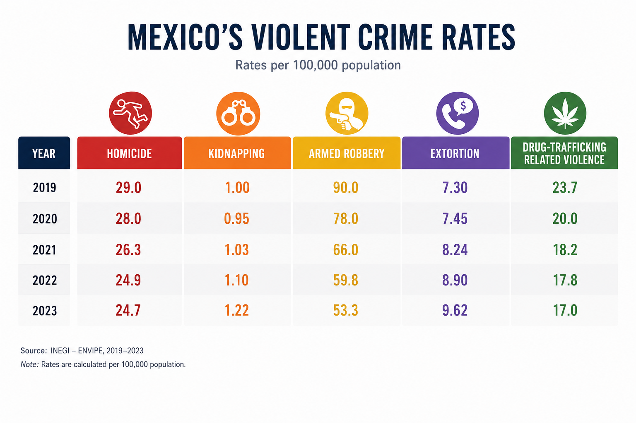
The Global Issue
Mexico has many global issues but the more important ones are the Drug Cartels and Public safety. Drug Cartels in Mexico are highly organized, underground criminals that control large portions of the country, and they dominate the global synthetic drug trade. They particularly trade in Fentanyl and Meth. Public safety in Mexico is a bad issue because they have high rates of violent crimes. These violent crimes include homicide, armed robbery, kidnapping and extortion. This is a big global issue to fix to better the community in Mexico and to increase tourists visiting rates.

Slide 4
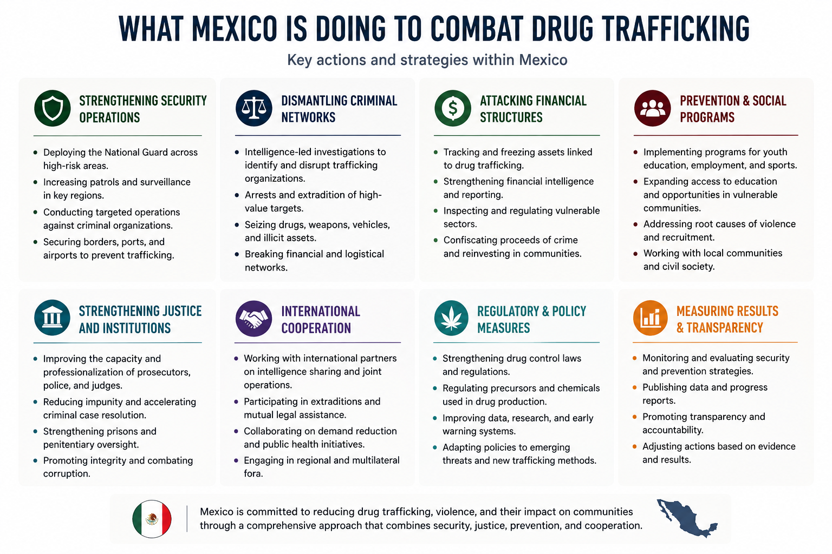
Country Responses
Mexico’s government, Claudia Sheinbaum, is aggressively working on identifying the main causes for these global problems, most addressed being drug trafficking. Claudia has launched Operation Northern Border, solely focused on breaking the chain of commands in the cartel groups such as the Sinaloa Cartel and CJNG. This operation resulted in over 41,000 traffickers and suppliers arrested, 1,900 drug labs seized and destroyed, and seized over 1.8 tons worth of fentanyl. Although these operations seem to be doing a lot, Mexico is still suffering from trafficking through undiscovered territory, stashing and storing drugs for someone else to collect. The government is tracking down on these loose ends and ending this global issue.

Slide 5
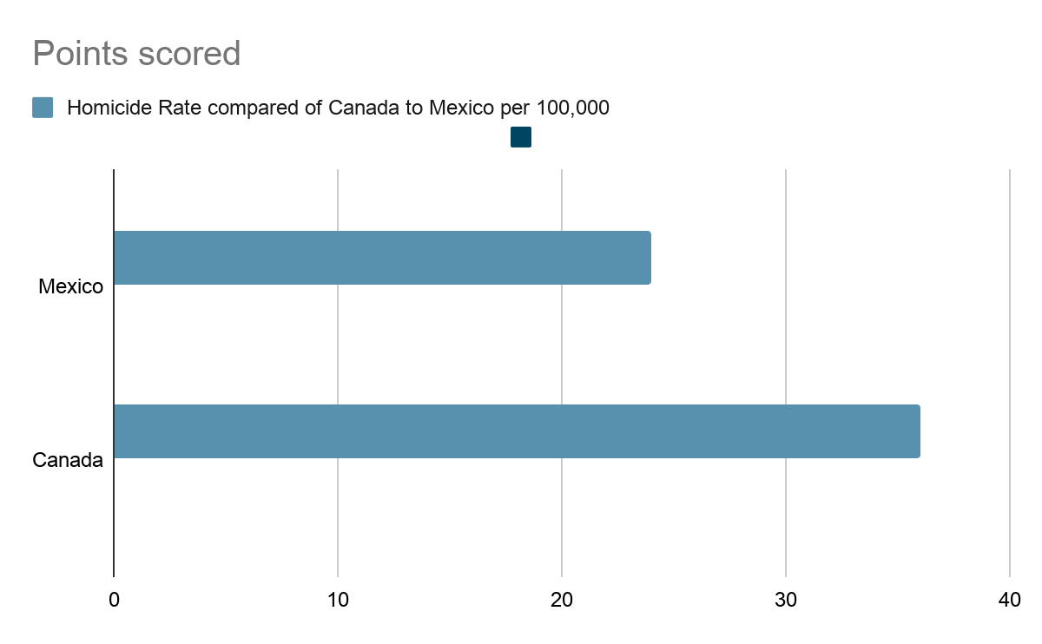
Consequences
Some problems with intended and unintended consequences range from different areas like capturing high rank cartel as a way to dismantle that specific group but the consequence is how that dismantled group has no leader and acts on pure rage as a honor for their lost leader risking citizen safety or police safety.
Some short term effects from the cartel for public safety can be how spikes of homicide occur due to a problem made by the police like kidnapped cartel members or killed leaders can make unpredictable cartel groups with a rage to kill innocent people for revenge and they will move to smaller, quieter states involving more and more people into the cartel business.
Some long term effects can be how bad cartels get disrupted and become small, ruthless groups with no fear to lose anything as they have lost one of their products or members. This is a crucial problem when tackling the cartel as public safety becomes a huge problem while raiding or arresting members with ties to the public.

Slide 6
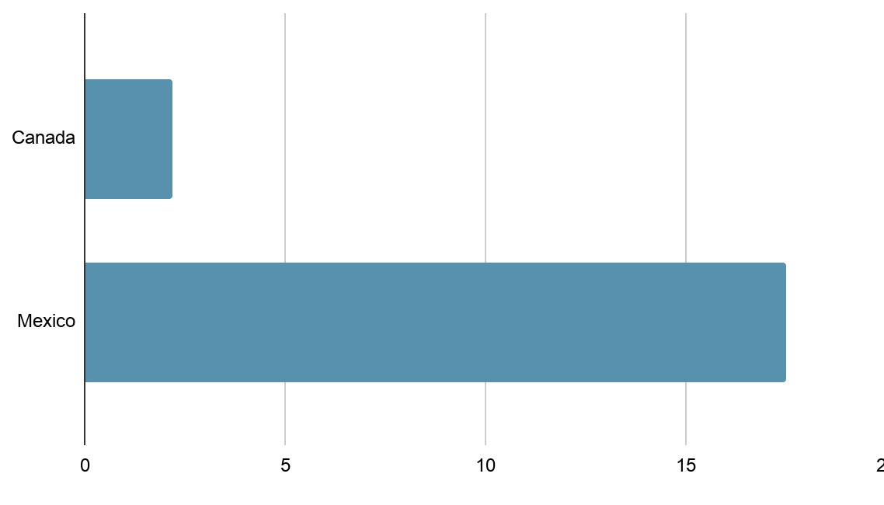
Comparing Canada to Mexico
Canada compared to Mexico sounds like heaven versus hell but Canada has some big problems as well. Mexico’s population is estimated to be around 131 million people compared to Canada having around 40 million people with Mexico having only around 1.96 million km in land mass versus Canada being the world’s second largest country in landmass and having 89 million people less than Mexico making it sound very populated in Mexico blending in cartel members very easily. Compared to Canada in homicide rates, Mexico has a rate of 17.5 people in 100,000 people compared to 2.2 people in 100,000 people making Mexico deathly dangerous. Cybercrime is much more common in Canada compared to Mexico because technology is not as valued in Mexico with them not knowing much about cyber currency. The police in Canada is heavily focused on civilian safety because national trafficking with different products aren’t as common as Mexico’s rates. However, Mexico’s police force is disciplined to militarize checkpoints and roads heavily making traffic much more common and worse if a drug is found on a truck or car.
Bar Graph for population in Canada versus Mexico:

Slide 7
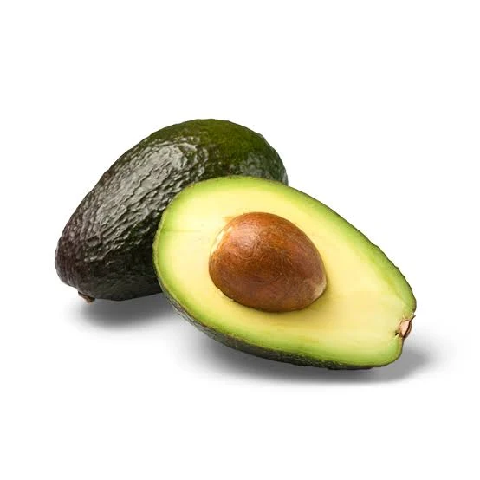
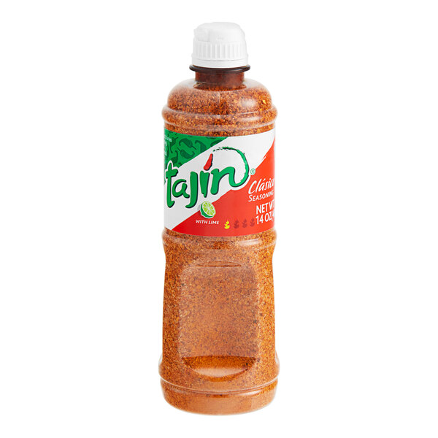
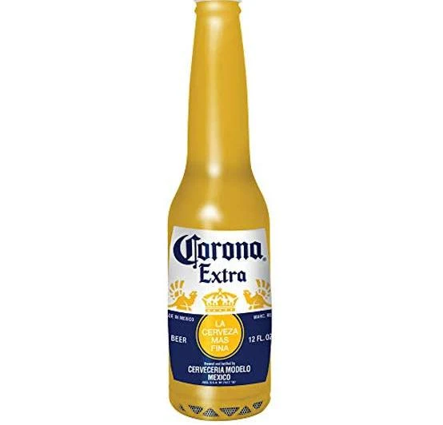
Reflection
Canadians should care about Mexico’s safety because it’s our neighbouring country from USA and because the trades between Mexico and Canada will be destroyed if we don’t care losing our 3rd best seller single handedly losing millions of dollars worth of products popular in Canada like avocados, Tajin, and Corona Beer.

Slide 8
Sources
<41K arrests and 1.8 tons fent seize>
<Operation Northern Border>
Google Gemini for images
AI Overview for summaries

