Slide 1

Afghanistan
Women's Rights and Education
By: Laila and Josie

Slide 2
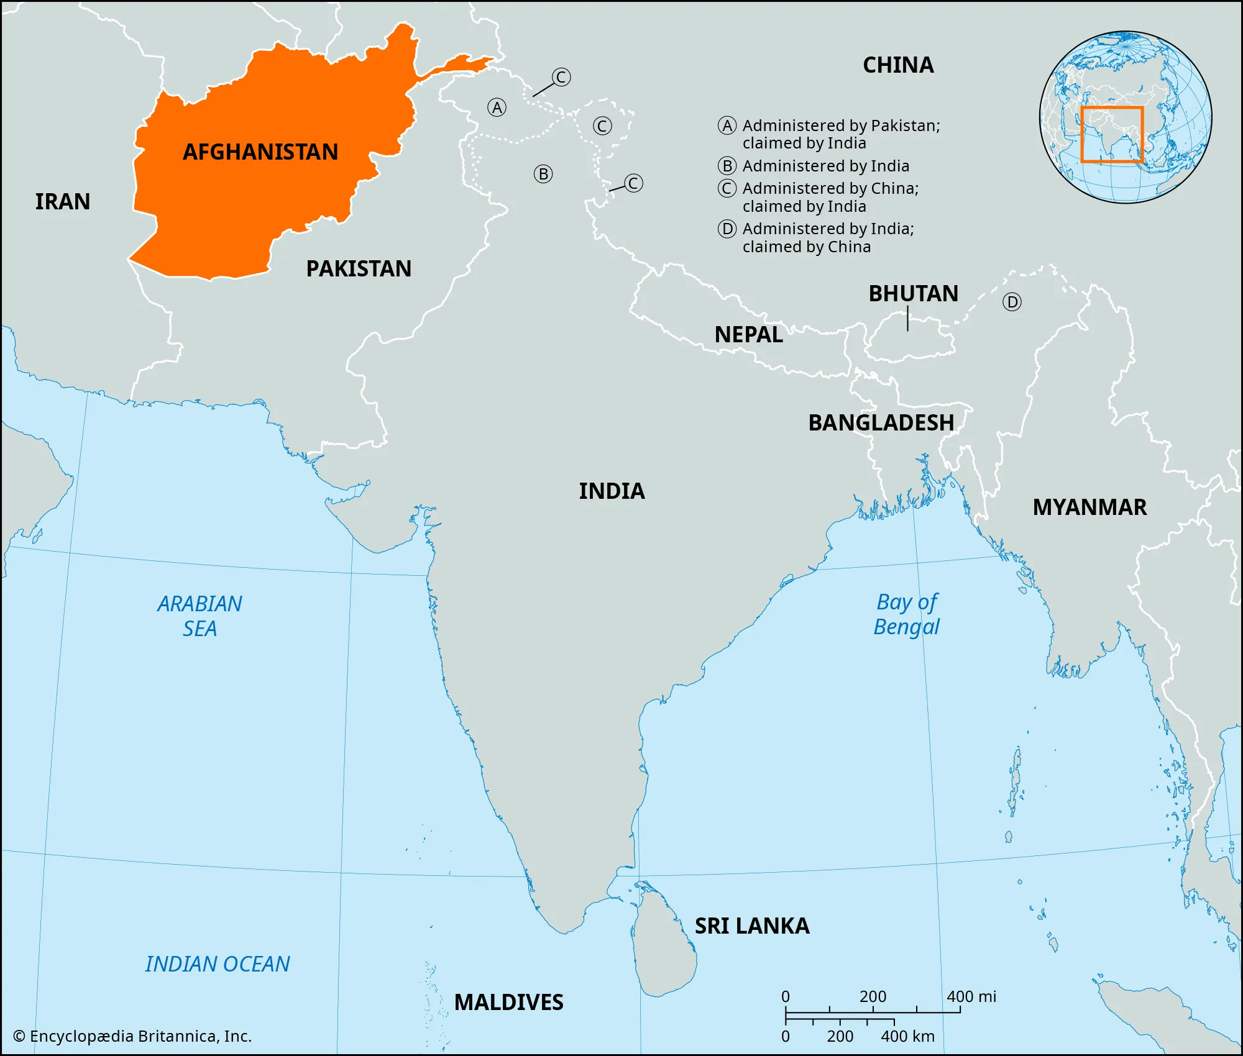
Afghanistan’s background
Culture/language: Afghanistan is a multilingual society with over 40 languages and lots of dialects spoken across different regions. The most common languages include Dari (Afghan Persian), and Pashto. Afghanistan has a traditional, fundamentalist culture rooted in Islamic principles.
Economic Context: Afghanistan has one of the poorest economies in the world even though it has such valuable natural resources. Some of the resources they have are minerals and there are lots. Some are lithium, copper, iron, gold, cobalt and so much more. They also are known for their farming and growing fruits and nuts. There is pomegranates, grapes, melons and other dry fruits. But however, after years of wars and political problems it has been hard to get these resources. Because of this afghanistan is one of the poorest countries in the world and imports more than exports.

Slide 3
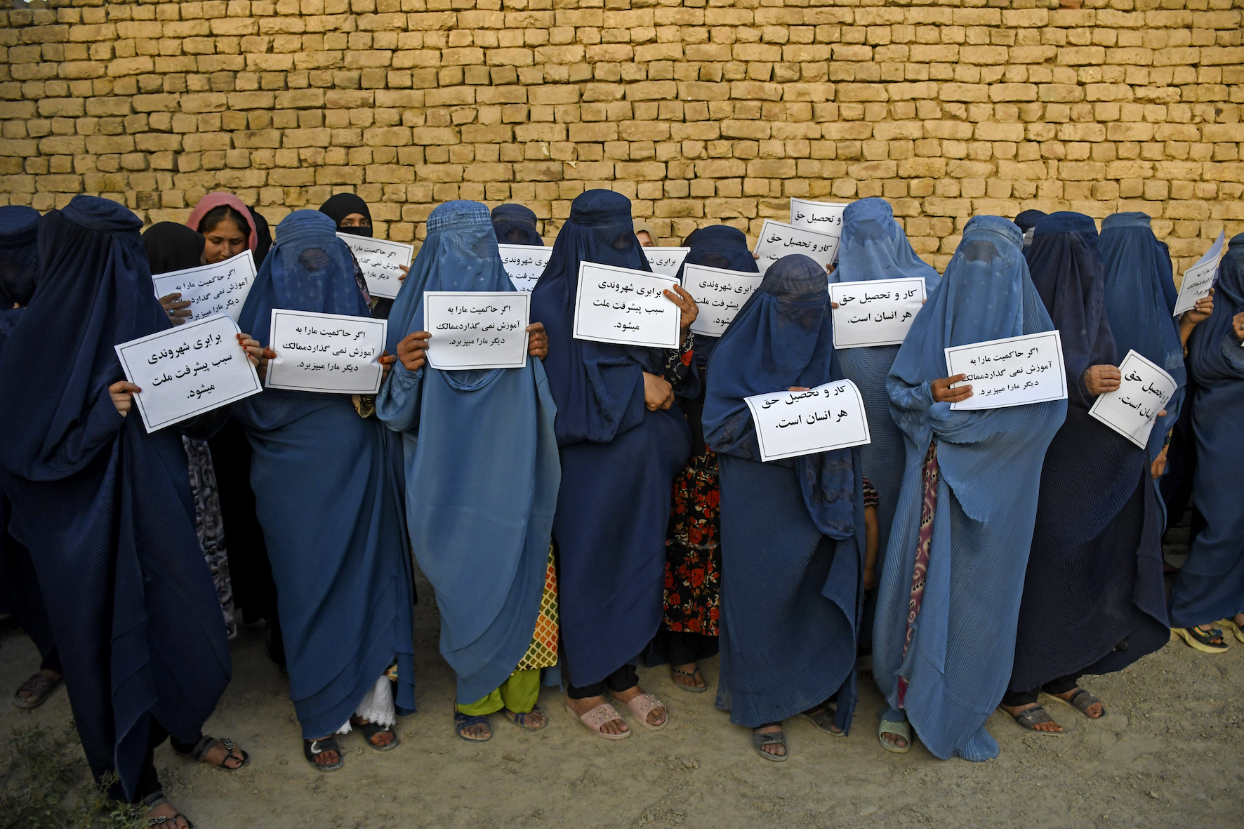
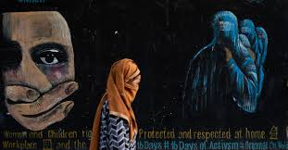
The main issue
The main facing issue in afghanistan for girls is the limited access to education Women's rights and education are major issues in Afghanistan. Women's rights means that girls and women should get equal access to all opportunities for education, healthcare, jobs and other basic opportunities. Since 2021 when the power of the taliban was returned, afghanistan became the one country that bans girls and women from secondary school and anything higher. at least 1.4 million girls have been denied access to attend secondary education, and in total, 3.8 million girls in Afghanistan are out of school, all of their knowledge and talents are getting lost or wasted. Woman are also facing lots of challenges when trying to access healthcare, getting jobs and other opportunities.Since the takeover, fear, travel restrictions, ban from education, and systemic discrimination are keeping the woman from things they need, and woman have been scared to even leave their homes. Here's a fact: 1 in 3 girls were being forced into marrage before the age of 18. This number continues growing and has an impact on women

Slide 4
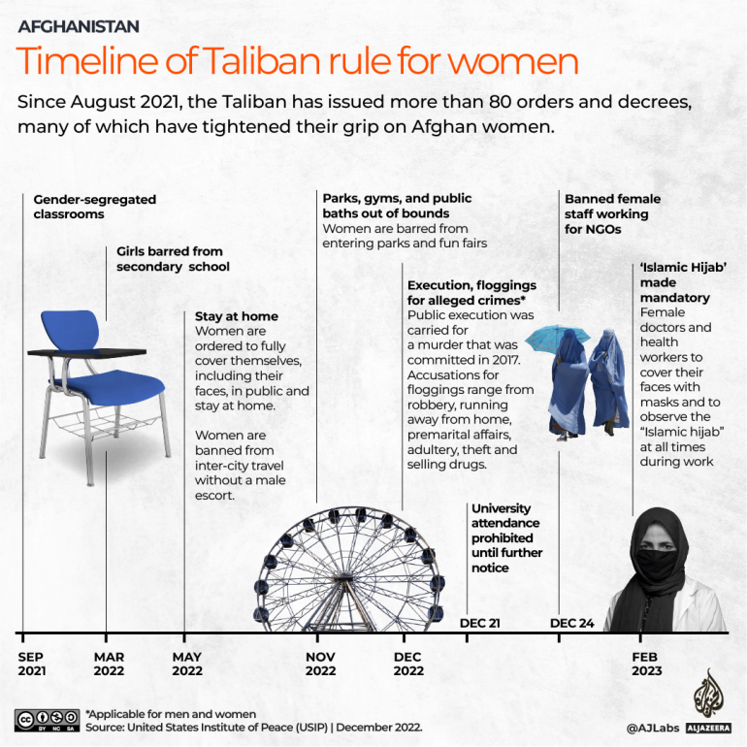
Country's response
In Afghanistan, the taliban governent since 2021 has just responded to womens rights and their education by continuing to introduce and enforce more strict rules, some that include baning girl above grade 6 from attending school. This just shows how this is active government actions that continue rather than trying to improve things for girls and women or getting them access into education. Evidence we can see from UNESCO, they reported that 80% of Afghanistan girls and young women are not attending school or university which has affected 2.5 million girls. And even the United Nations describes Afghanistan as “most repressive country in the world” for womens rights and their education. UNESCO has been trying and making a effort to provide and make alternative methods for their learning even with all of the difficult policies and conditions.

Slide 5
Consequences

Slide 6
Canada and reflection

Slide 7
Sources we used!
Medica Mondiale. (no date). Women’s rights in Afghanistan. https://medicamondiale.org/en/where-we-empower-women/afghanistan
Al jazeera news. (2023). International Women’s Day: The exclusion of Afghanistan’s women. https://www.aljazeera.com/news/2023/3/8/international-womens-day-the-exclusion-of-afghanistans-women
UN Women. (2025). FAQs:What it’s like to be a woman in Afghanistan today. https://www.unwomen.org/en/articles/faqs/faqs-afghanistan
UNESCO. (2024). Afghanistan: 1.4 million girls still banned from school by de facto authorities. https://www.unesco.org/en/articles/afghanistan-14-million-girls-still-banned-school-de-facto-authorities

