Slide 1





Sebastien Charles
Darwin Huang
Eric Mendoza-Conner

Slide 2





Technologies

Slide 3



Scraping

Slide 4
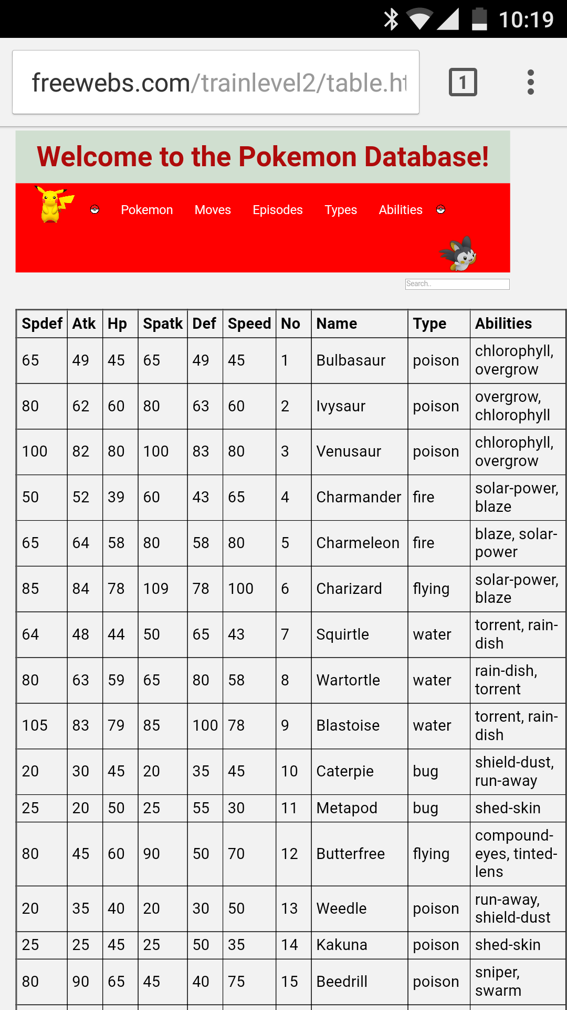
Functionality
All information about Pokemon, Moves, Types, Abilities, and Episodes
Click on Moves, etc. to find more information about it like a description and other Pokemon that can learn it

Slide 5
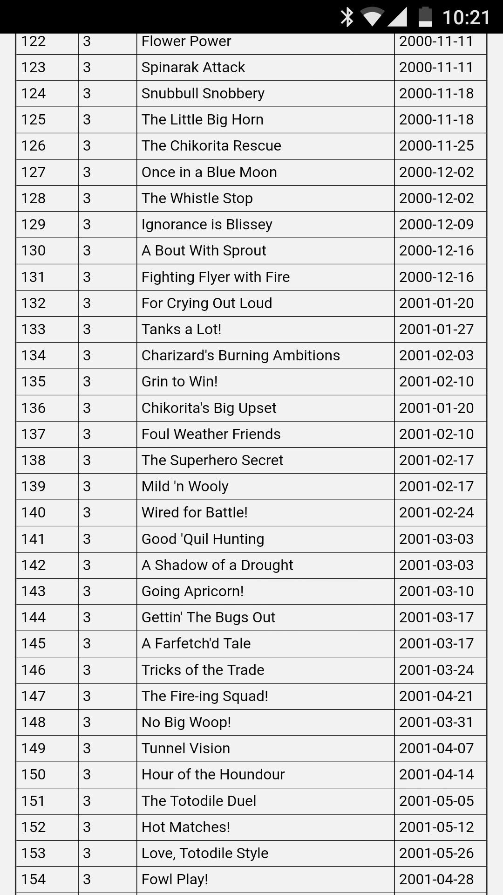
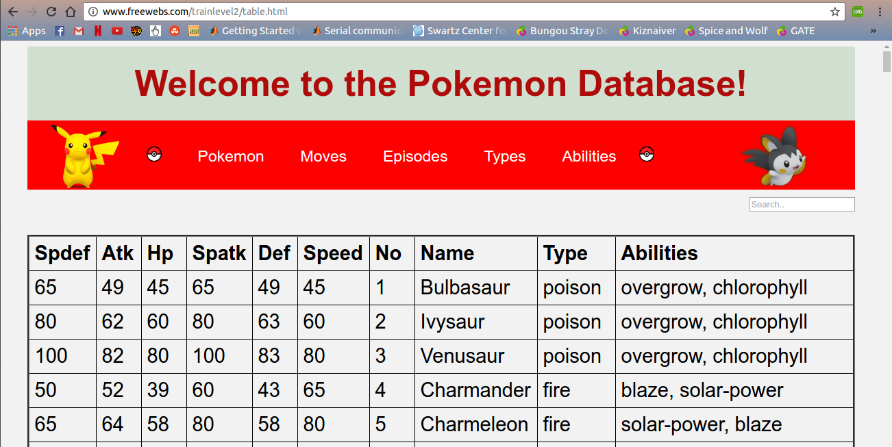
Demo
http://freewebs.com/trainlevel2/

