Slide 1







STACK OVERVIEW DEVELOPER SURVEY 2019
Dwayne Clarke
MAY 19, 2024

Slide 2



OUTLINE
Executive Summary
Introduction
Methodology
Results
Visualization – Charts
Dashboard
Discussion
Findings & Implications
Conclusion
Appendix

Slide 3

EXECUTIVE SUMMARY
Data contextualization and Analysis goal.
Methodology description.
Data gathering
Data analysis
Data visualizations
Results presentation supported with graphs and trends.
Discussion of overall findings and implications regarding the results previously exposed.
My Final Conclusions of my research

Slide 4

INTRODUCTION
Stack Overflow’s annual Developer Survey is the largest and most comprehensive survey of people who code around the world.
Results don’t represent everyone in the developer community evenly.
Nearly 90,000 developers.
Trends to predict where the developers are going.
Characterization of developers around the globe.

Slide 5

METHODOLOGY
Collect survey data & explore its content
Web Scraping
APIs.
Request library.
Data Wrangling
Exploratory data analysis
Analyzing data distribution.
Handling outliers.
Correlations.
Data Visualization
Highlight distribution of data, relationships, the composition and comparison of data.
Dashboards

Slide 6

RESULTS

Slide 7
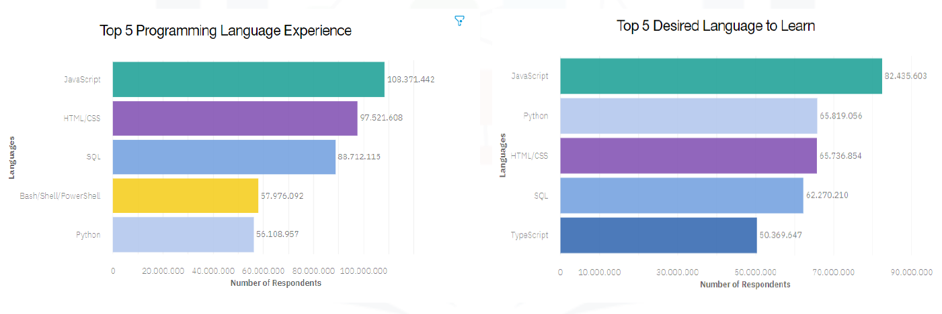
PROGRAMMING LANGUAGE TRENDS
Current Year from the top 5 instead top 10
Current Year from the top 5 instead top 10

Slide 8
PROGRAMMING LANGUAGE TRENDS - FINDINGS & IMPLICATIONS
Findings
JavaScript head programming language.
Python is growing and become more important in the future
SQL is database is become more important
Implications
Possible developer are forward to frontend languages for development
Shows new developers what languages are important.
Shows what language high school and college students in the focus on.

Slide 9
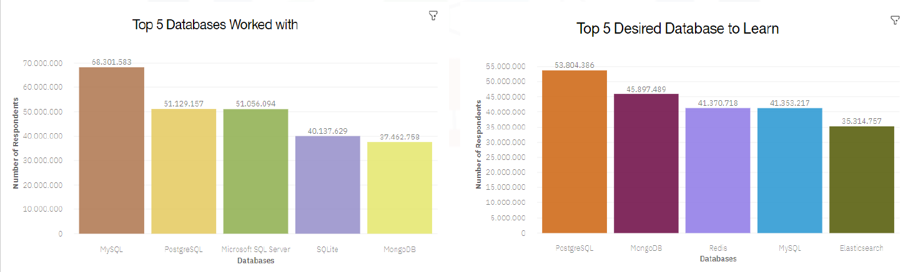
DATABASE TRENDS
Current Year from the top 5 instead top 10
Current Year from the top 5 instead top 10

Slide 10
DATABASE TRENDS - FINDINGS & IMPLICATIONS
Findings
MYSQL is most used code language for database
PostgreSQL is increase in popularly
Developers maybe using Linux for development.
Implications
Programming and Developers should start with MYSQL.
Many jobs are looking for MYSQL database for employees
Microsoft SQL server may not have the same popular as MYSQL and PostgreSQL

Slide 11
DASHBOARD

Slide 12
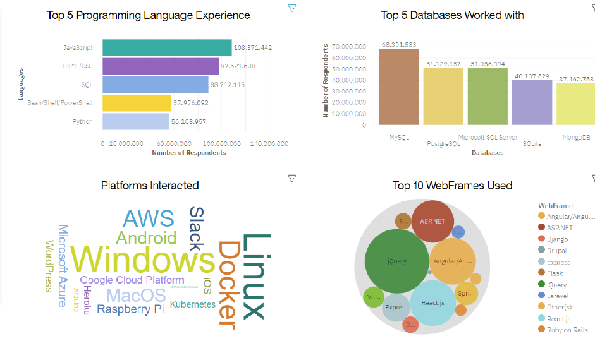
Current Technology Usage

Slide 13
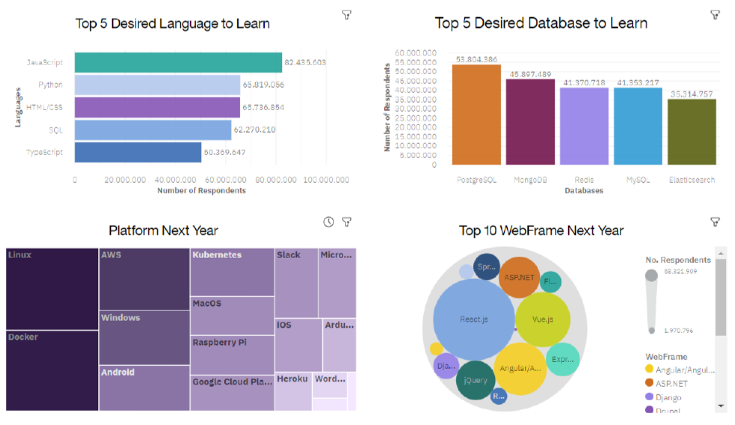
Future Technology Trend

Slide 14
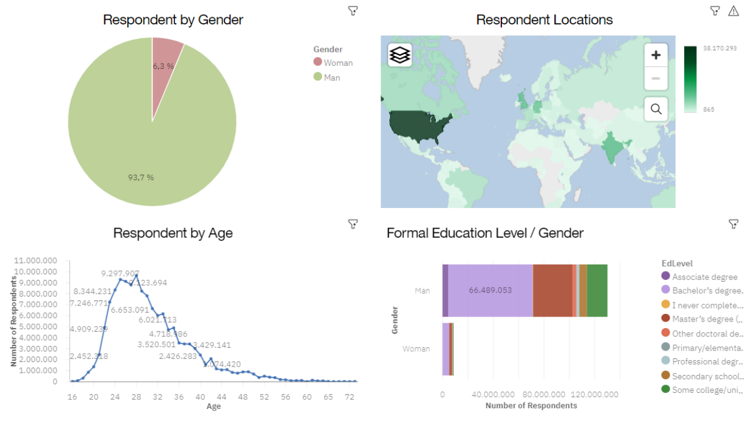
Popular Program Languages

Slide 15
DISCUSSION

Slide 16
OVERALL FINDINGS & IMPLICATIONS
Findings
Most developers are in there early 20’s.
Developers are in a heavy technology like Texas, Los Angeles, and New York.
The most used programs are JavaScript and MYSQL
Implications
The current generation is getting into programming.
Most of the popular language is frontend development
There are many locations for development and need programs in the future.

Slide 17

CONCLUSION
It’s a good idea to start with a program language that is popular in the U.S.
The job market is changing every single job and people will need to adapt
Developers will need to update and change there styles.

Slide 18

APPENDIX

Slide 19
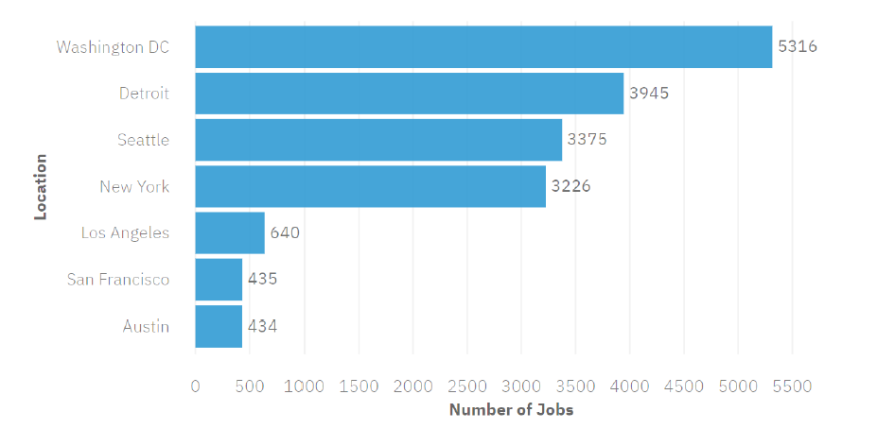
JOB POSTINGS

Slide 20
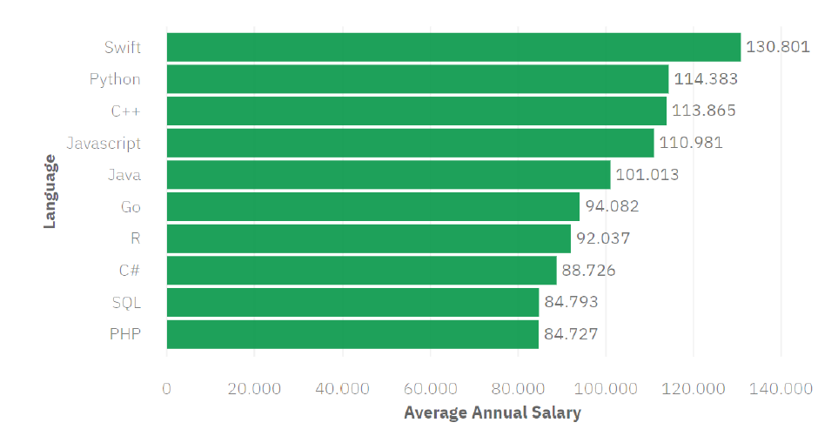
POPULAR LANGUAGES

