Slide 1




Supercomputer and Cluster Application Performance Analysis using Python
Daniel W. Barnette, Michael A. Heroux
(dwbarne, maherou)@sandia.gov
Sandia National Laboratories
Albuquerque, New Mexico
John W. Shipman
john@nmt.edu
New Mexico Institute of Mining and Technology
Socorro, New Mexico
PyCon 2011 Python Users Conference
Atlanta, Georgia
March 9-17, 2011
SAND2011-1290 C
Sandia National Laboratories is a multi-program laboratory managed and operated by Sandia Corporation, a wholly owned
subsidiary of Lockheed Martin Corporation, for the U.S. Department of Energy’s National Nuclear Security Administration
under contract DE-AC04-94AL85000.

Slide 2
Motivation
Sandia has developed/maintains/uses several DOD, DOE codes (CTH, AMG, UMT, SAGE, Xnobel, …); export controlled; long run times for typical applications
These are large codes; often benchmarked on new machines & simulators using a limited parameter space
Also…
Data management for performance results has long been relegated to manual entry into Excel spreadsheets which
Limits data analysis
Error-prone
Non-persistent storage
Limits collaborations
Usually owned by one person

Slide 3
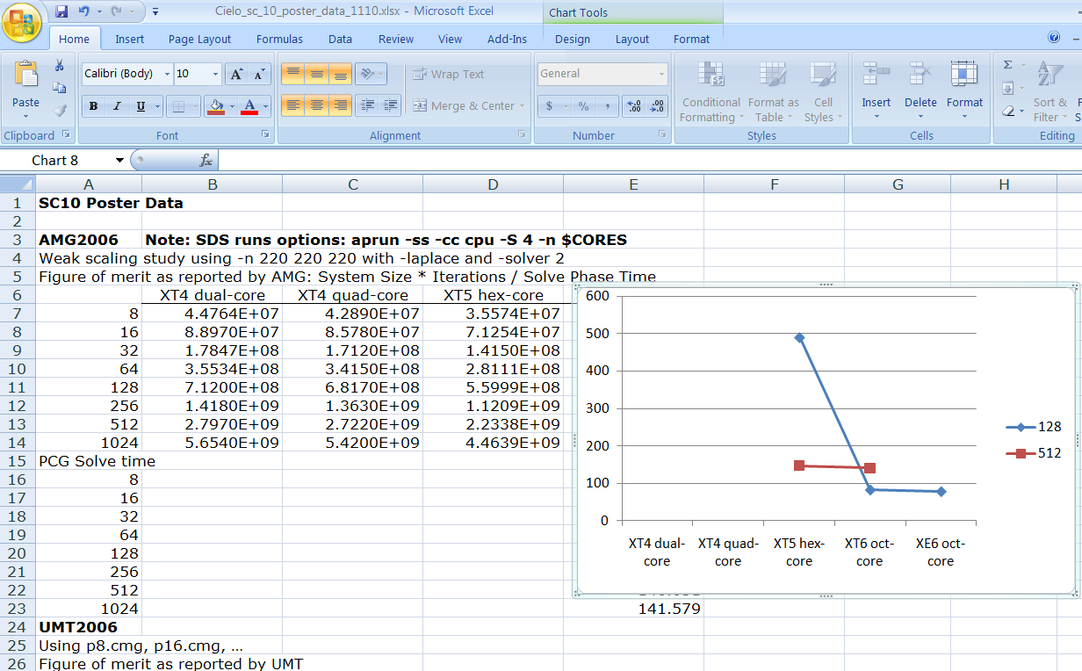
Common data collection approach: Excel Spreadsheets

Slide 4
Addressing the Problems
1. Scale DOWN large apps:
MANTEVO project
2. Scale UP data management and analysis techniques using Python:
Pylot / Co-Pylot / eCo-Pylot (Warning: name clash with www.pylot.org)

Slide 5
Mantevo* Project: Scaling Down Large Benchmarks
Mini-apps
Small, self-contained programs
Capture subset of large codes that defines performance; validate against parent benchmark to check physics kernel
Allow rapid exploration of parameter space
Aid in system design and acquisition decisions
Open Source (LGPL): Fosters external collaboration
Generate small YAML files containing performance data
MiniFE/HPCCG Unstructured implicit Finite Element/Finite Volume
phdMesh: Explicit Finite Element Method, contact detection
MiniMD: Molecular Dynamics force computations
MiniXyce: Electrical circuit simulation
MiniMC: Monte-Carlo simulations
CPU/GPU: In the works; probably a structured-grid aero code
https://software.sandia.gov/mantevo
* Greek: predict, presage
Notes:
\\Dropzone\public\VideoServices\McInteer\for_Mike

Slide 6
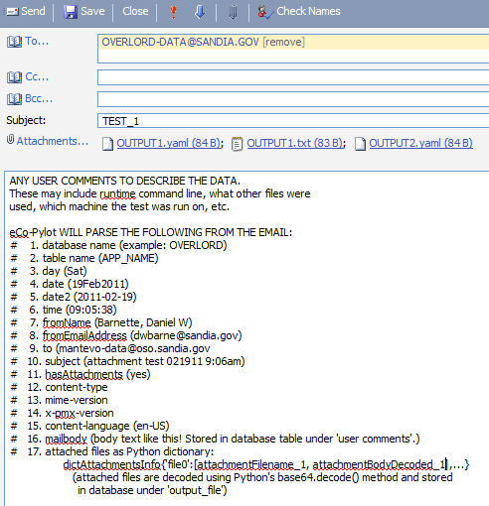
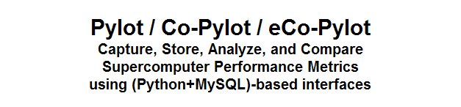
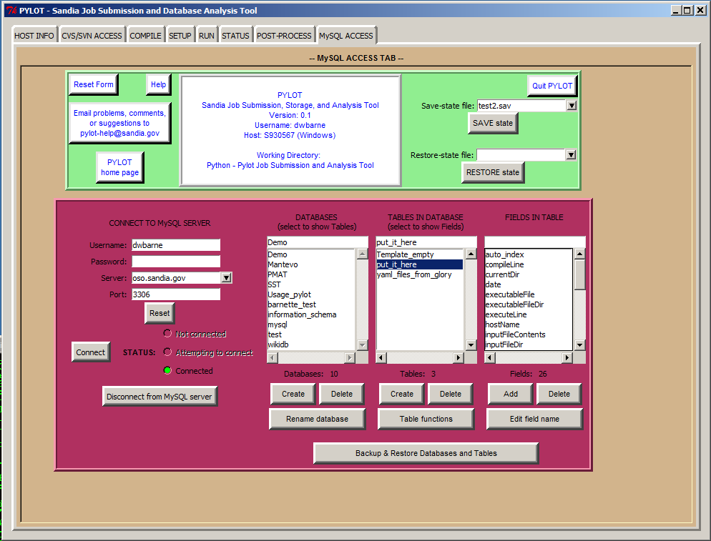
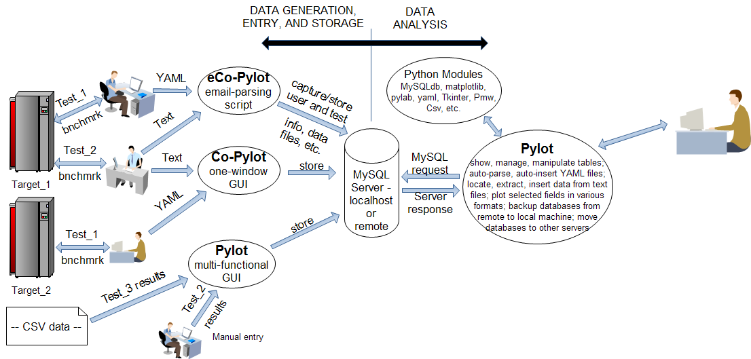

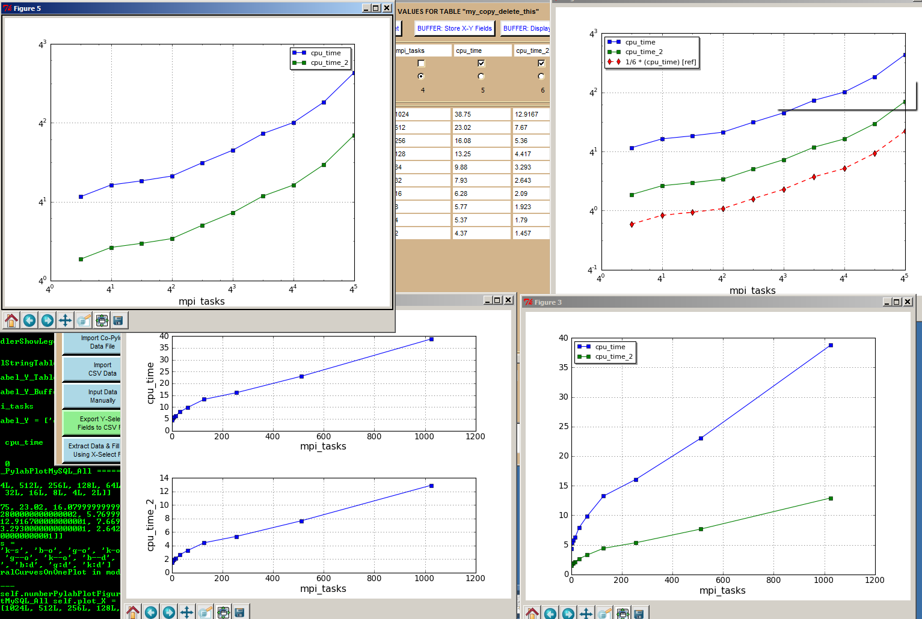

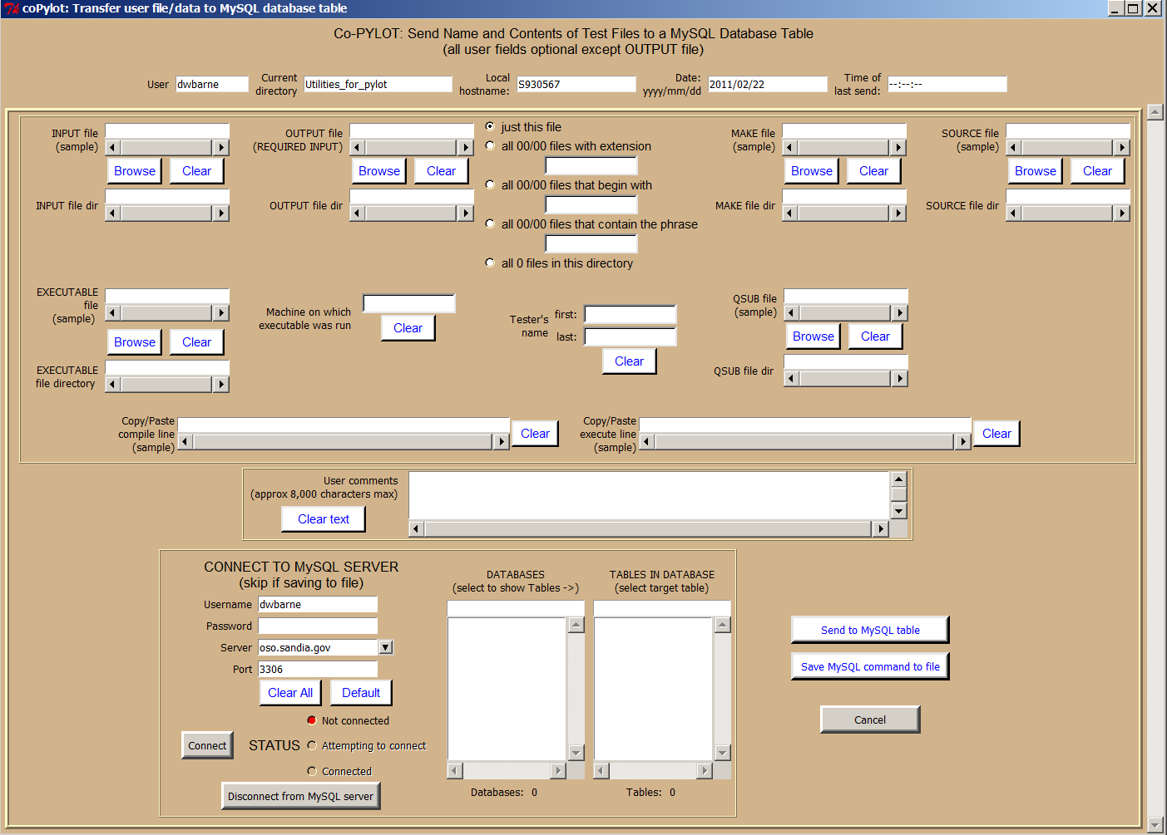
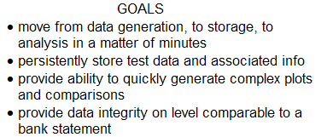
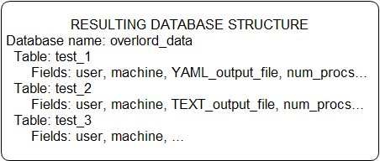
(uses matplotlib, MySQLdb, pylab, numpy, yaml, Tkinter, Pmw, …)

Slide 7
Co-PYLOT | eCo-PYLOT | PYLOT
1. Single-window, easy-to-manipulate interface for sending test data files to pre-formatted database table; easy for testers to use. 2. Allows tester to transfer up to 28 entities for database storage. 3. Automatically collects some user information such as date, time, etc., for simultaneous submission with data files to database table. | 1. Provides an easy, intuitive method for submitting test data files to a database table: EMAIL 2. Runs as a script on an email server 3. Using a .forward file, specially formatted emails, with all test data files as attachments, are intercepted. 4. Email is parsed to extract user info, date and time, test data files, database name (from email address), database table (from ‘Subject:’ line), etc. 5. Data is either auto-inserted into a database table if no errors are encountered, OR… 6. Errors generate a return email to sender stating what fields were missing, if any, or what error occurred. | 1. Displays MySQL database table and fields in intuitive row/column format, with user-selectable fields/columns (as usual in MySQL) and rows (NOT usual in MySQL) 2. Extracts data from data FILES stored in table fields; automatically expands the database with new fields to accept extracted data 3. Allows rapid plots of user-selected fields using X-Y, semi-log, log-log, or kiviat (radar) charts. 4. Can compare data across different databases, tables, database servers using built-in field storage buffer. 5. Performs statistical analyses on any field (text or numerical); rapidly generates pie charts, bar graphs 6. backup/restore entire databases, all tables of any database, or any table of any database 7. Allows manual insertion of data into database tables 8. edit any row or collection of user-selectable rows in a database table 9. … and more

Slide 8
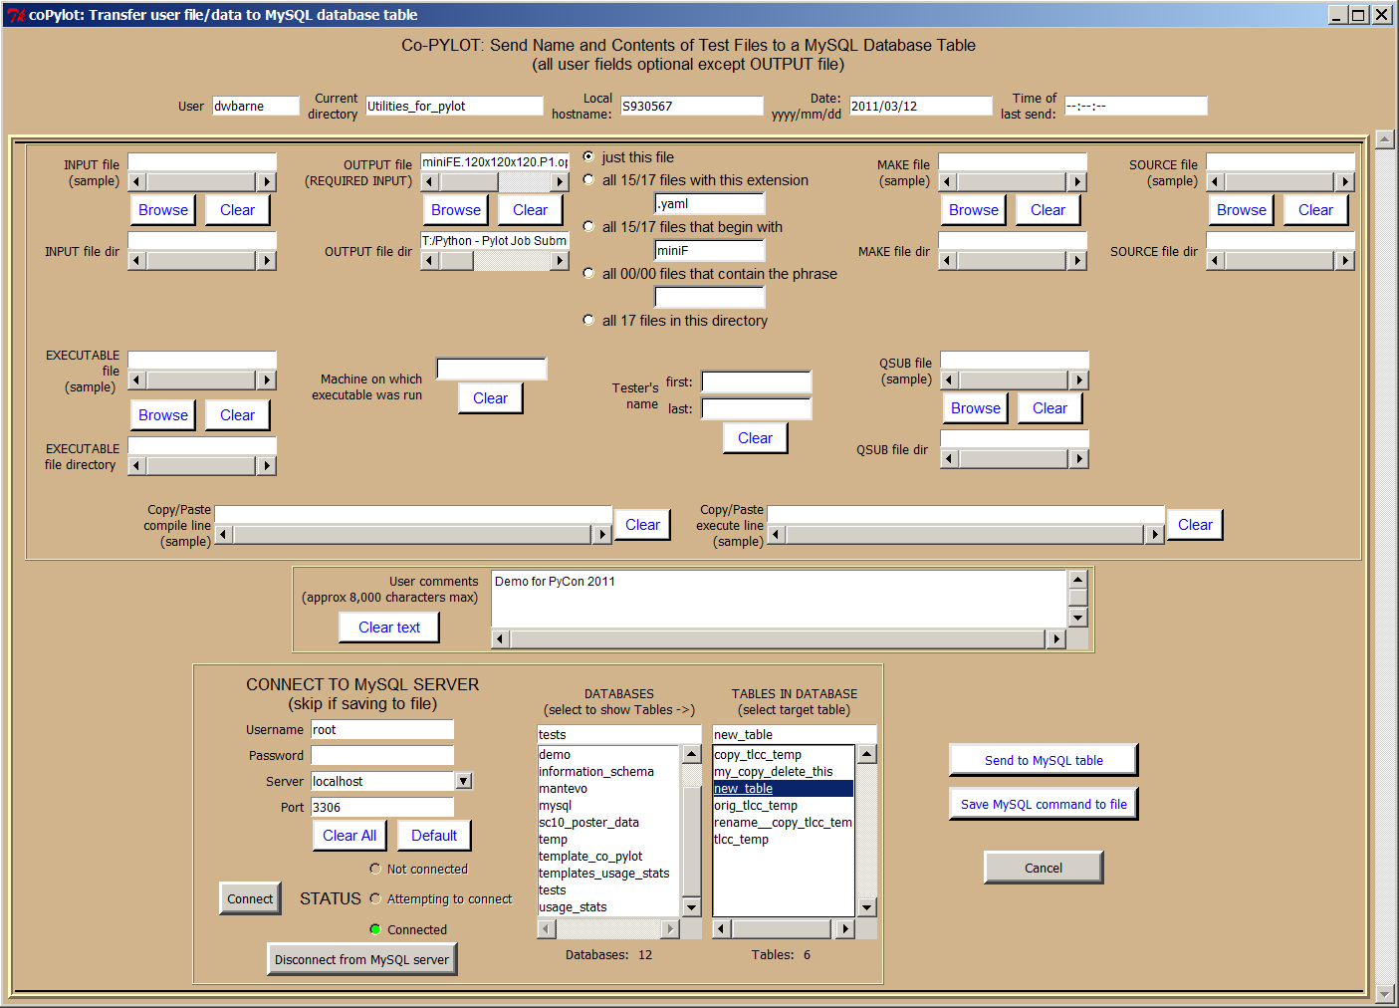
One Example: Co-Pylot Interface

Slide 9
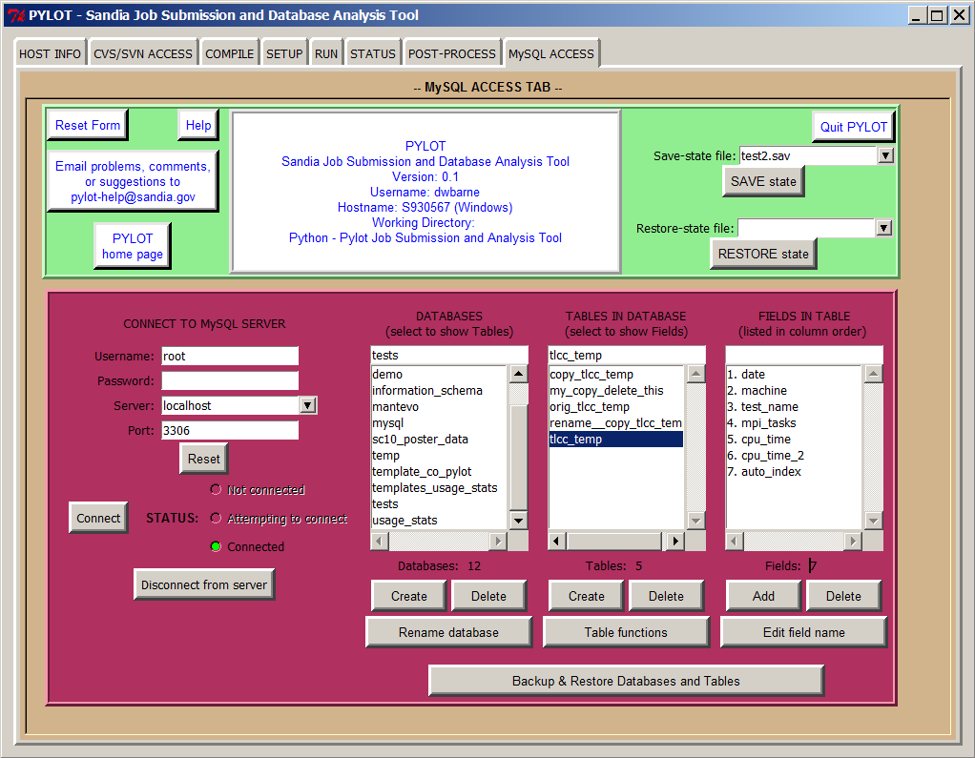
Pylot Main Screen

Slide 10
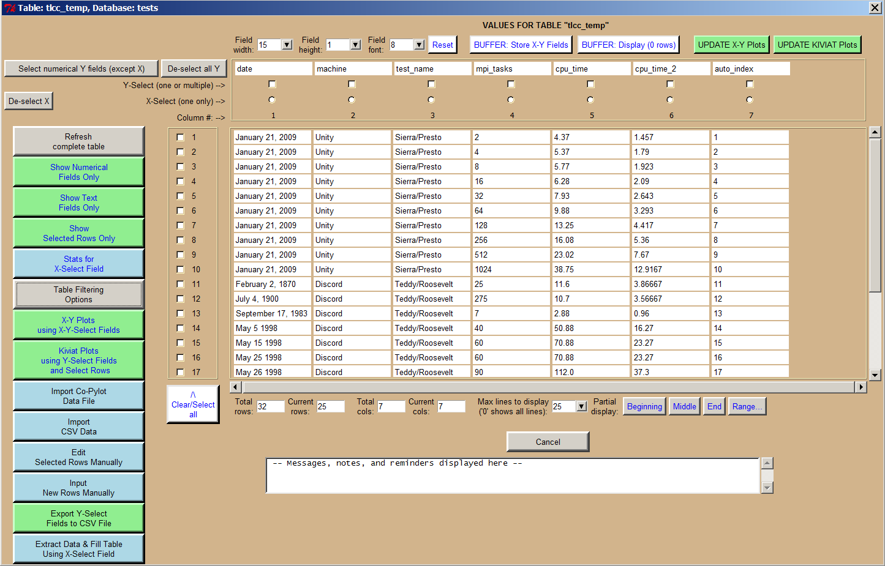
Pylot Database Screen

Slide 11
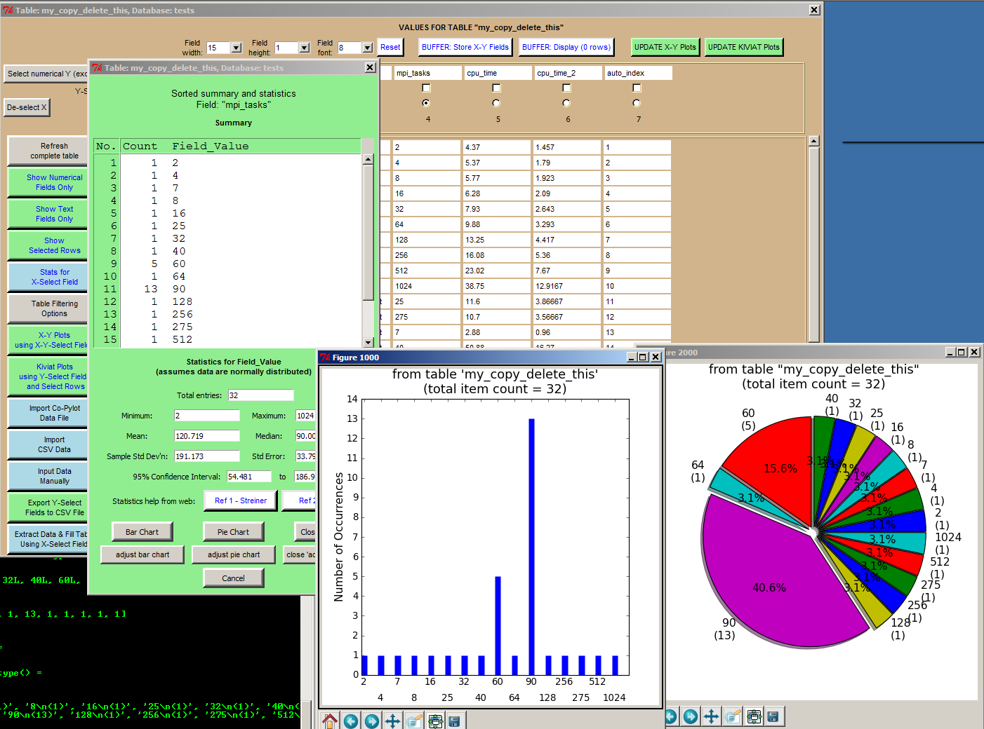
Pylot Bar and Pie Charts

Slide 12
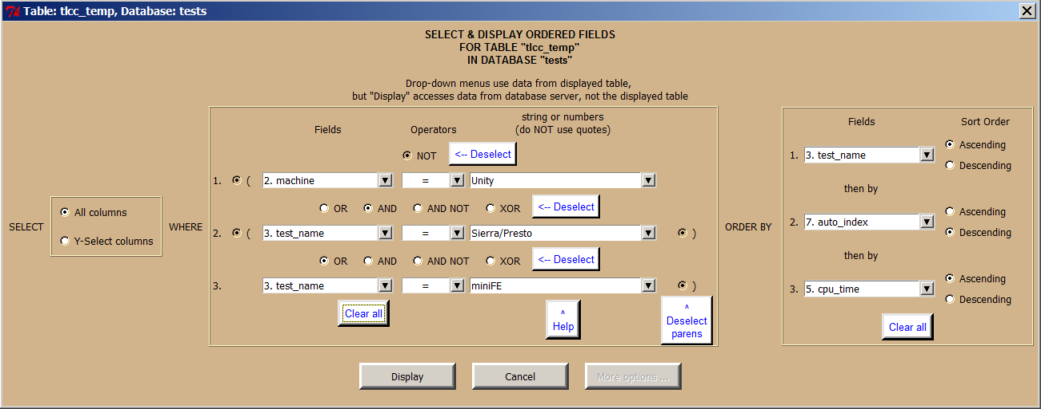
Pylot Filter

Slide 13
Pylot X-Y Plots

Slide 14
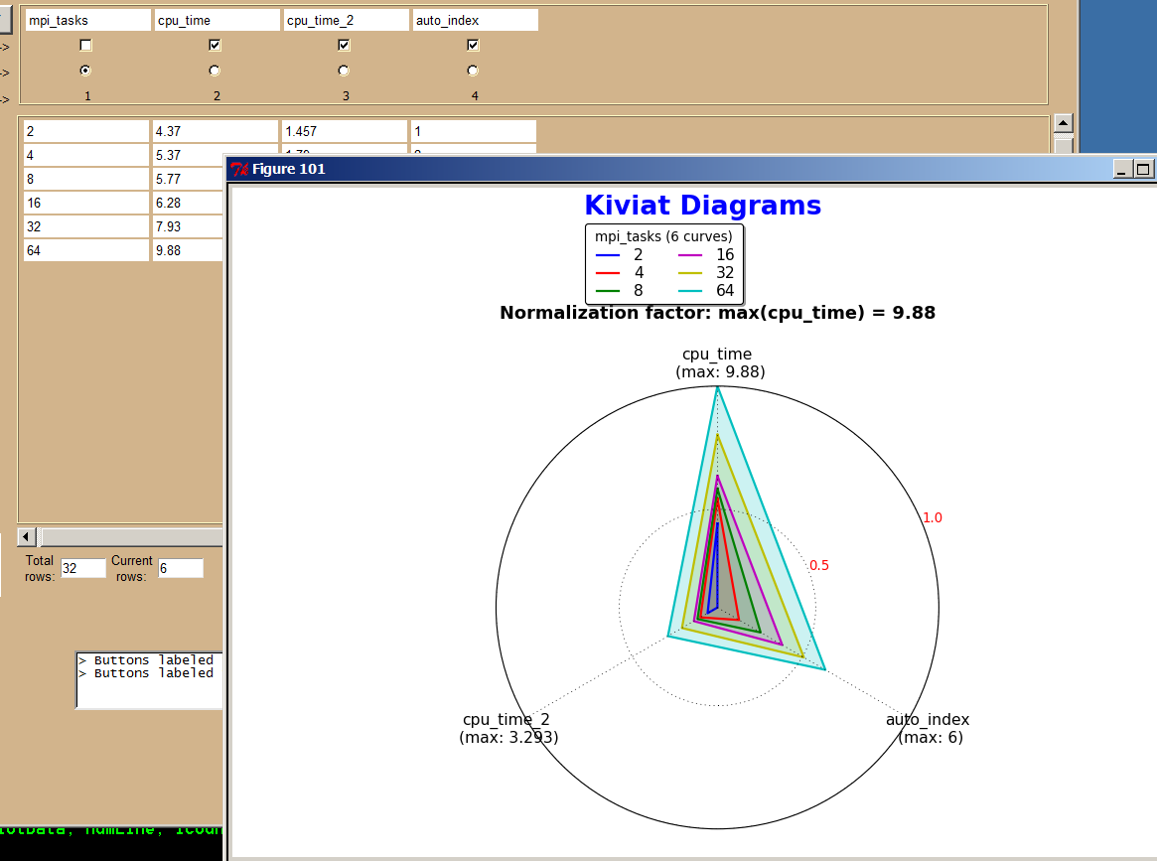
Pylot Kiviat (Radar) Chart

Slide 15
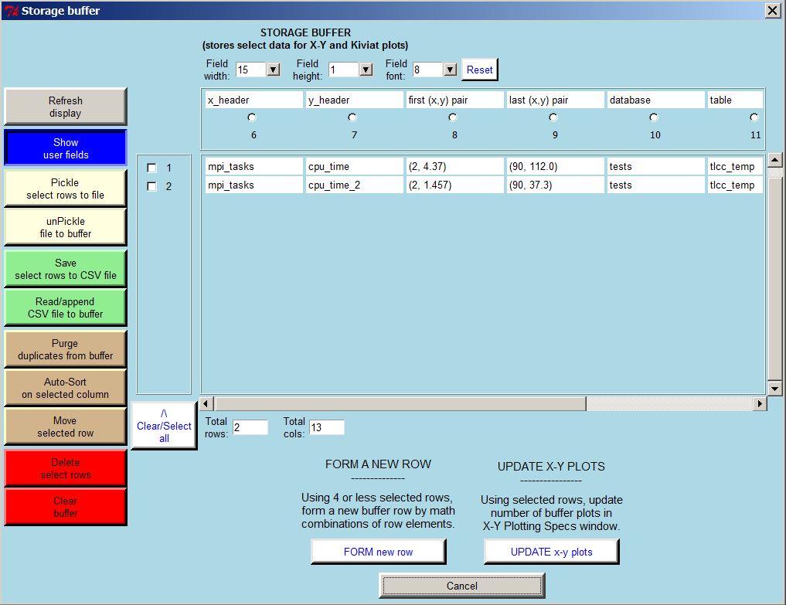
Pylot Storage Buffer

Slide 16
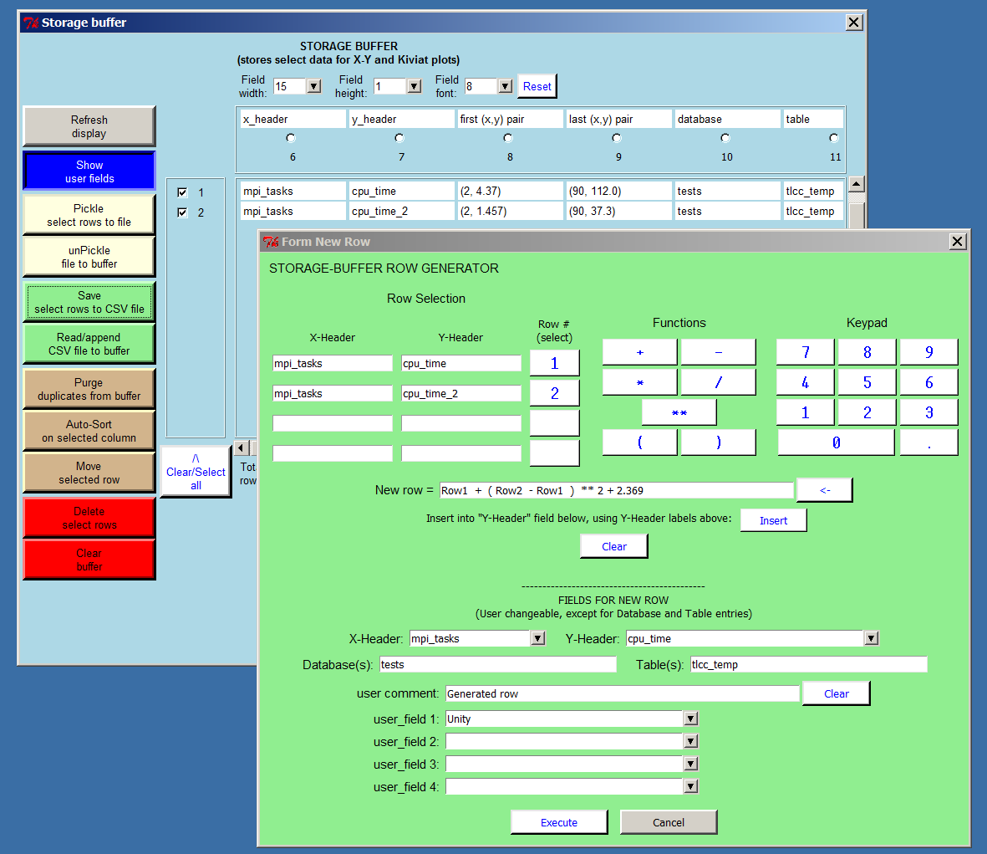
Pylot Storage Buffer – Row Generator

Slide 17
What’s next?
Pylot / Co-Pylot / eCo-Pylot should all be open source in April 2011 (approved by Sandia Labs)
If interested, send email to dwbarne@sandia.gov
Mantevo is available now: https://software.sandia.gov/mantevo
Stop by during Poster Session
- Board #14
- More discussion on Pylot / Co-Pylot / eCo-Pylot
- Live demos if requested

