Slide 1
CSCE 1035 – Computer Programming I
Chapter 11 Modules

Slide 2
Modules

Slide 3

What is a Module?
A module groups related code into one file (ending with the .py extension)
Can contain classes, functions, variables, and runnable statements.
“Python’s way to break programs into smaller, reusable parts.”
Allowing you to group related Python code into a module making it:
Easier to understand
Improves organization
Allows for reusability
Each module has its own namespace – a private symbol table used as the global symbol table by all functions in the module (explained later)
This is the greeting module

Slide 4
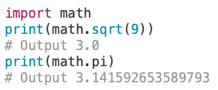
Using Importing Modules
A module can be imported into other modules using the import statement
import module1[, module2[,… moduleN]
When the Python interpreter encounters an import statement, it imports the module if it is present in the search path
Functions defined in the module can now be accessed with the dot operator
Coding practice: import statements are placed at the top of the file
Note: A module being required by another program is called a dependency
Simple example:
Notice: When using import the dot operator is used

Slide 5
Finding Modules

Slide 6
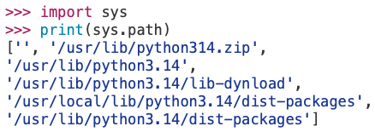

Locating Modules
When importing a module, the Python interpreter searches in a specific order:
Checks Built-in modules (sys, time, random, math, etc.) first.
The sys.path contains a list of directories Python searches when importing modules.
Directory of the executing script
List of directories given by PYTHONPATH environment variable
Directory where Python is installed
User-set Environment Variable
The '' in the PYTHONPATH’s list of directory represents the current working directory.

Slide 7
Locating Modules
For simple programs, a module is most likely placed in the same directory
For larger projects that contain hundreds of modules or use third-party modules located in different directories.
Add directories manually to Python’s search path using environment variable by setting the PYTHONPATH environment variable.
$ PYTHONPATH="${PYTHONPATH}:${HOME}/bin/"
$ export PYTHONPATH
$ echo $PYTHONPATH
:/Users/dom/bin/
$ python3.14
Python 3.14.0 (main, Oct 7 2025, 09:34:52) [Clang 17.0.0 (clang-1700.0.13.3)] on darwin
Type "help", "copyright", "credits" or "license" for more information.
>>> import sys
>>> print(sys.path)
['', '/Users/dom/bin', '/usr/lib/python314.zip', '/usr/lib/python3.14', '/usr/lib/python3.14/lib-dynload', '/usr/local/lib/python3.14/dist-packages', '/usr/lib/python3.14/dist-packages']
For beginners: do not stress about this since you would rarely set the PYTHONPATH.

Slide 8
Import Specific Names

Slide 9
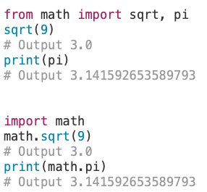
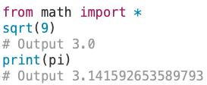
Importing Specific Names
You can import names (classes, functions, variables) from a module into the importing module’s symbol table using from … import …
from module_name import name1, name2, …
Math Module Example
Description | Example Import Statement | Using Imported Names
Import an entire module | import HTTPServer import math | print(HTTPServer.address) print(math.pi)
Import specific name from a module | from HTTPServer import address from math import pi | print(address) print(pi)
Can import all names from a module into current namespace using *
Avoid using due to overwriting built-in names or cause confusion.
Notice: When using from do not need to use the dot operator

Slide 10
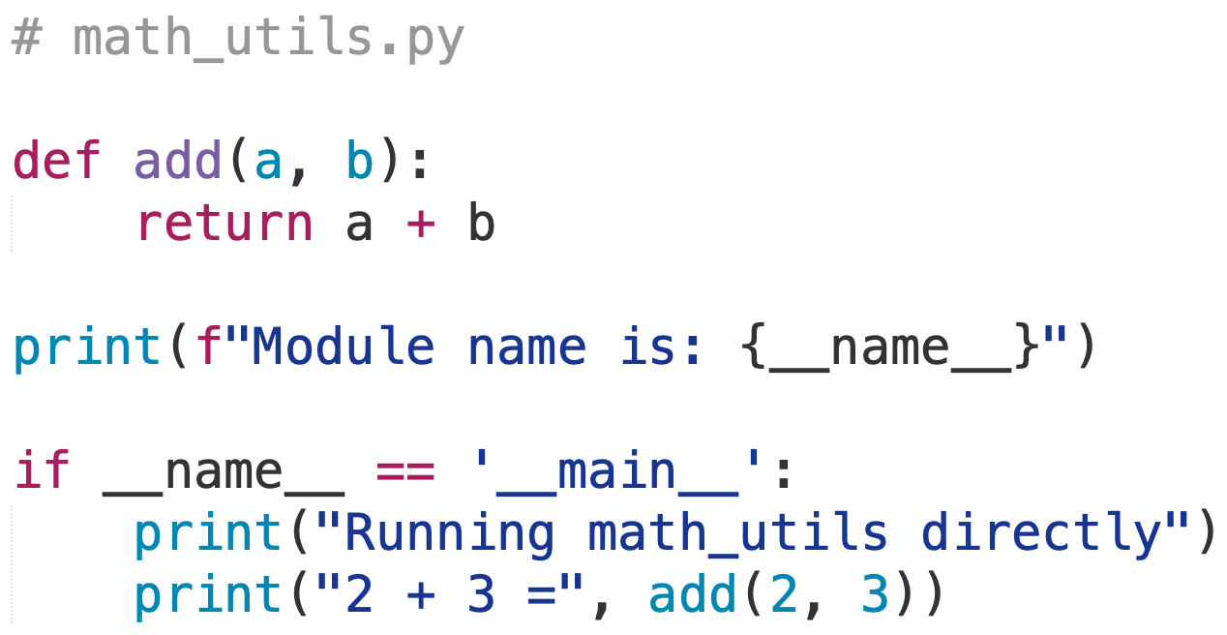
Executing Modules as Script
Reminder a Python file is both a module and a script
When a Python file is executed directly from the command line, __name__ is set to the string '__main__'.
If a module is being run directly, the __name__ is '__main__' allowing the execution as a script
Command line execution by doing $ python3 filename.py [arguments]
Command-line Output:
$ python3 math_utils.py
Module name is: __main__
Running math_utils directly
2 + 3 = 5
← True, because __name__ is __main__
Taken from Chapter 2 and Chapter 6

Slide 11
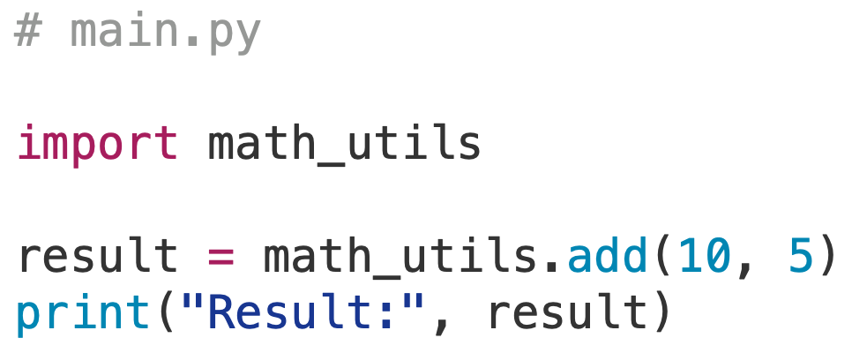
Executing Modules as Import
Reminder a Python file is both a module and a script
When a Python file is imported, __name__ is set to the module’s name (not '__main__')
An import statement executes the module’s code once, then keeps its functions and variables available under its module name
Can access module’s functions and variables through the dot operator
Command-line Output:
$ python3 main.py
Module name is: math_utils
Result: 15
← False, because __name__ is math_utils
Taken from Chapter 2 and Chapter 6

Slide 12
Executing Modules as Scripts or Import
Reminder a Python file is both a module and a script
Executed or Imported modules are distinguished by the global variable __name__
Value of __name__ is '__main__' only when the file is executed directly
Otherwise __name__ is the name of the module
In the Python file, check at the bottom using if __name__ == '__main__’:
When True: Module file is executed as a script
When False: Module file is being imported
Command-line Output:
$ python3 math_utils.py
Module name is: __main__
Running math_utils directly
2 + 3 = 5
$ python3 main.py
Module name is: math_utils
Result: 15
Taken from Chapter 2 and Chapter 6

Slide 13
Loading Modules

Slide 14
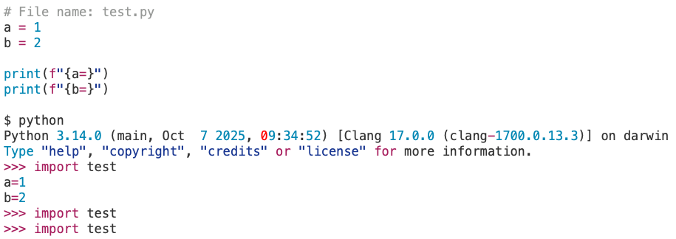
Loading Modules
A module is loaded only once per interpreter session, regardless of the number of times it is imported
This is to prevent the module execution from happening repeatedly if multiple imports occur
A dictionary of loaded modules is stored in sys.modules
If the module has not yet been loaded, then a new module object is created
A module object is simply a namespace that contains definitions from the module
If the module has already been loaded, then the existing module object is used
Notice:
Only loaded module once.
Terminal

Slide 15
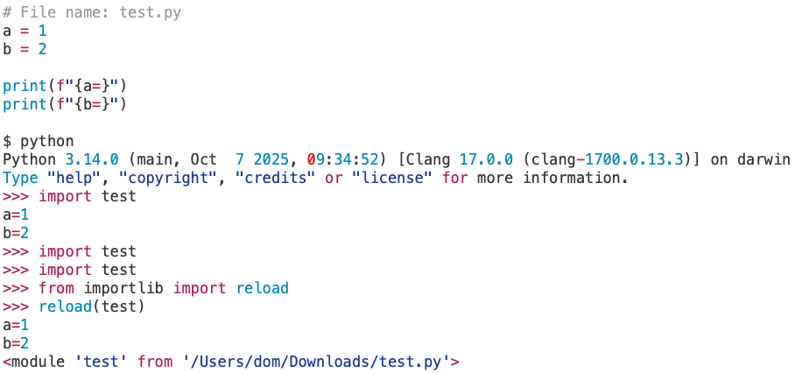
Reloading Modules
If the source code of an imported module needs to be changed, the reload() function can be used to reload and re-execute the changed module without stopping the whole program
The reload() function imports a previously imported module again
The module_name is the name of the module you want to reload
Reloading is useful when the file has changed compared to initial load.
Essentially, updating the module.
Notice:
Using reload to load module again.
Terminal

Slide 16
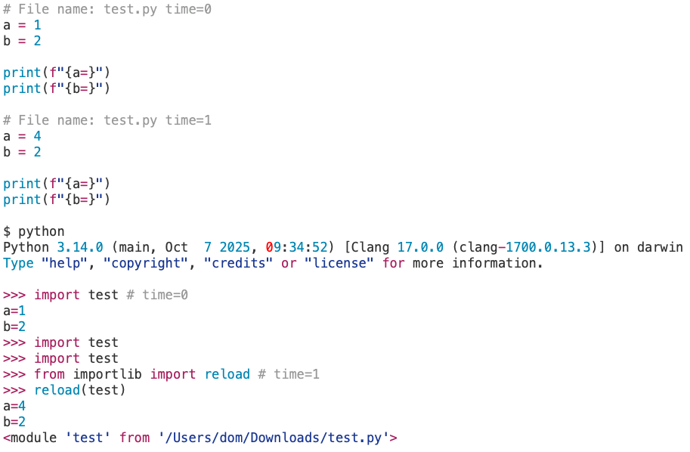
Reloading Modules
The reload(module_name) function imports a previously imported module
Terminal

Slide 17
Packages

Slide 18
Packages
Instead of importing a single module at a time, an entire directory of modules can be imported all at once
Python allows you to organize your modules into subfolders called packages where the name of the package is the name of the folder
A package is directory organized as a collections of modules
Modules are stored in directories, with each directory containing an __init__.py file that tells the interpreter that it is a package directory
The __init__.py file is often empty, but may contain code to initialize the package when imported
Each subdirectory of a root package directory is considered a subpackage, but __init__.py must be present
Python searches through sys.path directories for the package subdirectory

Slide 19
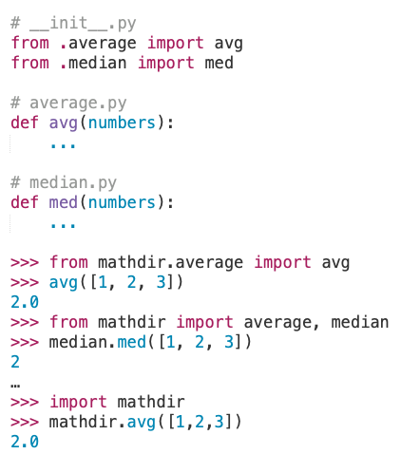
Packages
A package is a directory of folders that contains related modules.
Commonly, contains __init__.py
Modules
__init__.py
Package
…csce1035/CH-11
mathdir
average.py
median.py
Import
Package
Terminal

Slide 20
Packages
A package is a directory of folders that contains related modules.
Commonly, contains __init__.py
Modules
__init__.py
Package
…csce1035/CH-11
mathdir
average.py
median.py
Import
Package
Import
Package
Terminal

Slide 21
Standard Library

Slide 22
Common Standard Library Modules
Module name | Description | Documentation link
datetime | Creation and editing of dates and times objects | https://docs.python.org/3/library/datetime.html
random | Functions for working with random numbers | https://docs.python.org/3/library/random.html
copy | Create complete copies of objects | https://docs.python.org/3/library/copy.html
time | Get the current time, convert time zones, sleep for a number of seconds | https://docs.python.org/3/library/time.html
math | Mathematical functions | https://docs.python.org/3/library/math.html
os | Operating system informational and management helpers | https://docs.python.org/3/library/os.html
sys | System specific environment or configuration helpers | https://docs.python.org/3/library/sys.html
pdb | The Python interactive debugger | https://docs.python.org/3/library/pdb.html
urllib | URL handling functions, such as requesting web pages | https://docs.python.org/3/library/urllib.html
json | A lightweight data interchange format | https://docs.python.org/3/library/json.html
re | A regular expression (or RE) specifies a set of strings for pattern matching | https://docs.python.org/3/library/re.html
statistics | Functions for calculating mathematical statistics of numeric data | https://docs.python.org/3/library/statistics.html
pickle | For serializing and de-serializing a Python object structure | https://docs.python.org/3/library/pickle.html
Find more libraries here: https://docs.python.org/3/library/index.html

Slide 23
Battleship - Modules
Let’s create separate modules for the Battleship
Simplifies the code allowing for readability
Improves organization to separate out different parts
Allows for reusability for different games that could use the same functions
Modules to create:
Error logic
Game/menu logic
Print/log options
Go to Canvas > Files > Code and download the battleships.py code.

