Slide 1
CSCE 1035 - Computer Programming I
Instructor: Dominic Carrillo

Slide 2
Contact Information
Dominic Carrillo (Instructor)
Office: DP F268
Hours: TR 10:00-11:00
Email: DominicCarrillo@my.unt.edu
Aditya Pujari (TA)
Office: DP F220
Hours: W 9:00–11:00
Email: adityapujari@my.unt.edu

Slide 3
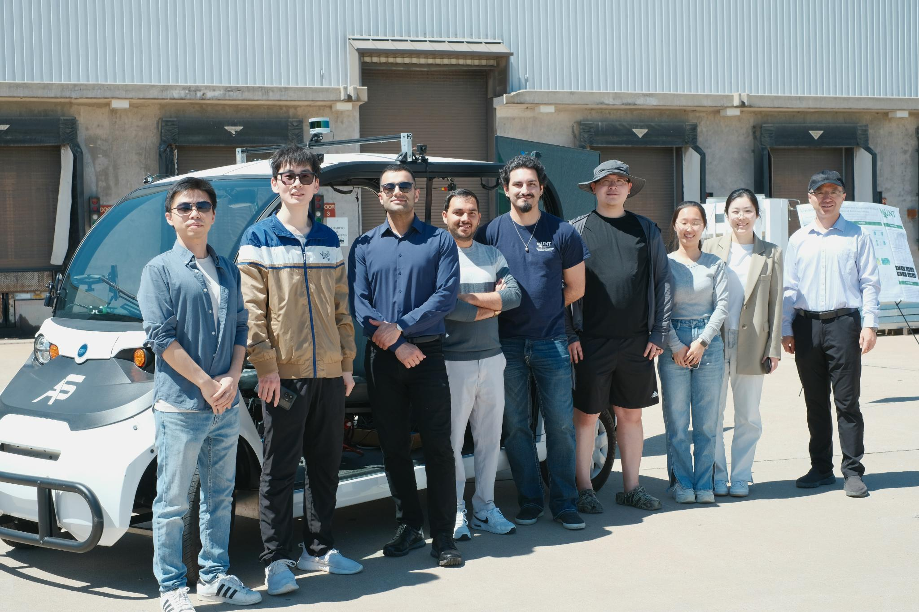
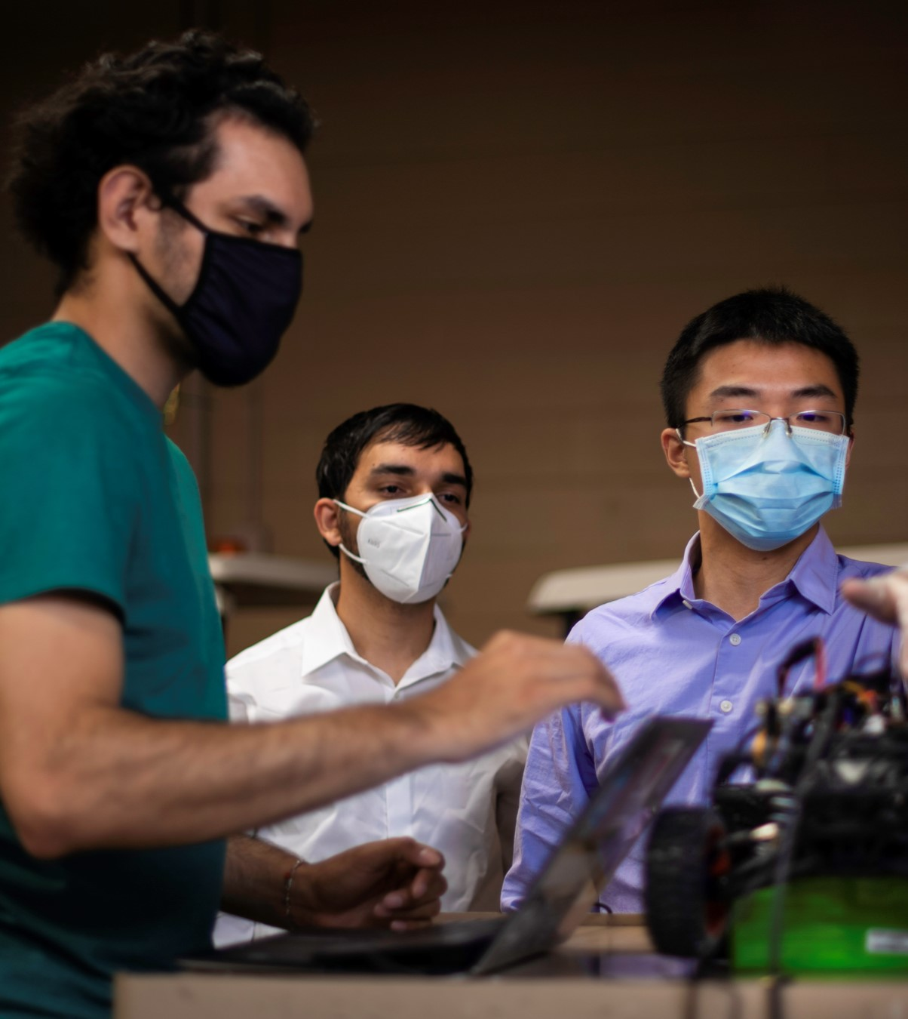
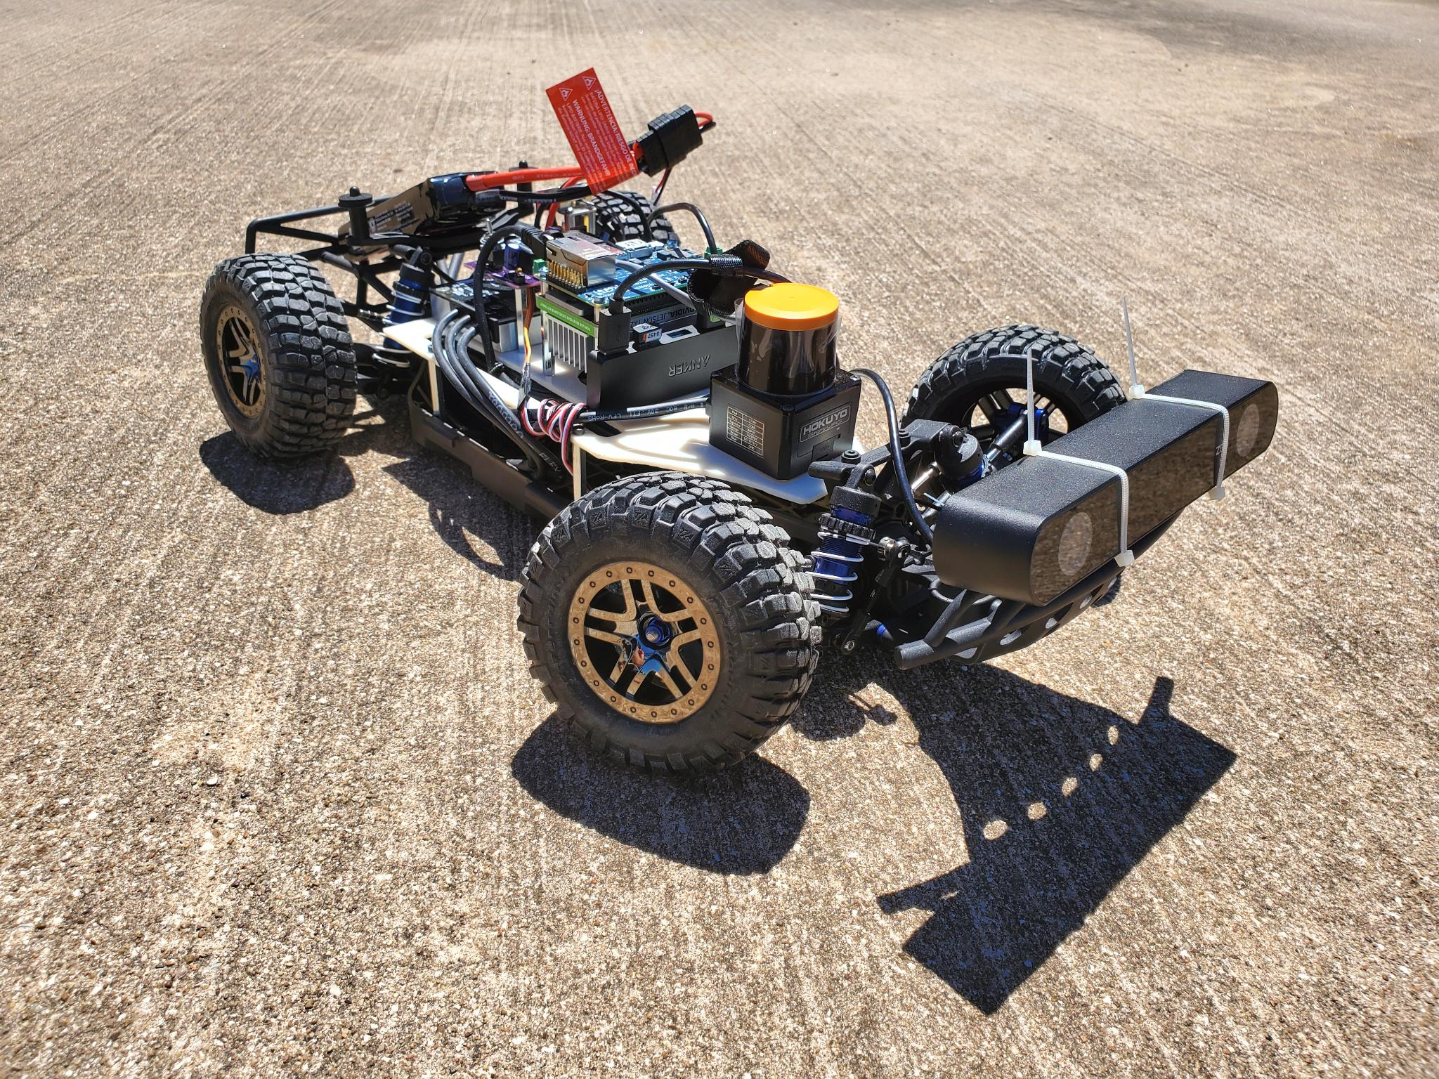
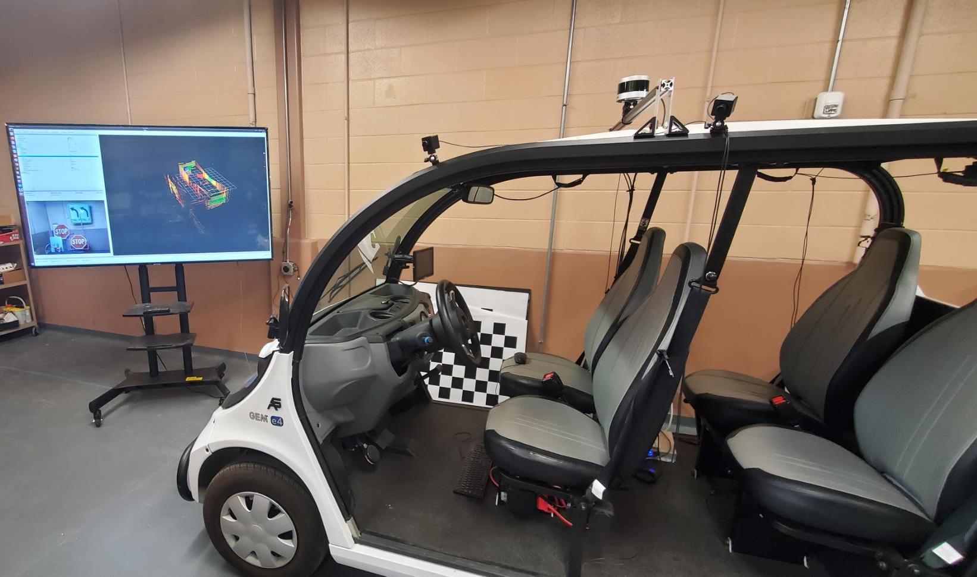
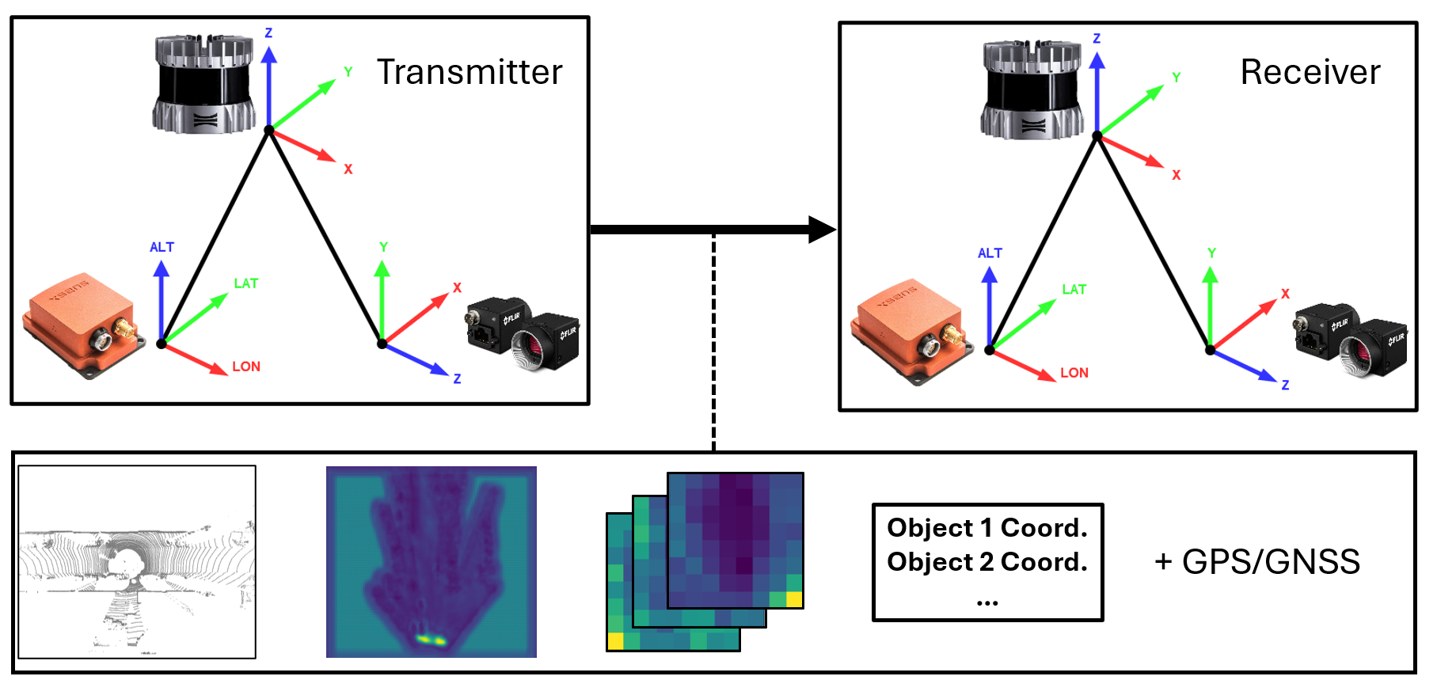
Dominic Carrillo
5th Year PhD Student
Started in 2019 from a CS & Math bachelor’s degree
Alma Mater: Sul Ross State University, Alpine, TX
Research Study is in Computer Vision for Autonomous Vehicle

Slide 4
Course Description – CSCE 1035
3 hours Overview of computers and programming. Focus is on problem analysis and techniques used in the development of algorithms and computer programs using a modern programming language. Topics include data types, expressions, statements, and operators, input/output, conditional statements, iteration, functions, lists and debugging. No prior knowledge of programming is assumed. Prerequisite(s): MATH 1100 (or higher) with a grade of C or better. Corequisite(s): CSCE 1015.

Slide 5
Course Objectives
By the end of this course, students will be able to:
Describe computers - CPU, Memory, Storage, I/O, and execute a program.
Build computer software by utilize computer’s hardware, editor(s), operating system, system software, and network.
Describe algorithms such as numeric computation, searching and sorting, and string manipulation.
Write readable, and efficient programs that include programming structures.
Use commonly accepted practices and tools to find and fix syntax, runtime, and logical errors in software.
Describe a software process model that can be used to develop significant applications composed of hundreds of functions.
Perform the steps necessary to edit and execute programs.

Slide 6
Course Structure
1 | [CH1] Intro to Python 3 | LAB 1
2 | [CH2] Variables & Expressions | LAB 2
3 | [CH3] Types | LAB 3
4 | [CH4] Branching | LAB 4
5 | [CH5] Loops | Assess 1
6 | [CH5-6] Loops / Functions | LAB 5
7 | [CH6] Functions | LAB 6
8 | [CH7] Strings | LAB 7
9 | [CH8] Lists & Dictionaries | Assess 2
10 | [CH9] Classes | LAB 8
11 | [CH10] Exceptions | LAB 9
12 | [CH11] Modules | LAB 10
13 | [CH12] Files | LAB 11
14 | Review all topics | Assess 3
15 | Project practices
16 | Project practices
17 | Finals

Slide 7
Course Requirements
Required book
Programming in Python 3 with zyLabs, Bailey Miller, Available from https://www.zybooks.com
Suggested book
The Fundamentals of Python: First Programs, Kenneth A. Lambert, Cengage Learning, 2011
Starting Out With Python, 4th Edition, Tony Gaddis, Pearson, 2014
Minimum Technology Requirements
Computer
Reliable internet access
Canvas Technical Requirements (https://clear.unt.edu/supported-technologies/canvas/requirements)

Slide 8
Grading Policy
Grading Breakdown:
Project 20%
Assignments 30%
Lab Assignments 20%
Attendance: 5%
Exams: 25%
Total: 100.0%
Grading
A = 90-100
B = 80-89
C = 70-79
D = 60-69
F = 50-59

Slide 9
Syllabus
Go to CANVAS and look under the syllabus tab!

Slide 10
zyBooks
URL Link: https://learn.zybooks.com/signin
Make sure to bookmark to find quickly and complete your labs.
Additional modules (13-17) can be completed but not required.

