Slide 1
CSCE 1035 – Computer Programming I
Chapter 8 List & Dictionary

Slide 2
Lists

Slide 3
List Overview
Methods:
Utilize adding, removing, and altering a list, along with getting the count or index of an element
Iteration:
Utilizing a for loop to iterate through each element in list, along with enumerate for index counter
Nesting:
List is a single-dimensional sequence of elements; however, an element can be another list
Slicing:
Similar to strings, return part of list based on the given parameters
Comprehensions:
Simple way to concisely create lists from iterables
Sort:
Utilize to rearrange elements in a list

Slide 4
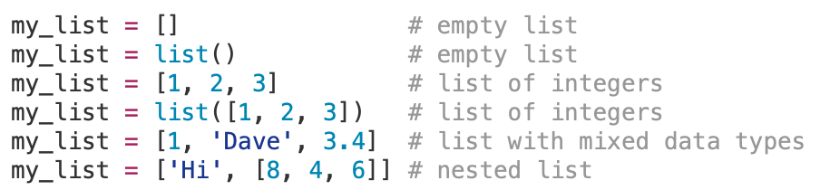
List Basics
A list are ordered, mutable sequences
List are heterogenous, meaning elements can be of different types.
Use square brackets with commas separation between elements.
Examples of list:
The constructor list() can convert tuples, strings, or ranges into lists.

Slide 5
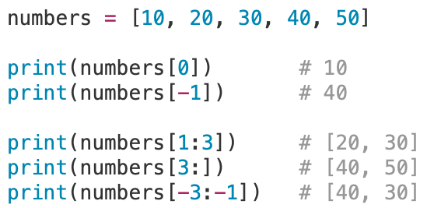
Accessing List Elements
Use square brackets [] with an index to access elements
Index starts at 0. Negative indices count from the end.
0 1 2 3 4 5
-5 -4 -3 -2 -1 :

Slide 6
List Methods

Slide 7
Basic List Operations
List Operation
my_list = [1, 2, 3] | Creates a list. | my_list = [1, 2, 3] print(my_list) | [1, 2, 3]
list(iterable) | Creates a list from an iterable. | my_list = list('123’) print(my_list) | ['1', '2', '3']
my_list[index] | Get an element from a list. | my_list = [1, 2, 3] print(my_list[1]) | 2
my_list[start:end:stride] | Get a new list containing elements from another list’s elements. | my_list = [1, 2, 3] print(my_list[1:2]) | [2]
my_list[i] = x | Change the value of the i^{th} element. | my_list = [1, 2, 3] my_list[1] = 4 print(my_list) | [1, 4, 3]
my_list.index(x) | Return index of first item in list with value x. | my_list = [5, 8, 14] print(my_list.index(14)) | 2
my_list.count(x) | Count the number of times value x is in list. | my_list = [1, 2, 3, 2, 2, 8] print(my_list.count(2)) | 3

Slide 8
Adding List Elements
Adding Elements
list.append(x) | Add an element to the end of the list. | my_list = [5, 6] my_list.append(7) | [5, 6, 7]
list.extend([x]) or list.extend(list2) | Add all items in [x] or list2 to list. | l1 = [1,2] l1.extend([3]) l2 = [4,5] l1.extend(l2) | [1, 2, 3] [1, 2, 3, 4, 5]
list.insert(i,x) | Insert x into list before position i. | my_list = [3, 4] my_list.insert(1, 1.8) | [3, 1.8, 4]
my_list + my_list2 | Get a new list with elements from one list added to the end of the other. | my_list = [1, 2] my_list2 = [3] print(my_list + my_list2) | [1, 2, 3]

Slide 9
Removing List Elements
Removing Elements
my_list.remove(x) | Remove first item from list with value x. | my_list = [5, 8, 14] my_list.remove(8) | [5, 14]
my_list.pop(x) or my_list.pop() | Remove and returns item from list at position i. Remove and returns last item in the list. | my_list = [5, 8, 14] val = my_list.pop() | [5, 8, 14] val is 14
del my_list[i] | Delete an element from a list at position i. | my_list = [1, 2, 3] del my_list[1] print(my_list) | [1, 3]
my_list.clear() | Creates an empty list | my_list = [1, 2, 3] my_list.clear() | []

Slide 10
Modifying List Elements
Modifying Elements
my_list.sort() | Sort the items of list in-place. | my_list = [14, 8, 5] my_list.sort() | [5, 8, 14]
my_list.reverse() | Reverse the elements of list in-place. | my_list = [14, 8, 5] my_list.reverse() | [5, 8, 14]

Slide 11
Additional List Operations
Function | Description | Example | Output
all(list) | True if every element in list it True, or if the list is empty. | print(all([1,2,3])) print(all([0,1,2])) | True False
any(list) | True if any element in the list is True. | print(all([1,2,3])) print(all([0,1,2])) | True False
max(list) | Get the maximum element in list. | print(max([-3,5,25])) | 25
min(list) | Get the minimum element in list. | print(min([-3,5,25])) | -3
sum(list) | Get the sum element in list. | print(sum([-3,5,25])) | 27
Reminder:
True is 1 (!=0)
False is 0

Slide 12
List Iteration

Slide 13
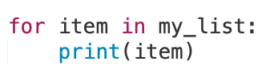
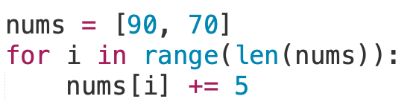
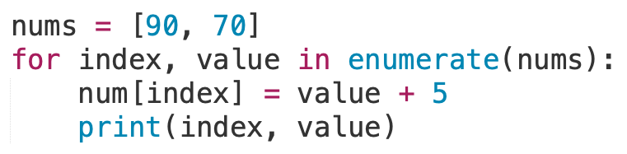
List Iteration
Use a for loop to iterate through each item in a list
Updates the variable as the next element in the list
Use enumerate() function to have an iteration counter in for loop over a list
Output
0 95
1 75

Slide 14
List Nesting

Slide 15
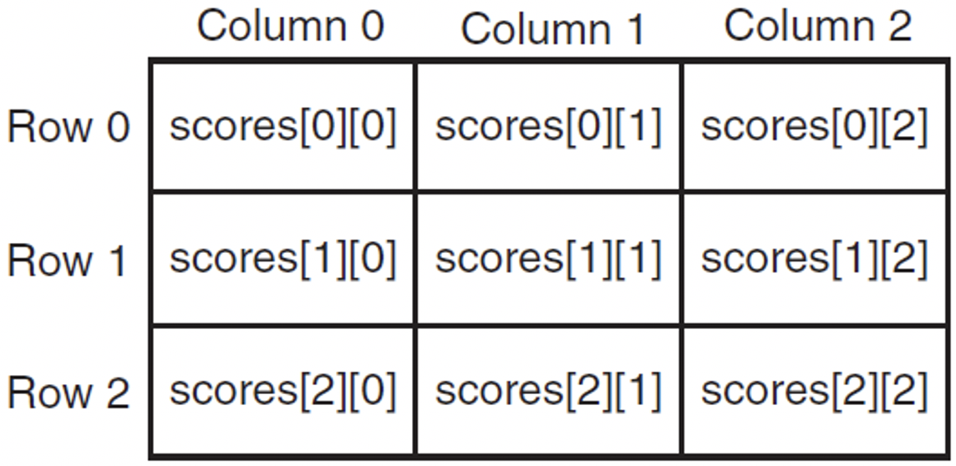
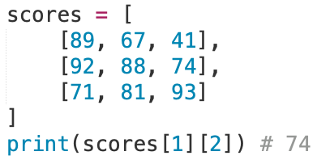
List Nesting
A list is a single-dimensional sequence of items
A list can hold other list, forming 2D or multi-dimensional structures.
Think a spreadsheet or chess board with rows and columns
A nested list can be created by placing a comma-separated sequence of sub-lists
To access data in a 2-D list, you need to use two indexes

Slide 16
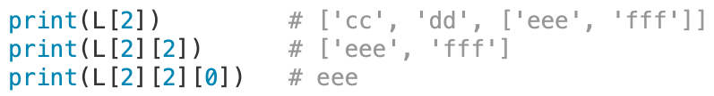
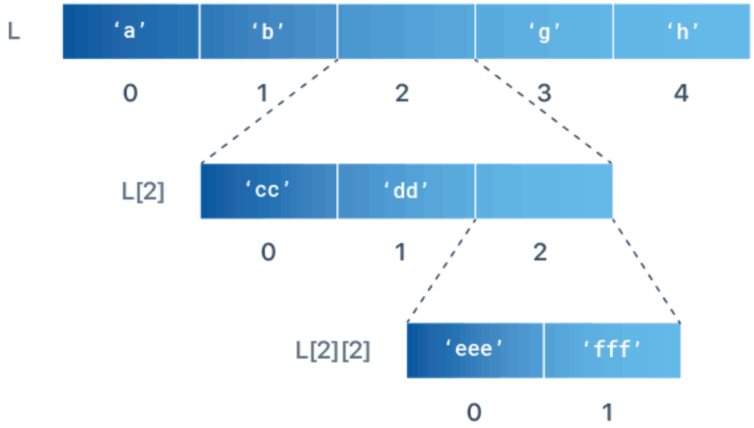
List Nesting
Let’s try another example
Given this list:
How do we get ‘eee’ as the output?

Slide 17

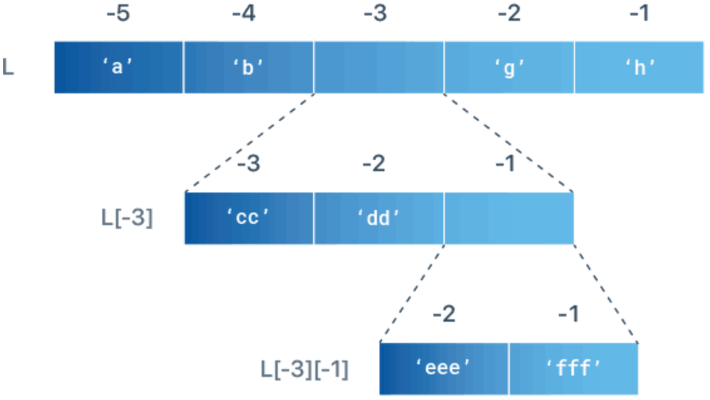
List Nesting
How about with negative indexing
Given this list:
How do we get ‘eee’ as the output?

Slide 18
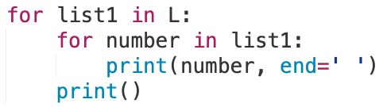

List Nesting
How would we iterate over a nested list to print out all elements?
How would we change 5 to 0 using the index numbers?
Output
1 2 3
4 5 6
7 8 9
Output [[1, 2, 3],[4, 0, 6],[7, 8, 9]]

Slide 19

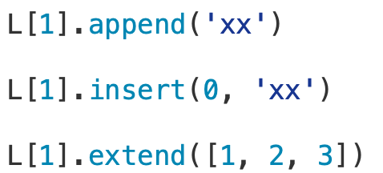


List Nesting
Given
Append ‘xx’ to the nested list in L?
Insert ‘xx’ to the nested list in L?
Extend the nested list in L with [1, 2, 3]?
Pop or Delete ‘cc’ from L by index?
Remove by value,‘cc’ from L?

Slide 20

2D Nested List Exercise
Write a Python program
User prompt for two digits, m (row) and n (column)
Create a two-dimensional array of size $m × n$
The value of each element is $i∗j$, where $i$ is the m^{th} row and n^{th} column
Print this 2D array out on the screen

Slide 21
List Slicing

Slide 22
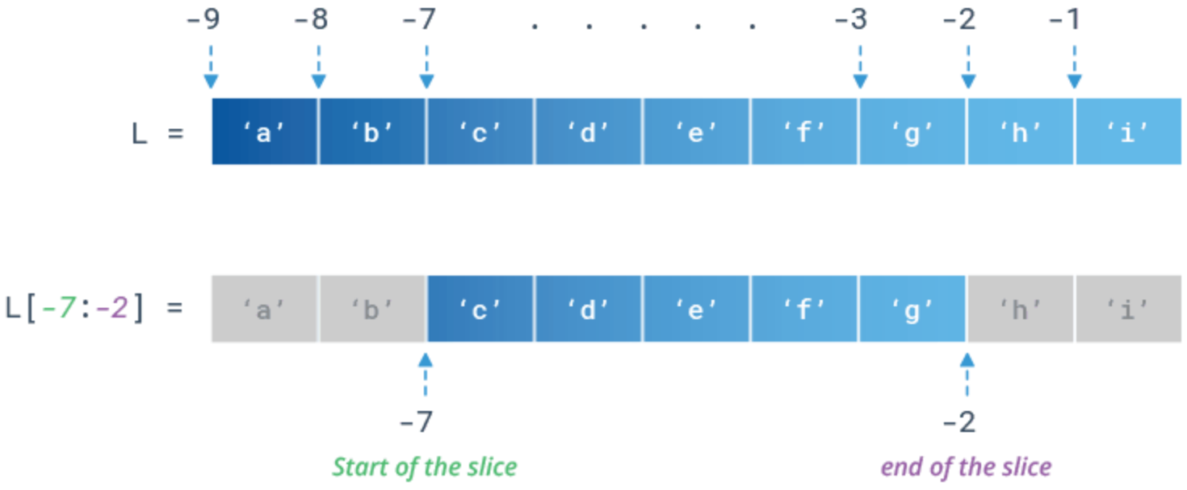
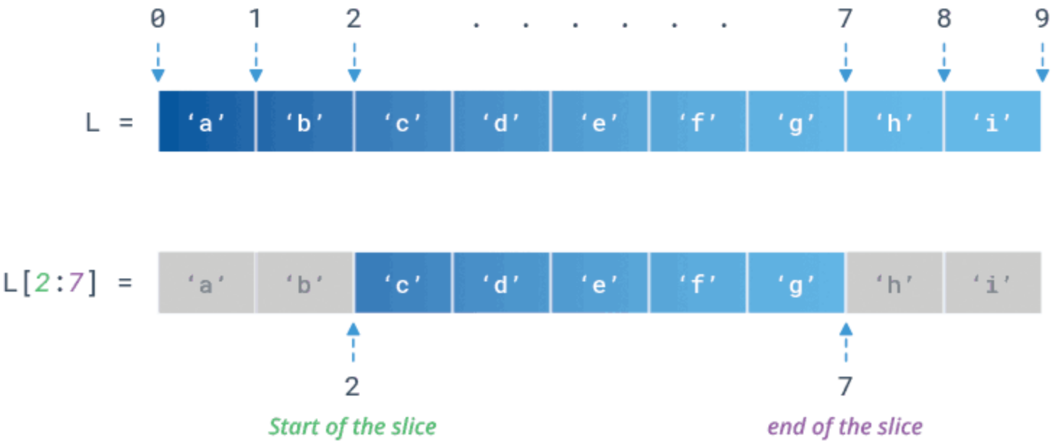
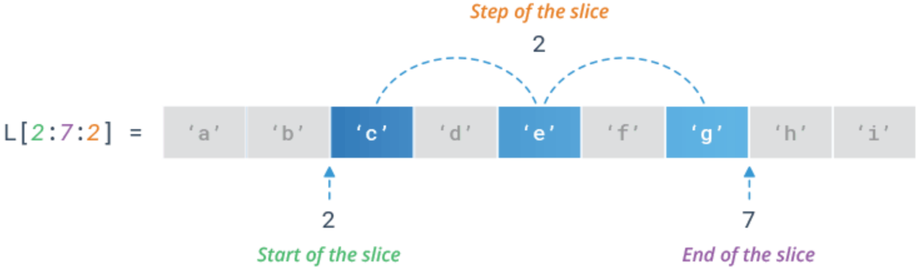
List Slicing
To extract a sub-list of elements use the slicing
If L is a list, to extract a sub-list use L[start:end:stride]
Returns a list from index start to index end (exclusive), at a step size stride
Reverse by using a negative stride
Reverse Slice
Slice
Stride Slice

Slide 23
List Slicing Operations
Operation | Description | Example | Output
L[start:end] | Get a list from start to end (excluding end). | L = [5, 10, 20] print(L[0:2]) | [5, 10]
L[start:end:stride] | Get every stride-th element from start to end (excluding end). | L = [5, 10, 20, 40, 80] print(L[0:5:2]) | [5, 20, 80]
L[start:] | Get a list from start to the end of the list. | L = [5, 10, 20, 40, 80] print(L[2:]) | [20, 40, 80]
L[:end] | Get a list from beginning to end (excluding end). | L = [5, 10, 20, 40, 80] print(L[:4]) | [5, 10, 20, 40]
L[:] | Get a copy of the entire list. | L = [5, 10, 20, 40, 80] print(L[:]) | [5, 10, 20, 40, 80]

Slide 24
List Comprehensions

Slide 25
List Comprehension
A list comprehension is a programming construct for generating a new list by applying an expression to each item in a collection.
The general syntax for a list comprehension is
[ expression for item in iterable ]
The iterable can be any collection or container of objects, like a list, tuple, or string.

Slide 26
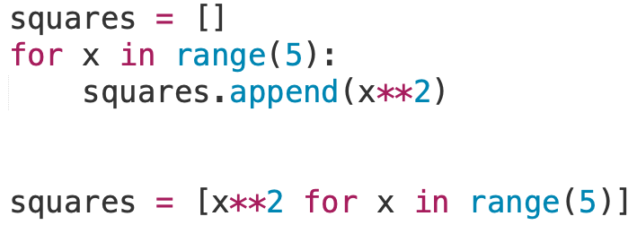
List Comprehension
Convert to a comprehension
Comprehension [ expression for item in iterable ]
Expression result for each iteration fills the list
Same as the for loop
Every iteration of loop, assign element to item x
Generators
Not a list but returns an iterator that yields items one by one.
Memory efficient for large amount of items
User () for the syntax

Slide 27
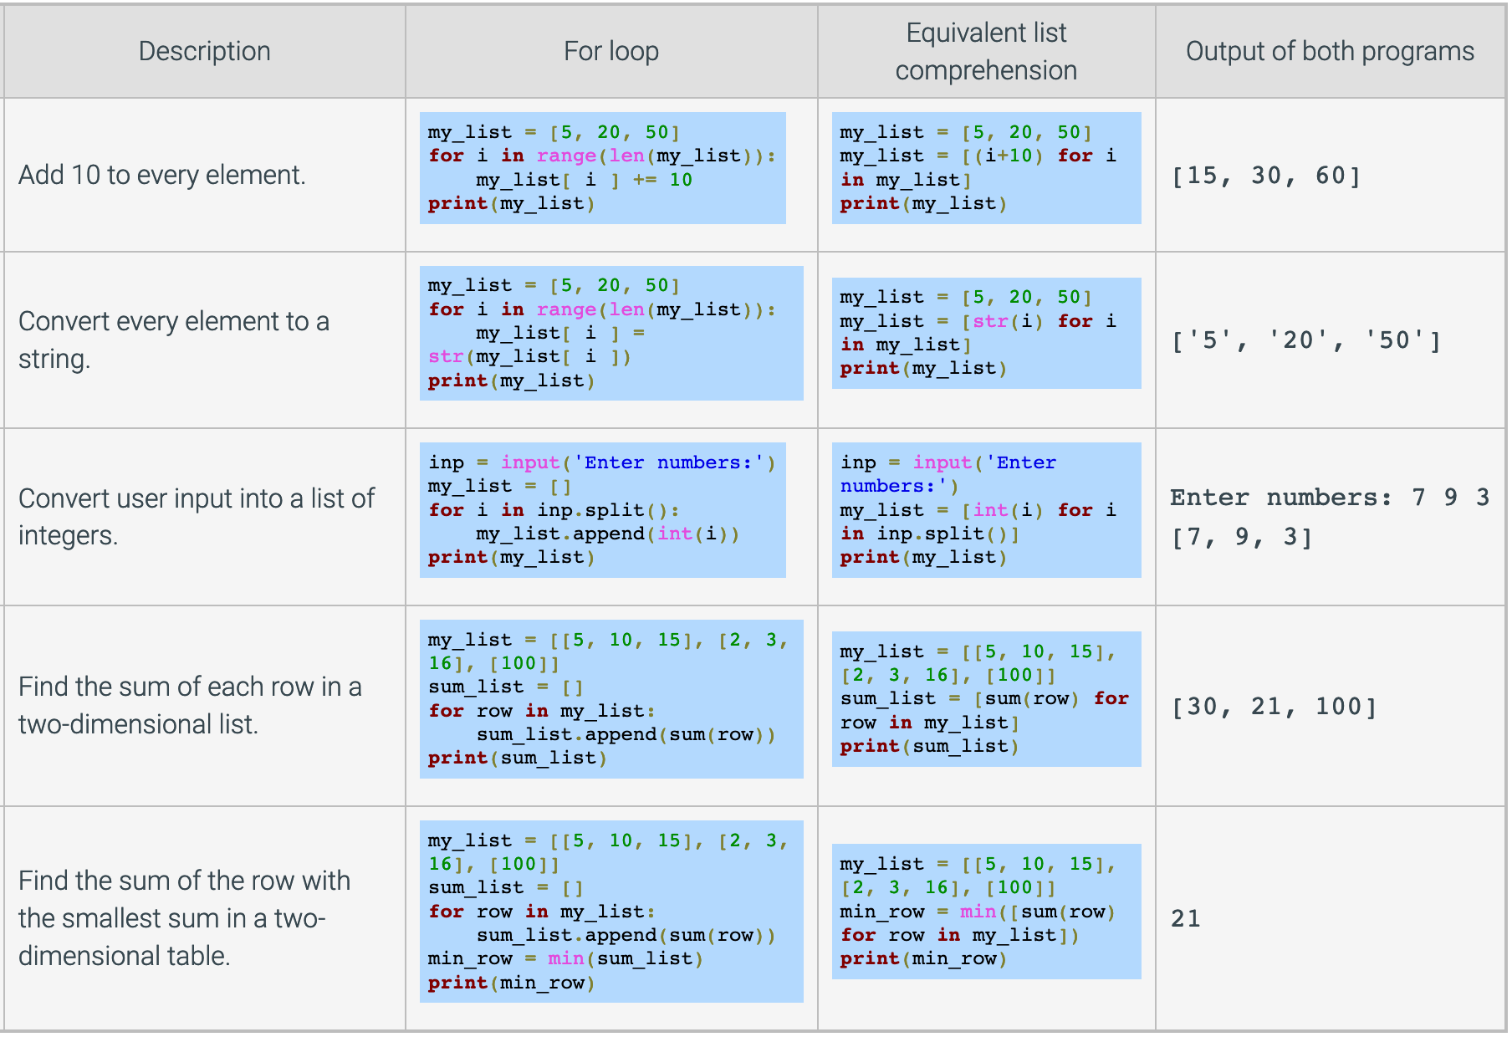
List Comprehension

Slide 28
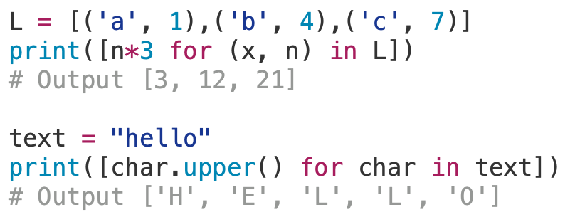
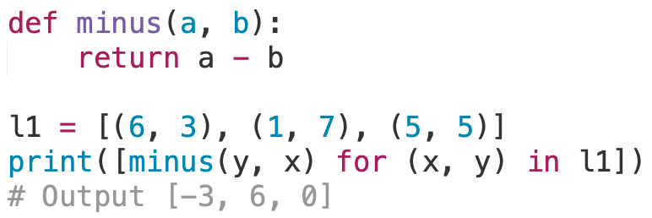
List Comprehensions
What about other iterable types?
Tuple
String
Expression can be a user-defined function

Slide 29
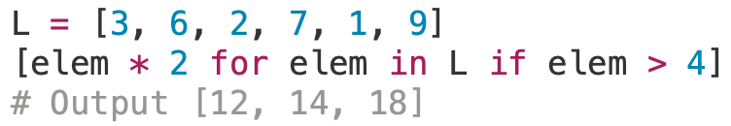
Conditional List Comprehension
A filtered list applies an expression only to items that meet a condition.
[ expression for item in iterable if condition ]
When the condition returns False, based on the items, they are omitted to be inserted in list

Slide 30
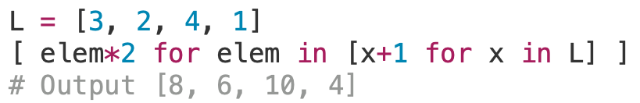
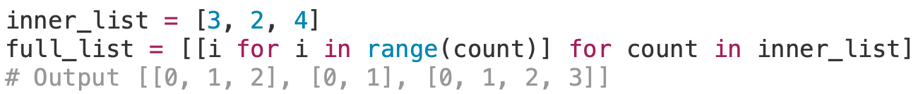
Nested List Comprehension
[ expression for item in iterable ]
The expression and iterable can be another list comprehension
The inner comprehension produces [4, 3, 5, 2]
The outer comprehension produces [8, 6, 10, 4]
The inner comprehension produces [0, 1, 2] and [0, 1] and [0, 1, 2, 3]
The outer comprehension produces [[0, 1, 2], [0, 1], [0, 1, 2, 3]]
Could we put a list comprehension
in be both expression and iterable?
Yes, but not practical.

Slide 31
Sorting List

Slide 32
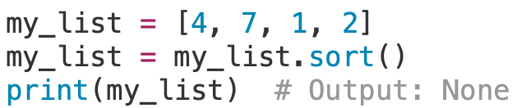

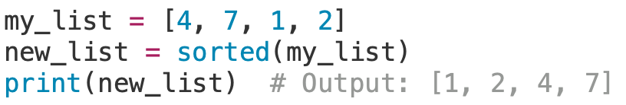
Sorting Lists
The sort() method rearranges list elements in-place
It uses standard comparison rules, element-by-element:
Numbers are compared by value.
Strings are compared by ASCII encoding.
Use sorted() to get a new sorted list without changing the original:
Why did it print None?
We re-assigned my_list

Slide 33
Command-Line Arguments

Slide 34
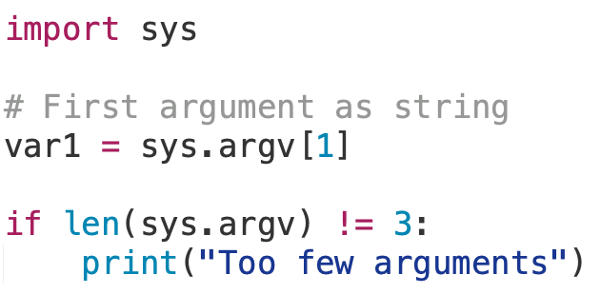
Command-Line Arguments
Arguments are passed to a program script at runtime.
Use double quotes (“...”) for arguments with spaces
Access command-line arguments with the Python sys module:
sys.argv is the list of command-line arguments (as strings)
len(sys.argv)is the number of command-line arguments

Slide 35
Dictionaries

Slide 36
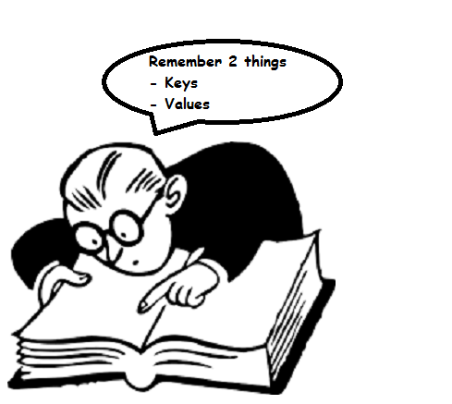
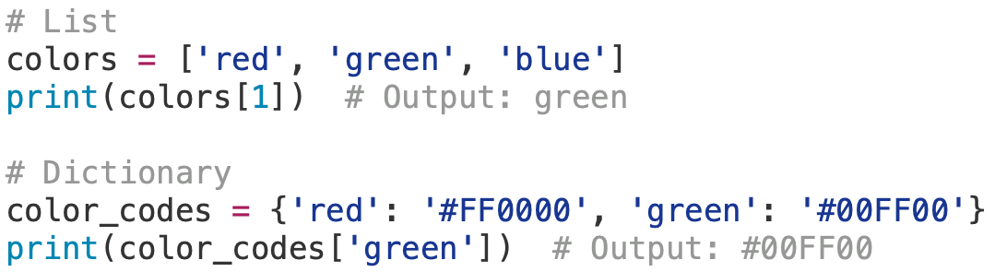
Dictionary
Dictionaries are mutable Python’s built-in mapping type
Store elements as key-value pairs inside {}.
Values can be any data type.
Dictionaries use keys to access values, not positions like list.
Can’t concatenation, slicing, and other operations because dictionaries are unordered.
Can insert or delete in place like list.

Slide 37
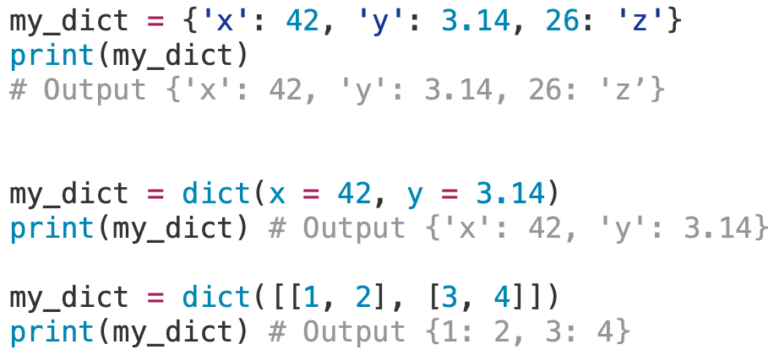
Dictionaries
Use a series of pairs of expressions, separated by commas within braces
Use dict() when converting lists of tuples or key-value pairs.

Slide 38
Dictionary Methods
Operation | Description | Example Code | Output
my_dict[key] | Retrieves the value via key. | jose_grade = my_dict['Jose'] | Grab value from dictionary
my_dict[key] = value | Update key with value. No key then adds key and value pair. | my_dict['Jose'] = 'B+' | Updates dictionary
del my_dict[key] | Deletes the key from the dictionary. | del my_dict['Jose'] | Returns dictionary without value
key in my_dict | Tests for the existence of a key in dictionary. | if 'Jose' in my_dict: # ... | True or False
d1.clear() | Removes all items from the dictionary. | d1 = {'Ahmad': 1, 'Jane’: 42} d1.clear() print(d1) | {}
d1.get(key, default) | Reads the value of the key from the dictionary. If the key does not exist, returns the default value. | d1 = {'Ahmad': 1, 'Jane': 42} print(d1.get('Jane', 'N/A’)) print(d1.get('Chad', 'N/A')) | 42 N/A
d1.update(d2) | Merges dictionaries d1 with d2. Existing keys in 1 are overwritten if same keys exist in 2. | d1 = {'Ahmad': 1, 'Jane': 42} d1.update({'John': 50}) print(d1) | {‘Ahmad’: 1, ‘Jane’: 42, ‘John’: 50}
d1.pop(key, default) | Removes and returns the key’s value from the dictionary. If key does not exist, the default is returned. | d1 = {'Ahmad': 1, 'Jane': 42} val = d1.pop('Ahmad’) print(d1) | {‘Jane’: 42}

Slide 39
Iteration over Dictionary

Slide 40
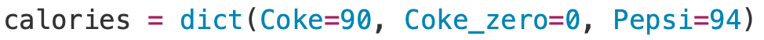
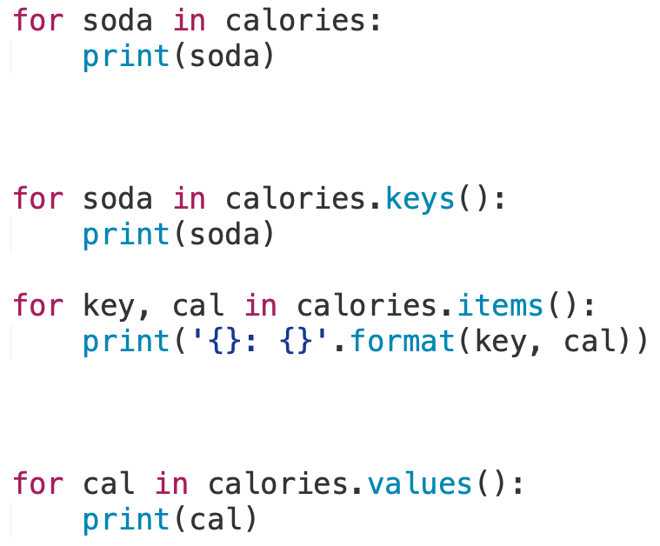
Dictionary Iteration
Output
Coke
Coke_zero
Pepsi
Output
Coke: 90
Coke_zero: 0
Pepsi: 94
Output
Coke
Coke_zero
Pepsi
Output
90
0
94

Slide 41
Dictionary Nesting

Slide 42
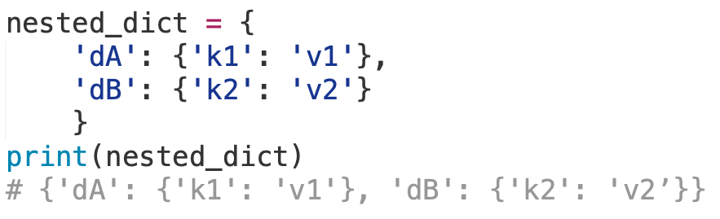
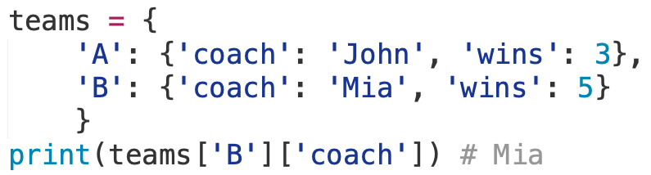
Dictionary Nesting
A nested dictionary contains another dictionary as a value
Access nested values using consecutive sets of brackets []

Slide 43
Dictionary Exercise

Slide 44
Dictionary Exercise: Soccer Team Roster
Create a program that store a roster and rating information for a soccer team. This is used by Coaches to rate players during tryouts to ensure a balanced team.
1. Prompt the user to input five pairs of Jerseys and Ratings
Player’s Jersey Number (0-99)
Player’s Rating (1-9)
Store the jersey number and ratings in a dictionary.
Output the dictionary’s elements with the Jersey number in ascending order
That is output the roster from smallest to largest jersey number
Hint: Dictionary keys can be stored in a sorted list
Example:
Enter jersey number and rating: 9 5
Enter jersey number and rating: 32 9
Enter jersey number and rating: 1 3
Enter jersey number and rating: 52 2
Enter jersey number and rating: 42 7
*******Roster*******
Jersey #01: Rating 3
Jersey #09: Rating 5
Jersey #32: Rating 9
Jersey #42: Rating 7
Jersey #52: Rating 2

Slide 45
Dictionary Exercise: Soccer Team Roster
Create a program that store a roster and rating information for a soccer team. This is used by Coaches to rate players during tryouts to ensure a balanced team.
2. Implement a menu of options for coaches to modify the roster.
Each option is represented by a single character.
Start program with menu options for coaches to choose.
End program when coach choose Quit.
Do not have to implement other option, at this moment.
Example:
MENU
a – Add player
d – Remove player
u – Update player rating
r – Output player above a rating
o – Output roster
q – Quit
Choose an option:

Slide 46
Dictionary Exercise: Soccer Team Roster
Create a program that store a roster and rating information for a soccer team. This is used by Coaches to rate players during tryouts to ensure a balanced team.
3. Implement the “Output roster” menu option.
Example:
*******Roster*******
Jersey #01: Rating 3
Jersey #09: Rating 5
Jersey #32: Rating 9
4. Implement the “Add player” menu option.
Prompt the user for jersey number and rating.
Append the values to dictionary
Example:
Enter jersey number and rating: 9 5
Enter jersey number and rating: 32 9
Enter jersey number and rating: 1 3

Slide 47
Dictionary Exercise: Soccer Team Roster
Create a program that store a roster and rating information for a soccer team. This is used by Coaches to rate players during tryouts to ensure a balanced team.
5. Implement the ”Remove player” menu option.
Prompt the user for jersey number.
Remove the player from the roster dictionary (delete the jersey number and rating)
Example:
Enter a jersey number: 32
6. Implement the ”Update player rating” menu option.
Prompt the user for jersey number.
Prompt for a new rating for the player.
Update the player’s rating in the roster dictionary
Example:
Enter a jersey number: 9
Enter a new rating for player: 6

Slide 48
Dictionary Exercise: Soccer Team Roster
Create a program that store a roster and rating information for a soccer team. This is used by Coaches to rate players during tryouts to ensure a balanced team.
7. Implement the ”Output players above a rating” menu option.
Prompt the user for rating.
Print the jersey number and rating for all players with ratings above the inputted value.
Example:
Enter a rating: 5
ABOVE 5
Jersey #09: Rating 5
Jersey #32: Rating 9
Jersey #42: Rating 7
...

