Slide 1
CSCE 1035 – Computer Programming I
Chapter 9 Classes

Slide 2
Classes: Introduction

Slide 3
What is an Object?
An object is a single “thing” in memory that stores data and has different behaviors (methods or attributes)
Every object has
Type (e.g., int, float, list, dict)
Data representation (attributes / variables inside it)
Methods (functions that interacts on its data)
Python automatically creates built-in objects for programmer to use
Including basic data types like integers and strings
Example Objects:
1234 → int object
3.14159 → float object
‘Hello’ → string object
[2, 3, 5, 7] → list object
{‘TX’: ‘Texas} → dictionary object

Slide 4
Primitive vs Abstract Data Structures
Primitive Types:
Abstract Data Types (ADT):
Abstraction: defines or captures general characteristics without explicit details
Triangles are 3-sided polygons; which is an abstraction of scalene, isosceles, equilateral triangles
ADT defines what operations can be done, not how they’re implemented
Example: a “List” lets you append and remove items without knowing the internal storage details
Object-oriented programming is based on objects that encapsulate the data and the functions.
Think: Objects = data + functions
Primitive Types | Examples | Meaning
int | 1, 2, 3 | Whole numbers
float | 3.14 | Numbers with decimals
str | 'Hi' | Text data
bool | True/False | Logic values

Slide 5
Object Basics
Objects are a data abstraction that capture
A grouping of data attributes (i.e., member variables)
Behaviors that can be performed on that data (i.e., methods)
Define operations, but hide implementation from user
Remember attributes and behaviors are encapsulated into the object
Objects = data + functions

Slide 6
Classes

Slide 7
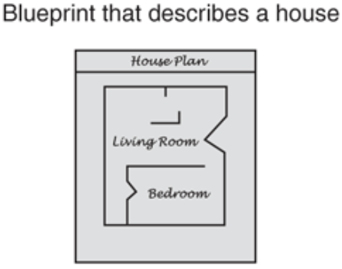
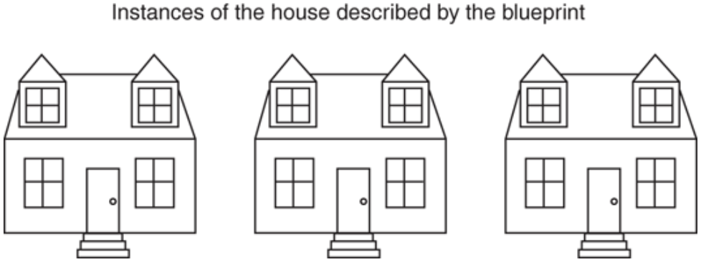
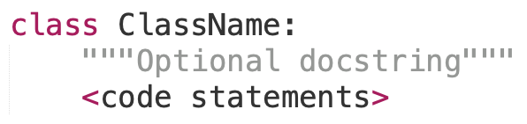
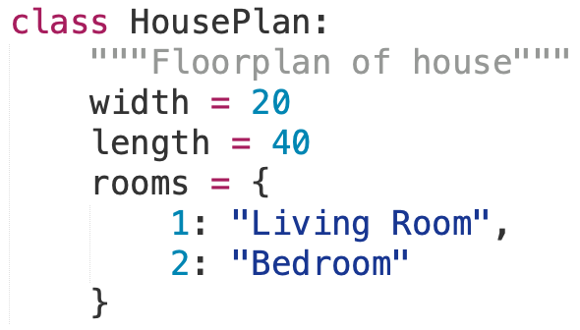
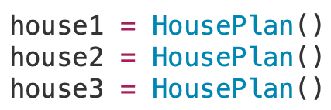
What are Classes?
Class Definition:
Is a blueprint for building objects
The instance is the actual object created from the blueprint
Classes
Encapsulate data (attributes)
Encapsulate functions (behaviors)
Act as blueprints
Objects are instantiated from classes
Implement information hiding
General format
house1
house2
house3

Slide 8
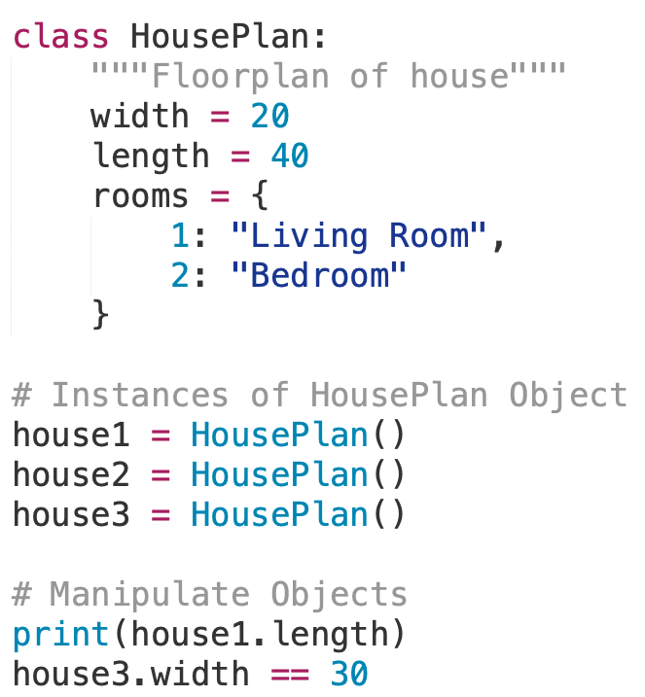
Class Declaration
Using the class keyword, creates a special data type that defines how to build a certain kind of object
Instances are objects that are created which follow the definition given inside the class
Defining a class
class header
Keyword class begins definition
Followed by name of class and colon :
Body of class
Indented block of code
Documentation string (optional)
Describes the class
Appears immediately after class header
Python does not use separate class interface definitions as in some languages – you just define the class and then use it

Slide 9
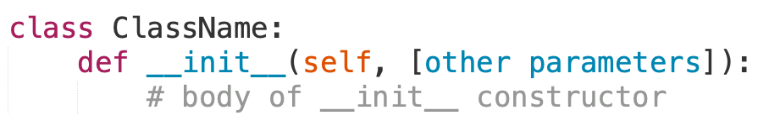
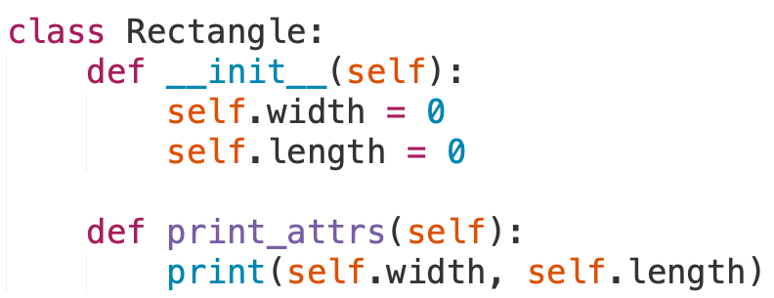
Class Constructors
All Python classes has a special method called a constructor that is automatically invoked when a new object is declared
Initializes attributes of the class
Returns None
The constructor method is called __init__()
Example
For all methods, including constructor, must include the self parameter that represents the object reference of the class

Slide 10
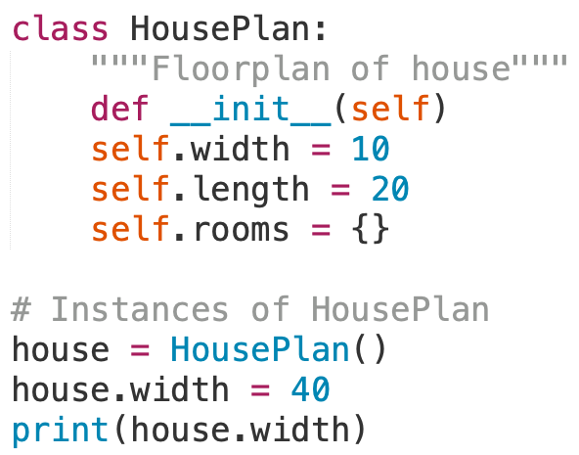
Instantiating Object from Classes
To create an instance of a class, you call the class using the name of the class and pass arguments accepted by the __init__() method
Although you must specify self explicitly when defining a method, you do not include it when calling the method
Assigns address of object into reference
house = HousePlan()
Creates
reference
variable
Calls constructor
and creates an
object
Once instantiated, you can access the object attributes using the dot operator

Slide 11
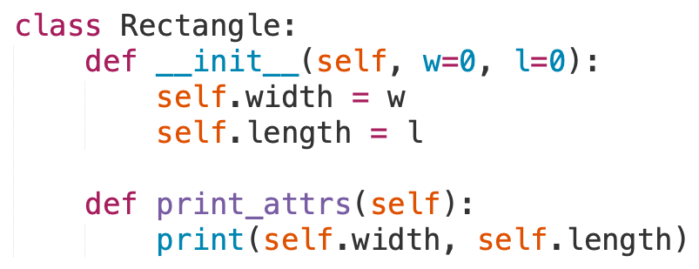
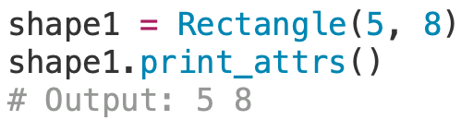
Instance Class Methods
To define a class methods, they are like regular functions but under the class scope.
Example:
Create object instance and call print method:
Every method in a class must have self as its first parameter, it refers to the current object
Every attribute in a class must be prefaced with self upon accessing it

Slide 12
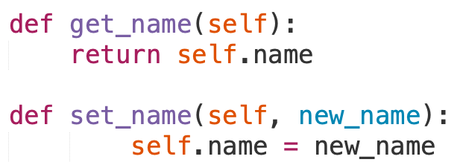
Accessors and Mutators
Also known as Getters and Setters
Accessors (get methods) → reads a value or attribute from the class object
Mutator (set methods) → updates a value or data members safely from the object
Can validate data to ensure validates inputted values
Accessors and mutators are a useful coding convention to provide data encapsulation
Data is controlled through methods, not directly changed
Hidden or Private internal structure of your class and should be used
(more on private values in following slide)

Slide 13
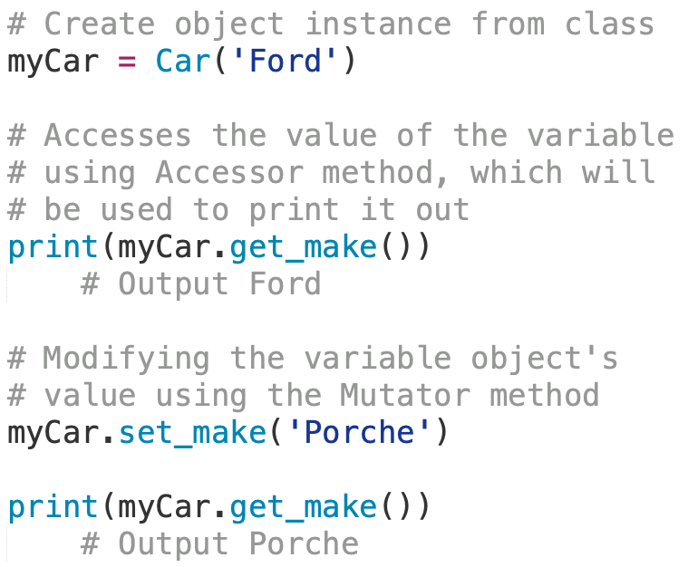
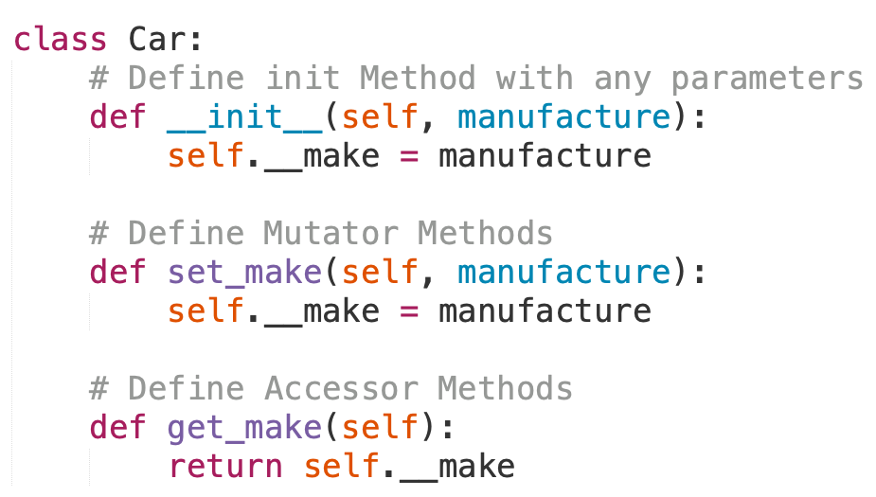
Accessors and Mutators

Slide 14
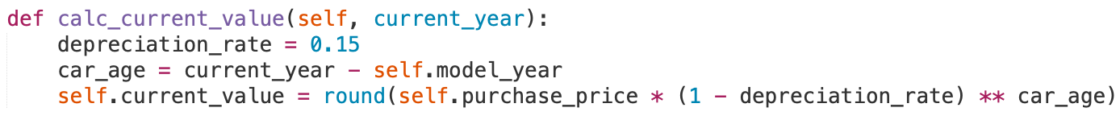
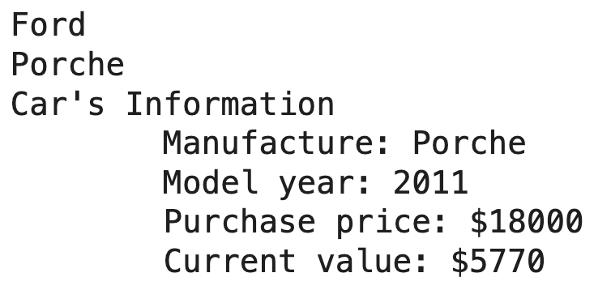
Exercise Car Class
Extend the Car class by
Create more attribute values called model_year, purchase_price, current_value
Define a new method called calc_current_value() in the class which passes the current year to calculate the current value.
Define a method called print_info() to print all relevant information
Example:
Where 2011 is car’s model year, 18000 is the purchase price
Using the print_info() outputs:

Slide 15
Class and Instance Object Types

Slide 16
Class vs Instance Attributes
Class attributes
Defined within a class definition, but outside any method
An assignment statement in the class, but outside any method creates a class attribute
It is an attribute of the class, not an object, so it represents class-wide information (i.e., one value for all class instances)
Considered to be static variables in some languages
Access by ClassName.name or self.__class__.name notation
Instance attributes
Associated with a particular instance of a class
Created and initialized by the __init__() constructor
Each instance has its own value for it
Access by object.name or self.name notation

Slide 17
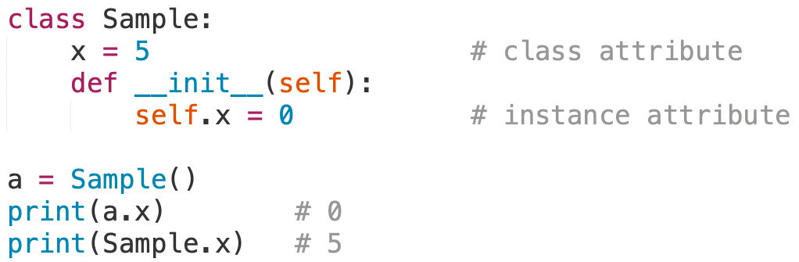
Class vs Instance Attributes
Example:
Attribute Type | Defined Where | Shared By | Example Access
Class Attribute | Outside any method | All instances of the class | ClassName.attr or self.__class__.attr
Instance Attribute | Inside __init__() | Only that object | self.attr or object.attr
Since all instances of a class share one copy of a class attribute, when any instance changes it, the value is changed for all instances
>>> Sample.x += 1
>>> b = Sample()
>>> print(b.__class__.x)
6
>>> print(b.x)
0

Slide 18
Class Constructors

Slide 19
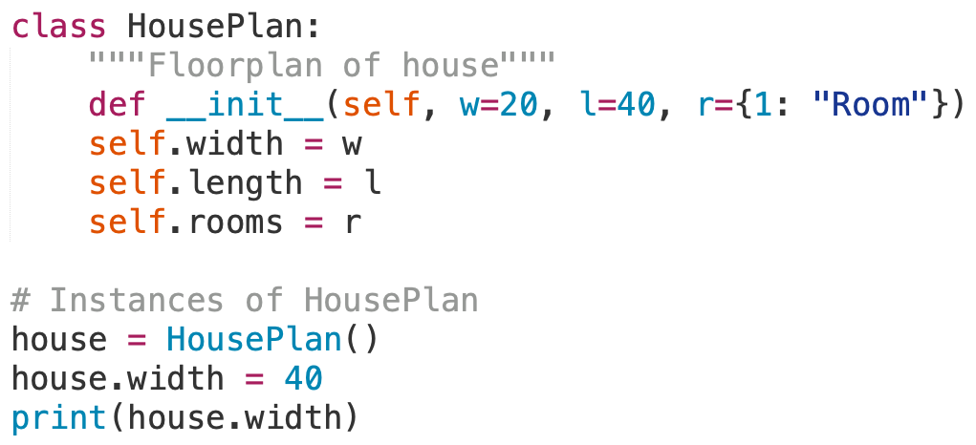
Customizing Constructors
The __init__() constructor can be customized with additional parameters
You can even specify default values as done with functions
Example

Slide 20
Customizing Constructors
The __init__() constructor can be customized with additional parameters
You can even specify default values as done with functions
Example

Slide 21
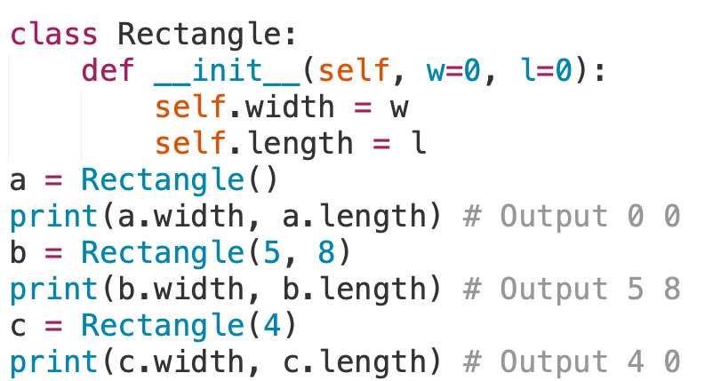
Customizing Constructors
The __init__() constructor can be customized with additional parameters
You can even specify default values as done with functions
Example
Default values
Understand the importance of the self parameter

Slide 22
Class Interfaces

Slide 23
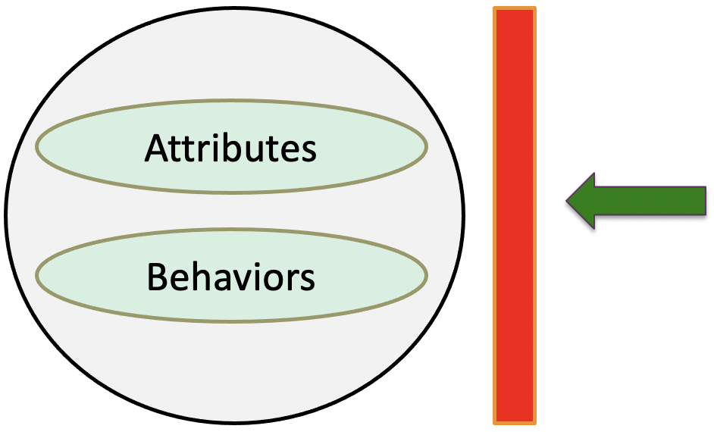
Implementing Abstraction
Information Hiding
In Python, everything is public by default.
Public attributes: any other class/function can see and change attribute
Public methods: any other class or function can call the method
However, we can signal privacy using naming conventions:
_name → “protected” (for internal use)
__name → “private” (name-mangled, harder to access directly)
User of object "sees" the abstract version of the object through the public interface

Slide 24
Implementing Public/Private Attributes
Python allows a class to prevent unintentional accessing of data directly using attribute naming conventions to hide data
_name → “protected” (for internal use)
Attributes that are not to be accessed directly are preceded with a single underscore _
You can still access and modify attributes directly, but you are not supposed to
__name → “private” (name-mangled, harder to access directly)
Private attributes with a double underscore __ are not to be modified by users
You can still access the attribute directly, but you must use a mutator to modify the attribute
Similarly, methods can be made private by prepending the double underscore __ to the method name

Slide 25
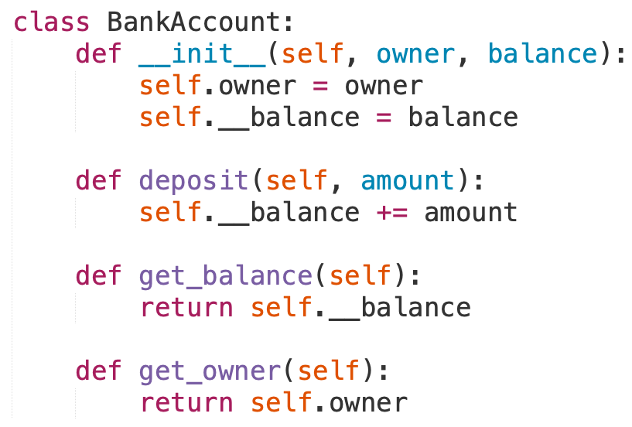
Implementing Public/Private Attributes
Could you call out
What is public?
What is private?
Which function is not necessary?
Due to data attribute being public
Why we do this?
Prevents accidental changes from outside
Encourages using methods (not direct access) to modify data.

Slide 26
Class Customization

Slide 27
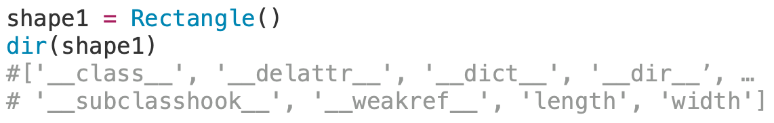
Class Customization
What are “Magic” or “Dunder” Methods?
Special methods that start and end with double underscores (__).
Python automatically calls them for built-in operations.
They come in three general classes
Numeric type operations (+, -, <, >, etc.)
Container operations ([], iterate, len, etc.)
General operations (printing, construction, etc.)
Python allows you to override standard methods, such as __init__
Operation | Method Called
print(obj) | obj.__str__()
len(obj) | obj.__len__()
obj1 + obj2 | obj1.__add__(obj2)
obj1 > obj2 | obj1.__gt__(obj2)
For more information, Python special method names.

Slide 28
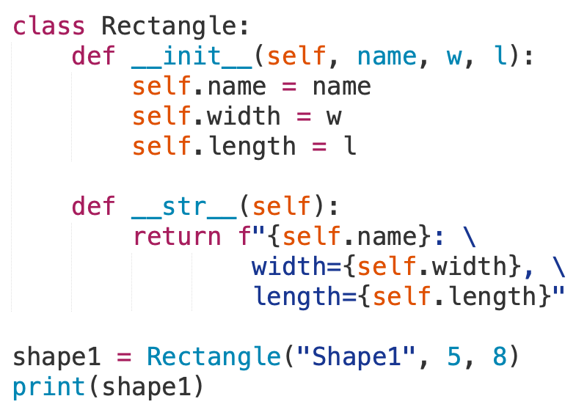
Class Customization
The special __str__() method can be overridden to change how a class instance object is printed
Let’s customize the __str()__ →
What would our output be?
Shape1: width=5, length=8
__str__() must return a string

Slide 29
Relational Operator Overloading
With custom class, we can redefine built-in relational operators' functionality
For example, > and >= can be used with class instances through operator overloading called rich comparison methods
Rich Comparison Method | Overloaded Operator
__lt__(self, other) | less-than <
__le__(self, other) | less-than or equal-to <=
__gt__(self, other) | greater-than >
__ge__(self, other) | greater-than or equal-to >=
__eq__(self, other) | equal to ==
__ne__(self, other) | not-equal to !=

Slide 30
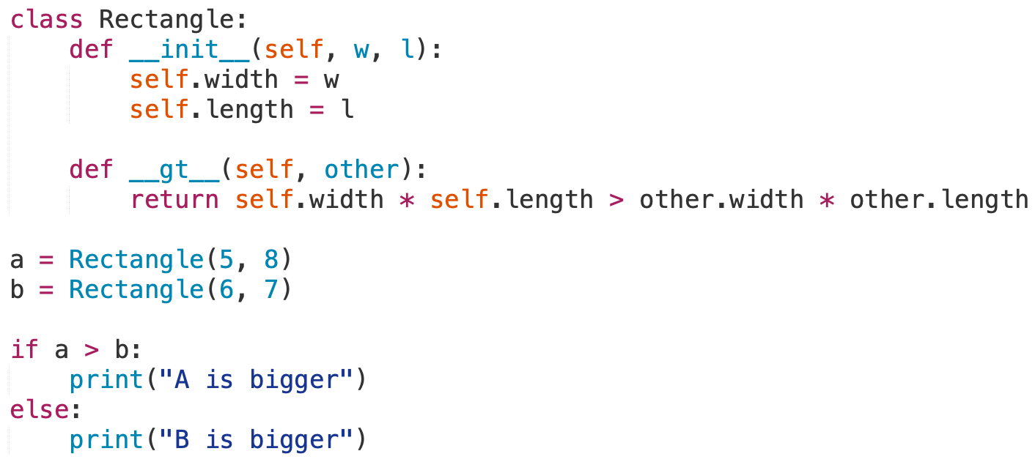
Relational Operator Overloading Example
Given the Rectangle Class, how would we compare two different size rectangles?
Redefined the greater than operator

Slide 31
Operator Overloading
With custom class, we can redefine built-in other operators' functionality
For example, +, -, and * when used with class instances through operator overloading
To Emulate Numerical Methods | Description
__add__(self, other) | Add +
__sub__(self, other) | Subtract -
__mul__(self, other) | Multiply *
__truediv__(self, other) | Divide /
__floordiv__(self, other) | Floored division //
__mod__(self, other) | Modulus %
__pow__(self, other) | Exponentiation **
__and__(self, other) | Logical AND
__or__(self, other) | Logical OR
__abs__(self) | Absolute value abs()
__int__(self) | Convert to integer int()
__float__(self) | Convert to floating point float()

Slide 32
Class Customization and Overload Methods
Math-like Operators
Expression | Method | Description
x + y | __add__ | Addition
x - y | __sub__ | Subtraction
x * y | __mul__ | Multiplication
x / y | __div__ | Division
x == y | __eq__ | Equality
x > y | __gt__ | Greater than
x >= y | __ge__ | Greater than or equal
x < y | __lt__ | Less than
x <= y | __le__ | Less than or equal
x != y | __ne__ | Not equal
Sequence Operations
Expression | Method | Description
len(x) | __len__ | Length of the sequence
x in y | __contains__ | Check if y contains x
x[key] | __getitem__ | Access element at key
x[key] = v | __setitem__ | Set element at key to value v
General Class Operations
Expression | Method | Description
x = myClass() | __init__ | Constructor
print(x), str(x) | __str__ | Convert to readable string
— | __repr__ | Developer-friendly representation of object
— | __del__ | Finalizer, called when object is deleted

Slide 33
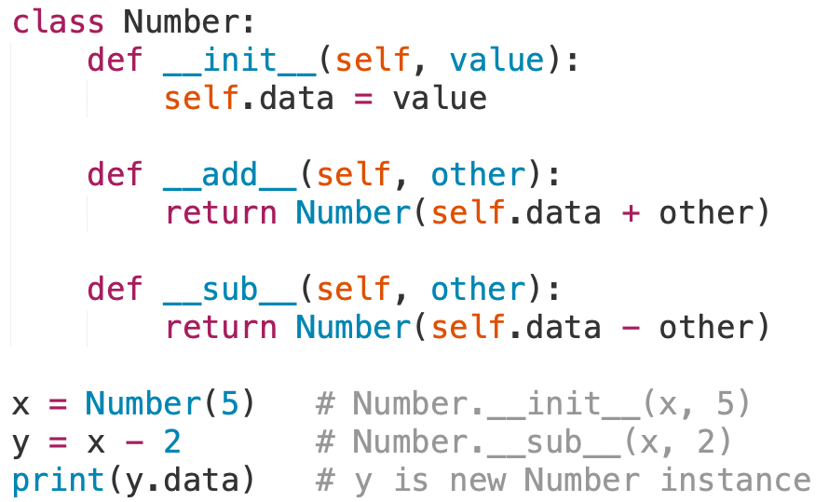
Operator Overloading Example
Could you tell which operators that is overloaded for class Number?
Which one is used above?
Note: Class Number will return a new object when performing math operations.
The Python built-in isinstance() function checks if an object is of a certain type:
isinstance(x, Number) # Outputs True

Slide 34
Memory Allocation and Garbage Collection

Slide 35
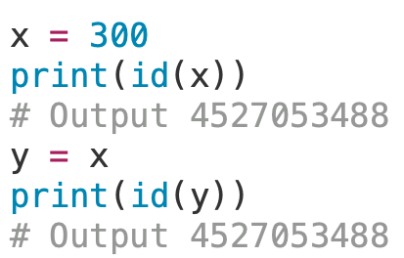
References and Reference Count
How are Python objects stored in memory on the computer?
A reference is a variable name of a container object pointing at object in memory
A reference count is integer counter that represents how many variables reference an object
Note: When object’s reference count is 0, object is no longer referenced
Simple Example:
Note: Multiple variables can refer to the same object
Variable Name
reference
Object in Memory
Deleting a variable name with del x only removes the reference, not the object itself.
del name
Name
Memory
X
Name
X
Memory

Slide 36
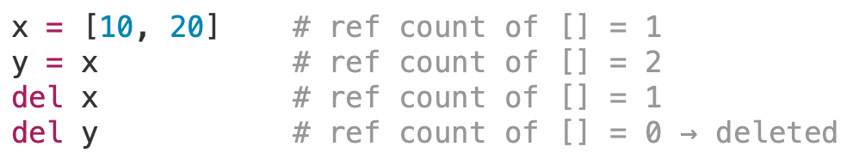
References and Reference Count
Example of reference count:
Breakdown:
x = [10, 20]: A list object is created in memory (say at address 0xABC123), and x points to it.
y = x: Now y also points to the same memory address.
del x: Removes the name x, but the object still exists because y points to it.
del y: Removes the last reference.
Reference count = 0, Python's garbage collector deletes the object and frees the memory.

Slide 37

Garbage Collection
Garbage collection is a way for a program to automatically release memory when the object taking up that space is no longer in use
How does reference counting garbage collection work?
Add and Remove Reference
If Reference Count is 0
When reference count is 0, objects are immediately deleted

Slide 38
Exercise Calculator Class
Write a Calculator class that emulates basic functions of a calculator:
Attributes: value
Methods:
__init__() – set the attribute to 0.0
add(num) – add the parameter to the attribute
subtract(num) – subtract the parameter to the attribute
multiply(num) – multiply the attribute by the parameter
divide(num) – divide the attribute by the parameter
clear() – set the attribute to 0.0
get_value() – return the attribute
Note: Make sure to have self when creating the methods
Given two float inputs num1 and num2, the program output the following:
The initial value of the instance attribute, value
The value after adding num1
The value after multiplying by 3
The value after subtracting num2
The value after dividing by 2
The value after calling the clear() method
Example Output
If the input is:
10.0
5.0
The output is:
0.0
10.0
30.0
25.0
12.5
0.0

