Slide 1
CSCE 1035 – Computer Programming I
Chapter 10 Exceptions

Slide 2
Handling Exceptions

Slide 3

Exceptions
What is an Exception?
A syntax error is caught before the program runs.
A runtime error is an exception — an event that something unexpected happened while the program is running.
When Python can’t continue, therefore an error occurs, it raises an exception (an error object).
If not handled, the program terminates and prints a traceback showing where the error occurred.
Examples of runtime errors:

Slide 4
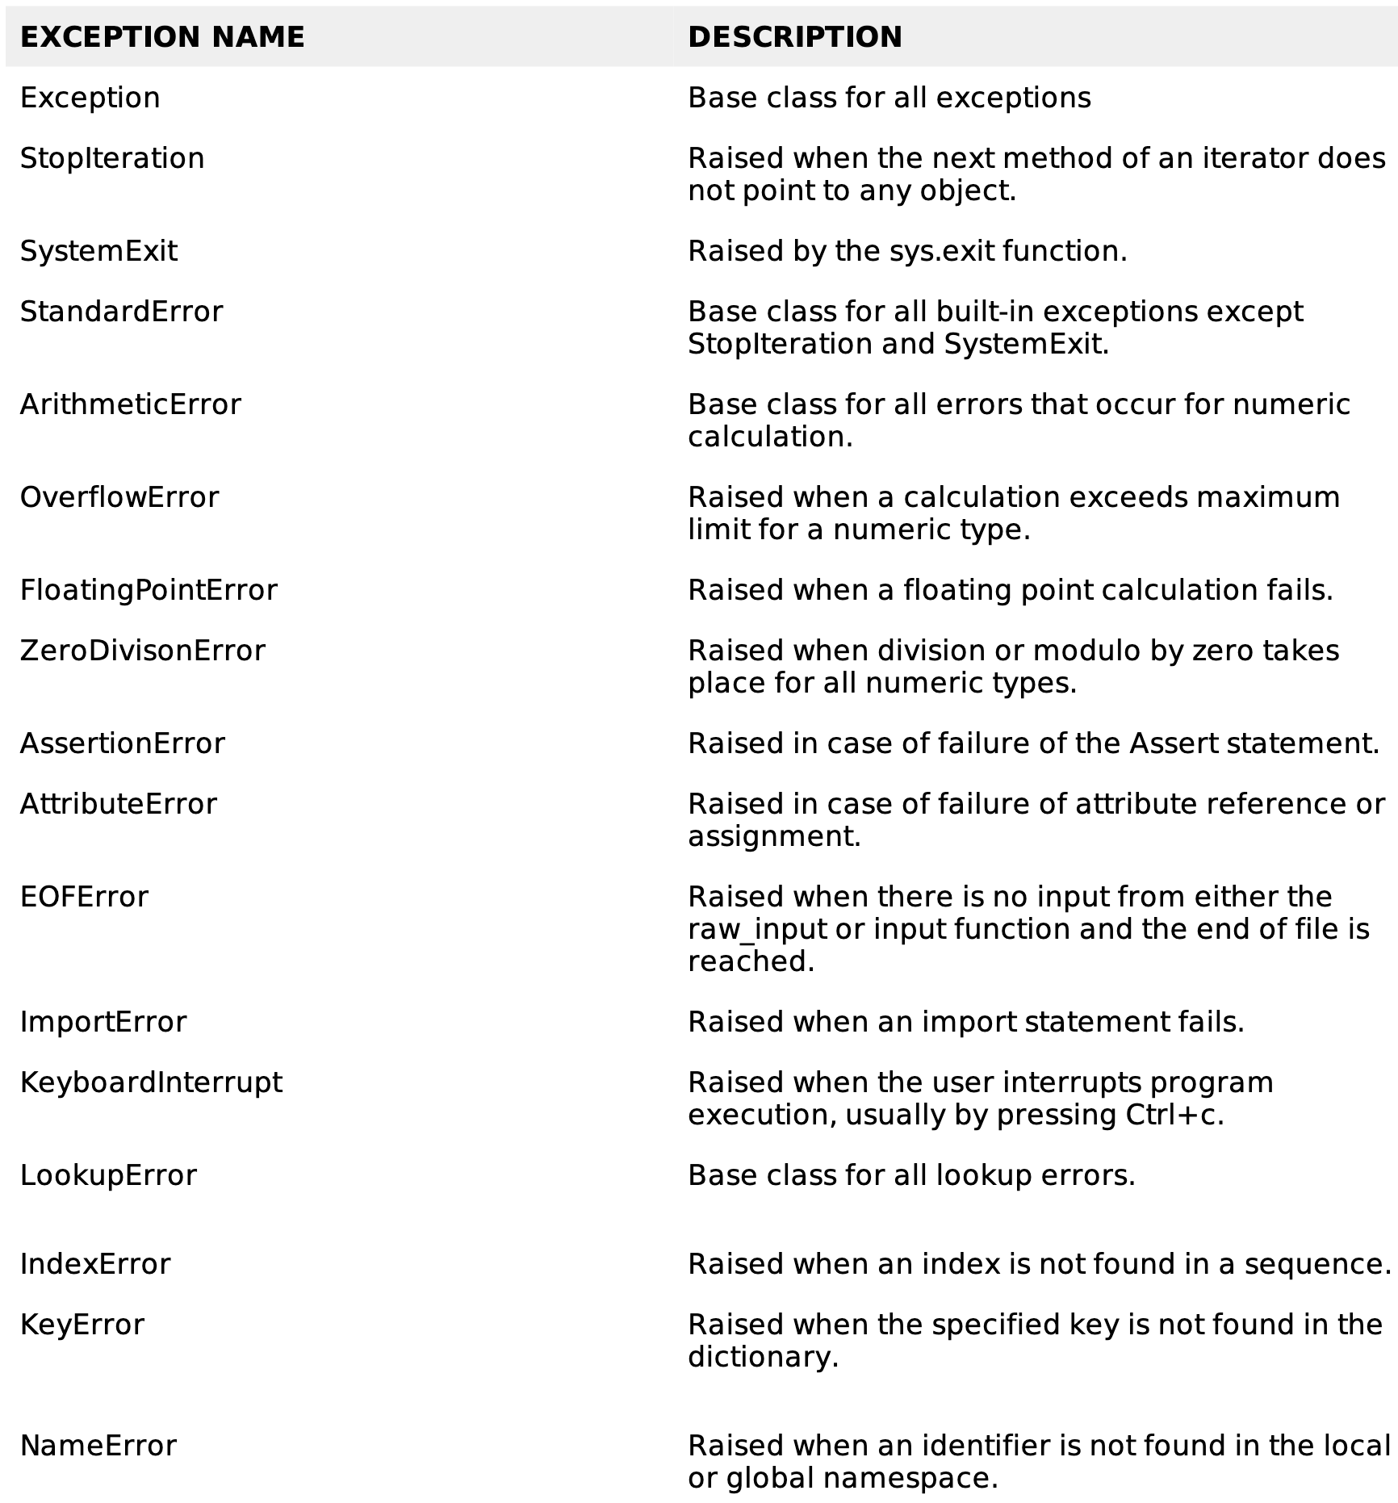
Standard Exceptions
For more information visit Python’s Exception Documentation: Link

Slide 5
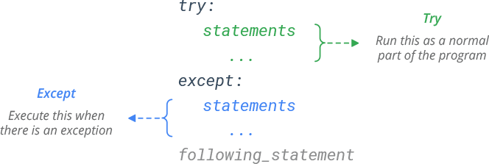
Exception Handling
For any suspicious of your code may raise an exception then place your code under a try block
If the exception occurs, the code in the try block stops being executed and code in the except block is executed
An except block is a block of code that handles the problem as elegantly as possible
Simple Overview: Use try / except to prevent program crashes.
Code inside try runs first.
If an error occurs → except is executed.
If no error occurs → except is skipped, not executed.

Slide 6
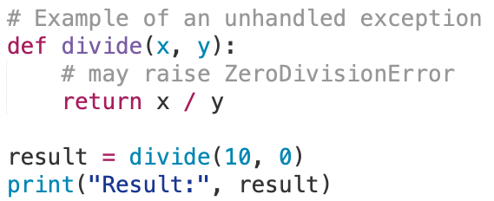
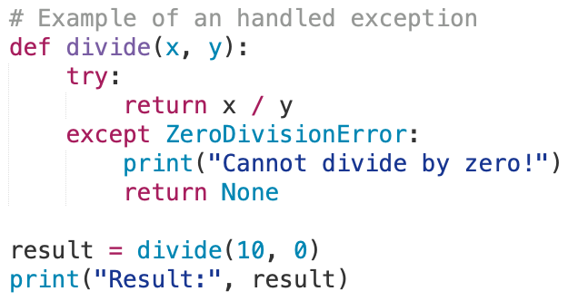
Unhandled Exceptions
Two possibilities for an exception to go unhandled
There is no except block specifying the exception of the right type
The exception was raised outside of the try block
For the cases, an exception error will terminate the program
Python will provide a traceback as an error message including the line numbers and information
$ python example.py
Traceback (most recent call last):
File "example.py", line 5, in <module>
result = divide(10, 0)
ZeroDivisionError: division by zero
$ python example.py
Cannot divide by zero!
Result: None

Slide 7
Handle Multiple Exceptions

Slide 8
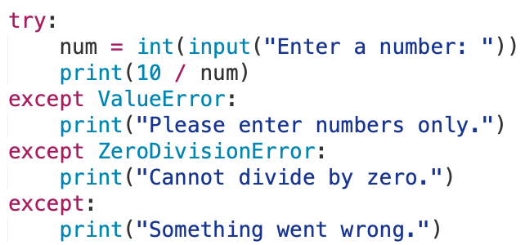
Handle Multiple Exceptions
A single try block can have multiple except blocks
Useful when a try block could contain multiple different types of exception errors
Write an except block for each type of exception error to be handled
If no exception handler exists for an error type, then an unhandled exception error may occur
An except block with no specific exception error type
Handles any generic exception error that is raised in the try block
Last of except blocks in the series
Example of handling multiple exceptions:

Slide 9
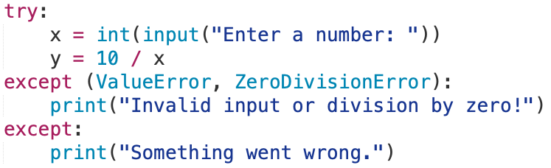
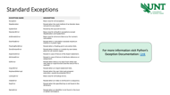
Handle Multiple Exceptions
A single try block can have multiple except blocks
Multiple exceptions can be put into a single except block using parentheses to have except block handle all of them
Other Exception Errors
from slide 4

Slide 10
Try Exceptions with Functions

Slide 11
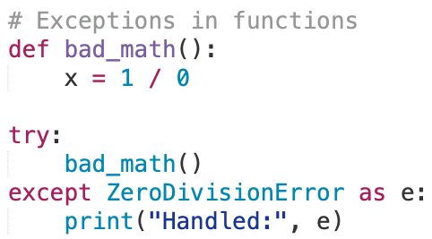
Try Exceptions with Functions
Exceptions can propagate up from functions to the try block that called them.
Meaning the exception error doesn’t have to be within the try block
They also handle exceptions raised by functions called within the try block.
$ python example.py
Handled: division by zero

Slide 12
Raising Exception

Slide 13
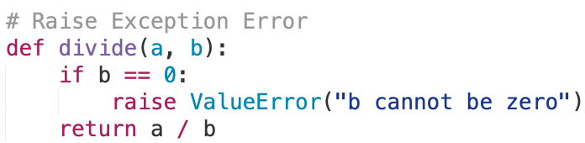
Raising Exceptions
How is an exception error or exception object is created?
When an exception error is raised; Python will create an object of an appropriate exception class and raise the object.
The raise statement allows the programmer to force a specified exception to occur
raise ExceptionClass('Error details’)
Example of Programmer made exception:
Here a new ValueError object is created with a message of “b cannot be zero”

Slide 14
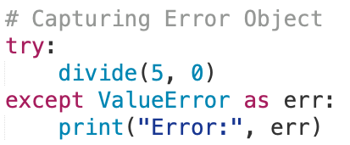
Raising Exceptions
When an exception object is created in memory when an exception is thrown
We can assign the exception object to a variable in the except clause
except ExceptionClass as err:
err stores the exception object with its message.
The error variable can be used in the print() function to display the error message

Slide 15
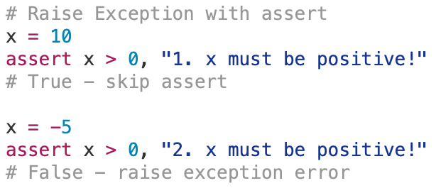
Raising Exception with assert
What Does assert Do?
assert is a quick way to test a condition while your program runs.
If the condition is True, nothing happens.
If the condition is False, Python automatically raises an AssertionError
Use Case | Why
Checking assumptions | Makes sure your logic stays valid
Debugging | Stops the program immediately if something’s wrong
Testing functions | Quick internal self-check
Assertions for development and debugging, can be disabled by adding –O.
$ python -O my_program.py
All assert statements are ignored.
$ python example.py
AssertionError: 2. x must be positive!

Slide 16
Using Finally to Cleanup

Slide 17
The else and finally Blocks
An else block after the except block(s)
Executed when the code in the try block does not raise an exception
Skipped when the an exception was raised
A finally block after the except and else block(s)
Code within the finally block always runs after execution of the code in the try, and possibly in the except blocks
Purpose is to perform cleanup before exiting (e.g., close files, release resources).
Execute lines of code no matter, for both when an error occurs or when no errors occurs
Even if the try block contains a return, break, or continue, the finally block still runs before exiting that block.
You may want to exit the system as a result of an exception
import sys
sys.exit([arg])
sys.exit(0) can stop a program gracefully (0 means “success”).

Slide 18
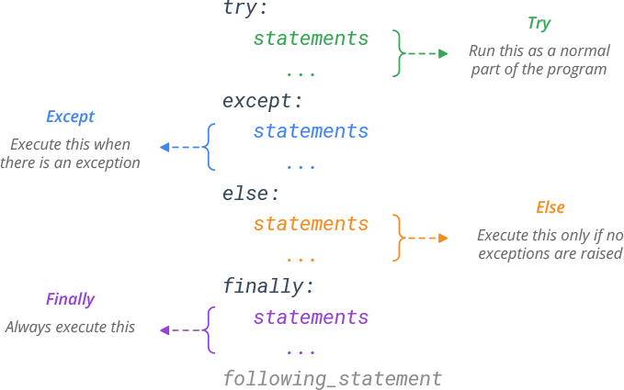
Try-Except-Else-Finally Syntax

Slide 19
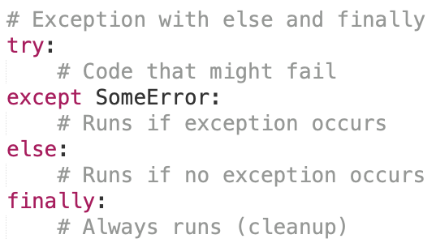
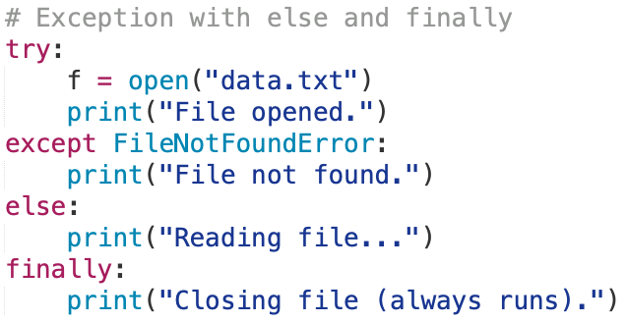
Finally Block Scenarios
No exception
Execution continues in the finally clause, and then proceeds with the rest of the program
Handled exception
Exception handler executes and then the finally clause
Unhandled exception
The finally clause executes and then the exception is re-raised
try block exit
The finally clause executes if any break, continue, or return statement causes the try block to be exited
General Form:
Example:
Utilize code on Google Colab / Jupyter Notebook to trying out the different scenarios and their outputs.

Slide 20
Custom Exceptions

Slide 21
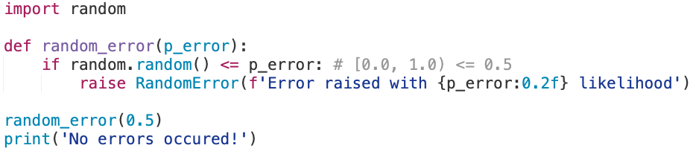
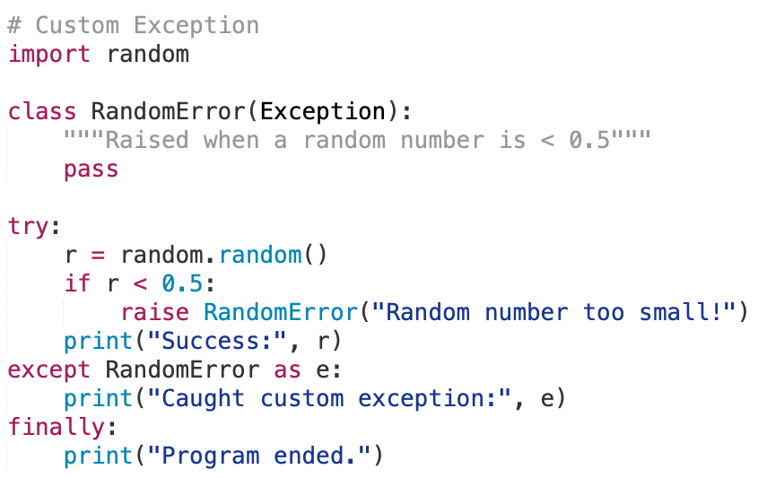
Custom Exceptions
You can define your own exception types to represent special errors in your program.
Now let’s design a custom RandomError exception
Custom Exception
Docstring with triple quote
pass – do nothing, empty class statement
Usage of Custom Exception
Exception Object’s message
Handling the error with print

Slide 22
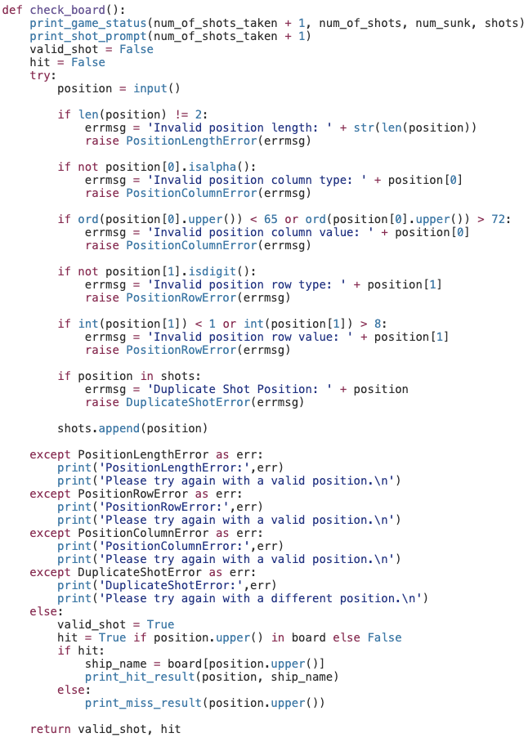
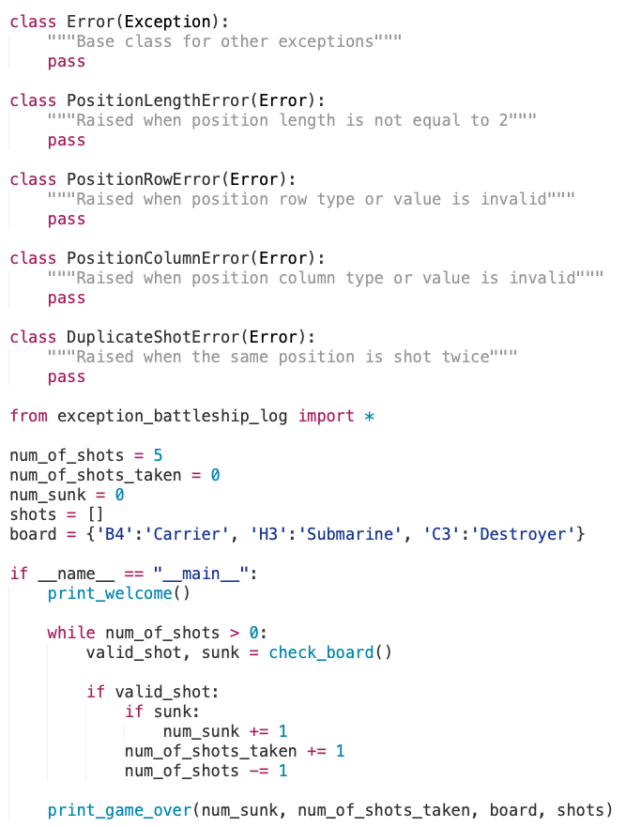
Try-Except Exercise

