Slide 1
CSCE 1035 – Computer Programming I
Chapter 2 Variables and Expressions

Slide 2
2.1 Variables and Assignments

Slide 3
Variables & Assignment Operator
A variable is a name that represents a value stored in the computer memory
Used to access and manipulate data stored in memory
A variable references the value it represents
An assignment statement is used to create a variable and make it reference data
General format: variable = expression
Variable name should not be enclosed in quotation marks
The variable receiving the value must be on the left side of the assignment operator "="
You can only use a variable if a value is assigned to it
Examples
age = 21
my_cost = your_cost + 100

Slide 4
2.2 Identifiers

Slide 5
Variable Naming Rules
Variable names are called identifiers
Case sensitive
num_Cars and num_cars are different identifiers
Identifier rules
First character must be a letter (upper or lower case) or an underscore
Remaining characters, if any, may be letters (upper or lower case), numbers (i.e., digits), or underscore characters
Variable name cannot be a Python reserved word (i.e., keyword)
Variable name should reflect its use
Recommend using underscore convention between words
Avoid names that start and end with double underscores (e.g., __init__) since Python has special usages for these

Slide 6
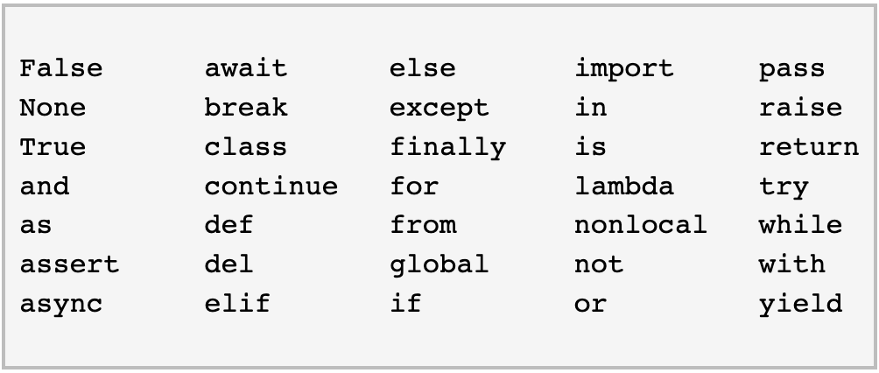
Keywords
Keywords are used by the Python language
Must be used as defined in the language
Cannot be used as identifiers

Slide 7
2.3 Objects

Slide 8
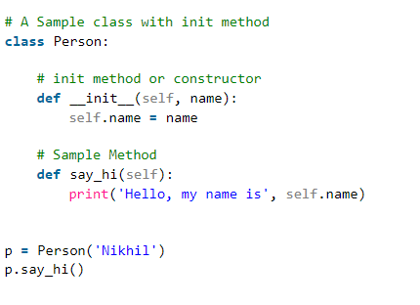
Object-Oriented Programming (OOP)
Python is an object-oriented programming (OOP) language
OOP is a methodology that defines problems in terms of objects that send messages to each other
An object is a single software unit that combines attributes and methods
An attribute is a "characteristic" of an object, like a variable associated with a kind of object
A method is a "behavior" of an object, like a function associated with a kind of object
For now, just know that an object represents a value and is automatically created by the interpreter when executing a line of code

Slide 9
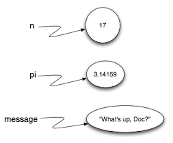
Objects
Name binding is the process of associating names with interpreter objects
Properties of objects
Value
Type (e.g., integer, string, float, etc.)
Determines mutability of an object
Integers and strings are immutable
List, dict and Set are mutable
Identity (unique identifier that describes the object)
Objects are automatically reclaimed when no longer needed

Slide 10
2.4 Numeric Types: Floating-Point

Slide 11
Floating-Point Numbers
Numbers that can have fractional parts a represented as floating-point (or float) values
A numeric literal without a decimal point produces an int value
A literal that has a decimal point is represented by a float (even if the fractional part is 0)
Can be written using scientific notation
3.41e1 means 34.1 3.67e17 means 367000000000000000.0 5.89e-6 means 0.00000589
The float type stores only an approximation to the real number being represented
Range is approximately 2.3x10⁻³⁰⁸ to 1.8x10³⁰⁸ – anything smaller or larger may cause an overflow error

Slide 12
Formatting Floating-Point Numbers
By default, most programming languages output at least 5 digits after the decimal point for floating-point numbers
Python allows several ways to format the output of floating-point numbers
'{:f}'.format(<floating-point number>)
A . followed by a number specifies the number of decimal places
print('{:.2f}'.format(my_float))
You can also pad floating-point numbers with whatever and however many characters
print('{:06.2f}'.format(my_float))
This does affect the number of positions after the decimal point
Check out https://pyformat.info/ for many common use examples of formatting in Python

Slide 13
2.5 Arithmetic Expression

Slide 14
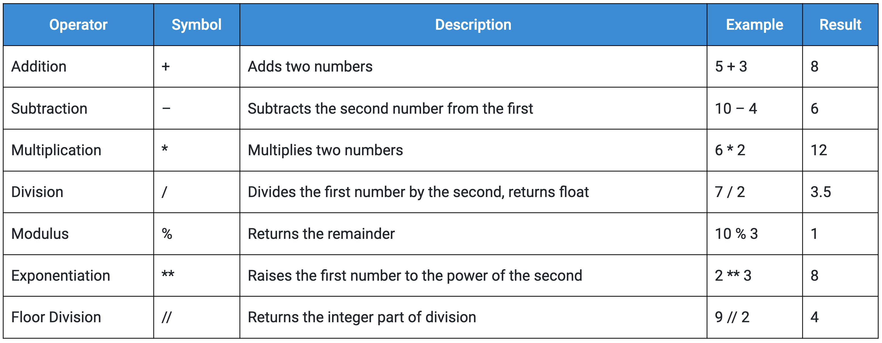
Arithmetic Expression
Precedence rules for operators follow PEMDAS
Use parentheses to alter the order of operations
x + y * z y is multiplied by z first
(x + y) * z x and y are added first

Slide 15
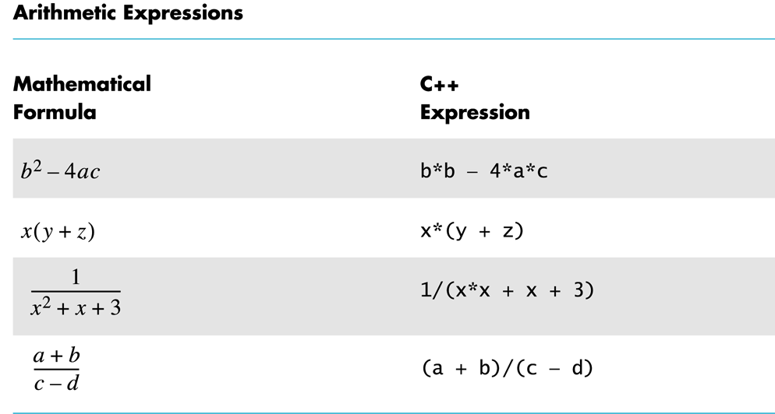
Arithmetic Expression

Slide 17
2.6 Python Expressions

Slide 18
Spacing and Compound Operators
Use spacing to make expressions readable
Which is easier to read?
x+y*z or x + y * z
Some expressions occur very often that Python contains a shorthand way to express them
+= count = count + 2 becomes count += 2
–= count = count – 2 becomes count –= 2
*= bonus = bonus * 2 becomes bonus *= 2
/= time = time / factor becomes time /= factor
%= rem = rem % (x + y) becomes rem %= (x + y)

Slide 19
2.7 Division and Modulo

Slide 20
Division Operations
Division always yields a floating-point number (unlike C/C++)
Floor division operator //
Performs division and gives only integer quotient
Truncates division operator
Modulo operator %
Evaluates the remainder of the division of two operands
These do not have to be integers!

Slide 21
2.8 Module Basics

Slide 22
Using Modules
Modules are files containing Python definitions and statements (e.g., names.py)
A module’s definitions can be imported into other modules using "import module_name", without the .py extension
Once a module is imported, you can access an object defined in the module using dot notation
E.g., print(names.first)
Separating code into different modules makes management of larger programs simpler
Python comes with a library of standard modules described in the Python Library Reference (https://docs.python.org/3.6/library/)
Assumes the object called first is defined in names.py

Slide 23
Underscore Naming Conventions
Single underscore: _
Can represent (i.e., store) the last expression in the interpreter
Can represent the values that we don’t care (i.e., insignificant)
Can be a visual separator for digit grouping purposes (e.g., 1_000)
Single leading underscore: _var
Internal use, non-public (i.e., should not import)
Single trailing underscore: var_
Avoids conflict with keywords or built-ins (e.g., class_)
Double leading underscore: __var
Python interpreter rewrites attribute name to avoid naming conflicts in subclasses, called name mangling (e.g., __var replaced by _classname__var)
Double leading and trailing underscores: __var__
Reserved for special use in Python, called Magic Names
Names like __init__, __call__, etc. are all magic methods

Slide 24
Executing Imported Modules
Modules have the __name__ variable set to the module name
The __name__ is a special built-in variable that evaluates to the name of the current module
If a module is being run directly (from the command line), the __name__ instead is set to the string '__main__'
When a Python file is called as a script, the __name__ is set to '__main__'
This allows you to create modules that can also be executed as scripts
Adding if __name__ == '__main__' allows code inside block to execute when file is passed to the interpreter directly, not imported

Slide 25
2.9 Math Module

Slide 26
Using the Math Library
Suppose we wanted to write a program to compute the roots of an equation using the quadratic formula
The only part of this that we may not know how to do is find the square root
But the solution (i.e., the square root function, sqrt()) can be found in the math library!
To use the library, we need to import math in our code
Importing a library makes whatever functions and attributes are defined within it available to your program

Slide 27
Using the Math Library
sqrt(x) is known as a function call
Variables, expressions, or literals inside the parentheses are passed to the function and considered to be arguments (or parameters) of the function
Some functions take 0, 1, 2, or even more arguments
The pow(b, e) function accepts 2 arguments to compute b^{e}
To access the sqrt() library routine, we need to access it as math.sqrt(x)
Using this dot notation tells Python to use the sqrt() function found in the math library module
You can use from math import * to remove math prefix

Slide 28
Commonly Used Functions
The math module has a number of commonly used functions and constants
Command name | Description
abs(value) | absolute value
ceil(value) | rounds up
cos(value) | cosine, in radians
floor(value) | rounds down
log(value) | logarithm, base e
log10(value) | logarithm, base 10
max(value1, value2) | larger of two values
min(value1, value2) | smaller of two values
round(value) | nearest whole number
sin(value) | sine, in radians
sqrt(value) | square root
Constant | Description
e | 2.7182818...
pi | 3.1415926...
Check out http://docs.python.org/3.6/library/math.html
documentation for Python’s math module.

Slide 29
2.10 Representing Text

Slide 30
Escape Sequences
Escape sequences tell the interpreter to treat certain characters in a special way
\ is the escape character
To use a newline character in output \n as in print('\n')
Other escape sequences: \t a tab \\ a backslash character \" a double quote character
\' a single quote character
\b a backspace character

Slide 31
Conversion/Encoding of Text
Raw strings do not treat backslash \ as a special character
Every character you put into a raw string stays the way it is written
Prefix an 'r' before a string literal tells the Python interpreter to interpret that string literally
ord() returns an encoded integer value for a one-character string
ord("a") is 97, while ord("A") is 65
chr() returns a decoded one-character string for an integer
chr(99) is "c”
Real-world uses:
Cryptography e.g., Caesar or substitution ciphers by utilizing ord() and chr() to shift characters by a fixed number number.
Data Normalization and Validation e.g., verifying an input character is a number by checking if it between ord(‘0’) and ord(‘9’).
Text Processing & NLP
Systems Programming & Protocol Design

