Slide 1
CSCE 1035 – Computer Programming I
Chapter 3 Types

Slide 2
3.1 String Basics

Slide 3
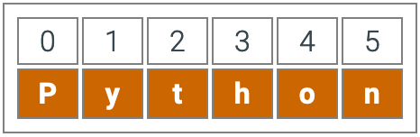
Strings
A string is a sequence of characters
A string is a literal enclosed by a single or double quotes
Using the input()can create a string
Examples:
var1 = “Welcome to Class”
var2 = ‘Introduction to Python’
Python sequence types like the string type order items from first to last.
Character indexes are string positions.
name = “Dominic”
The first character is at index 0, the second at 1, etc.
print(name[0]) => “D”
print(name[1]) => “o”
String slice: varName[startIdx:endIdx]
name[0:2] is “Dom”
Use len() to find the length of a string
String are immutable (i.e., read only)

Slide 4
Container Types
Containers are built-in data types in Python
Can hold objects of any type (including their own type)
Tuple
An immutable sequence type, holding a collection of objects in a defined order (indexed by integers)
List
A mutable sequence type, holding a collection of objects in a defined order (indexed by integers)
Dictionary
A mapping type, associating keys to values (unordered, indexed by keys)
Set
An unordered collection of unique elements (accessed through set operations)

Slide 5
Python Methods and Functions
Function
A function is a block of code to carry out a specific task, contains its own scope (inside the function), and is called by its name
All functions contain zero or more arguments
<function_name>(<arg-1>, …, <arg-n>)
On exit, a function can or cannot return one or more values
Method
A method behaves like a function, but has a slightly different syntax
A method is always called with a given data value called an object
<object>.<method_name>(<arg-1>, …, <arg-n>)
A method knows about the internal state of the object with which it is called
In Python, all data values are, in fact, objects

Slide 6
3.2 List Basics

Slide 7
Creating Lists
A list is a sequential collection of values
Each value has a location (i.e., an index)
Values are enclosed in []
my_list = [3, 'a', True]
empty_list = []
Indices range from 0 to n – 1, where n is the length of the list
And from –1 to –n (starting from end of list, moving left)
Lists are heterogeneous
Values can be of any type
Strings are homogeneous since their elements must be characters
Can refer to a list by its name to refer to the list itself or by its elements using []
A list item is called an element

Slide 8
Accessing and Updating Lists
Unlike strings, lists are mutable
Individual elements can be changed the same way any variable can be changed, with an assignment statement
my_list = [1, 9, 'a', 4, 'Peter']
m = 3
my_list[m] = 4
my_list[m + 1] = 'Peter'
Copying mutable sequences
Use [:] to make deep copy of an entire sequence
list2 = list1 # both refer to same ref,
# changing one affects both
list3 = list1[:] # Independent copies, two refs

Slide 9
Accessing and Updating Lists
Use append to add any type of element to right end of list
my_list.append('3')
Can also use + operator, but both operands must be a list
my_list = my_list + ["Joe"]
Use remove to remove an item by value
my_list.remove('Joe’) my_list.remove(value)
Use pop to remove an item by index and get its value
my_list.pop(1) my_list.pop(Index)
Use clear to remove all items
my_list.clear()

Slide 10
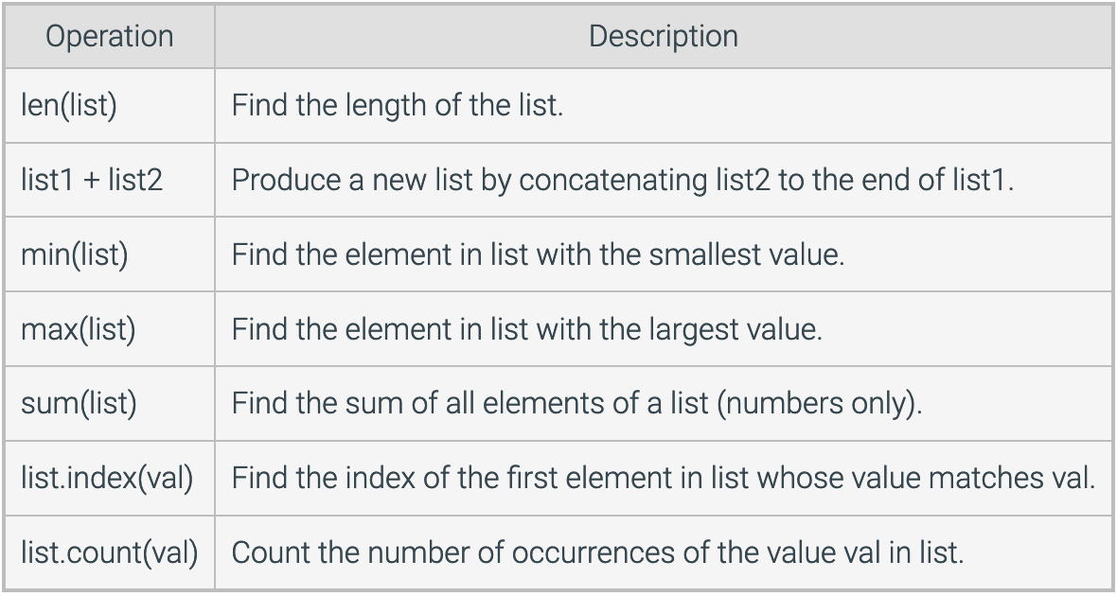
List’s Methods & Functions
len(['a', 'b', 'c’])
['a','b','c'].index('a')

Slide 11
List’s Methods & Functions
len() is a function on collections, returns the length
len(['a', 'b', 'c’])
['a','b','c'].index('a')
index() is a method on collections, returns the index of the first occurrence of its argument

Slide 12
3.3 Tuple Basics

Slide 13
Tuples & Named Tuples
A tuple is sequence data type
Enclosed with parentheses and contain values separated by commas
Support indexing and other functions such as len()
Tuples can be thought of as read-only lists
Example:
tiny_tuple = ('abcd', 786, 2.23, 'john', 70.2)
print(tiny_tuple[2:])
print(tiny_tuple * 2)
A Named Tuple can capture collection of data; define a new simple data type that consists of named attributes.
Keeps immutability while making code more descriptive
Examples:
from collections import namedtuple
Point = namedtuple(“Point”, [”x”, “y”, “z”, “intensity”])
p1 = Point(10, 20, 15, 0.5)
print(p1.x, p1.y) # Access by name
print(p1[0], p1[1]) # Access by index

Slide 14
3.4 Set Basics

Slide 15
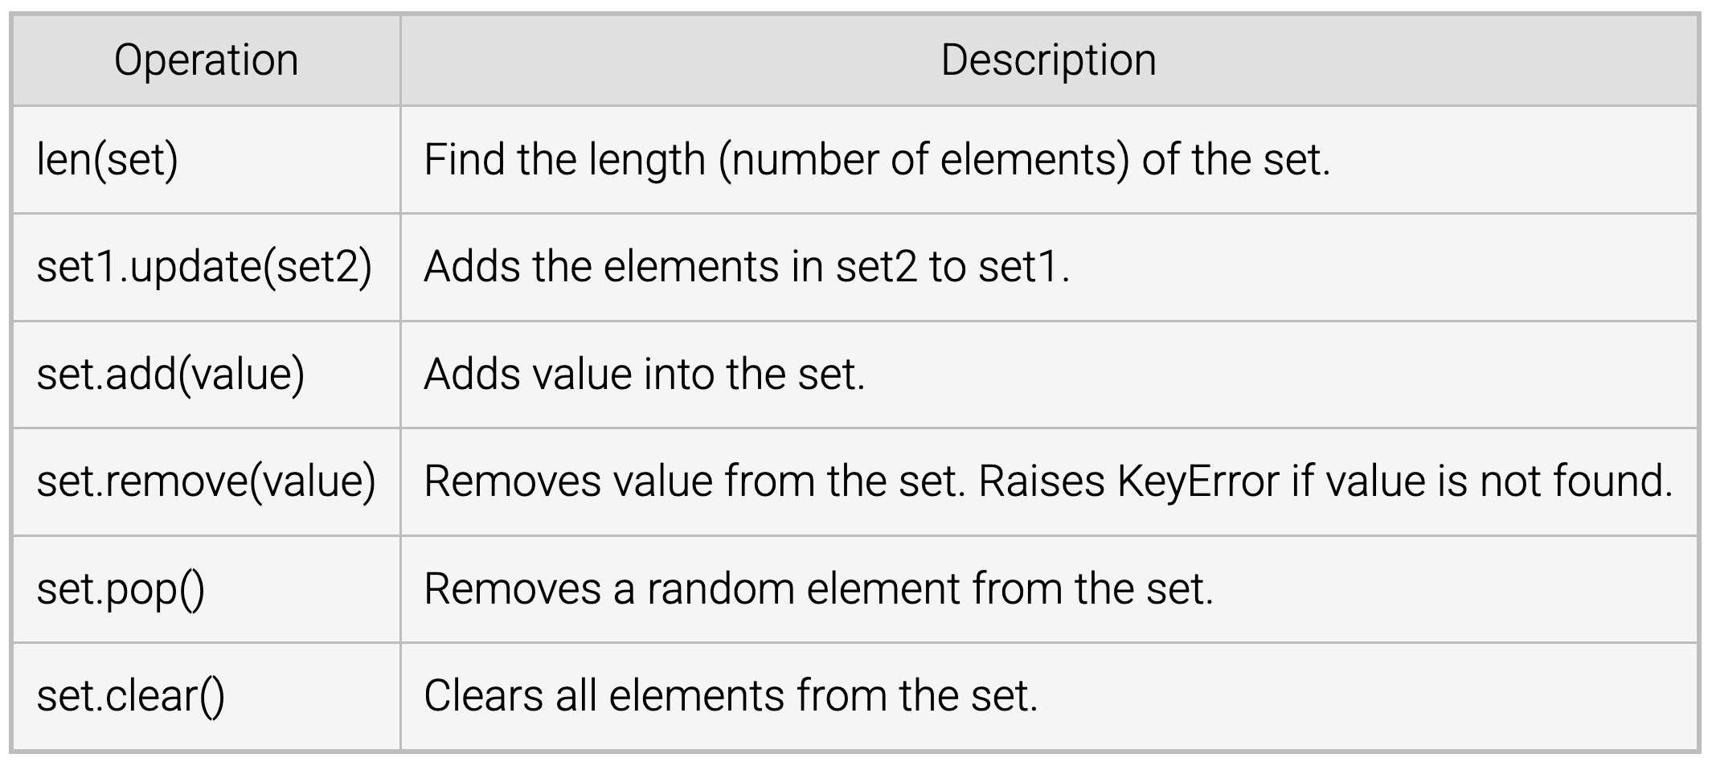
Sets
A set is an unordered collection of items
Every element is unique and must be immutable
Set are mutable – contain elements of different types, but not lists
Cannot access or alter via indexing
Sets can be used to perform mathematical set operations
Initialization
By placing literal elements inside curly braces {}, separated by commas
By using the function set()
Must pass a list into set(), all duplicates will be omitted to create the set
Functions

Slide 16


Set Operations
Sets utilize all the standard mathematical set operations using operators or methods
The union ( | ) is the merger of two sets
>>> s1 = set([4, 6, 9])
>>> s2 = set([1, 6, 8])
>>> s1.union(s2)
{1, 4, 6, 8, 9}
>>> s1 | s2
{1, 4, 6, 8, 9}
The intersection ( & ) is taking any elements that is in both sets
>>> s1 = set([4, 6, 9])
>>> s2 = set([1, 6, 8])
>>> s1.intersection(s2)
{6}
>>> s1 & s2
{6}

Slide 17


Set Operations
The difference ( – ) between two sets, which is the set of elements that are in the first set, but not the second
>>> s1 = set([4, 6, 9])
>>> s2 = set([1, 6, 8])
>>> s1.difference(s2)
{9, 4}
>>> s1 - s2
{9, 4}
The symmetric difference ( ^ ) of two sets is the set of elements that are in one of either set, but not in both
>>> s1 = set([4, 6, 9])
>>> s2 = set([1, 6, 8])
>>> s1.symmetric_difference(s2)
{1, 4, 8, 9}
>>> s1 ^ s2
{1, 4, 8, 9}

Slide 18
3.5 Dictionary Basics

Slide 19
Dictionaries
A dictionary is a container used to describe associative relationships
Data type for non-sequential collections, and are mutable
Dictionaries are a hash-table type for fast lookup, mapping data to unique keys
Dictionaries are mappings through key : value pairs
A key is unique and acts as an index to find the associated value
Keys can be any immutable type, such as a number, string, or tuple but are usually numbers or strings
A value describes some data associated with a key, such as a definition
A dictionary can be created by listing key-value pairs inside curly braces {}
An empty dictionary consists of {}
Access the value associated with a particular key using square brackets []
Example
student = {"name": "Alice", "age": 20}
print(student["name"])

Slide 20
Dictionaries
You can extend a dictionary by adding new entries
If already exists, will replace existing entry
passwd['newuser'] = '123456’
To remove an entry from a dictionary
del passwd[‘newuser’]
A common method for building dictionaries is to start with an empty collection and add key-value pairs one at a time
passwd = {}
for line in open('passwords', 'r').readlines():
user, password = str.split(line)
passwd[user] = password

Slide 21
Dictionary Functions
Method | Description
.keys() | Returns a view of all keys in the dictionary
.values() | Returns a view of all values
.items() | Returns a view of key-value pairs as tuples
.get(key, default) | Safely retrieves the value for a key; returns default if key is missing
.update(other_dict) | Merges another dictionary into the current one
.setdefault(key, default) | Returns the value if key exists; otherwise sets it to default
.pop(key, default) | Removes key and returns its value; returns default if key is missing
.popitem() | Removes and returns the last inserted key-value pair (LIFO in Python ≥3.7)
.clear() | Removes all items from the dictionary

Slide 22
3.6 Common Data Types

Slide 23
Python Data Types
Type | Description
int | Numeric type: Used for variable-width integers.
float | Numeric type: Used for floating-point numbers.
None | Special singleton type: Represents the absence of a value or a null return. Type is NoneType.
bool | Boolean type: Subclass of int, with only two values — True and False. Often used in logical expressions and control flow.
string | Sequence type: Used for text.
list | Sequence type: A mutable container with ordered elements.
tuple | Sequence type: An immutable container with ordered elements.
set | Set type: A mutable container with unordered and unique elements.
frozenset | Set type: A immutable container, similar to a set.
dict | Mapping type: A container with key-values associated elements.

Slide 24
Special Data Types
Type | Description
complex | Numeric type: Represents complex numbers in the form a + bj or a + bJ. Useful in scientific computing and signal processing.
bin | Integer literal prefix: Represents binary numbers using 0b or 0B. Example: 0b01000001 equals 65.
oct | Integer literal prefix: Represents octal numbers using 0o or 0O. Example: 0o134 equals 92.
hex | Integer literal prefix: Represents hexadecimal numbers using 0x or 0X. Example: 0x17ab equals 6059.

Slide 25
3.8 Type Conversions

Slide 26
Type Conversion
Data can be converted from one type to another
Utilize data type name to convert one type and return the data in another type
int() converts compatible data into an integer
float() converts compatible data into a floating-point number
str() converts compatible data into a string
Example
x = "123” # int as string
num = int(x) # string to int
s = str(456) # int to string
f = float("3.14") # string to float
int("7.1") # throws an ERROR
float("Test") # throws an ERROR
Python interpreter does it implicitly
>>> print(type(1 + 2.0))
<class 'float’>
You can determine the data type of a variable using the type() function

Slide 27
Type Conversion Functions
Function | Description
int(x [, base]) | Converts x to an integer. If x is a string, base specifies the numeral system (e.g., base 2 for binary).
float(x) | Converts x to a floating-point number.
complex(real [, imag]) | Creates a complex number from real and optional imaginary parts.
str(x) | Converts object x to a string.
tuple(s) | Converts sequence s to a tuple (immutable).
list(s) | Converts sequence s to a list (mutable).
set(s) | Converts sequence s to a set (unique, unordered).
dict(d) | Creates a dictionary from a sequence of (key, value) tuples.
frozenset(s) | Converts sequence s to a frozen set (immutable version of set).
chr(x) | Converts integer x to its corresponding character (Unicode code point).
ord(x) | Converts a character x to its integer Unicode code point.

Slide 28
3.9 Binary Numbers

Slide 29
Binary
A binary is number in the Base-2 system (0,1).
Usage in Programming: Memory representation, bitwise operations
b = 0b1010 # binary literal
print(b) # 10
Conversion:
bin(10) # int convert to bin, '0b1010’
int('1010', 2) # binary convert to int
Type | Description
bin | Integer literal prefix: Represents binary numbers using 0b or 0B. Example: 0b01000001 equals 65.
oct | Integer literal prefix: Represents octal numbers using 0o or 0O. Example: 0o134 equals 92.
hex | Integer literal prefix: Represents hexadecimal numbers using 0x or 0X. Example: 0x17ab equals 6059.

Slide 30
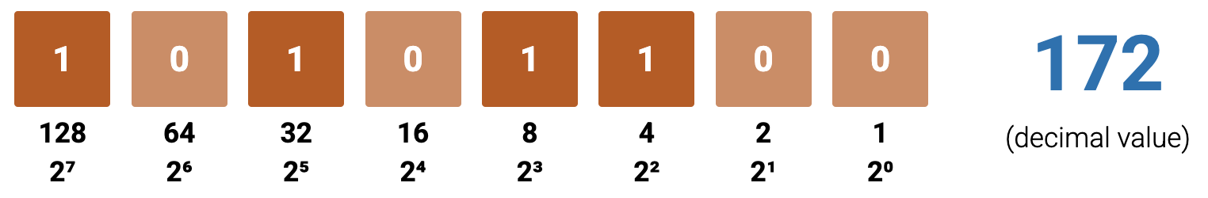

Conversions
Binary-to-Decimal: Conversion of a binary number (base-2) into its decimal (base-10) equivalent by summing powers of 2.
Decimal-to-Binary: Conversion of a decimal number (base-10) into binary (base-2) by repeatedly dividing by 2 and recording remainders.
$$128+0+32+0+8+4+0+0=172$$
Try it out → zyBooks Participation: 3.9.1: Binary number tool

Slide 31
3.10 String Formatting

Slide 32
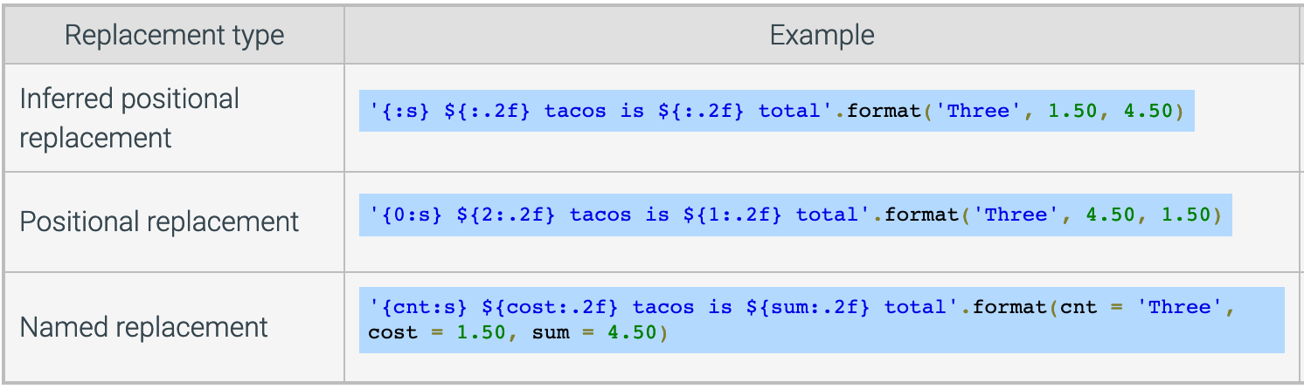
String Format
The string format() method allows you to create a string with placeholders that are replaced by values or variable values at execution
The colon ’:’ separates the "what" on the left from the "how" on the right

Slide 33
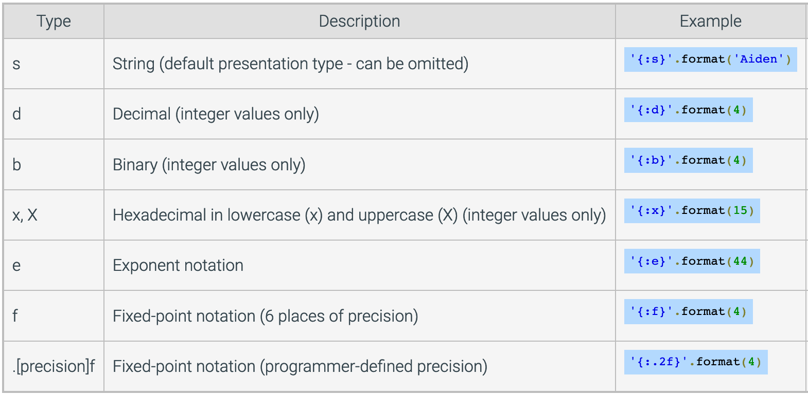
Format Specification
A format specification inside a replacement field allows a value’s formatting in the string to be customized

Slide 34
Formatted String Literals (f-strings)
f-strings allow dynamic insertion of expressions into strings using `{}` placeholders.
Use `=` inside `{}` to show both the expression and its result.
Example: `f"{2*4=}"` outputs `"2*4=8"`
Use double braces `{{` and `}}` to include literal curly braces in output.
Example: `f"{{teacher}}: Dominic"` outputs `"{teacher}: Dominic"`
Format specifications customize output using a colon `:` inside `{}`.
Example: `f"{4:.2f}"` outputs `"4.00"`(2 decimal places)
name = "Alice"
age = 20
print(f"My name is {name}, I am {age} years old.")

