Slide 1
CSCE 1035 – Computer Programming I
Chapter 4 Branching

Slide 2
Branches

Slide 3
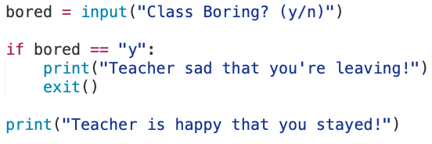
What is Branching?
Branches
Allow a program to choose between two or more alternatives
Decision are based on a condition that evaluate to True or False (i.e., a Boolean expression)
Each alternative path may produce a different result
Python’s keyword for conditional statements
if statements
if-else statements
if-elif-else statements
Nested if-else statements

Slide 4
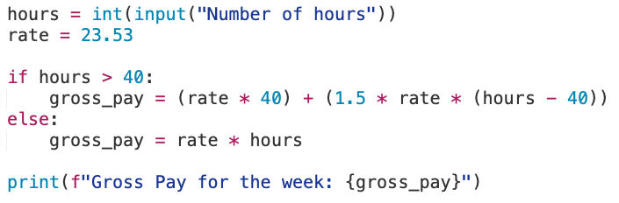
Branching Example
To calculate hourly wages there are two choices
Regular time (up to 40 hours)
Overtime (over 40 hours)
Program needs to choose which of these expressions to use

Slide 5
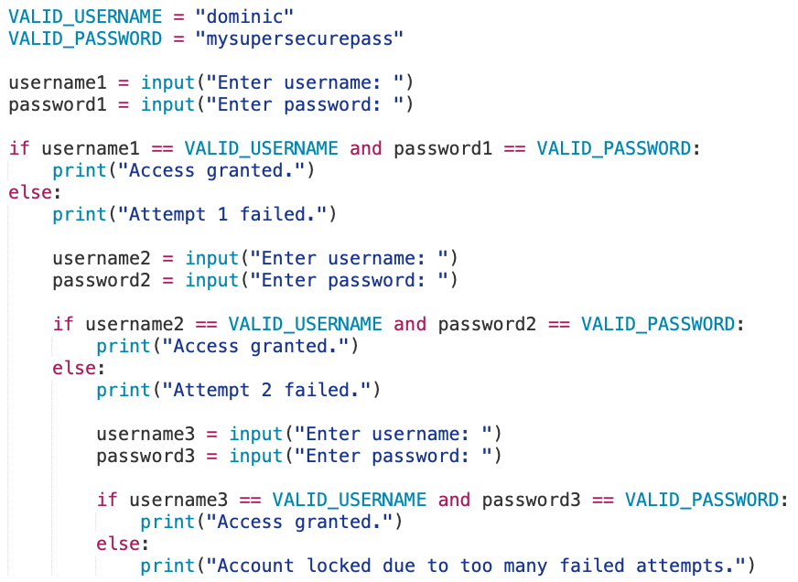
Branching Example
User Login System
Verify the username
Verify the password
If both are correct, print granted
Only check 3 times
Do you think this can be done better?

Slide 6
If Statement

Slide 7
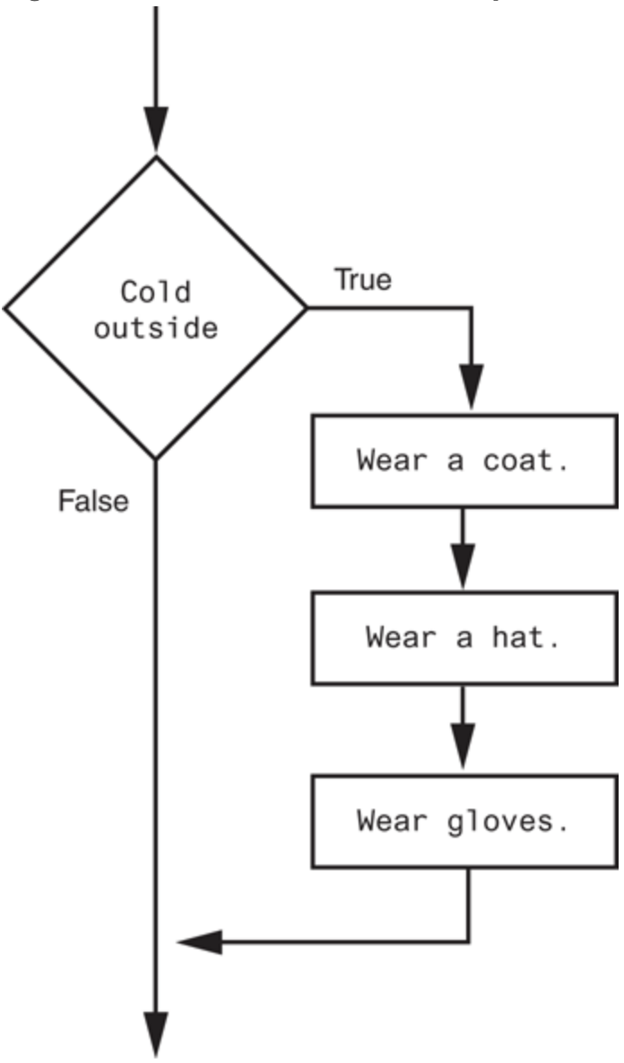
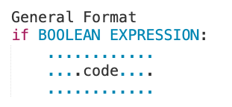
The if Statement
The if statement used to create a decision structure, allowing a program to have more than one path of execution
The if True causes one or more statements to executed
A decision structure that performs three actions

Slide 8
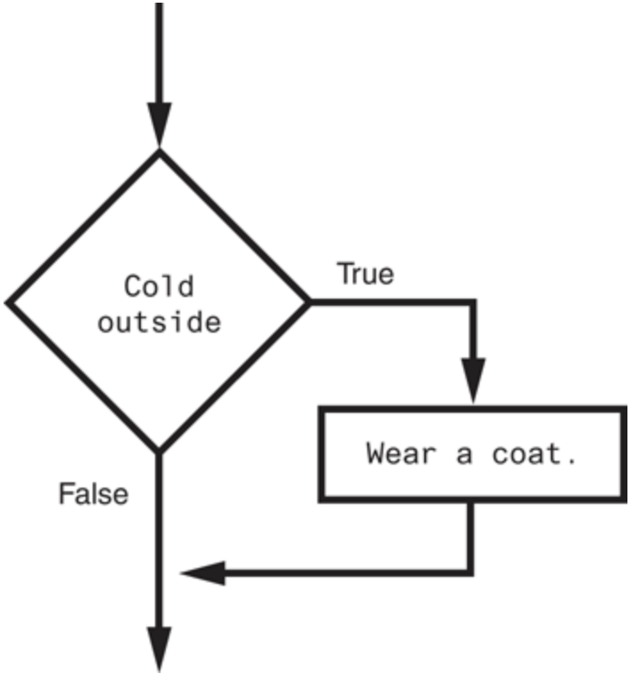
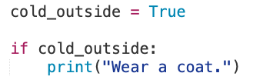
The if Statement
General format for an if statement expression are as follows:
Operand types
Integer
Float
String
Boolean
Lists and tuples
Dictionaries
Could this be written differently?
A simple decision structure

Slide 9
The if Statement
General format for an if statement expression are as follows:
Boolean expressions evaluate to either true or false
( )
Examples:
GOOD: if INT == INT:
GOOD: if FLOAT == FLOAT:
GOOD: if STRING == “5”:
BAD: if INT == BOOLEAN:
BAD: if 3.14 == “3.14”:
Where is the Boolean Expression in this Gross Pay Example?

Slide 10
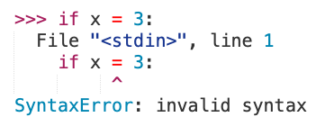
The if Statement
A relational operators checks how one operand’s value relates to another
The assignment operator is =
It is used to assign values to variables
Example: x = 3
The equality operator is ==
It is used to compare values
Example: if x == 3:
Operators | Description
< | a < b means a is less than b.
> | a > b means a is greater than b.
<= | a <= b means a is less than or equal to b.
>= | a >= b means a is greater than or equal to b.
== | a == b means a is equal to b.
!= | a != b mean a is not equal to b.
Python Interpreter will catch

Slide 11
If-Else Statement

Slide 12
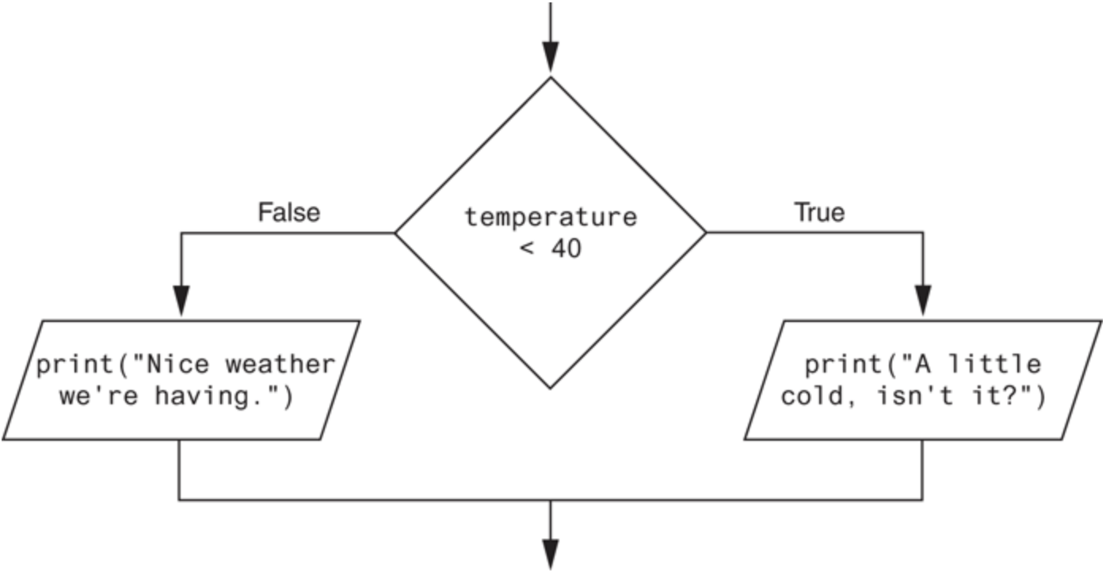
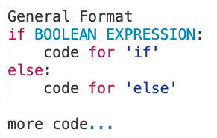
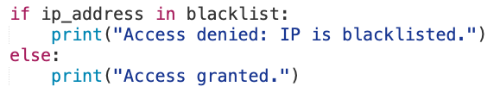
The if-else Statement
The if-else statement will execute one block of statements if the condition is true, else the other block if the condition is false.
A dual alternative decision structure
IF-ELSE are aligned
Code blocks are indented

Slide 13
If-elif-else Statement

Slide 14
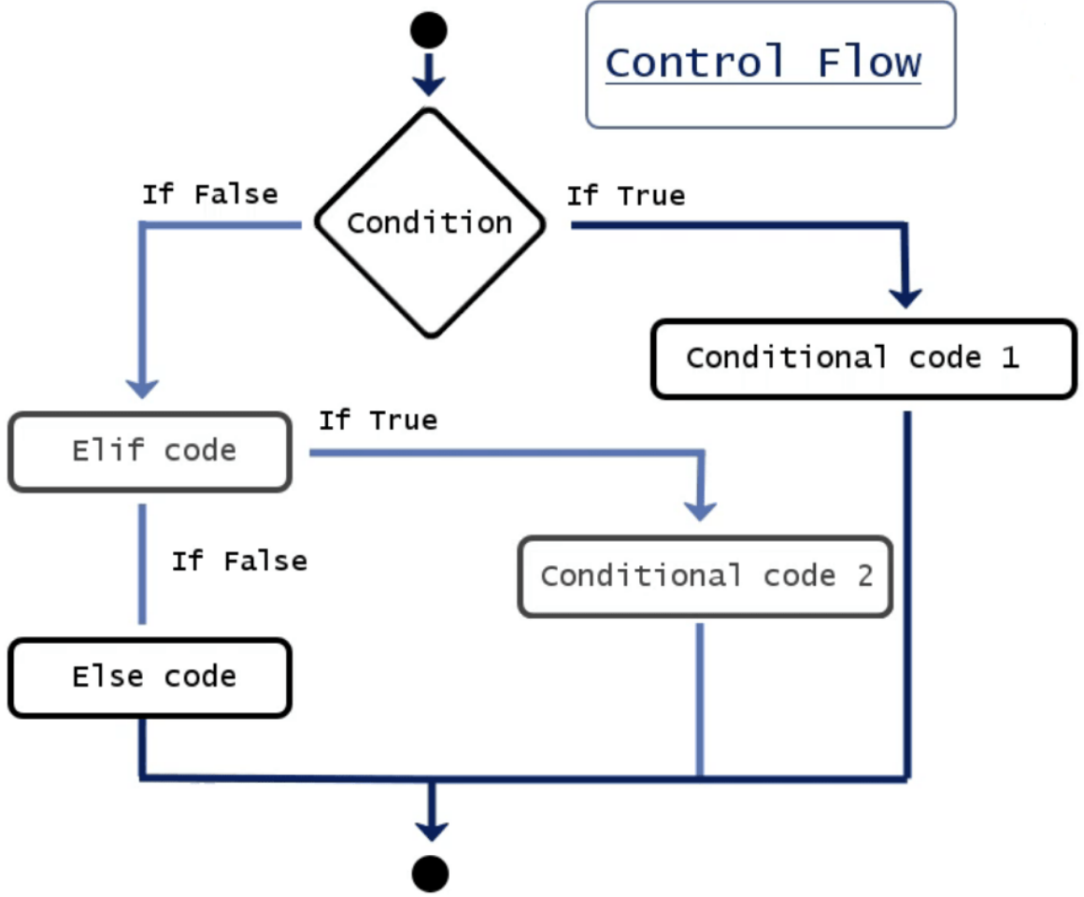
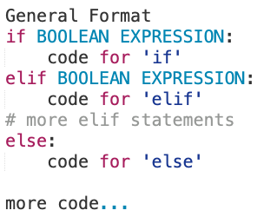
The if-elif-else Statement
An if-else statement can be extended to have three or more branches using the elif statement; if-else a.k.a. elif
A chained conditional allows more than two possibilities, meaning more than two branches
An if-else statement is a two-way branch. However, three, four, or even more branches can be designed using nested if-else statements
A Python if-elif-else ladder

Slide 15
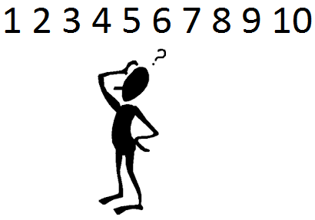
The if-elif-else Statement
Example: Number Guessing Game
A random number is stored in variable number
A user then guesses the number, storing the result in guess
How do we give hints?
Let’s see some pseudo code to implement the number guessing game
Get a Random Game Number
Get the User's guess number
Check if guess is too high
print was too high
Check if guess is too low
print was too low
Check if guess equal to game number
print they were correct

Slide 16
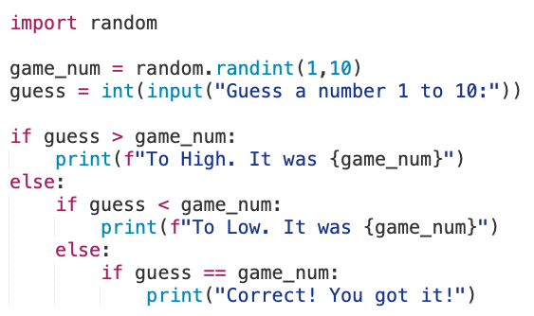
The if-elif-else Statement
Example: Number Guessing Game
Get a Random Game Number
Get the User's guess number
Check if guess is too high
print was too high
Check if guess is too low
print was too low
Check if guess equal to game number
print they were correct
Do you think this can be done better?

Slide 17
The if-elif-else Statement
Example: Number Guessing Game
Get a Random Game Number
Get the User's guess number
Check if guess is too high
print was too high
Check if guess is too low
print was too low
Check if guess equal to game number
print they were correct
Do you think this can be done better?
Yes, it can be!

Slide 18
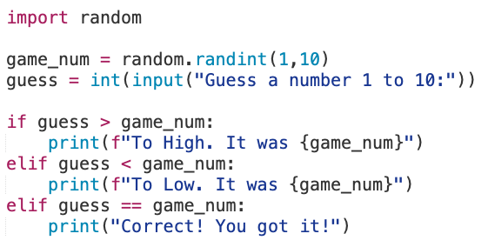
The if-elif-else Statement
Use the elif alternative instead of indenting several nested if-else statements

Slide 19
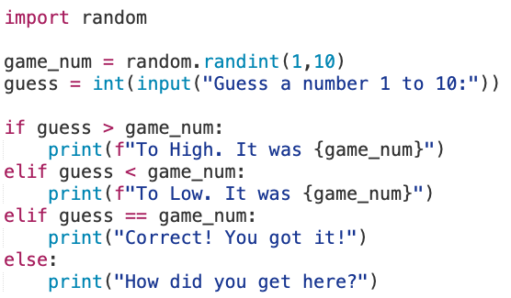
The if-elif-else Statement
What about the else statement at the end?
What are your thoughts?

Slide 20
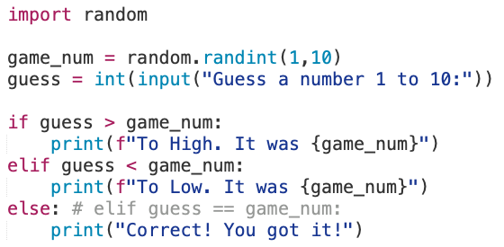
The if-elif-else Statement
Previous slide code is not possible to enter in the else statement at the end.

Slide 21
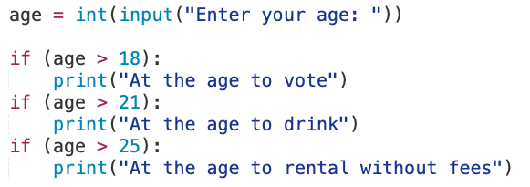
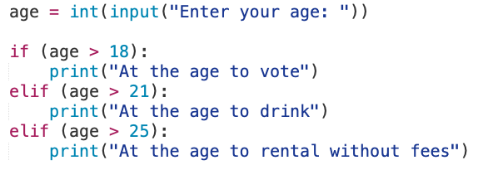
Multiple if versus elif
Would using multiple if statements in a sequence yields different results than nested if-else statements?
Multiple if statements in sequence
Nested if-else statements
Will these yield the same result? Why or why not?

Slide 22
Operators and Rules

Slide 23
Logical Operators
The logical and and the logical or operators allow you to connect multiple Boolean expressions to create a compound expression
The logical not operator reverses the truth of a Boolean expression
[not] Expression1 operator Expression2
Operator | Meaning
and | True only if both expressions are true.
or | True if at least one expression is true.
not | Reverses the truth value (True → False, False → True).

Slide 24
Logical Operators
The truth table is a tool for making sense of complex Boolean expressions
A | not A
True | False
False | True
A | B | A and B
True | True | True
True | False | False
False | True | False
False | False | False
A | B | A or B
True | True | True
True | False | True
False | True | True
False | False | False
For example, if y = 8, then the expression
not ((y < 3) or (y > 7))
is evaluated in the following sequence:
not (false or true) → not true → false

Slide 25
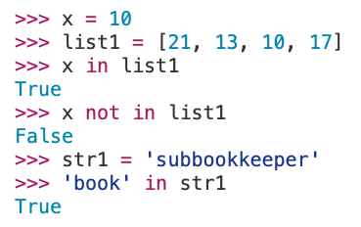
Membership and identity operators
Python’s membership operators in and not in test for membership in a sequence, such as strings, lists, or tuples
Can be used to check whether a substring is found in a string
Operator | Description
in | Returns True if an item is found in the specified sequence.
not in | Returns True if an item is not found in the specified sequence.

Slide 26
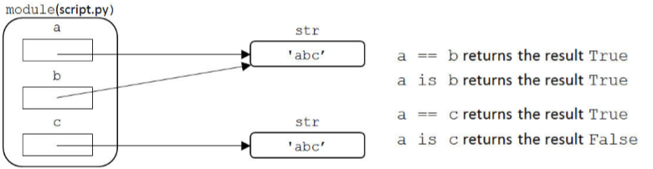
Identity Operators
Identity operators compare memory locations of two objects
Do operands on both sides of operator point to same object?
Python interpreters typically pre-create objects for a small range of numbers to avoid constantly recreating objects
Can use the id() function to get the memory location ID
Operator | Description
is | Returns True if the ID of two objects are the same.
is not | Returns True if the ID of two objects are not the same.

Slide 27
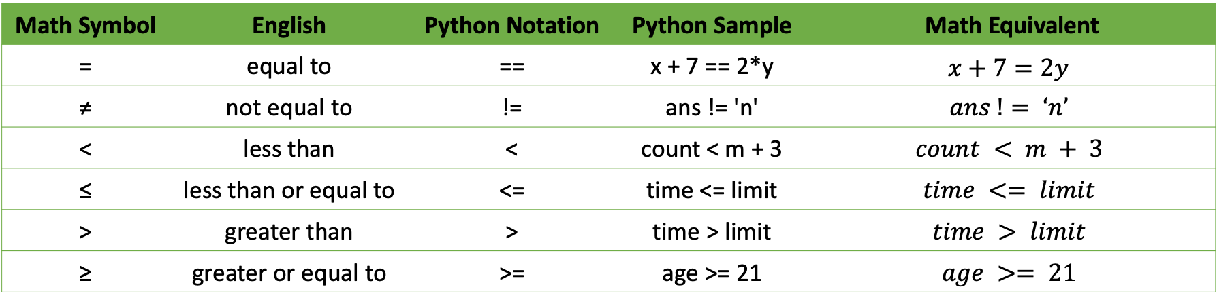
Equality and Relational Operators
Equality and Relational operator checks how one operand's value relates to another
Math Symbol | English | Python Notation | Python Sample | Math Equivalent
= | equal to | == | x + 7 == 2*y | $$x+7=2y$$
≠ | not equal to | != | ans != 'n' | $$ans != ‘n’$$
< | less than | < | count < m + 3 | $$count < m + 3$$
≤ | less than or equal to | <= | time <= limit | $$time <= limit$$
> | greater than | > | time > limit | $$time > limit$$
≥ | greater or equal to | >= | age >= 21 | $$age >= 21$$

Slide 28


Equality and Relational Operators
Equality and Relational operator checks how one operand's value relates to another
Math Symbol | English | Python Notation | Python Sample | Math Equivalent
= | equal to | == | x + 7 == 2*y | $$x+7=2y$$
≠ | not equal to | != | ans != 'n' | $$ans != ‘n’$$
< | less than | < | count < m + 3 | $$count < m + 3$$
≤ | less than or equal to | <= | time <= limit | $$time <= limit$$
> | greater than | > | time > limit | $$time > limit$$
≥ | greater or equal to | >= | age >= 21 | $$age >= 21$$
Could we chain multiple operators?

Slide 29
Operator Chaining
Yes, in Python, comparisons can be chained together
if 0 < x < y <= 100:
This evaluates to if 0 < x, then if x < y, then if y <= 100
If 0 < x is not true, then there is no need to evaluate if x < y and so forth
Meaning if 0 < x is not true then if 0 < x < y <= 100 is not true either
Given these two set of Boolean expressions
x < y <= z x < y and y <= z
Do they both evaluate to the same Boolean value?
The subtle difference between is the chained comparison,
The y is evaluated only once in the first Boolean expression

Slide 30
Comparison Rules
Operand types
Integers are arithmetically compared
Floats are arithmetically compared
Strings are compared using ASCII or Unicode values and order for each character
Booleans are treated as integers (False = 0, True = 1)
Lists and tuples are compared in ordered of every element in the sequence
Dictionaries are compared only with == and !=
Must have the same keys and corresponding values to be true
Operands must be of the same type, or comparable!
Bad comparisons get a TypeError

Slide 31
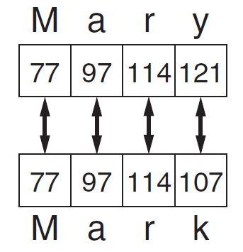
Comparison Rules
Floating-point numbers use < or > rather than equality ==
Remember that floating-point types are only approximations
Example: what would happen if you have the following check?
num = 0.5_0000_0000_0000_0000_1
if num == 0.5:
print(“num is the same as 0.5”)
Comparing strings
String comparisons are case sensitive
Compared character-by-character based on the ASCII values for each character
If shorter word is substring of longer word, longer word is greater than shorter word
Comparing each character in a string

Slide 32
Precedence Rules
Arithmetic, logical, and relational operators are evaluated in the order shown
Operator | Description | Explanation
() | Items within parentheses are evaluated first | In (a * (b + c)) - d, the + is evaluated first, then *, then -.
* / % + - | Arithmetic operators (PEMDAS) | z = 45 * y < 53 evaluates * first, then <.
< > <= >= == != | Relational, equality, and membership operators | x < 2 or x >= 10 is evaluated as (x < 2) or (x >= 10) because < and >= have precedence over or.
not | Logical NOT | not x or y is evaluated as (not x) or y.
and | Logical AND | x == 5 or y == 10 and z != 10 is evaluated as (x == 5) or ((y == 10) and (z != 10)) because and has precedence over or.
or | Logical OR | x == 7 or x < 2 is evaluated as (x == 7) or (x < 2) because < and == have precedence over or.

Slide 33
Code Block and Indentation

Slide 34

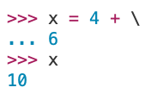
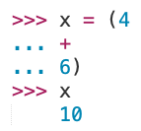
Python Statement
A Python statement is one instruction
Most of the time, there is exactly one Python statement per line
It is possible to have multiple statements separated by a semi-colon ; on a single line
There are two ways to make a statement span multiple lines
Use multi-line statements to improves code readability for long statement

Slide 35

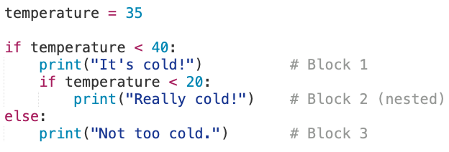
Code Block
A code block is a set of statements that will be executed together, one after the other
A group of statements that run together, with no explicit braces, brackets, or keywords
Defined by indentation (spaces at the start of the line).
New block starts after the delimiter : (e.g., if, else, for, while).
Indentation rules
Standard: 4 spaces per level.
Be consistent — do not mix tabs and spaces.
Python raises an IndentationError if mixed.

Slide 36
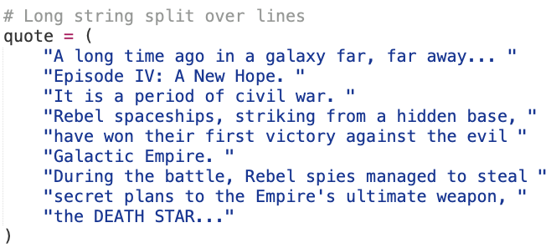
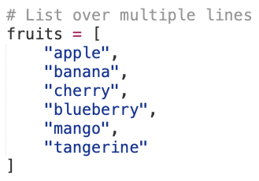
Special Cases in Indentation
Line wrapping
Long statements can span multiple lines.
This does not mean a new block.

Slide 37
Conditional Expressions

Slide 38
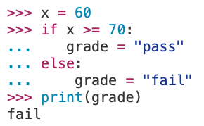
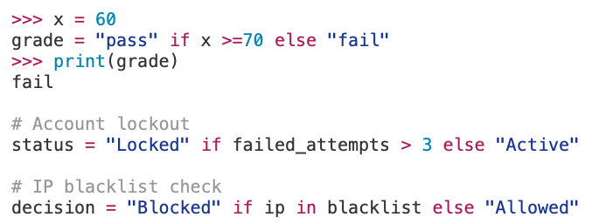
Conditional Expressions
Python also supports a conditional expression, or an inline if-else statement
With three operands, it is often referred to as a ternary operation
The conditional expression is evaluated and based on the results, if true the first expression is used, else the second expression is used when false

