Slide 1
CSCE 1035 – Computer Programming I
Chapter 5 Loops

Slide 2
Loops (General)

Slide 3
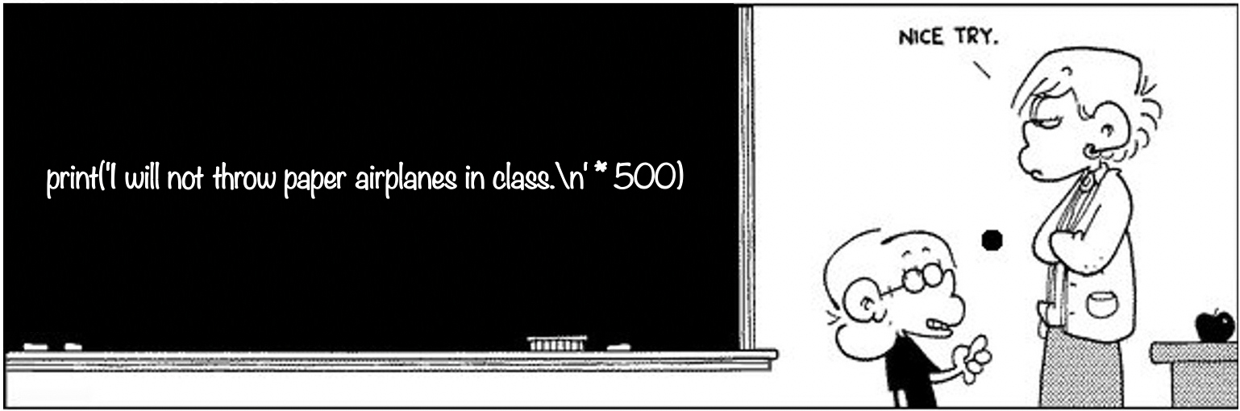
Looping
What should you do if a teacher asked you to write 500 times "I will not throw paper airplanes in class"?
I will not throw paper airplanes in class.
I will not throw paper airplanes in class.
I will not throw paper airplanes in class.
I will not throw paper airplanes in class.
…
…
…
count = 1
while count <= 500:
print('I will not throw paper airplanes in class.')
count = count + 1

Slide 4
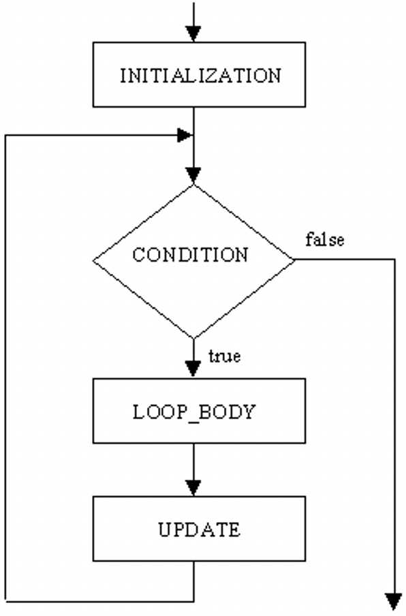
Loop Concept
Loop in programming, allow for repeated action for a specific task
Iterations are repeated execution of a set of instructions or code block when a condition is met
Loop design questions
What should be included in the loop body?
How many times should the loop be iterated?
Are there times to break out of the loop?
Python natively supports the while and for loops
Other loops are do-while and nested loops

Slide 5
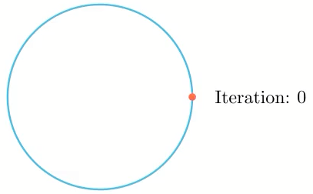
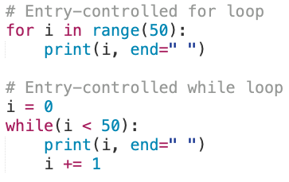
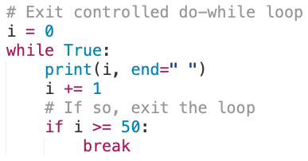
Loop Concept
There are two types of loops;
Entry-Controlled: the check condition is checked before entering the body of the loop.
while and for loops
Exit-Controlled: the check condition is evaluated at the end of the body of the loop.
do-while loops

Slide 6
While Loops

Slide 7
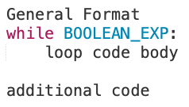
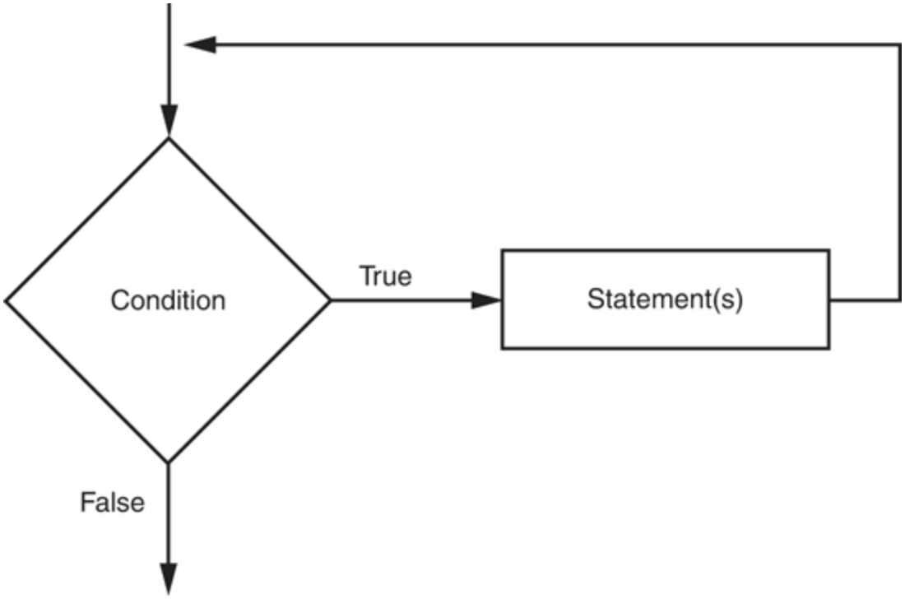
while Loop Syntax
A while loop is a condition-controlled loop
A condition-controlled loop causes a statement(s) to repeat as long as a condition is true
Loop body can include one or more statements to be executed if condition is true
The while loop is an entry loop, meaning that the condition will be tested before performing an iteration
The logic of a while loop

Slide 8
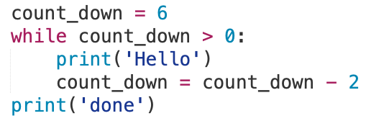
while Loop Syntax
Example
If condition is true, indented code in while block runs
At end of while block, control automatically goes back to while condition line
Initialization Action
Boolean Expression
Update Action
while Block
This process continues indefinitely until while condition is false

Slide 9
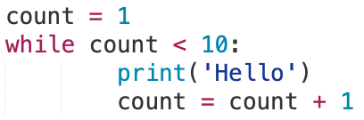
Counters
Often when creating and using loops, we need to keep count of how many times the loop has been executed
Usually used as the test condition for the while or for loop
Example
count = 1
while count < 10:
print('Hello')
count = count +1
In this simple example, count is referred to as the counter
Other forms of counting
Count down by 1’s instead of up
Count by 2’s
…what are others?

Slide 10
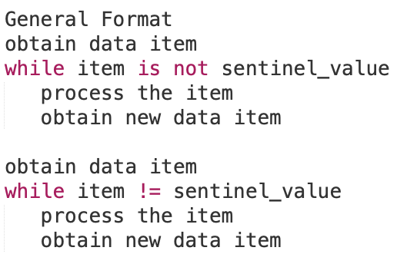
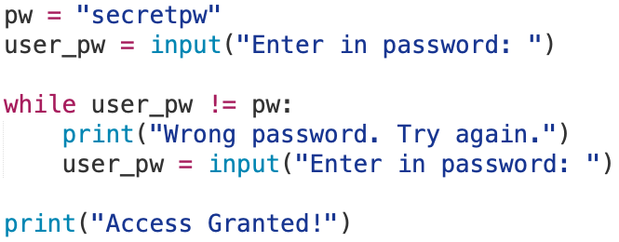
Sentinel Loops
The continuation to process data until reaching a special value that signals the end of the loop.
This special value, is a sentinel value, which is distinguishable and will cause the loop to end.
The while loop continues to process until the item meets the condition with the sentinel value to stop the while loop.
This is done via user control input or item process in the code block

Slide 11
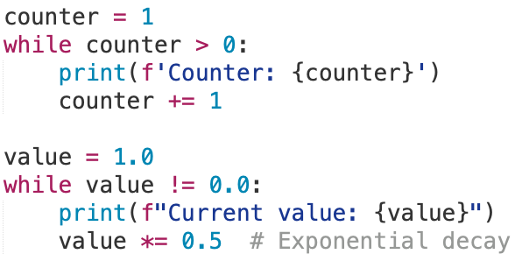
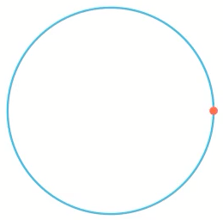
Infinite Loops
An infinite loop is a loop that never stops because the loop's condition is always True.
If needed to exit or stop program must send an interrupt i.e., CTRL-C
Loop body contain updates for the boolean expression but never becomes false.
Common error is accidentally creating an infinite loop unintendedly.
Example:

Slide 12
docstrings
Strings at the top of module files (and the top of functions and classes) become "docstrings", which are inserted into the __doc__ attribute of the object
Can use single or double quotes to delimit the string, double are common
print(__doc__)
Can print the docstrings for built-in Python objects
>>> import sys
>>> print(sys.__doc__)
PyDoc is a tool that can extract the docstrings and display them, either via the help command or via a GUI/HTML interface
>>> help(list)
For fun, the Python developer left a docstring for all python programmers
>>> import this

Slide 13
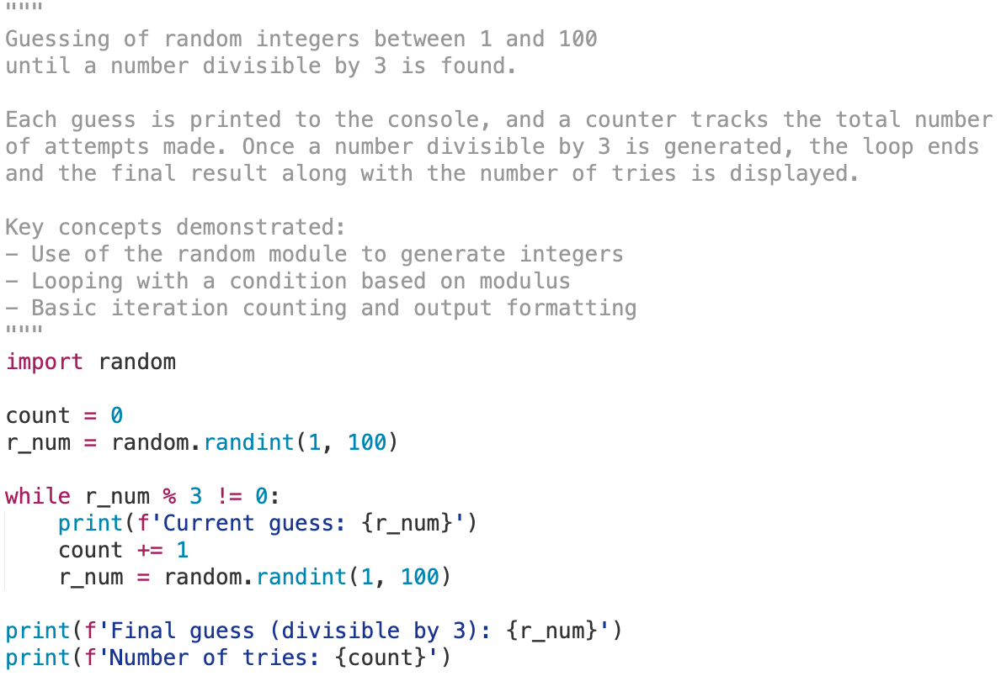
docstrings
How could we make this easier to understand (as a user or a programmer)?
Print statement(s) for our users.
What about the programmer?
docstrings

Slide 14
More while Loop Examples

Slide 15
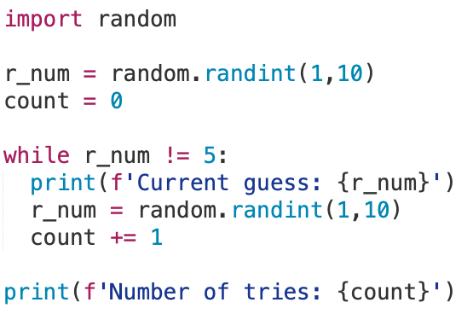
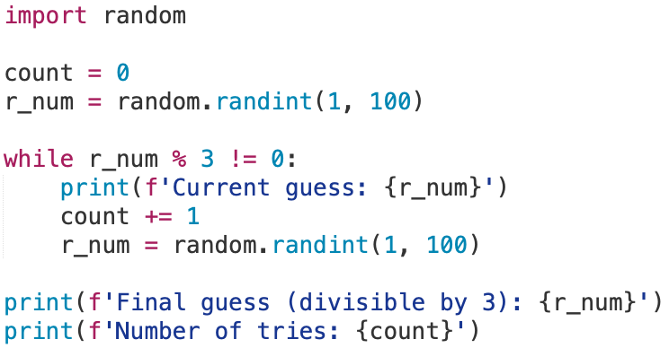
while Examples
Tell me what is going on in these while loops and how it is exiting

Slide 16

while Loop Practice
Write a program to add natural numbers up to n
Problem Statement
Input/Output Description
Hand Example
Algorithm Development
Implementation
Testing
Pseudo Code:
User input into variable n
Loop from 0 up to n
Sum up count for every iteration
Print out sum with current count for every iteration
Print out final sum

Slide 17
while Loop Practice
Write a program to play the guessing game by getting the user’s input and check against a randomly generated number. If to high or low, then say it is. If it correct, then tell them they won.
Problem Statement
Input/Output Description
Hand Example
Algorithm Development
Implementation
Testing
Pseudo Code:
Get a Random Game Number
Get the User's guess number
Check if guess is too high
print was too high
Check if guess is too low
print was too low
Check if guess equal to game number
print they were correct

Slide 18
For Loops

Slide 19
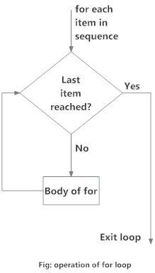
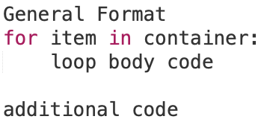
for Loops Syntax
A for loop is a count-controlled loop that iterates a specific number of times through a sequence of values
Loop body can include one or more statements to be executed if condition is true
A for loop statement iterates over each element in a container, one at a time, assigning a variable to the next element to be used in the loop body.
Container can be a list, a tuple, a string, a dictionary, a set, etc.
The loop index item takes on each successive value in the sequence
The statements in the body of the loop are executed once for each item
The logic of a for loop

Slide 20
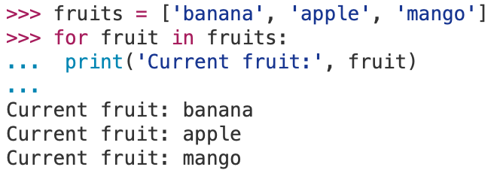
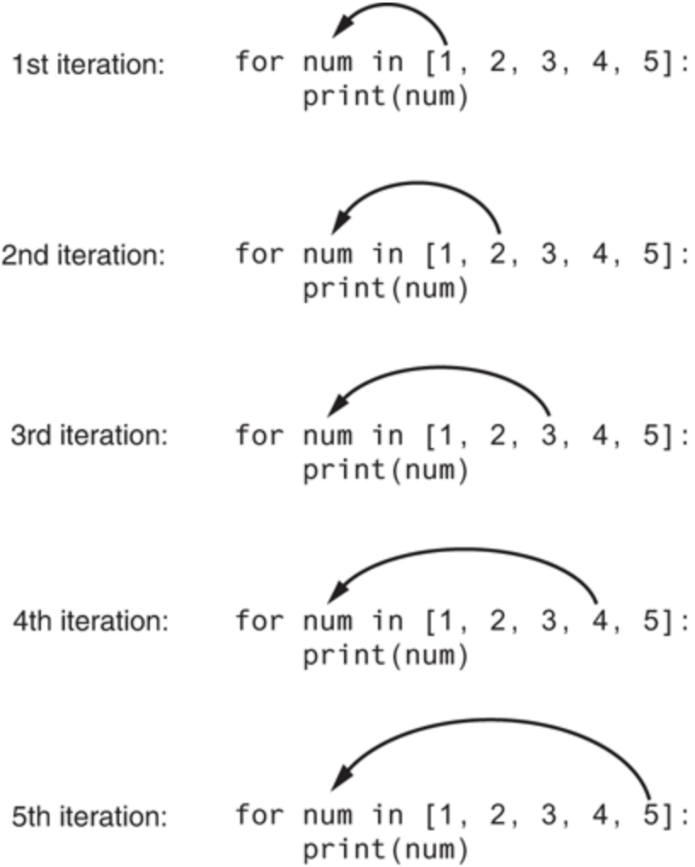
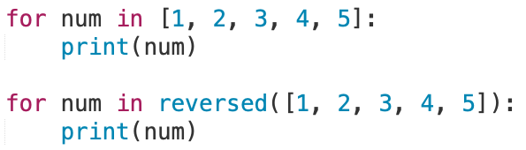
for Loops Example
A for loop steps through each of the items in a container, or any other type of object that is iterable
If container is a list or a tuple, then loop steps through each element of the sequence

Slide 21

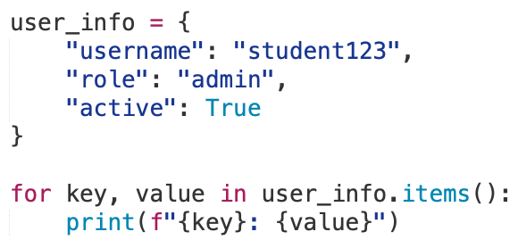
for Loops Example
A for loop can iterate over other containers such as strings and dictionaries.
String Example
Seen as a sequence type like a list, so the behavior of the loop is identical.
Each iteration assigns the loop variable being the next character in the string.
Dictionary Example
Each iteration assigns the loop variable with each key in the dictionary, in order of the keys
The key’s value can be accessed by using the key.
Output:
username: student123
role: admin
active: True

Slide 22
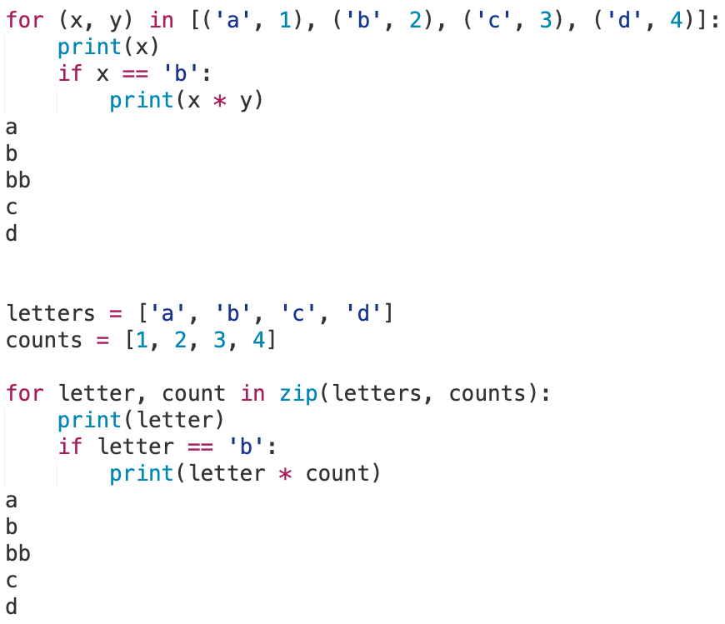
for Loops Iteration
The item, or target variable, in the for loop can be more than a single variable name
When the container elements are themselves sequences, then the item can match the structure of the elements
This multiple assignment can make it easier to access the individual parts of each element

Slide 23
for Loops Practice
Develop a program to manage a dictionary of fruits and their prices. Ask the user to input the name of a fruit to check if it is or is not in the dictionary. When the input is not in the dictionary then create a new entry. Finally, print the entire dictionary using a for loop.
Pseudo Code:
Let there be a dictionary of fruits with their prices.
Ask the user for a name of a fruit
If the user’s fruit exist in the dictionary, then print out it already exist.
If the user’s fruit doesn’t exist, then ask for a price and enter dictionary
Lastly, print out the full dictionary (keys, values) using a for loop.
Using a for loop to iterate over a dictionary
ages = {"Sam": 4, "Mary": 3, "Bill": 2}
for name in ages.keys():
print(name, ages[name])
Using a for loop to iterate over a dictionary
ages = {"Sam": 4, "Mary": 3, "Bill": 2}
for name, val in ages.items():
print(name, val)

Slide 25
Counter using range() Function

Slide 26
The range Function
The range function creates an iterable list of values
range([start,] stop[, step])
Repeats for values start (inclusive) to stop (exclusive)
Default start value is 0, step value is 1
Provides a range of iterable values
Counting forward
range(10, 20)
>>> 10 11 12 13 14 15 16 17 18 19
Counting backward
range(20, 10, -1)
>>> 20 19 18 17 16 15 14 13 12 11
Counting by different amounts
range(0, 50, 5)
>>> 0 5 10 15 20 25 30 35 40 45

Slide 27

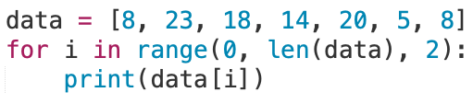
The range() function with for loops
Range() is useful with for loops
1 squared is 1
2 squared is 4
3 squared is 9
4 squared is 16
5 squared is 25
How would we print every second element in a list?
8
18
20
8

Slide 28
While versus For Loops

Slide 29
Choose Wisely
Some general rules you can follow:
Use a for loop when number of iterations is computable before entering the loop
E.g., counting down from N to 0, printing results N times, etc.
Use a for loop when accessing the elements of a container
E.g., adding 1 to every element in list, printing the key of every entry in a dictionary, etc.
Use a while loop when the number of iterations is not computable before entering the loop
E.g., iterating until a user enters a sentinel value, etc.
Use a while loop when using a Boolean expression flagging mechanism
E.g., control over when the loop exits, based on condition or internal state change.
Both use a counting system, however, the for loop the programmer does not explicitly set the incrementation since it iterates the iterable. Whereas the while loop requires an incrementation if not will loop infinitely.

Slide 30
Nested Loops

Slide 31
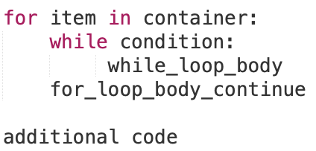
Nested Loops
The body of a loop may contain any type of statement, including another loop
A nested loop is a loop contained inside another loop
For nested loops, all iterations of the inner loop are executed for each iteration of the outer loop
Total number of iterations in a nested loop
number_iterations_inner x number_iterations_outer
Outer Loop
Inner Loop
Can mix-and-match between while loops and for loops

Slide 32
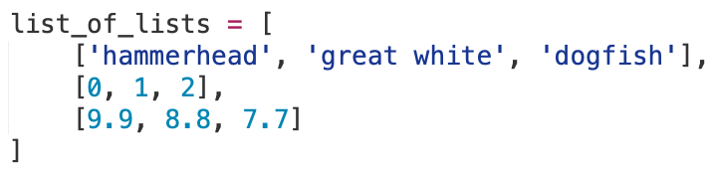


Nested Loop Examples
When one for loop is used, the program will output each internal list as an item
When using a nested for loop, we can iterate over the individual items contained in the lists
Output:
['hammerhead', 'great white', 'dogfish']
[0, 1, 2]
[9.9, 8.8, 7.7]
Output:
hammerhead
great white
dogfish
0
1
2
9.9
8.8
7.7

Slide 33
Develop Programs Incrementally

Slide 34
Common Loop Errors
Off-by-one errors, where the loop executes one too many or one too few times
Check your comparison if should be < or <=
Check that the initialization uses the correct value
Does the loop handle the zero iterations case?
Step through the loop with changing variables
print() statements can be used to trace a value
Infinite loops usually result from an error in the condition that controls the loop
Check the direction of inequalities whether it should be < or >
Test for < or > rather than equality ==
Recall that a float is really only an approximation

Slide 35
Incremental Development
Want to avoid debugging these large, complex programs.
(If possible) Developing a simple version of the program to become a module or become the base of larger program.
Goal is incremental development
Incrementally write code
Include comments for future implementation via #TODO or #FIXME
Then test it periodically to ensure each new part works as expected
Benefits include that errors are easier to isolate, find, and fix

Slide 36
Break and Continue

Slide 37
break and continue Statements
The break statement terminates the current loop and transfers execution at the next statement following that loop
The most common use for break is when some external condition is triggered that requires an exit from a loop
The continue statement skips all the remaining statements in the current iteration of the loop and moves control back to the top of the loop
The continue statement will cause program to immediately retest its condition prior to the next iteration
Both the break and continue statements can be used in both while and for loops
The pass statement is used when a statement is required syntactically, but you do not want any code to execute

Slide 38
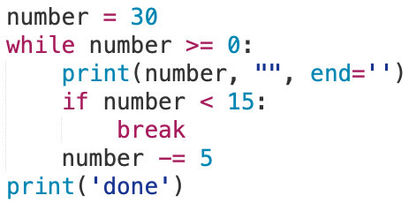
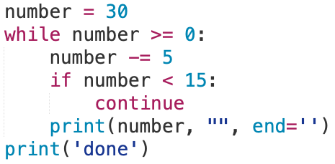
break and continue Statements
Break
This iteration is over and there are no more iterations
Continue
This iteration is over; do the next iteration
Break and Continue can be used in the for loop as well.

Slide 39
Loop Else

Slide 40
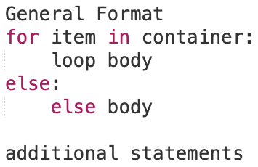
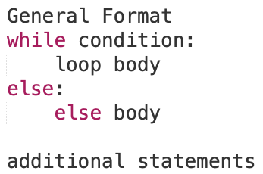
Loop Else
A loop may optionally include an else clause that executes only if the loop terminates normally (i.e., not using break)
If used with a for loop, the else statement is executed when the loop has exhausted iterating the list
If used with a while loop, the else statement is executed when the condition becomes false

Slide 41
Enumeration

Slide 42
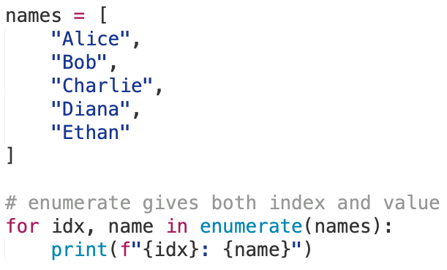
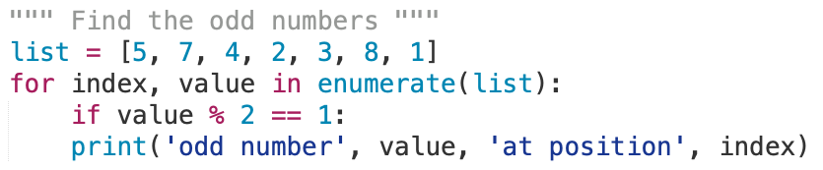
Enumeration
The enumerate()function used to get current position index and corresponding element value when iterating over a sequence (list, set, string, etc).
Outputs:
odd number 5 at position 0
odd number 7 at position 1
odd number 3 at position 4
odd number 1 at position 6
Outputs:
0: Alice
1: Bob
2: Charlie
3: Diana
4: Ethan

